Slide 1

Overview:
This is a single player game.
1.The game is to spot the mines in the mine field.
2.This is a logical game
3.First two to three guess are to be made to get into the logic
4.The logic is when a box is opened a number is generated , which gives the number of mines present around that opened box.

Slide 2


Slide 3
Skill Level
When the game is started, the player is presented with a grid of blank squares.
The size of the grid is dependent on the skill level chosen by the player, with higher skill levels having larger grids and more number of mines.

Slide 4
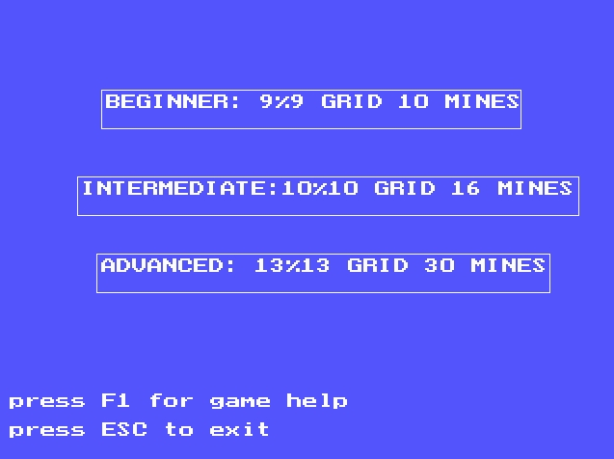

Slide 5
Main()
Minegen()
Numgen()
Open()
Flag()
Check()

Slide 6
Minegen()
Description: This function generates the coordinates of the boxes randomly and those random boxes are considered as the mines in the game.

Slide 7
Flag()
Description: If the box is not opened, marks the selected box as flag i.e. user’s marks it as a mines and De-Flags the box which is already flagged.
Parameters: Takes two parameters, values of the co-ordinates of the box to be flagged or De-flagged.

Slide 8
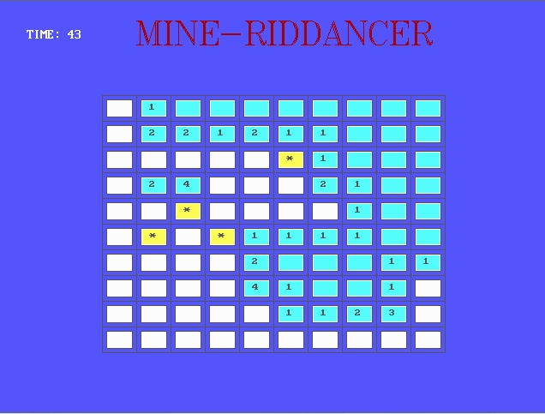

Slide 9
Open()
Description: This functions opens the selected box if the box is not flagged or not opened and This function also checks the opened box coordinates with the coordinates of the mine boxes and if the mine box is opened the game gets terminated and returns the value in the box by calling numgen() function.
Parameters: This function takes two parameter, the coordinates of the box to be opened.

Slide 10
Numgen()
Description: This function generates the number which gives the number of mines present around that certain opened box by calling check() function for each and every box around certain opened box.
Parameters: This box takes three parameters two parameters gives the coordinates of the opened box and other parameter gives the value return by check() function at every iteration.

Slide 11
Check()
Description: This function checks each box around the opened box, increments the varible passed by numgen() function if any box coordinates around the opened box matches with mine box coordinates.
Parameters: This box takes three parameters two parameters gives the coordinates of the opened box and other parameter gives the value return by check() function at every (n-1) Iteration.

Slide 12
THANK YOU

