Slide 1
ARTIFICIAL INTELLIGENCE PROJECT
NIM GAME
SUBMITTED BY:-
ASHISH GUPTA
VAIBHAV HARKAWAT
RIYA SHARMA
SUBMITTED TO:-
SUBHASH CHANDRA GUPTA

Slide 2
NIM GAME
Nim is a mathematical game of strategy in which two players take turns removing objects from distinct heaps. On each turn, a player must remove at least one object, and may remove any number of objects provided they all come from the same heap. The goal of the game is to be the player who removes the last object.

Slide 3
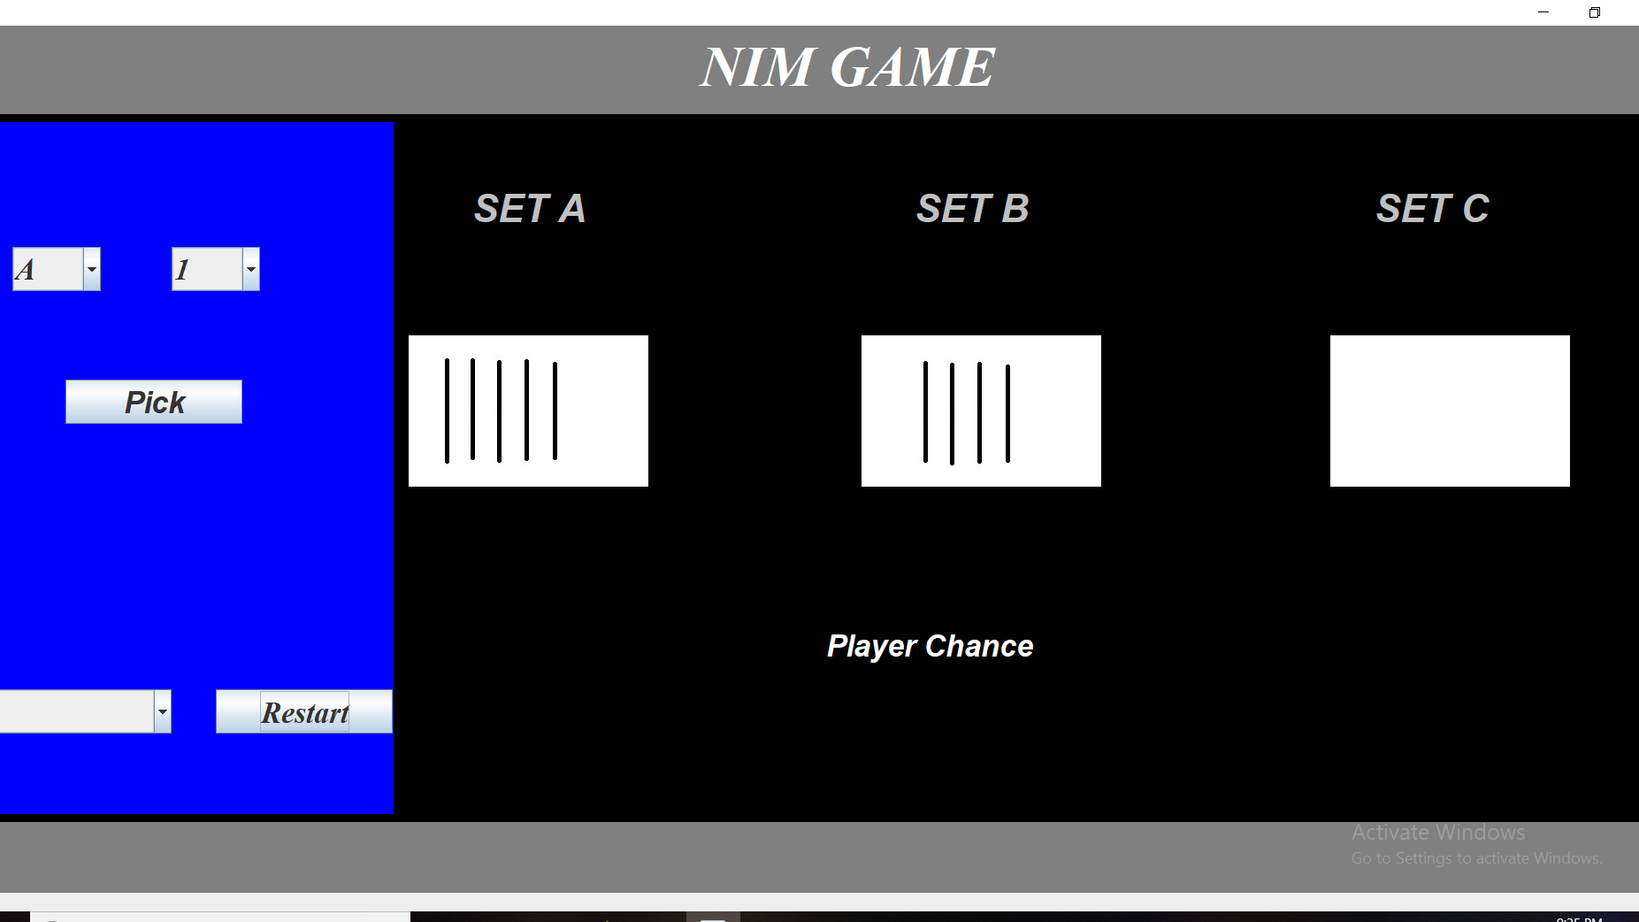

Slide 4
DESCRIPTION:
We have a game in which we have 3 sets
SET A contains 5 sticks
SET B contains 4 sticks
SET C contains 3 sticks
You have to pick the stick from one of the set .
You can pick as many sticks as you want but at a
time from only one set .
Winner of the game will be the one who will pick
up the last remaining sticks.
Either of the computer or user can start the game.

Slide 5
HEURISTICS :
If in any 2 sets number of sticks are equal and the remaining set is empty then pick the number of sticks same as the other player or just follow the other player.
If there is a pattern of 1 stick , 2 sticks , 3 sticks in the sets then do same as the step 1.

Slide 6
If Not In Winning Position Then Do This:
Number of sticks are equal and the remaining set contains sticks that may or may not be equal to others then pick all the sticks from the remaining set.
If by picking up some sticks from any set we are getting a pattern of 1 stick , 2 sticks , 3 sticks then pick the suitable number of sticks from that set.

Slide 7
THANK YOU

