Slide 1



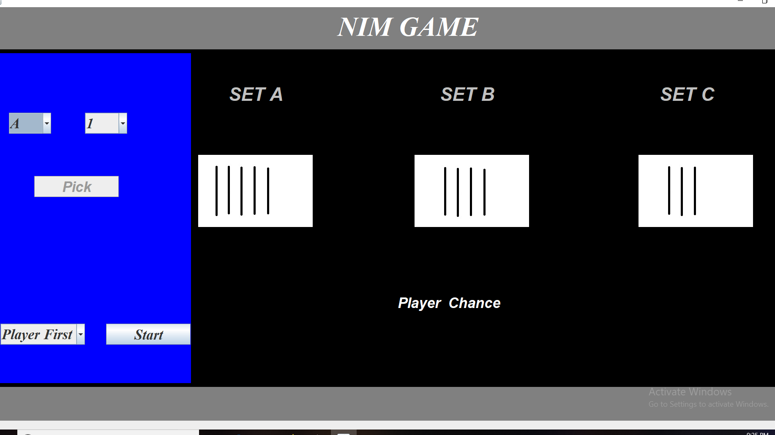
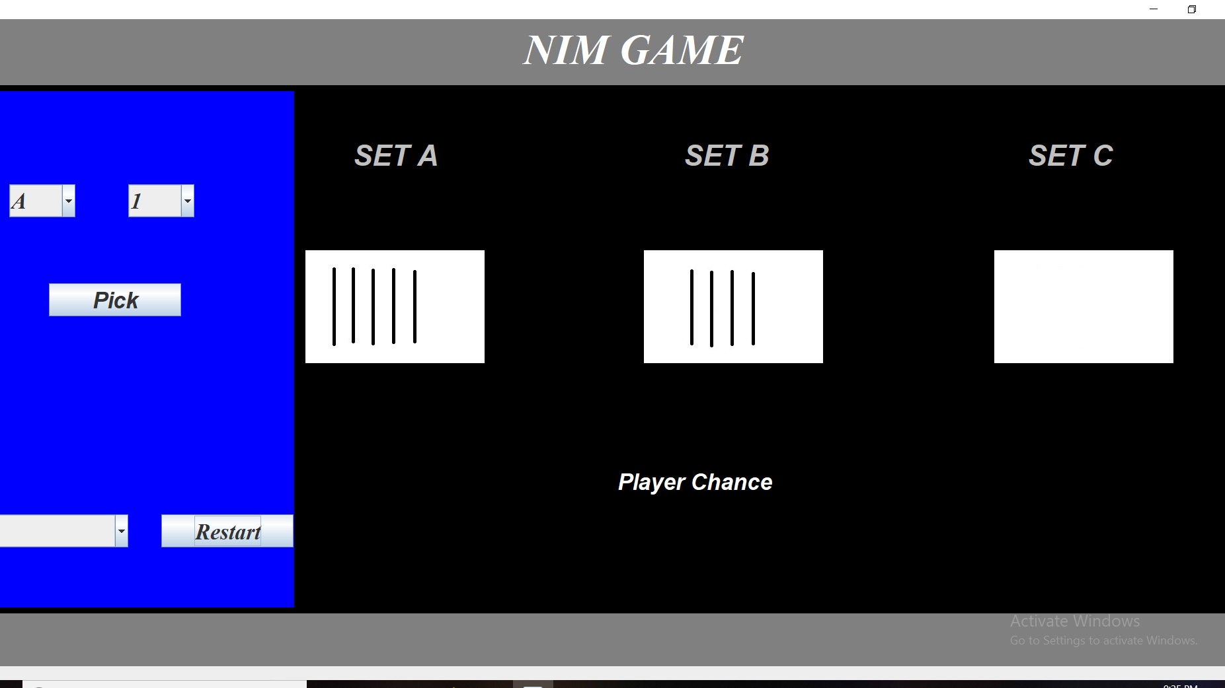
AI BASED NIM GAME
BIRLA INSTITUTE OF TECHNOLOGY, MESRA(JAIPUR CAMPUS)
MO-2018
ARTIFICIAL INTELLIGENCE PROJECT
INTRODUCTION
DIAGRAMS
ABSTRACT
We have a game in which we have 3 sets
SET A contains 5 sticks
SET B contains 4 sticks
SET C contains 3 sticks
You have to pick the stick from one of the set .
You can pick as many sticks as you want but at a
time from only one set .
Winner of the game will be the one who will pick
up the last remaining sticks.
Either of the computer or user can start the game.
Nim is a mathematical game of strategy in which two players take turns removing objects from distinct heaps. On each turn, a player must remove at least one object, and may remove any number of objects provided they all come from the same heap. The goal of the game is to be the player who removes the last object.
METHODOLOGY
If in any 2 sets number of sticks are equal and the remaining set is empty then pick the number of sticks same as the other player or just follow the other player.
If there is a pattern of 1 stick , 2 sticks , 3 sticks in the sets then do same as the step 1.
PREPARED BY-
ASHISH GUPTA(BE/25027/16
VAIBHAV HARKAWAT(BE/25039/16)
RIYA SHARMA(BE/25003/16)
[BE CSE Vth SEM]
CONCLUSION
It is seen that our heuristics are working properly and it is observed that a fresh player will going to have a very less likelihood of wining the game against computer and has she or he will play the game more and more times then the likelihood will increase in an exponential fashion.
SUPERVISED BY-
MR. SUBHASH GUPTA
(ARTIFICIAL INTELLIGENCE PROFESSOR)

