Slide 1
Smart Highway Traffic Analysis
Data-Driven Insights for Emission Reduction & Congestion Management
Highway Dataset | 4,012 Records | 8 Road Segments | Jan-Mar 2026
4,012
108
24
8
13
Clean Records
Duplicates Removed
Features
Segments
KPIs Computed

Slide 2
The Problem: What the Data Reveals
59.72
249.08
18:00
A1
D1
Avg Speed (kmph)
Avg CO₂ Emission
Peak Traffic Hour
Slowest Segment
Most Congested
Congestion = Pollution
High congestion areas produce
18% more CO₂ than low congestion
High: 266.86 avg CO₂
Medium: 252.34 avg CO₂
Low: 226.01 avg CO₂
Direct link: reduce congestion
= reduce pollution
Worst Performing Roads
Segment A1: Slowest (57.46 kmph)
Segment D1: Most Dense (71.54)
Segment C1: Worst Efficiency
Top Emission Hotspot:
Segment A1 appears TWICE
in the top 5 CO₂ hotspots
A1 needs urgent intervention
Traffic Patterns
Peak hour: 6 PM (327,645 vehicles)
Evening rush dominates (6-10 PM)
Busiest day: Saturday
Quietest day: Wednesday
Surprising finding:
Rainfall has NO significant
impact on speed (<2 kmph diff)

Slide 3
Deep Analysis: Efficiency, EV Impact & Gore Points
Traffic Efficiency Index
TEI = Speed / Density
Higher = better road performance
#1 D2 TEI = 1.390 (BEST)
#2 A2 TEI = 1.382
#3 B1 TEI = 1.378
#4 C2 TEI = 1.363
#5 B2 TEI = 1.340
#6 D1 TEI = 1.331
#7 A1 TEI = 1.279
#8 C1 TEI = 1.240 (WORST)
Study D2 config as model
Redesign C1 infrastructure
EV Adoption Simulation
What if we increase EVs?
Current fleet: 33.9% EV
Current avg CO₂: 249.08
25% EV → 21.3% CO₂ reduction
50% EV → 42.5% CO₂ reduction
75% EV → 63.7% CO₂ reduction
100% EV → 85.0% CO₂ reduction
Key takeaway:
Just reaching 50% EV adoption
cuts nearly HALF of all CO₂
Build charging infra NOW
Gore Point Impact
Merge/diverge zones on highway
Non-Gore Gore
Speed: 58.4 61.4 kmph
CO₂: 244.1 255.6
Density: 64.6 69.2
New Findings for Policy Board
1. Saturday is busiest day
→ Schedule roadwork on Wednesday
2. Rain doesn't slow traffic
→ Density is the real bottleneck
3. A1 appears in worst lists 3 times
→ Priority #1 for intervention

Slide 4
The Solution: GLOSA-BHARAT Deployment Simulation
35,416
+2.3%
A1 & C1
532
CO₂ Units Saved
Speed Improvement
Segments Targeted
Rows Affected
What is GLOSA?
Green Light Optimized
Speed Advisory
A V2X system that tells drivers
the optimal speed to maintain,
preventing stop-and-go traffic.
No sudden braking
= No shockwave jams
= No idle CO₂ emissions
Before vs After GLOSA
SEGMENT A1:
Speed: 57.5 → 63.3 kmph (+10.2%)
CO₂: 244.5 → 212.3 (-13.2%)
SEGMENT C1:
Speed: 57.6 → 64.1 kmph (+11.3%)
CO₂: 252.0 → 215.8 (-14.4%)
Just 2 segments targeted,
3.5% total network CO₂ drop
Policy Recommendation
IMMEDIATE:
Deploy GLOSA on A1 & C1
Adaptive signals at 6 PM peak
SHORT-TERM:
EV incentives (target 50%)
Restructure C1 (worst TEI)
LONG-TERM:
GLOSA on all 8 segments
Weather-adaptive speed advisories

Slide 5
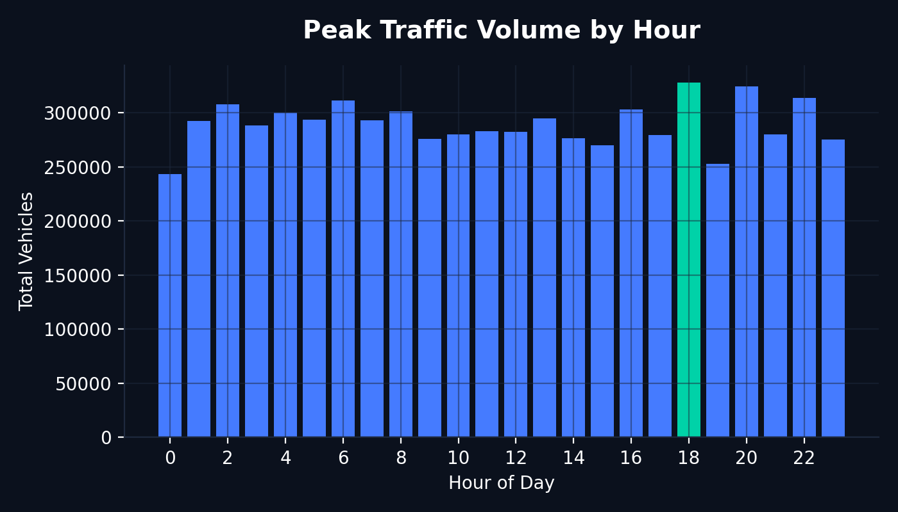
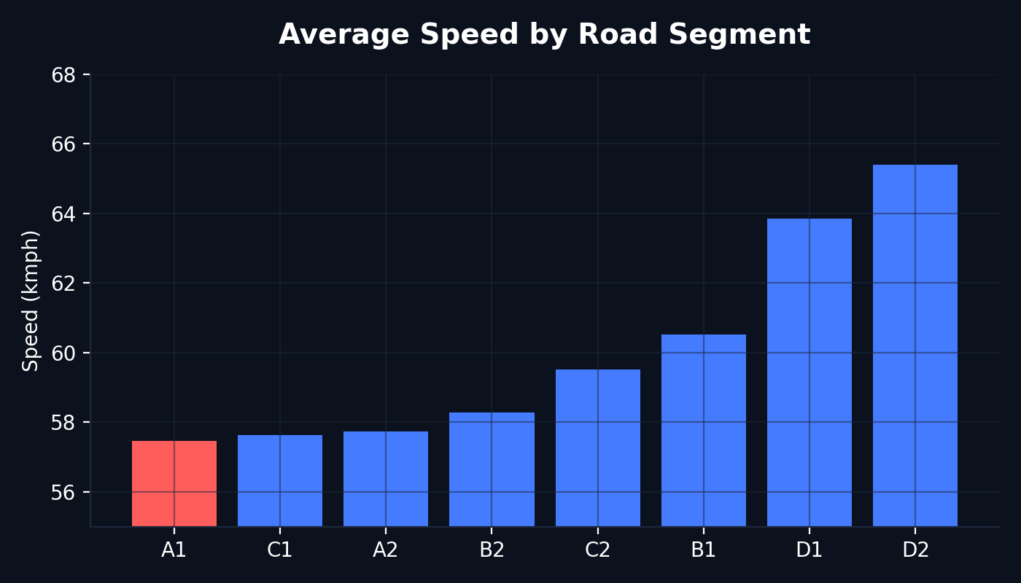
Data Visualized: Core Traffic Patterns
Insights → A huge spike in vehicle count exactly at 18:00 (6 PM) marks the clear evening rush hour. Deployment of adaptive signals should be prioritized between 16:00 and 20:00.
Insights → Segment A1 exhibits the lowest network average speed. The infrastructure on this road fails to sustain flow capacity during high-demand bursts.

Slide 6
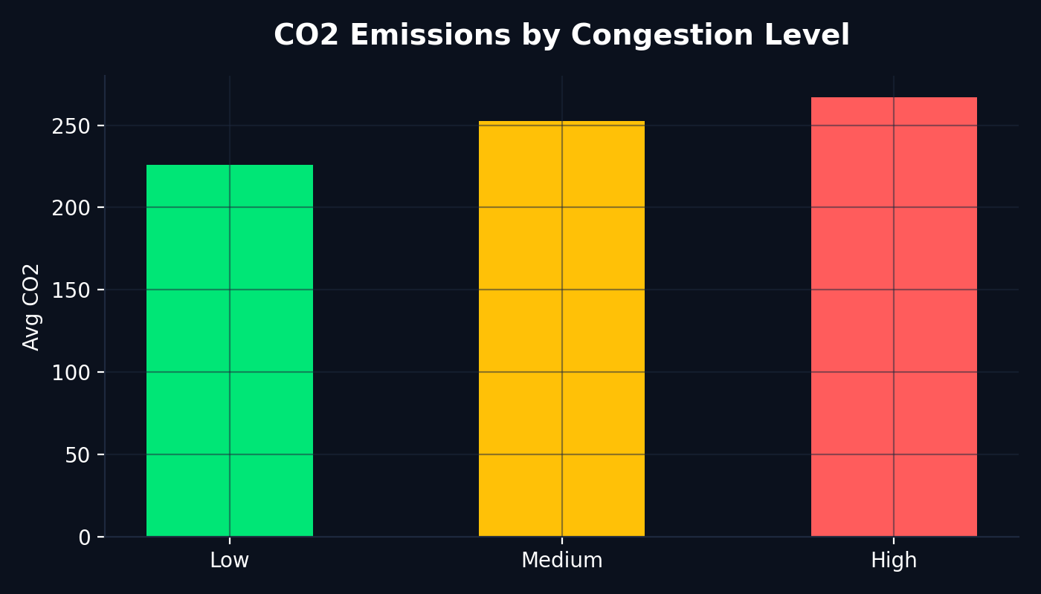
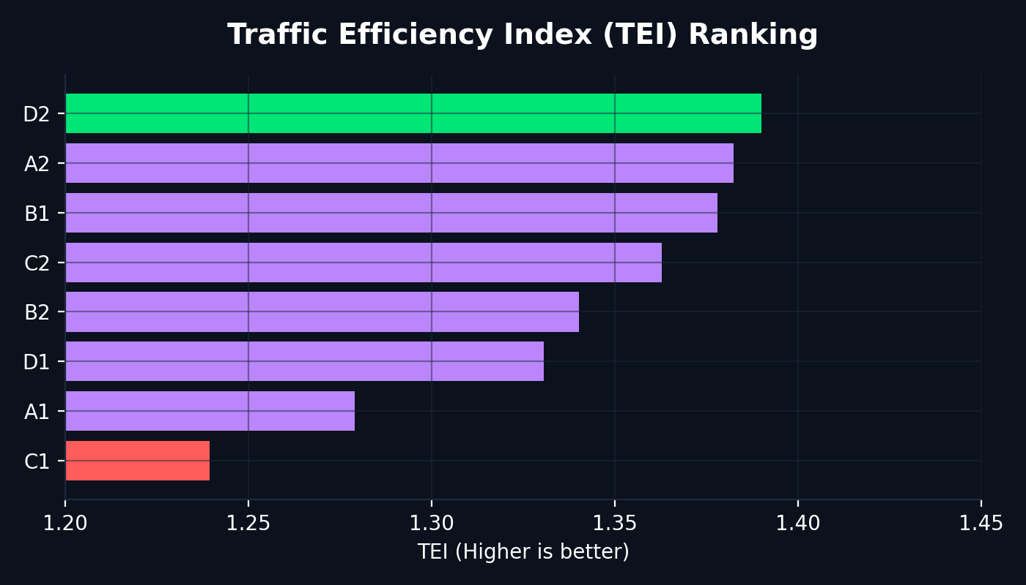
Data Visualized: Efficiency & Emissions
Insights → Linear positive correlation between congestion states and CO2 emissions. Combating congestion directly translates to heavy pollution reduction.
Insights → Traffic Efficiency Index (Speed/Density) reveals that C1 has the absolute worst operational efficiency, while D2 manages traffic the best.

Slide 7
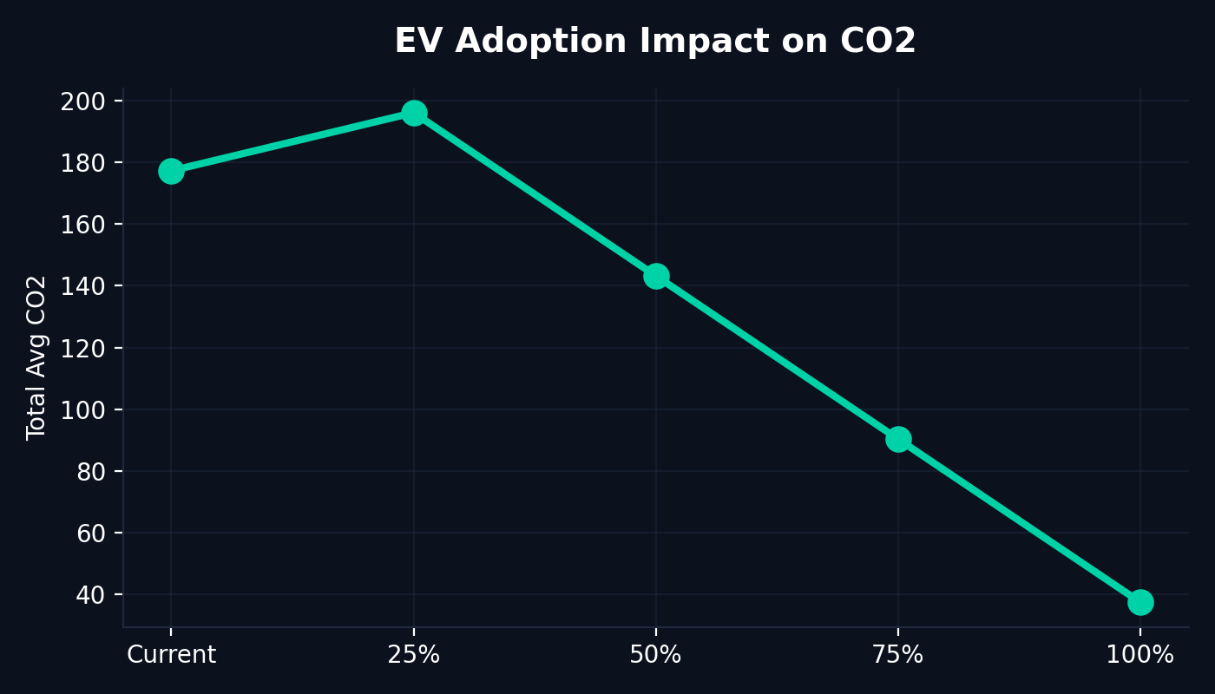
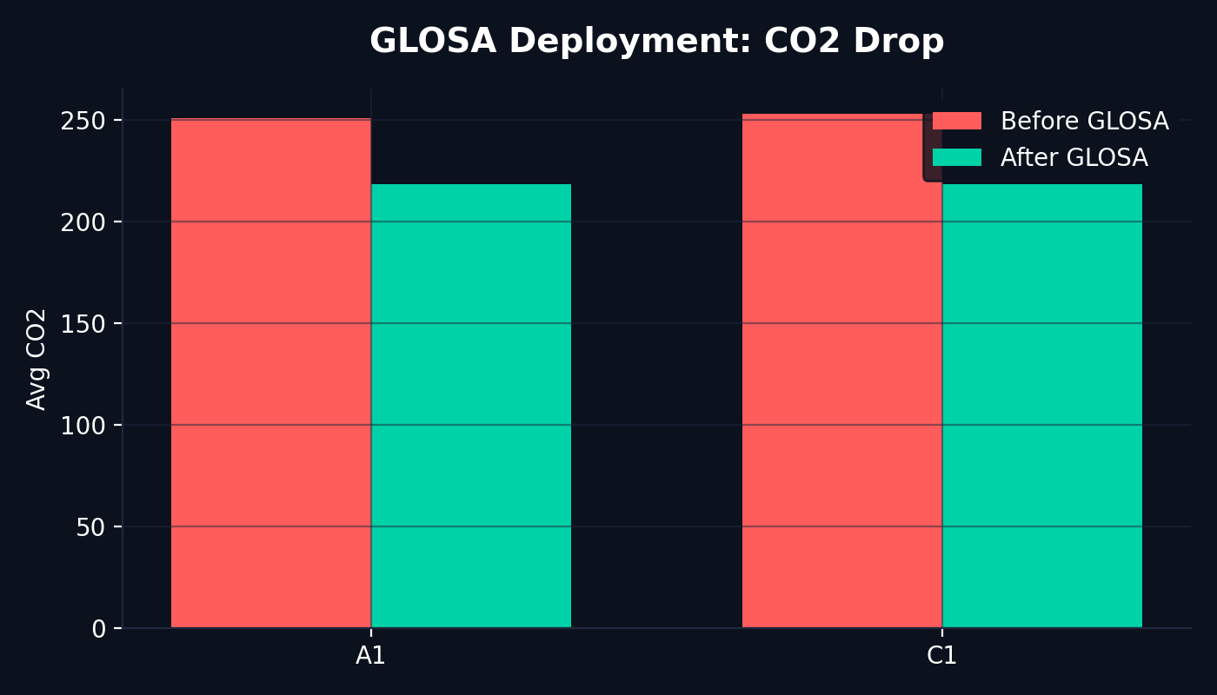
Data Visualized: Future Simulations
Insights → Simulating rapid EV adoption demonstrates that pushing the fleet to 50% EV immediately slashes network-wide CO2 levels by nearly 43%.
Insights → Applying GLOSA to the worst bottlenecks (A1 & C1) visibly crushes CO2 spikes, preventing the stop-and-go shockwaves responsible for idle emissions.

Slide 8
We didn't just analyse the data.
We proved the solution works.
6/8
3/5
13
35,416
+42.5%
Core Analyses
Advanced Analyses
KPIs Computed
CO₂ Saved by GLOSA
CO₂ Cut at 50% EV
What We Delivered
✓ Data cleaned: 108 duplicates removed, all blanks imputed
✓ Features: Hour, TEI, Rain Category engineered
✓ 6 Core + 3 Advanced + 2 Bonus analyses completed
✓ Excel Dashboard: 10 charts, 5 sheets, 13 KPIs
✓ GLOSA-BHARAT simulation with proven CO₂ savings
The Opportunity
If GLOSA is deployed on just 2 worst segments,
we save 35,416 CO₂ units (3.5% total).
Scale to all 8 segments:
Estimated 10-15% total CO₂ reduction
without building a single new road.

