Slide 1
Tower of Hanoi
By Ashish Dadhore

Slide 2
Data Structure
Data may be organized in many different ways; the logic or mathematical model of particular organization of data is called data structure
Data are simply values or set of values.

Slide 3
Basic type of Data Structure
Linear we consider a data structure as Linear if It’s element forms a sequence (i.e. Linear list)
Non Linear and the Non linear if they
are not

Slide 4
A list of Linear Data Structures
Data Structure types we will consider include:
  Arrays
  Stacks
  Queues
  Link List

Slide 5
Stacks
Play

Slide 6
Stacks
PROCESS

Slide 7
Stacks
PROCESS

Slide 8
Stacks
Ist Element
PROCESS

Slide 9
Stacks
IInd Element
PROCESS

Slide 10
Stacks
IIIrd Element
PROCESS

Slide 11
Stacks
Let Moved Left

Slide 12
Stacks
Let Moved Left

Slide 13
Stacks
Let Moved Left

Slide 14
Stacks
Let Moved Left

Slide 15
Stacks
Hence We got The Disk out from the Stack

Slide 16
Stack
A stack is a linear structure in which the data item may be added or removed from only one end.
Stack is also called Last In First Out (LIFO).
Terms: “PUSH” is Used to Add the Element
“POP” is Used to Remove the Element

Slide 17
Stack
PUSH
POP
TOP= 4
TOP= 3
TOP= 3
99
CC
CC
CC
BB
BB
BB
AA
AA
AA

Slide 18
Recursion
A problem-solving technique involving the progressive decomposition of a problem into smaller and smaller problems that can all be solved in the same way.
Examples
  Backtracking – 8 Queens, Knight’s Tour
  Divide-and-Conquer – QuickSort, Tower of Hanoi

Slide 19
Conditions for using Recursion
Be able to break the original problem down into progressively smaller or simpler versions of the same problem
Identify a Base Case as the smallest, simplest version of the problem
The Base Case must be immediately solvable or have a known solution

Slide 20
How Recursion Works
Given
fact(n) = if (n==1) return 1;
else return n*fact(n-1);
120
fact(5)
5*
fact(4)
24
4*
fact(3)
6
3*
fact(2)
2
2*
fact(1)
1
1

Slide 21
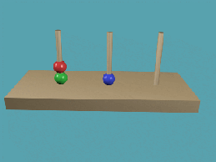
Tower of Hanoi

Slide 22
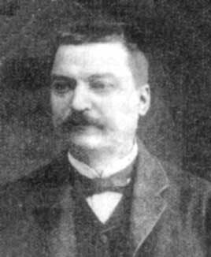
Tower of Hanoi
Actually, the Tower of Hanoi puzzle was invented in 1883 by the French mathematician Edouard Lucas (1842-1891), who made up the legend to accompany it.

Slide 23
Tower of Hanoi
initial state
Beg
Aux
Last
final state
Beg
Aux
Last

Slide 24
Towers of Hanoi - Complexity
For 1 rings we have 1 operations.
For 2 rings we have 3 operations.
For 3 rings we have 7 operations.
For 4 rings we have 15 operations.
In general, the cost is 2^{N} – 1 = O(2^{N})
Each time we increment N, we double the amount of work.
This grows incredibly fast!

Slide 25
Towers of Hanoi (2^{N}) Runtime
For N = 64
2^{N} = 2⁶⁴ = 18,450,000,000,000,000,000
If we had a computer that could execute a million instructions per second…
It would take 584,000 years to complete
But it could get worse…

Slide 26
Method in ‘C’
void tower (int cnt, char A, char B, char C)
{
if (cnt==1)
move (A,B);
else {
tower (cnt-1,A,C,B);
move (A,B);
tower(cnt-1,C,B,A);
}
}

Slide 27
THANX

