Slide 1

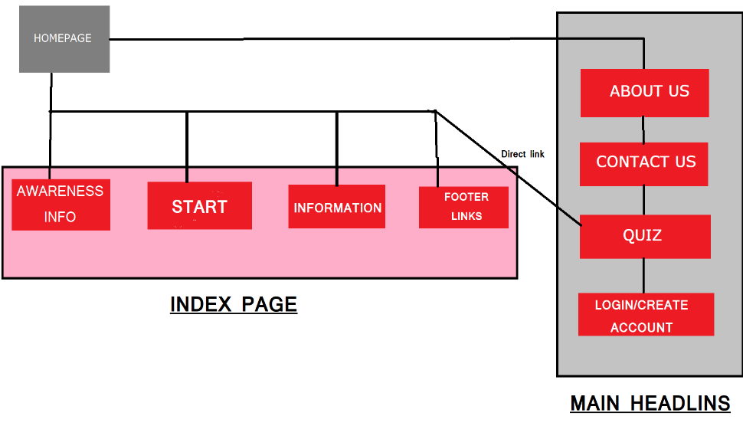
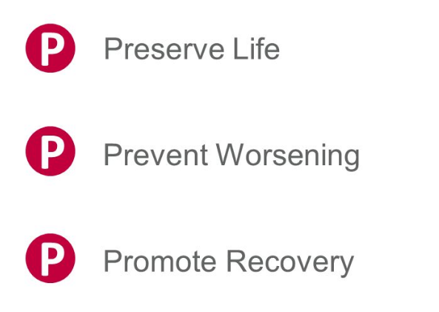
TSSM’S Bhivrabai Sawant College Of Engineering And Research
Department of Computer Engineering
A. Y. 2022-2023
Group Co-Ordinator : Ashish Dadasaheb Jadhav
Guide Name:
FAST-AID INFO Website For FIRST-AID
Introduction:
We have developed a Website on Fast-aid to saving the life of the casualty.
Objective:
The Objective of fast aid are to: preserve life, prevent illness or injury from becoming worse.
Literature:
HTML Tutorial – javatpoint
CSS Tutorial – javatpoint
and some other Web Design Languages.
System Architecture:
Methodology:
Informative website.
Conclusion: By using our website ,
One can save the life of Other or help them to recover.
Project Developed by:
Shankar Adagale
Ashish Jadhav
Subodh Phadtare
Aniket Salunke
Atharva Bhosale
FEATURES:

