Slide 1
Objects in JavaScript

Slide 2
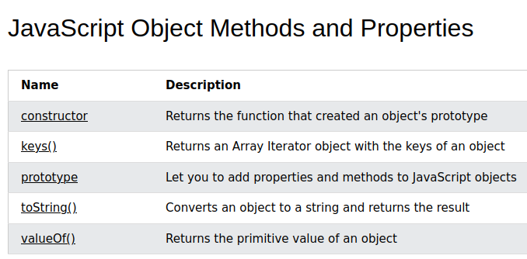
https://www.w3schools.com/jsref/jsref_obj_object.asp
# Make note of keys() and toString()

