Slide 1
JavaScript Objects

Slide 2
Real Life Objects, Properties, and Methods
In real life, a car is an object.
A car has properties like weight and color, and methods like start and stop.
All cars have the same properties, but the property values differ from car to car.
All cars have the same methods, but the methods are performed at different times.

Slide 3
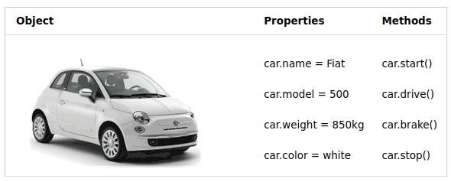

Slide 4
JavaScript Objects
You have already learned that JavaScript variables are containers for data values.
This code assigns a simple value (Fiat) to a variable named car:
let car = "Fiat";
Objects are variables too. But objects can contain many values.
This code assigns many values (Fiat, 500, white) to a variable named car:
const car = {type:"Fiat", model:"500", color:"white"};
The values are written as name:value pairs (name and value separated by a colon).
It is a common practice to declare objects with the const keyword.

Slide 5
Object Definition
You define (and create) a JavaScript object with an object literal:
Example
const person = {firstName:"John", lastName:"Doe", age:50, eyeColor:"blue"};
Spaces and line breaks are not important. An object definition can span multiple lines:
Example
const person = {
firstName: "John",
lastName: "Doe",
age: 50,
eyeColor: "blue"
};

Slide 6
Object Properties
The name:values pairs in JavaScript objects are called properties:
Property Property Value
FirstName John
LastName Doe
age 50
EyeColor blue

Slide 7
Accessing Object Properties
You can access object properties in two ways:
objectName.propertyName
or
objectName["propertyName"]
JavaScript objects are containers for named values called properties.

Slide 8
Object Methods
Objects can also have methods.
Methods are actions that can be performed on objects.
Methods are stored in properties as function definitions.
# A method is a function stored as a property.
Example
const person = {
firstName: "John",
lastName : "Doe",
id : 5566,
fullName : function() {
return this.firstName + " " + this.lastName;
}
};
In the example above, this refers to the person object.
I.E. this.firstName means the firstName property of this person.

Slide 9
What is this?
In JavaScript, the this keyword refers to an object.
Which object depends on how this is being invoked (used or called).
The this keyword refers to different objects depending on how it is used:
In an object method, this refers to the object.
Alone, this refers to the global object.
In a function, this refers to the global object.
In a function, in strict mode, this is undefined.
In an event, this refers to the element that received the event.
Methods like call(), apply(), and bind() can refer this to any object.
Note:
this is not a variable. It is a keyword. You cannot change the value of this.

Slide 10
The this Keyword
In a function definition, this refers to the "owner" of the function.
In the example above, this is the person object that "owns" the fullName function.
In other words, this.firstName means the firstName property of this object.

Slide 11
Accessing Object Methods
You access an object method with the following syntax:
objectName.methodName()
Example
name = person.fullName();
If you access a method without the () parentheses, it will return the function definition:
Example
name = person.fullName;

Slide 12
Do Not Declare Strings, Numbers, and Booleans as Objects!
When a JavaScript variable is declared with the keyword "new", the variable is created as an object:
x = new String(); // Declares x as a String object
y = new Number(); // Declares y as a Number object
z = new Boolean(); // Declares z as a Boolean object
Avoid String, Number, and Boolean objects. They complicate your code and slow down execution speed.

Slide 13
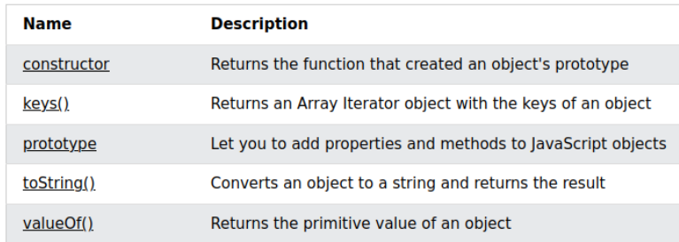
JavaScript Object Methods and Properties
# Make note of keys() and toString()
https://www.w3schools.com/jsref/jsref_obj_object.asp

