Slide 1
Cascaded Style Sheets

Slide 2
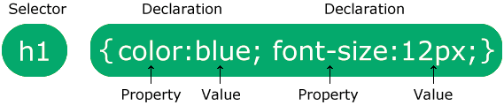
CSS Syntax
The selector points to the HTML element you want to style.
The declaration block contains one or more declarations separated by semicolons.
Each declaration includes a CSS property name and a value, separated by a colon.
Multiple CSS declarations are separated with semicolons, and declaration blocks are surrounded by curly braces.

Slide 3
An Example
p {
color: red;
text-align: center;
}
p is a selector in CSS (it points to the HTML element you want to style: <p>).
color is a property, and red is the property value
text-align is a property, and center is the property value

Slide 4
CSS Selectors
CSS selectors are used to "find" (or select) the HTML elements you want to style.
We can divide CSS selectors into five categories:
1) Simple selectors (select elements based on name, id, class)
2) Combinator selectors (select elements based on a specific relationship between them)
3) Pseudo-class selectors (select elements based on a certain state)
4) Pseudo-elements selectors (select and style a part of an element)
5) Attribute selectors (select elements based on an attribute or attribute value)

Slide 5
The CSS id Selector
The id selector uses the id attribute of an HTML element to select a specific element.
The id of an element is unique within a page, so the id selector is used to select one unique element!
To select an element with a specific id, write a hash (#) character, followed by the id of the element.
#para1 {
text-align: center;
color: red;
}

Slide 6
The CSS class Selector
The class selector selects HTML elements with a specific class attribute.
To select elements with a specific class, write a period (.) character, followed by the class name.
.center {
text-align: center;
color: red;
}

Slide 7
The CSS Universal Selector
The universal selector (*) selects all HTML elements on the page.
* {
text-align: center;
color: blue;
}

Slide 8
The CSS Grouping Selector
To group selectors, separate each selector with a comma.
h1, h2, p {
text-align: center;
color: red;
}
This is equivalent to writing:
h1 {
text-align: center;
color: red;
}
h2 {
text-align: center;
color: red;
}
p {
text-align: center;
color: red;
}

Slide 9
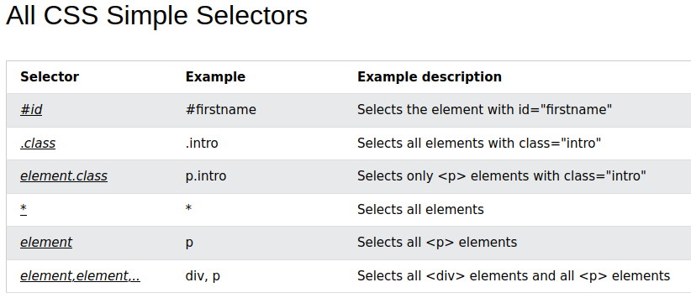

Slide 10
Three Ways to Insert CSS
There are three ways of inserting a style sheet:
External CSS
With an external style sheet, you can change the look of an entire website by changing just one file!
Each HTML page must include a reference to the external style sheet file inside the <link> element, inside the head section.
Internal CSS
An internal style sheet may be used if one single HTML page has a unique style.
The internal style is defined inside the <style> element, inside the head section.
Inline CSS
An inline style may be used to apply a unique style for a single element.
To use inline styles, add the style attribute to the relevant element. The style attribute can contain any CSS property.

Slide 11
Cascading Order
What style will be used when there is more than one style specified for an HTML element?
All the styles in a page will "cascade" into a new "virtual" style sheet by the following rules, where number one has the highest priority:
1. Inline style (inside an HTML element)
2. External and internal style sheets (in the head section)
3. Browser default
So, an inline style has the highest priority, and will override external and internal styles and browser defaults.

Slide 12
CSS Colors
CSS Color Names
In CSS, a color can be specified by using a predefined color name.
Example:
Tomato
Orange
DodgerBlue
MediumSeaGreen
Gray
SlateBlue
Violet
LightGray

Slide 13
CSS RGB Colors
Each parameter (red, green, and blue) defines the intensity of the color between 0 and 255.
For example, rgb(255, 0, 0) is displayed as red, because red is set to its highest value (255) and the others are set to 0.
To display black, set all color parameters to 0, like this: rgb(0, 0, 0).
To display white, set all color parameters to 255, like this: rgb(255, 255, 255).

Slide 14
CSS HEX Colors
In CSS, a color can be specified using a hexadecimal value in the form:
#rrggbb
Where rr (red), gg (green) and bb (blue) are hexadecimal values between 00 and ff (same as decimal 0-255).
For example, #ff0000 is displayed as red, because red is set to its highest value (ff) and the others are set to the lowest value (00).
To display black, set all values to 00, like this: #000000.
To display white, set all values to ff, like this: #ffffff.

Slide 15
Rule of Thumb
You do not fixate elements on the screen using properties like: top, right, bottom, left.

Slide 16
Block-level Elements
A block-level element always starts on a new line, and the browsers automatically add some space (a margin) before and after the element.
A block-level element always takes up the full width available (stretches out to the left and right as far as it can).
Two commonly used block elements are: <p> and <div>.
The <p> element defines a paragraph in an HTML document.
The <div> element defines a division or a section in an HTML document.

Slide 17
CSS float Property
img {
float: right;
}
Definition and Usage
The float property specifies whether an element should float to the left, right, or not at all.
Note: Elements next to a floating element will flow around it. To avoid this, use the clear property or the clearfix hack (see example at the bottom of this page).

