Slide 1
Yeast P-P I Network for HW 3

Slide 2
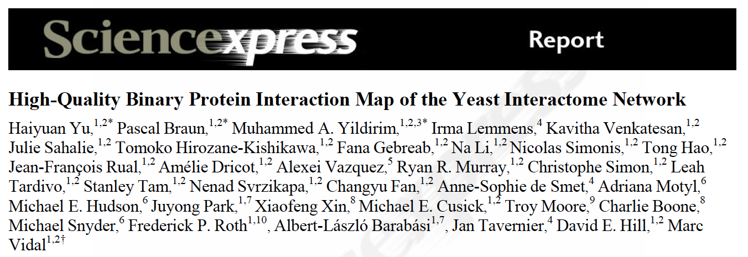
Source

Slide 3
Goal of Paper
Quality assessment of current interactions
Quality of data sources
Has data source for map creation affected conclusions?

Slide 4
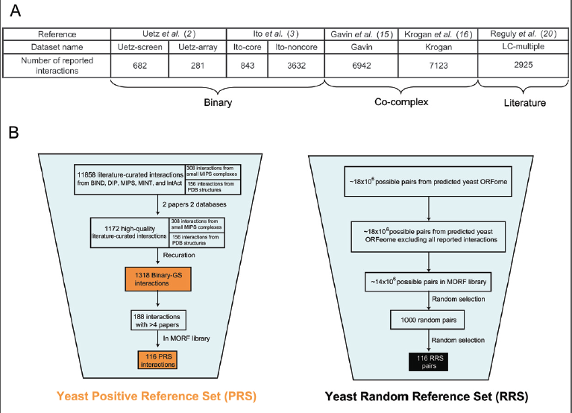
Notes:
Data sets and methods for quality looking at literature

Slide 5
Quality-Y2H
Y2H best for binary interactions when compared with a binary gold standard data set (Binary_GS_data.xslx)
Overlap between high quality datasets is low due to low sensitivity (many false negatives) instead of false positives
Due “completeness”
missing 10% of ORFs in each mapping could reduce testing space to (.9x.9) x (.9x.9) =.66
assay sensitivity rates of 0.2

Slide 6
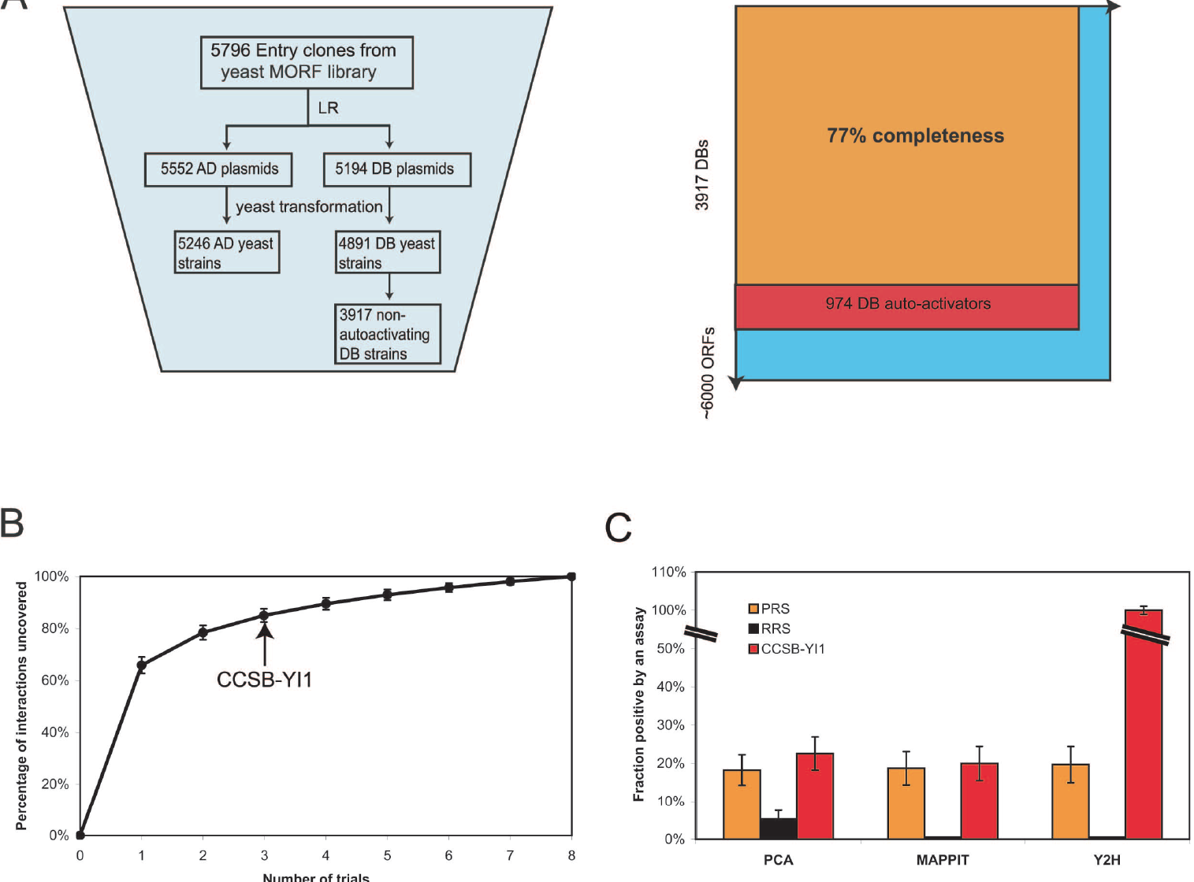

Slide 7
HW 3
Analyze the structure of the Union and CCB1 datasets
Small world, connectivity,radius, etc
Find hubs, are hubs correlated with phenotype-changing genes (From Yeast deletion project), compare with null hypothesis (choose set of genes at random and check essentiality)
Compare your results to the Yu Paper for the Y2H data
Do the below for the largest connected component in the network only
Find the most central genes with respect to betweenness, is there a correlation with essential genes?
Find modules in networks using MCL, compare the modules with 10% and 25% of the connections randomly removed.
Choose 1 cluster and look at the annotation for the genes, is there any common function?

