Slide 1
FINAL PROJECT 1
AI Customer Complaint
& Case Processing System
A GenAI batch workflow that reads complaint documents and produces structured data, customer emails and management summaries
Python · OpenAI · LangChain · LangGraph · Pydantic
Ashish Jain
Certification Programme in Generative and Agentic AI Development
Notes:
Good morning. I built an AI system that processes customer complaint documents end to end. I will show you the business problem, the architecture, the code that matters, and then run it live.

Slide 2
THE PROBLEM
Reading complaints by hand does not scale
What a human does today
Why it is a poor fit for a human, and a good fit for an LLM
Read the document — a PDF, a Word form or a transcript
Type the customer and case details into a system
Decide whether the case needs escalation
Write a reply to the customer
Write a summary note for the manager
1
Repetitive
The same five steps for every single complaint that arrives.
2
Inconsistent
Two humans categorise and escalate the same case differently.
3
Unstructured input
Nothing is in a fixed position, so a rule-based parser cannot work.
Notes:
The work is repetitive, slow and inconsistent between agents. And because the input is free text in three different file formats, you cannot solve it with a rule-based parser — which is exactly why an LLM is the right tool.

Slide 3
THE SOLUTION
One command, three artefacts per document
Batch : python app.py
reads every .pdf, .docx and .txt file in the data/ folder
Web : streamlit run streamlit_app.py
The same pipeline in a browser — this is what gets deployed
1
2
3
Structured case data
Customer reply email
Internal case summary
Customer name, email, phone, category, issue, resolution, three Yes/No business flags, case status and priority — validated against a schema.
A professional response addressed to the customer, restating the issue and giving the resolution or the next step — inventing nothing.
Overview, key issue, action taken, current status and one concrete recommended next action for the service manager.
structured_data/*.json
customer_emails/*.txt
case_summaries/*.txt
Plus one consolidated final_report.csv across the whole batch, and a timestamped run.log
Notes:
Everything is produced by one command. Three artefacts per document, plus a consolidated CSV that an operations team would actually use.

Slide 4
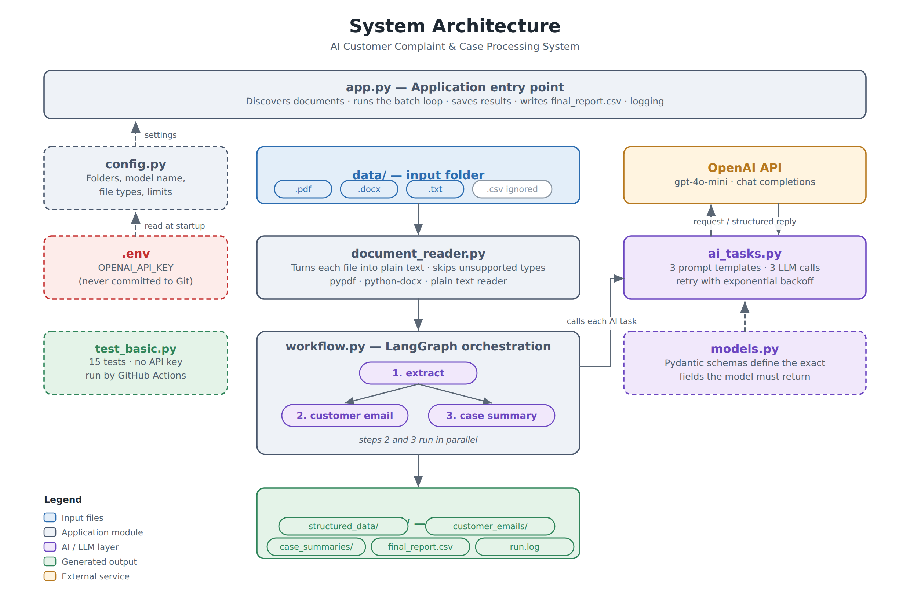
ARCHITECTURE
Notes:
Six small modules, each with one job. app.py runs the batch. document_reader turns files into text. workflow orchestrates. ai_tasks holds the prompts and the LLM calls. models defines what the model must return. config holds every setting. Nothing depends on app.py, which is why the whole thing is testable.

Slide 5
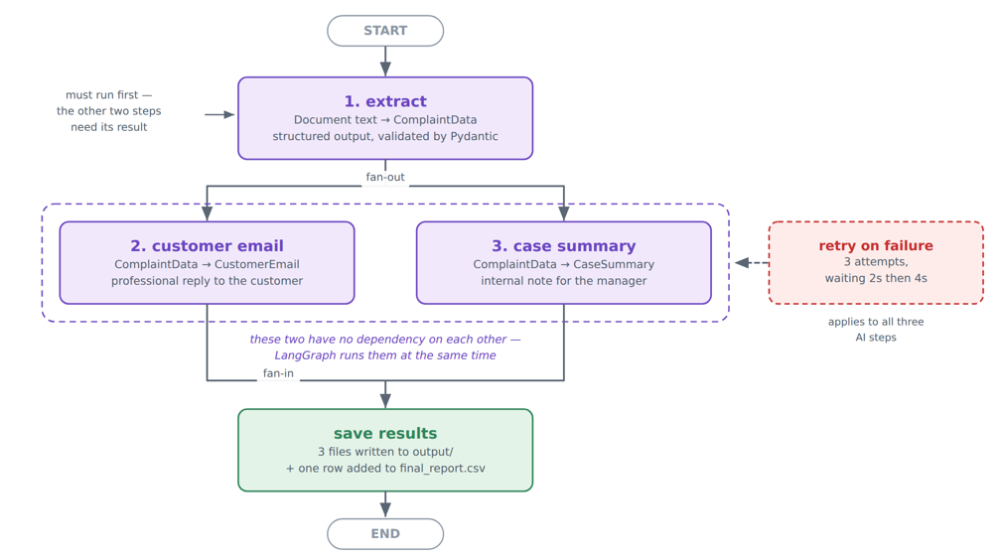
WORKFLOW — LANGGRAPH
Sequential where it must be, parallel where it can be
Why a graph?
Extraction must run first — both other tasks consume its output.
The email and the summary depend only on that output, not on each other.
Two edges out of one node, so LangGraph runs them in the same superstep.
A fourth task is one node and one edge — the other three do not change.
Notes:
This is the orchestration requirement. Extraction is a genuine sequential dependency. The email and the summary are not dependent on each other, so I draw two edges out of extract and LangGraph runs them together. Each document finishes noticeably faster.

Slide 6
THE CORE IDEA
The model fills in a schema — we never parse text
chain = EXTRACTION_PROMPT | llm.with_structured_output(ComplaintData)
result = chain.invoke({"document_text": text})
# result is a validated ComplaintData object, not a string
1
The schema is the prompt
2
Invalid answers cannot pass
Each Field(description=...) in models.py is sent to the model as part of the instruction.
complaint_category is a Literal of nine values. An invented category fails validation.
3
Absence is recordable
4
The report is always clean
Optional fields default to None, so the model can say a detail is missing instead of inventing one.
No text parsing anywhere in the project, so the CSV cannot be corrupted by odd wording.
Notes:
This is the single most important idea in the project. I do not ask for text and then parse it. with_structured_output binds the Pydantic class to the model, so it has to return exactly those fields, and LangChain validates the reply before my code sees it.

Slide 7
PROMPT ENGINEERING
Four measures that stop the model inventing facts
1
A rule in every prompt
The shared rule, included in all three prompts
Defined once as a constant and included in all three system messages.
“Use ONLY information that is present in the text you are given. If something is not mentioned, leave it empty or false. Never invent names, phone numbers, dates, amounts or promises.”
2
Structured output
Fixed fields, not free prose in which an invented detail can hide.
Why it matters
An email that promises a refund the company never agreed to is worse than no email at all. So the email prompt adds: if no resolution is recorded, say the case is under review and give the next step — do not promise a refund or a date.
3
Optional fields
None is a legitimate answer, so the model has somewhere to put absence.
4
Generation reads the extraction
Not the raw document — so it can only use facts already validated.
Notes:
Fabricated detail is the central risk here. Four measures work together: the shared rule, structured output, optional fields that default to None, and the fact that the two generation tasks receive the validated extraction rather than the raw document.

Slide 8
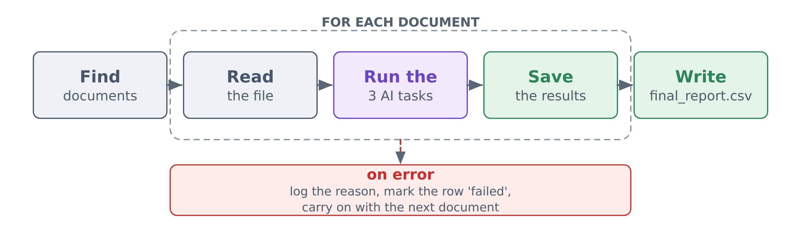
BATCH PROCESSING & ERROR HANDLING
One bad document never stops the batch
1
The API call
2
The file
3
The document
call_with_retry() makes up to three attempts, waiting 2 seconds and then 4. Recovers from dropped connections and rate limits.
A corrupt PDF, a scanned image with no text layer, or an almost-empty file is rejected with a message the user can act on.
A try/except per document. The failure is logged, the batch continues, and the document still gets a CSV row marked ‘failed’.
Notes:
The principle throughout is that a failure must end up visible in the output rather than quietly reducing the number of rows in the report. I also check for the API key before processing anything, so a missing key costs nothing.

Slide 9
STACK
Technology choices and why
OpenAI gpt-4o-mini
Strong structured-output support at low cost — about $0.03 for the whole sample batch.
LangChain
Prompt templates and with_structured_output, which binds a Pydantic schema to the model.
LangGraph
Expresses the three tasks as a graph, giving real parallel execution of the two independent tasks.
Pydantic v2
Defines the required output shape and validates the reply before the application uses it.
pypdf · python-docx
Mature pure-Python readers, one per format, behind a single read_document() function.
pytest · GitHub Actions
15 tests that need no API key, run automatically on every push.
Notes:
Every choice is deliberate. gpt-4o-mini because it supports structured output well and is cheap. LangGraph because the parallelism is real, not decorative. Pydantic because it is both the schema and the validation.

Slide 10
RESULTS
Six documents, three formats, one run
6
18
~$0.03
15
documents processed
from 3 file formats
API calls
(3 per document)
cost of a complete
run on gpt-4o-mini
automated tests,
no API key needed
DOCUMENT STATUS CATEGORY ESCALATE CASE STATUS
complaint_001.pdf success Billing No Resolved
complaint_002.pdf success Delivery Yes Escalated
complaint_003.txt success Warranty Yes Escalated
complaint_004.docx success Account Access Yes Escalated
complaint_005.docx success Service Quality No Resolved
enquiry_006.txt success Other No Closed
What to notice
The last row is an enquiry, not a complaint — the system sets is_complaint to No.
Escalation comes from meaning, not keywords: one document mentions a manager but is resolved.
An unsupported .csv in the folder is skipped without error.
Notes:
Point at the escalate column — the system worked that out from the meaning of the text. And the last row is the interesting one: it is an enquiry, not a complaint, which a keyword rule would get wrong.

Slide 11
ENGINEERING PRACTICE
Tested, versioned and reproducible
Testing
Version control
Continuous integration
15 tests in test_basic.py
None of them calls the API — free, and under a second
Covers file reading, Pydantic validation and CSV building
A test proves an invented category is rejected
.gitignore excludes .env and output/
The API key can never reach GitHub
A commit-by-commit history, not one bulk commit
.env.example is committed in its place
GitHub Actions runs pytest on every push
No secret needs configuring, because the tests need no key
A green tick on every commit
Defined in .github/workflows/tests.yml
Notes:
The tests need no API key, which is the detail that makes continuous integration possible — GitHub can run the full suite on every push without a secret and without cost.

Slide 12
SKILLS DEMONSTRATED
Where each assessed skill lives in the code
Python
LLM API integration
Prompt Engineering
all seven files
ai_tasks.build_llm()
three prompts, ai_tasks.py
Structured Outputs
Pydantic
Batch Processing
with_structured_output()
models.py — three schemas
app.py — the loop + CSV
Sequential / Parallel
Error Handling
Modular Code
workflow.py — LangGraph
retry, validation, try/except
six single-purpose modules
File Processing
Git / GitHub
Basic Logging
document_reader.py
.gitignore + Actions
screen + output/run.log
Notes:
All twelve assessed skills, and where to find each one. The project report has this same table with more detail.

Slide 13
HONEST ASSESSMENT
What it does not do yet, and what comes next
Current limitations
Next steps
Scanned PDFs have no text layer — they are correctly rejected, not silently misread.
Documents are processed one at a time; the parallelism is within a document, not across them.
No human review step — emails are written to disk, not sent.
No confidence threshold at which the system would ask for human input.
English only; other languages are untested.
1
OCR
Add Tesseract so scanned complaint documents can be processed too.
2
Concurrency across documents
A thread pool — the program spends nearly all its time waiting on the API.
3
Automatic routing
Send escalated cases to the responsible team using category and priority.
4
Policy retrieval (RAG)
Ground the email in the real refund window and service-level targets.
Notes:
I would rather state the limits than have the panel find them. The most valuable next step is OCR, because scanned documents are common in the real world; after that, concurrency across documents, since the program is almost entirely waiting on the network.

Slide 14
IN SUMMARY
Unstructured documents in,
governed business output out
Structured output
Explicit orchestration
Failures stay visible
Binding every reply to a Pydantic schema removes text parsing from the system entirely.
LangGraph makes the dependency between the three tasks visible, and runs two of them in parallel.
Three levels of error handling; a failed document still appears in the report with its reason.
Thank you — questions welcome
Notes:
To close: three design decisions carry most of the value — structured output, explicit orchestration, and error handling that keeps failures visible. Happy to take questions, and I can run it live on any document you would like to give me.

