Slide 1
Memwalker
Compiled by:
Ashish Jain

Slide 2
MEMWalker
A simple program, which can be used to dump registers memory along with its bit meanings.
It is coded in C language. So can be compiled on any embedded platform running linux.
Also, it can be used to get register bits description of already present set of memory values.
SOC Description File
Device1
Device2
Output:
QMAN: 0x21202345
RJ (0.10 ) – 15 #reject
STT (10..22) – 42 #state
CGR (23--30) – 100
#CGR counters
EQ (31..31) : 10
#EQ stats
Mmap()
Memwalker
Device n
Memory names to be walked

Slide 3
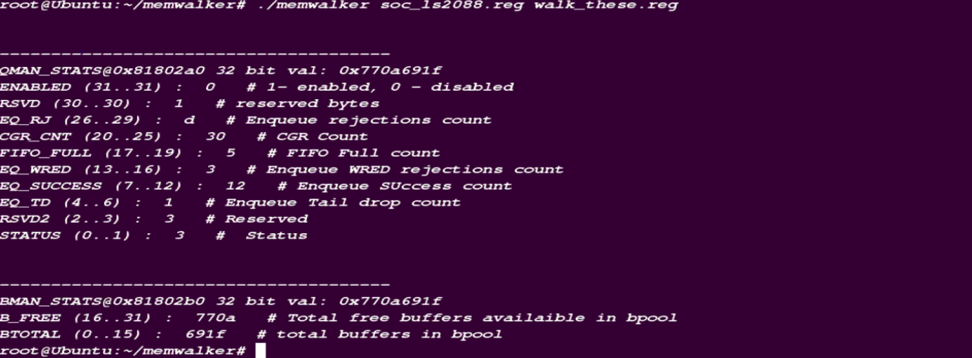
Sample RUN OUTPUT:

