Slide 1
Home Service
Booking System
Book Home Maintenance Professionals
Presented by: Ashish John

Slide 2
Introduction
A Home Service Booking System is a digital platform that enables users to book household services online in an easy and efficient way. It connects customers with skilled service providers such as electricians, plumbers, cleaners, and technicians.
Eliminates manual searching
Provides convenience and accessibility
Available anytime and anywhere

Slide 3
Objectives
The main objective of this system is to simplify and modernize the process of booking home services.
Provide an easy-to-use interface
Ensure reliable and quality services
Save time and effort
Improve user satisfaction

Slide 4
User Module
The user module allows customers to interact with the
system and book services easily.
Register and login
Browse services
Book services
View booking history

Slide 5
Admin Module
The admin module controls the entire system and ensures smooth operation.
Manage users and providers
Add/update/delete services
Monitor bookings
Generate reports

Slide 6
Service Provider Module
This module allows service providers to manage their tasks and availability.
Accept or reject bookings
Update availability
Manage profile and services
View assigned jobs

Slide 7
Key Features
The system includes various features that enhance usability and efficiency.
User-friendly interface
Secure authentication
Real-time booking
Online payment integration
Ratings and reviews

Slide 8
Database Design
The system uses a relational database to store and manage data efficiently.
Users Table
Services Table
Bookings Table
Payments Table
Maintains relationships between data

Slide 9
Technologies Used
The system is developed using modern web technologies.
Frontend: HTML, CSS, JavaScript
Backend: PHP
Database: MySQL

Slide 10
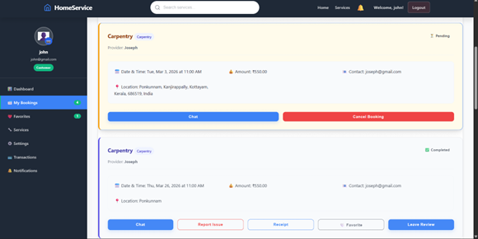
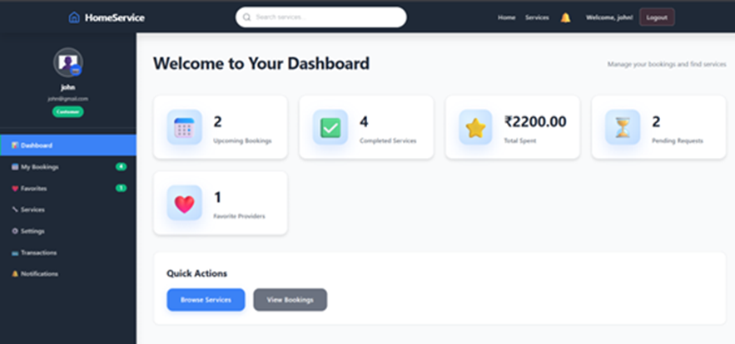
Screenshots

Slide 11
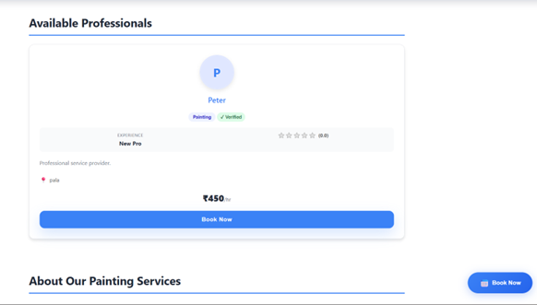
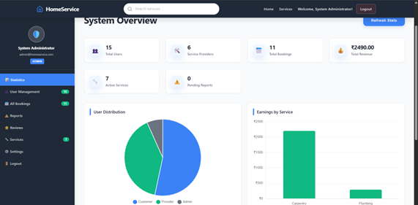
Screenshots

Slide 12
Advantages
This system provides multiple benefits to users and service providers.
Saves time and effort
Easy access to services
Reliable and secure system
Transparent pricing

Slide 13
Conclusion
The system successfully simplifies home service booking.
Improves user convenience and satisfaction
Provides a scalable and efficient online solution

Slide 14
Thank You

