Slide 1
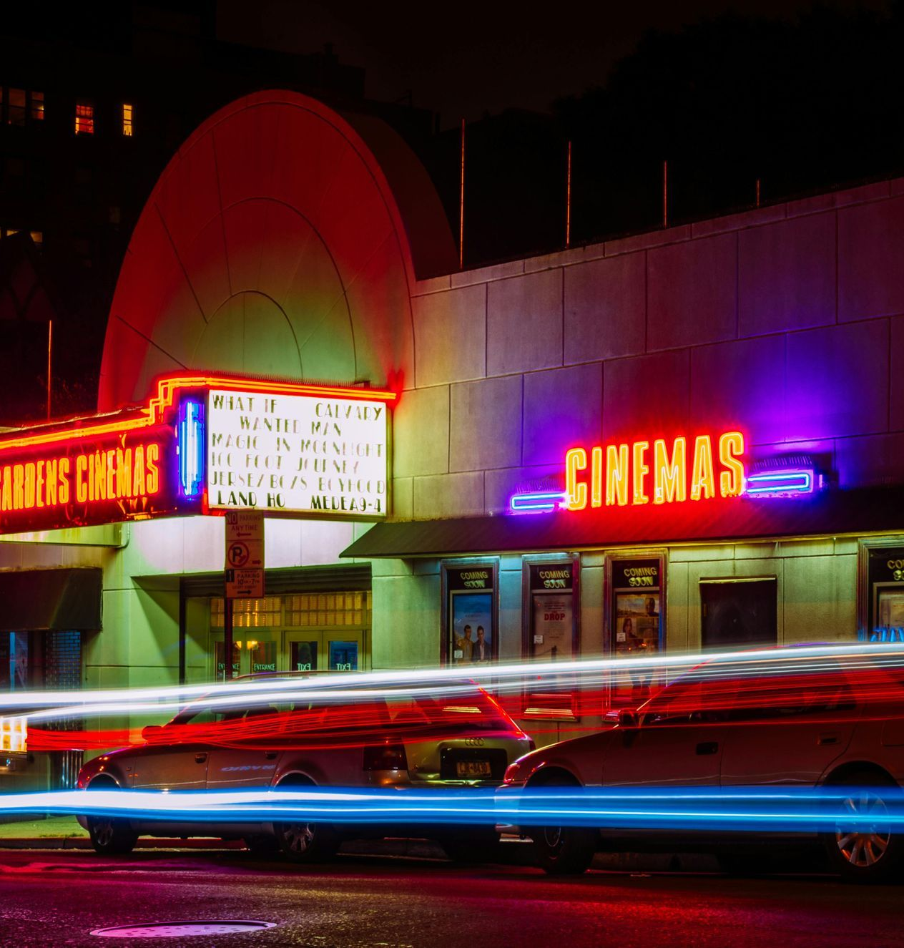
Project Title : Movie Recommendation System by Collaborative Filtering
Student Name : Ashish Joon
Mentor Name : Dr. Narayan Singh Chaturvedi

Slide 2

Introduction
Project Overview :
This Project focuses on building a Movie Recommendation System that predicts user preferences and suggest movies using collaborative filtering.
Data Collection : Utilizing the MovieLens dataset with millions of user ratings and movie details provides a comprehensive foundation for building accurate and reliable recommendations.
Project Goals : The primary goal of this project is to create a highly accurate and efficient system for recommending movies to users, improving their experience through personalization and data-driven insights.

Slide 3

Problem Statement
With the increasing volume of movies available across platforms, users face difficulty in discovering content tailored to their preferences. This project addresses the challenge of personalizing movie recommendations by leveraging collaborative filtering techniques to predict user preferences based on historical ratings and behavior
Need for Personalization
Consumers face an overwhelming number of movie choices, leading to the need for personalized recommendations that cater to individual tastes.
Challenges
Achieving accurate recommendations is challenging due to factors like data sparsity and the dynamic nature of user preferences.
Addressing Data Limitations
Overcoming the cold start problem and making recommendations with limited user data is a key challenge that requires advanced techniques.

Slide 4

Methodology
Dataset Description
The project uses a combination of movie ratings and metadata datasets, including user ratings, movie genres, release dates, and other features. Data preprocessing involved memory optimization to handle large datasets.
Approach
The chosen approach leverages collaborative filtering, specifically the Singular Value Decomposition (SVD) method, which identifies latent factors underlying user-movie interactions to generate accurate predictions.
Evaluation Metrics
To assess the performance of the recommender system, the project utilizes common evaluation metrics such as precision, recall, and F1-score. These metrics help quantify the accuracy and relevance of the generated movie recommendations.

Slide 5

Implementation
Hyperparameter Tuning
Optimizes the model's performance using GridSearchCV to identify the best parameters for predicting user ratings
Data Preprocessing
Includes tasks like cleaning, transforming, and preparing the data for model training.
Model Training
Involves fitting the SVD model on a training dataset of user-movie interactions.

Slide 6
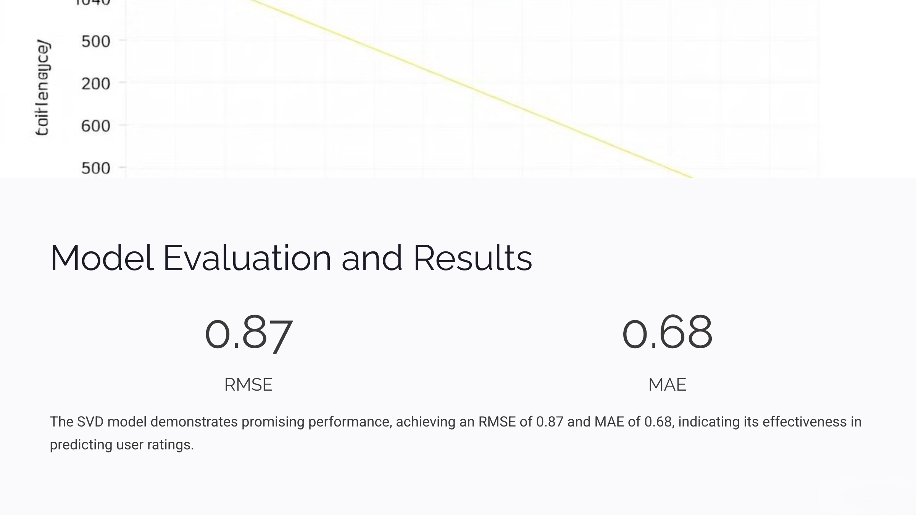

Slide 7
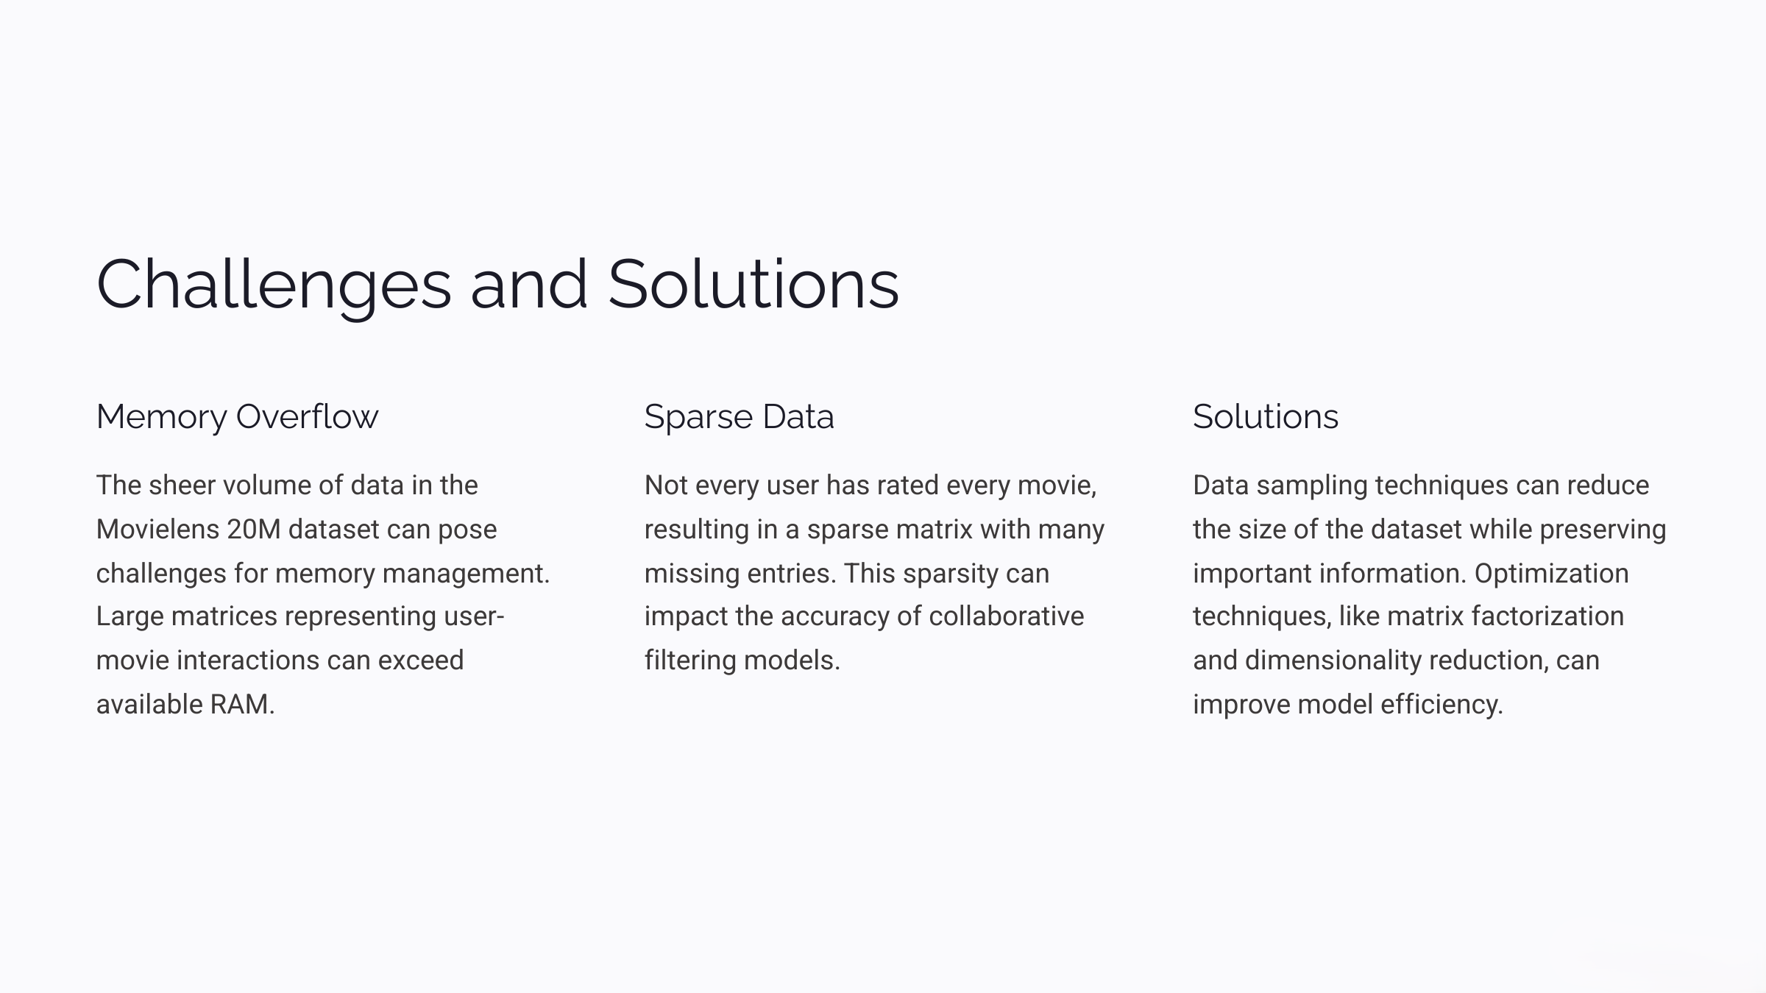

Slide 8

Conclusion and Next Steps
The developed movie recommendation system demonstrates the potential of collaborative filtering with SVD for personalized recommendations. Future work involves addressing limitations and exploring new techniques to enhance its effectiveness and provide users with more insightful and engaging movie suggestions.

Slide 9
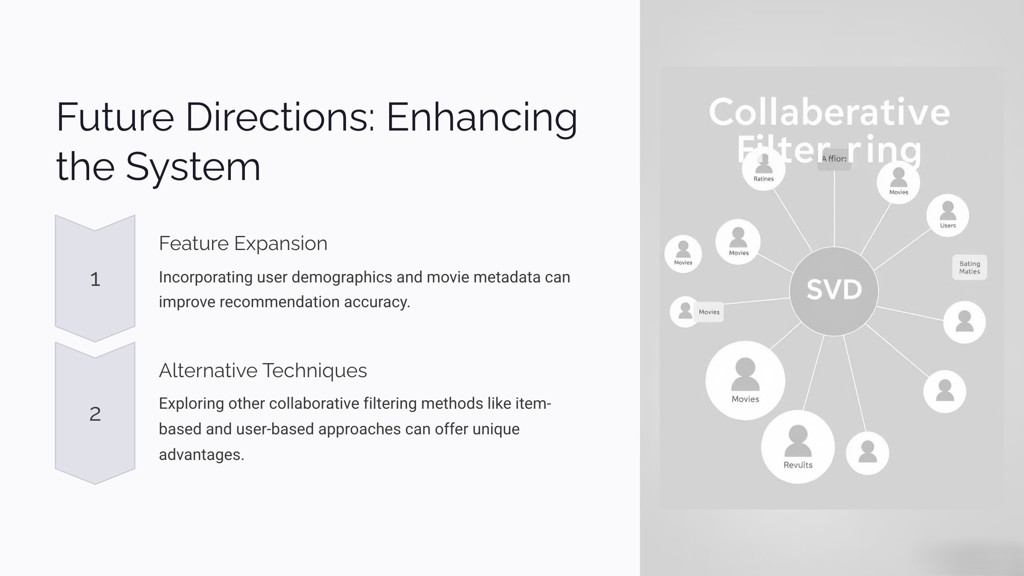

Slide 10

THANK YOU

