Slide 1


Python File Handling: A Comprehensive Guide
File handling is one of the most fundamental aspects of programming. It allows your programs to interact with permanent storage, making it possible to store data between program executions, process large datasets, import and export data, configure applications, log information, and share data between different systems.
For programmers transitioning from other languages like C/C++ or Java, Python offers a much more streamlined approach to file handling with powerful, high-level abstractions that simplify common operations while maintaining flexibility for advanced use cases.
by Ashish S

Slide 2
Types of Files in Python
Text Files
Binary Files
Human-readable text (characters, strings)
Raw bytes (not human-readable)
Access mode: Text mode ('t')
Access mode: Binary mode ('b')
Line endings: Automatically translated
Line endings: No translation (preserved as-is)
Common formats: .txt, .csv, .html, .py, .json
Common formats: .jpg, .png, .pdf, .mp3, .xlsx
Requires encoding specification (UTF-8, ASCII)
No text encoding (raw bytes)
Understanding the difference is crucial because text files require encoding/decoding between bytes and text, while binary files are processed as raw bytes without interpretation. Operations on binary files preserve exact bit patterns.

Slide 3

Opening and Closing Files
The open() Function
File Modes
Python's built-in open() function is the gateway to file operations, with parameters for file path, mode, encoding, and more. The mode parameter specifies how the file will be accessed (read, write, append).
Common modes include 'r' (read), 'w' (write), 'a' (append), 'x' (exclusive creation), with modifiers like 't' (text, default) and 'b' (binary). Combinations like 'rb' or 'w+' provide additional functionality.
Context Managers
The recommended way to work with files is using the with statement, which automatically handles file closing even if exceptions occur, preventing resource leaks and ensuring proper cleanup.

Slide 4





Reading from Files
Read Entire File
Use file.read() to load the entire file content into a single string. For large files, specify a size limit with file.read(size).
Read Line by Line
Use file.readline() for a single line or file.readlines() for a list of all lines. Consider memory usage with large files.
Iterate Directly
The most Pythonic approach: for line in file: which reads one line at a time, is memory efficient, and more readable.
File Position
Use file.tell() to get current position and file.seek() to move to specific positions in the file.

Slide 5





Writing to Files
Basic Writing
Use file.write('text') to write strings to a file. The 'w' mode creates a new file or truncates an existing one, while 'a' mode appends to existing content.
Writing Multiple Lines
Use file.writelines(list_of_strings) to write multiple strings at once, or loop through a list and write each line individually with newlines.
Formatted Writing
Use string formatting or the print() function with the file parameter to write formatted text. For structured data, use specialized modules like csv.
Flushing and Syncing
Use file.flush() to force writing buffered data to disk, and os.fsync() for critical data that must be physically written immediately.

Slide 6




Working with Binary Files
Binary Mode Basics
Converting Between Strings and Bytes
Use 'b' in the mode ('rb', 'wb') to work with binary data. This preserves exact byte values without text encoding or newline translation. Data is read/written as bytes objects, not strings.
Use string.encode(encoding) to convert strings to bytes and bytes.decode(encoding) to convert bytes to strings. Specify the encoding (e.g., 'utf-8') for proper conversion.
Serialization with Pickle
Structured Binary Data
Use the pickle module to serialize Python objects to binary files. This allows saving complex data structures like dictionaries and lists directly to files for later retrieval.
Use the struct module for precise control over binary formats, allowing you to pack and unpack values in specific binary layouts for compatibility with other systems.

Slide 7








Error Handling and Best Practices
Handle Exceptions
Use Context Managers
Implement comprehensive error handling for file operations, catching specific exceptions like FileNotFoundError and PermissionError.
Always use the with statement to ensure files are properly closed, even if exceptions occur.
Process Large Files in Chunks
Validate Paths
Check if files exist before operations and create directories if needed using os.path or pathlib.
For large files, read and process data in chunks instead of loading everything into memory at once.

Slide 8
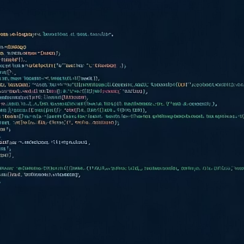
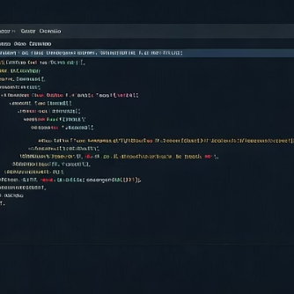



Practical Examples and Advanced Topics
Python's file handling capabilities extend to advanced topics like memory-mapped files for efficient large file processing, file change monitoring for reactive applications, working with compressed files (ZIP, GZIP), temporary file management, and file locking for concurrent access in multi-process environments.
These powerful features, combined with Python's clean syntax and extensive standard library, make it an excellent choice for applications that require sophisticated file operations.

