Slide 1
Multiple Sequence Alignment - msa

Slide 2
Progressive alignment: Scoring scheme
Scoring scheme is arguably the most influential component of the progressive algorithm
Matrix-based algorithms
  ClustalW, MUSCLE, Kalign
  Use a substitution matrix to assess the cost of matching two symbols or two profiled columns
  Once a gap, always a gap
Consistency-based schemes
  T-Coffee, Dialign
  Compile a collection of pairwise global and local alignments (primary library) and to use this collection as a position-specific substitution matrix

Slide 3
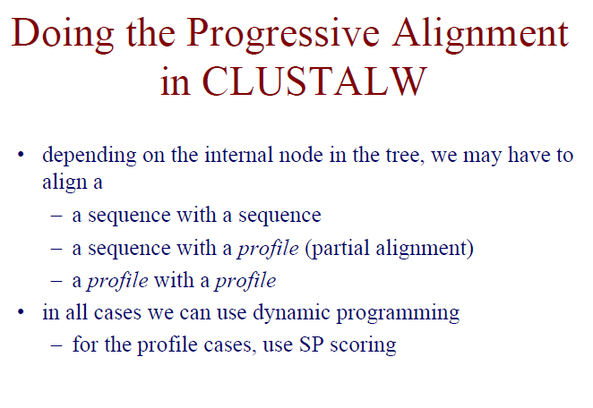

Slide 4
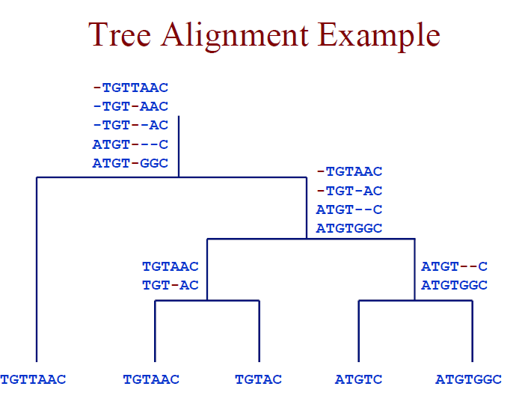

Slide 5
Construction of Profile
The starting point for the creation of a profile is a sequence or group of sequences (the probe).
~ This probe is usually a group of typical sequences of functionally related proteins/nucleotides that have been aligned by similarity in sequence or three-dimensional structure.
A sequence profile is a position-specific scoring matrix (or PSSM) that gives a quantitative description of a sequence motif.

Slide 6
Position Specific Score Matrix (PSSM)
A position specific scoring matrix (PSSM) is a matrix based on the amino acid frequencies (or nucleic acid frequencies) at every position of a multiple alignment.
From these frequencies, the PSSM that will be calculated will result in a matrix that will assign superior scores to residues that appear more often than by chance at a certain position.

Slide 7
Position-Specific Scoring Matrix
M(p,a) composed of 21 columns and N rows (N = length of probe). The row p corresponds to a sequence position of the probe. The first 20 columns of each row specify the score for finding, at that position in the target, each of the 20 amino acid residues.
An additional column contains a penalty for insertions or deletions at that position

Slide 8
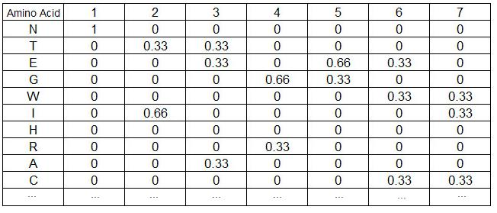
Creating a PSSM: Example
NTEGEWI
NITRGEW
NIAGECC
Amino acid frequencies at every position of the alignment:

Slide 9

Creating a PSSM: Example
Amino acids that do not appear at a specific position of a multiple alignment must also be considered in order to model every possible sequence and have calculable log-odds scores. A simple procedure called pseudo-counts assigns minimal scores to residues that do not appear at a certain position of the alignment according to the following equation:
Where
  Frequency is the frequency of residue i in column j (the count of occurances).
  pseudocount is a number higher or equal to 1.
  N is the number of sequences in the multiple alignment.

Slide 10
Creating a PSSM: Example
In this example, N = 3 and let’s use pseudocount = 1:
Score(N) at position 1 = 3/3 = 1.
Score(I) at position 1 = 0/3 = 0.
Readjust:
Score(I) at position 1 -> (0+1) / (3+20) = 1/23 = 0.044.
Score(N) at position 1 -> (3+1) / (3+20) = 4/23 = 0.174.
The PSSM is obtained by taking the logarithm of (the values obtained above divided by the background frequency of the residues).
To simplify for this example we’ll assume that every amino acid appears equally in protein sequences, i.e. f_{i} = 0.05 for every i):
PSSM Score(I) at position 1 = log(0.044 / 0.05) = -0.061.
PSSM Score(N) at position 1 = log(0.174 / 0.05) = 0.541.

Slide 11
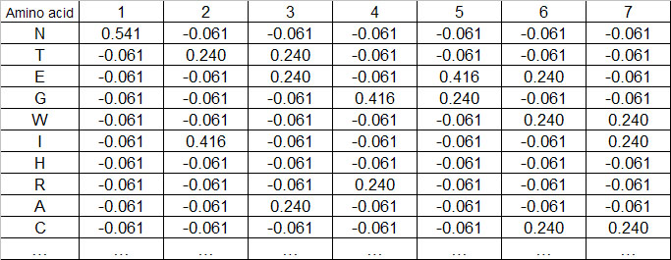
Creating a PSSM: Example
The matrix assigns positive scores to residues that appear more often than expected by chance and negative scores to residues that appear less often than expected by chance.

Slide 12
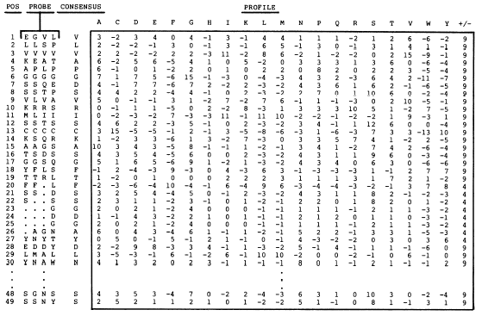
Profiles: PSSM
Insertion/deletion penalty
Gribskov et al. PNAS. 84 (13): 4355 (1987)

Slide 13
Profiles for families of sequences can be built from MSAs
1
2
3
1
2
3
A
C
T
G
—
50%
25%
0%
0%
25%
75%
0%
0%
25%
0%
25%
0%
25%
0%
50%
C
A
A
—
G
A
A
A
—
T
A
—
Note: While profiles can be used for any kind of sequence data, we’ll focus on protein sequences

Slide 14
Profiles
Profile: A table that lists the frequencies of each amino acid in each position of protein sequence.
Frequencies are calculated from a MSA containing a domain of interest
Allows us to identify consensus sequence
Derived scoring scheme allows us to align a new sequence to the profile
  Profile can be used in database searches
  Find new sequences that match the profile
Profiles also used to compute multiple alignments heuristically
  Progressive alignment

Slide 15
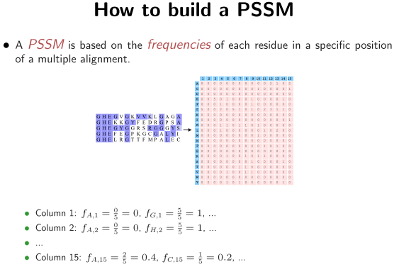

Slide 16
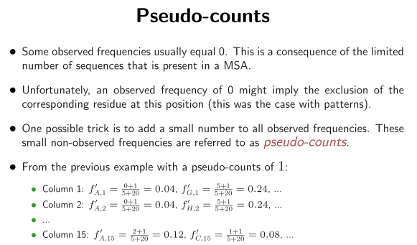

Slide 17
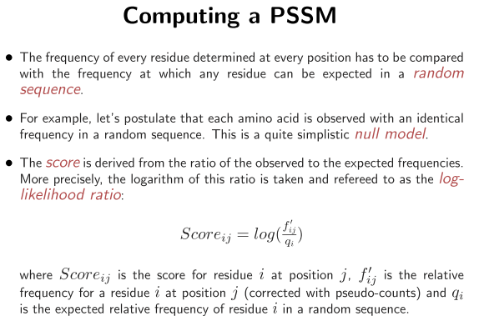

Slide 18
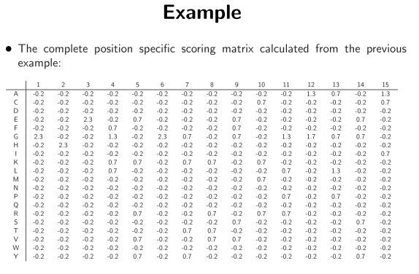

Slide 19
Profiles: Consensus Sequence
A consensus residue C(p) is generated at each position of the profile to aid the display of alignments of target sequences with the profile.
The consensus residue c is the amino acid at p that has the highest score M(p,c).
  c is the amino acid most mutationally similar to all the aligned residues of the probe sequences at p, rather than the most common one

Slide 20
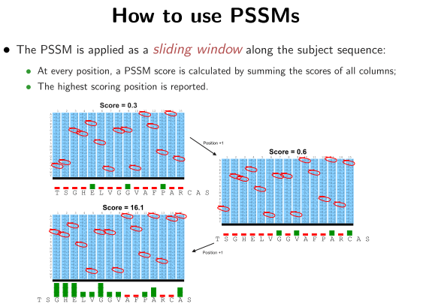

Slide 21
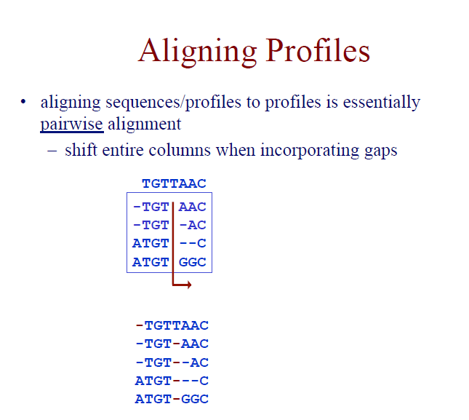

Slide 22
Feasible Method
Progressive alignment method
  Clustal
  T-coffee
  Muscle

Slide 23
ClustalW/Progressive method Problems
(1) Sequences that are similar only in some smaller regions ClustalW tries to find global alignments, not local.
(2) Sequence that contains a large insertion compared to the rest

Slide 24
ClustalW method Problems
(3) Sequence that contains a repetitive
element (such as a domain), while
another sequence only contains one copy.
VS

Slide 25
Problems with progressive alignment method
- Because of its progressive nature, mistakes that appear during early alignments cannot be corrected later as new sequence information is added. So, the error is propagated in future alignments.
- One must choose suitable substitution matrices and gap penalties during the every stage of a progressive alignment.

Slide 26
Comments
Pairwise alignment is an optimal algorithm.
Multiple alignment is not an optimal algorithm. Better alignments might exist!
The algorithm yields a possible alignment, but not necessarily the best one.

Slide 27
Iterative (e.g., genetic algorithms)
Two sequence with highest pair-wise similarity are aligned
The sequence that is most similar to profile of the alignment of the first two is sorted out
That is aligned to the first two by profile –sequence alignment
This is continued until all sequence is included

Slide 28
Sequence X1 is removed and realign to a profile of the other aligned sequences x2,….Xn by profile sequence alignment .This process is repeated for sequence X2… Xn
Previous realignment step is repeated a number of times until the alignment score converges.

Slide 29
Summary
There is no single method that always generates the best alignment
Therefore best is to use more than one method
Alignment editors can be used to correct the alignments

