Slide 1



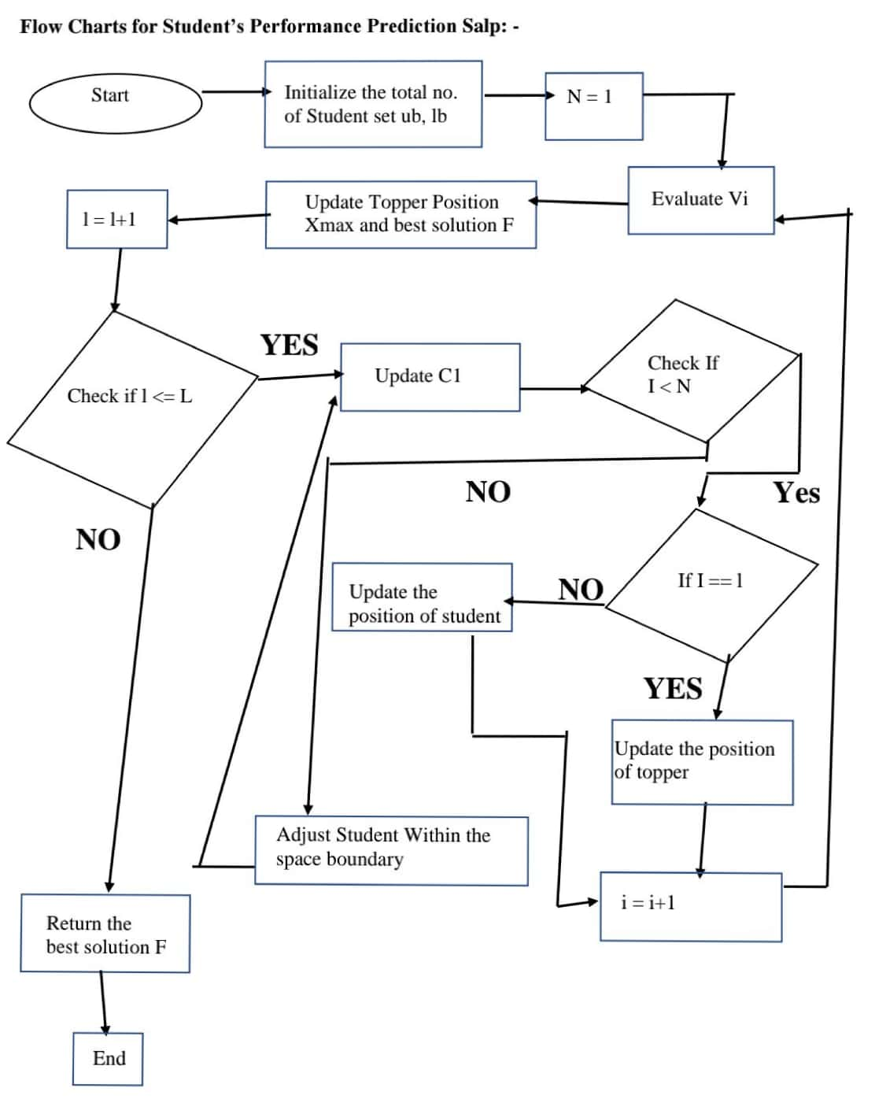
STUDENTS PERFORMANCE PREDICTION USING NATURE INSPIRED ALGORITHMS
Submitted by: Ashish Kumar (17803012), Keshav Agarwal (17803029) Department of CSE, Jaypee Institute of Information Technology, A-10, Sec-62, Noida-201307, Uttar Pradesh, India
ABSTRACT
One of the significant facts in higher learning institution is the explosive growth of educational data. These data are increasing rapidly without any benefit to the management. The main objective of any higher educational institution is to improve the quality of managerial decisions and to impart quality education. Predicting successful and unsuccessful students at an early stage of the degree program help academia not only to concentrate more on the bright students but also to apply more efforts in developing remedial programs for the weaker ones in order to improve their progress while attempting to avoid student dropouts. The aim of this study is to apply the nature inspired algorithms on k means algorithm to improve clustering technique to analyze the relationships between students’s behavioral and their success.
INTRODUCTION
Predicting successful and unsuccessful students at an early stage of the degree program help academia not only to concentratemore on the bright students but also to apply more efforts in developing remedial programs for the weaker ones in order to improve their progress while attempting to avoid student dropouts. Performance evaluation is one of the basis to monitor the progression of student performance in higher education. With traditional grouping of students based on their average scores, it is difficult to obtain a comprehensive view of the state of the students’ performance and simultaneously discover important details from their time to time performance. With the help of nature inspired techniques, such as clustering, it is possible to discover the key characteristics from the students’ performance and possibly use those characteristics for
future prediction.
CONCLUSION
In this study, data based on some selected input variables collected through questionnaire method. Some of most influencing factors were identified and taken to predict the performance in semester end examinations. By using by nature inspired algorithms. we can acquire effectiveness on supervising the development of students’ academic performance in higher educational institutions to offer exact outcomes in a small time period. The obtained results reveal that ‘type of school’ is not influence student performance and on the other hand, parent’s occupation plays a major role in predicting performance.
FUTURE WORK
Application may be more optimized by use of new nature inspired algoriths like Ant Colony Optimization, Bat Algorithm, Bees Algorithm for more accurate results.
SOLUTION APPROACH
In this project, 3 parameters are taken into account i.e. Accuracy, False Fail Rate and False Pass Rate for each of the algorithm used. False pass Rate, False Fail Rate and Accuracy error of K-Means are calculated a seen that and it is not optimized solution. optimization of K_x0002_Means is done using Salp, Chaotic Salp and GWO. Accuracy, False Pass Rate and False Fail Rate error of K-Means using Salp are also calculated and seen that it is optimized result but is also lag when data is large. So, Similarly, Accuracy, False Pass Rate and False Fail Rate of K-Means using Chaotic Salp swarm are calculated is also show optimized result but is also have its own drawbacks. By seeing these result, it can be clearly visualized that the result of K-Means is improved using Salp Swarm Optimization and Chaotic Salp Swarm Optimization, But the most important is that it struck in local optima when it has to deal with high dimension so it will unable to give optimum result so for that using Grey Wolf Optimization is used such that it will not stuck in high dimensional and it has been visualized in above graph which is screenshot. By which is can be clearly seen that result is further more optimized. using grey wolf optimization we have seen that cluster of K-means is optimized and its performance is improved as gwo is free from the initialization of input parameters.
REFERENCES
[1] X. S. Yang, “Nature-inspired optimization algorithms: Challenges and open problems,” J. Comput. Sci., vol. 46, p. 101104, 2020, doi: 10.1016/j.jocs.2020.101104.
[2] O. J. Oyelade, O. O. Oladipupo, and I. C. Obagbuwa
“Application of k Means Clustering algorithm for prediction of Students Academic Performance,” vol. 7, pp. 292–295, 2010, [Online]. Available: http://arxiv.org/abs/1002.2425.
[3] K. Govindasamy, “Analysis of Student Academic Performance Using,” vol. 119, no. 15, pp. 309–323, 2018.
[4] X. S. Yang, “Engineering optimizations via nature-inspired virtual bee algorithms,” Lect. Notes Comput. Sci., vol. 3562, no. PART II, pp. 317–323, 2005, doi: 10.1007/11499305_33.

