Slide 1
Leaf disease detection by using image processing technique
Presented by:-
B. Mounika
N. Pratyusha
M.N.V. Vara Lakshmi
Y. Ravi Teja
K.S.V.S Ashish

Slide 2
Contents:-
Abstract
Basic steps for disease detection
Applications

Slide 3
Abstract :-
The analysis of the plant diseases may involve the detection of the abnormalities introduced in the plant leaves, which may or may not be visible to the naked eyes. One cannot proceed with any random solution in the form of any pesticide or fertilizer, unless there’s a sheer and accurate understanding of the disease spots and proper pattern recognition which otherwise would lead to a catastrophic situation where besides the loss of the money, the plant will remain untreated and the diseases will also get more time to spread. An artificial intelligence technique has been employed which includes image acquisition, image enhancement and restoration, and information extraction from images.

Slide 4
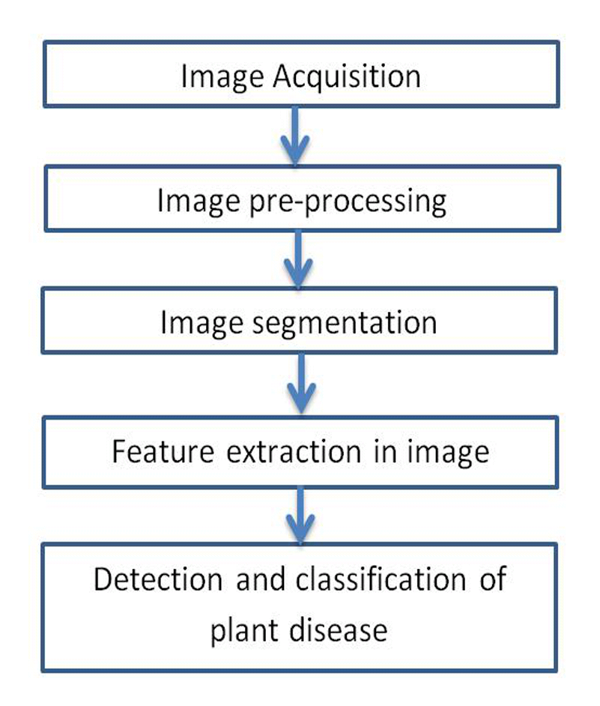
Basic steps for disease detection :-

Slide 5
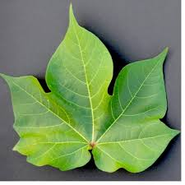
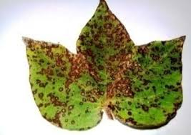
1.Image Acquisition
Leaf image is captured through the camera.
The image is in RGB form.
Healthy Leaf
Diseased leaf

Slide 6
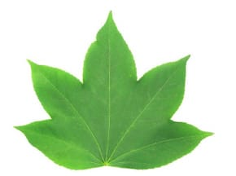
2.Pre-processing
Noise and other objects are removed by using different pre-processing techniques.
Image clipping – cropping of the image, image smoothing is done using smoothing filters, image enhancement is carried out by increasing contrast.

Slide 7
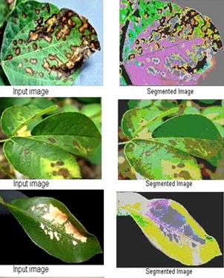
3.Segmentation
Partitioning of image into various parts of same features. This can be done by using K-means clustering.

Slide 8
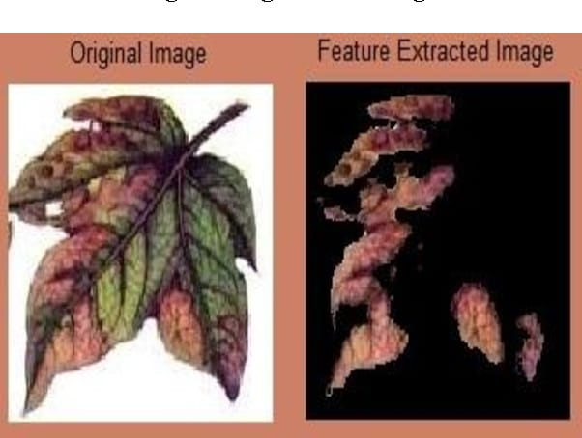
4.Feature Extraction
It is used for identification of an object. Color, texture, morphology, edges etc., are the features which can be used in plant disease detection.

Slide 9
5.Classification & Testing
Classification is done by comparing the given input image with the existing database.
The classification is carried by different mechanisms like SVM(Support Vector Machine), deep learning etc.,

Slide 10
Applications:-
In farms for agriculture purposes.
In botanical gardens to maintain the plant health.
At green houses, to prevent the spread of diseases among sensitive plants.
In nurseries where medical herbs are cultivated.

Slide 11
THANK YOU

