Slide 1
Continuous Integration
presented by : Ashish Kamat

Slide 2
Agenda
  Motivation behind Continuous Integration
  Integration can be time consuming
  CI to the rescue
  What is Continuous Integration
  How CI works?
  4 features required for CI
  Benefits of CI
  How does CI work?
  Best practices of CI

Slide 3
Motivation behind Continuous Integration
When many people are working on a project in parallel, there is an “integration problem”
  Work done separately need to be integrated successfully.
Levels of the integration problem:
  Merge conflicts: People have modified the same file concurrently.
  Compile conflicts: No merge conflicts, but people have modified files concurrently such that the resulting system does not compile.
  Test conflicts: No merge conflicts, no compile conflicts, but people have modified files concurrently such that the system does not execute successfully.

Slide 4
Integration can be time consuming
In some development organizations, groups may work independently on separate “branches” of the system for many months.
For example, one group might work on the “navigation system” for an aircraft, while another might work on the “flight control system”.
When these two branches are “integrated” into a single working system, there may be months of work involved in resolving hidden inconsistencies.

Slide 5
CI to the rescue
CI started out as a way of minimizing code integration headaches.
The idea was, “If it’s painful, don’t put it off, do it more often”.
It’s much better to do small and frequent code integrations rather than big ugly ones once in a while.
Soon tools were invented to help us do these integrations more easily, and to check that our integrations weren’t breaking anything.

Slide 6
What is CI
  CI is the process of building software with every change committed to a project's version control repository.
  Continuous integration involves integrating early and often, so as to avoid the pitfalls of "integration problems".
  The practice aims to reduce rework and thus reduce “cost and time.”

Slide 7
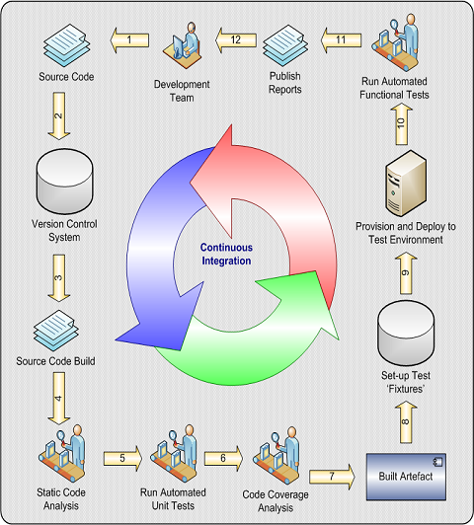
How does CI work?

Slide 8
4 features required for CI
1. The code must be under version control system.
2. The system must be able to be built and tested automatically. So, a build tool should be used.
3. Upon commit, the system is immediately and automatically “integrated”:
  compiled, tested, etc.
  4. There should be some feedback mechanism for the build status.

Slide 9
Benefits of CI
  Increase visibility which enables greater communication
  Spend less time debugging and more time adding features
  Reduce integration problems allowing you to deliver software more rapidly
  Reverting to a bug-free state in case of build failures
  Immediate unit and intégration testing of all changes
  Limit the risk of regression
  Immediate feedback to developers on the quality, functionality, or system-wide impact of code they are writing
  Metrics generated from automated testing and CI focus developers on developing functional, quality code

Slide 10
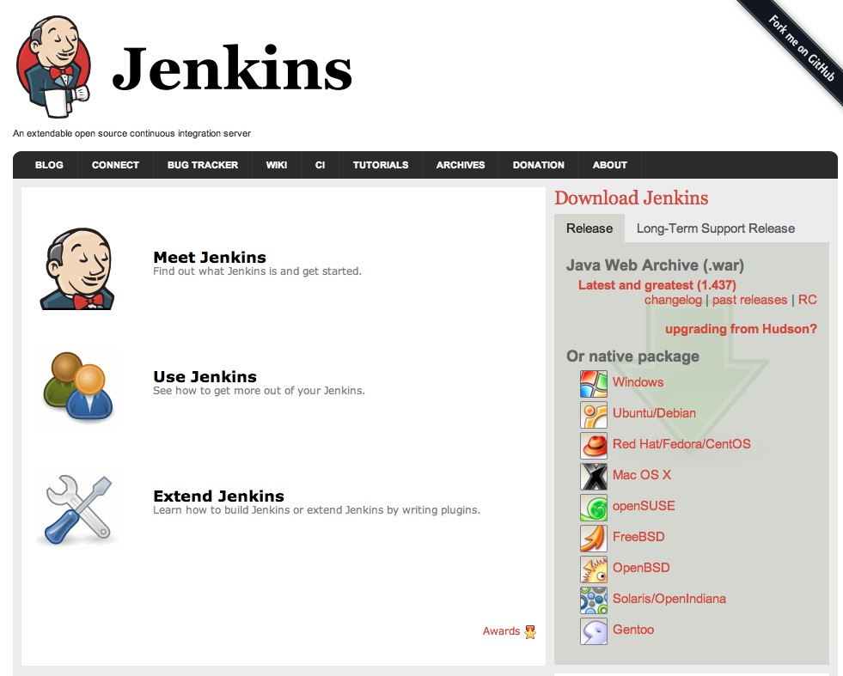

Slide 11

CI best practices

Slide 12
Team Responsibilities in CI
  Check in frequently
  Before checking in, run the build locally
  Don’t check in broken code
  Don’t check in untested code
  After checking in, make sure the system built successfully on the integration machine. If it didn’t, fix it as soon as you can or revert the changes you pushed.

Slide 13
When should the build be triggered?
Build should be triggered if anything changes in version control system like:-
1. Source code
2. Database scripts
3. Configuration files

Slide 14
CI server configuration should include:-
  Build script should compile the code and run the unit tests
  Code inspection should be performed. (e.g. using Sonarqube)
  Documentation should be generated. (e.g. javadocs, UML diagrams, etc)
  Feedback: You must send the right information to the right people at the right time and in the right way.

Slide 15
Characteristics of a build
  Good builds know how to fail fast.
  It is annoying to fail after so many other portions of the build have passed, and you are losing precious time targeting the failed targets.

Slide 16
Three build types
  1. Private build
  A developer will run a private build prior to committing code to the repository.
  2. Integration build
  It runs when code is pushed to the repository by the team. It should run on a separate dedicated machine.
  Fowler discusses different types of builds that can be run as part of an integration build. He calls these “staged builds,” which include a “commit build” and “secondary build(s).”
  A commit build is your fastest integration build (< ten minutes) and includes a compile and the unit tests.
  A secondary build is an integration build that runs slower tests, such as component, system, and performance tests. It can also include automated inspections such as coding standard adherence and code complexity.

Slide 17
Three build types
  3. Release build
  A release build readies the software for release to users. One of the goals of CI is to create deployable software. A release build may occur at the end of an iteration or some other milestone, may include more extensive performance and load tests.
  Release builds can create the installation media to run it in the user’s environment and or create release notes.

Slide 18
How to run builds fast?
  Stage builds:- One approach to reducing build duration is to run a lightweight build followed by a “heavyweight” build.
  CI server should have its own dedicated machine.
  Perform Distributed Integration Builds
  Run faster tests first. Unit tests require the least setup (by definition, none), and system tests need the most (everything).

Slide 19

Any Questions?

Slide 20
Thank You!

