Slide 1
Advanced Topics on
SQL Injection Protection
Sam NG
CISA, CISSP
SQLBlock.com
samng@sqlblock.com
Feb 27th, 2006

Slide 2
Introduction
SQL injection ^{[1, 2]} is now one of the most common attacks in the Internet. Simply go to Yahoo! or Google and search for "SQL injection" and we can find tones of related documents.
Although the awareness of SQL injection is rising, still many people do not have very concrete ideas on how to prevent SQL injection attack.
This article is not going to tell you what is SQL injection, nor going to tell you the latest techniques in SQL injection attacks, but more important, how to prevent SQL injection correctly and in a more integrated approach.

Slide 3
Methods to prevent SQL Injection
Input Validation
Static query statement
Least Privilege
Code Verification
Web Application Gateway
SQL Driver Proxy
MISC methods
Development
Phase
QA Phase
Production
Phase

Slide 4
Methods to prevent SQL Injection
Input Validation
Static query statement
Least Privilege
Code Verification
Web Application Gateway
SQL Driver Proxy
MISC methods
Development
Phase
QA Phase
Production
Phase

Slide 5
Method 1: Input Validation
Some programmers may think escaping apostrophe with two apostrophes (and back slash with two back slashes for MySQL) is all input validation has to do
This is completely WRONG!
A few important steps are missed and probably the program is still vulnerable to SQL injection.

Slide 6
Method 1: Input Validation (cont’d)
There are at least four steps we have to do for input validation
Escape apostrophe with two apostrophes (and back slash with two back slashes for MySQL)
Make sure numeric fields really look like numbers
Do step “1" and “2" not only on users' direct input, but on all non-constant variables
Check if the inputs are within your expectation (e.g. 0 < age < 120, login id without space, etc.)

Slide 7
1.1: Escape inputs properly
Escaping apostrophe with two apostrophes (or back slash with two back slashes for MySQL) usually can be done with one line of code.
However, we have to ensure that the decoding is done in the correct order.
To avoid SQL injection properly, the apostrophe-escaped input should NOT be further en/decoded by any other coding scheme.

Slide 8
Consider the following PHP code
[PHP]
$magic_quotes_runtime = “on”;
$url = urldecode($_REQUEST[‘url’]);
$query = “INSERT INTO tbl_links (type, url) VALUES(1, ‘$url’)”;
Malicious user can bypass the magic quote by using “%27” to represent an apostrophe.
“%27” will be decoded to a single apostrophe by the urldecode() function, and hence destroying the protection provided by the magic quote.

Slide 9
1.2: Validate numeric fields
[ASP]
Dim conn, rec, query, prod, price
prod = Replace(Request.Form(“prod”), “’”, “’’”)
price = Replace(Request.Form(“price”), “’”, “’’”)
Set conn = CreateObject("ADODB.Connection")
conn.Open = "DSN=AccountDB;UID=sa;PWD=password;"
query = “select * from sales where prod=’” & prod
& “‘ and price > ” & price
Set rec = conn.Execute(query)
Basically, the above ASP code will issue query like
select * from sales where prod='foo' and price > 100
It is true that the "prod" field will not be injected.

Slide 10
However…
The "price" field can still be injected
Numeric fields are not prefixed nor suffixed with apostrophe
The hacker doesn't need to put an apostrophe inside the field to balance the other apostrophe
So there is actually nothing to escape!
Hacker can inject with “100 union ... --”
Note again, no apostrophe is needed inside the injecting code, and escaping can’t help you

Slide 11
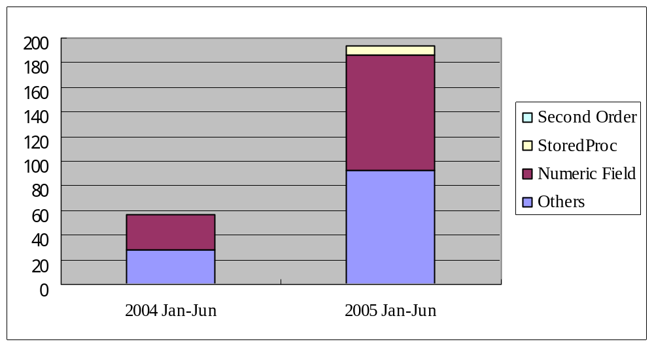
Table 1. SQL injection vulnerabilities found in BugTraq SecurityFocus
Period | Others | Numeric Field | StoredProc | Second Order | Total
2004 Jan-Jun | 28 | 29 |  |  | 57
2005 Jan-Jun | 92 | 94 | 7 | 1 | 194

Slide 12
Table 1 (cont’d)
Table 1 shows statistics of SQL injection vulnerabilities found during 2005 Jan-Jun, and 2004 Jan-Jun.
The data are collected from BugTraq SecurityFocus, filtered by selecting the publish date as stated above and with titles containing the word “SQL”. Non-SQL injection related vulnerabilities are manually removed.
From the table, we see about 50% of the SQL injection vulnerabilities are related to numeric field injection.

Slide 13
Prevent Numeric Field Injection 1
Check if the numeric field is really a number
Please be reminded that some languages, such as Perl and PHP, can convert a string into to a number as long as the string begins with digits.
Return true even if
$category = “2 union …”
if ($category > 0) {
$categ = "AND catid=$category ";
} elseif ($category == 0) {
....
}
“AND catid=2 union…”;

Slide 14
Prevent Numeric Field Injection 2
Put a pair of apostrophes before and after the numeric field variable, and escape the variable as usual.
i.e. treat the numeric field variable just as string
e.g. some_var > ‘20’ instead of some_var > 20
Works as most database servers will convert the string back to a number if necessary, and the overhead is very minimal.

Slide 15
1.3 Column Names
Some web application may dynamically include different column names in a query depending on user’s input.
For example, a web application may allow a user to select which column to be sorted by.
Like numeric fields, column names are usually not apostrophe quoted.

Slide 16
1.3 Column Names (cont’d)
Dim cat, orderBy, query
cat = Replace(Request.Form(“cat”), “’”, “’’”)
orderBy = Replace(Request.Form(“orderBy”), “’”, “’’”)
query = “select * from tbl_prod ”
& “where cat = ‘” & cat & “’ “
& “order by “ & orderBy
The above code fragment shows a typical vulnerable ASP code with dynamic column names specified after the “order by” keyword.

Slide 17
Prevent SQL injection in column names
The two techniques in numeric fields handling can be applied to column names as well.
verify if the column name is within our expectations (e.g. alphabets without spaces), OR
quote the column name with -- not apostrophe this time – double-quote (“) for MS-SQL, PostgreSQL and Oracle, back-tick (`) for MySQL.
MS-SQL and PostgreSQL allow double-quote to occur inside the column name by using two double-quotes (““), while Oracle seems not supporting this.
Although both techniques work, we suggest not allowing meta-characters in column names and verifying the column names accordingly.

Slide 18
1.4 Prevent second order attacks
Dim conn, rec, query1, query2, login_id, old_pass, new_pass
login_id = Replace(Request.Form(“login_id”), “’”, “’’”)
old_pass = Replace(Request.Form(“old_pass”), “’”, “’’”)
new_pass = Replace(Request.Form(“new_pass”), “’”, “’’”)
Set conn = CreateObject("ADODB.Connection")
conn.Open = "DSN=AccountDB;UID=sa;PWD=password;"
query1 = “select * from tbl_user where login_id=’” & login_id
& “’ and password=‘” & old_pass & “’”
Set rec = conn.Execute(query1)
If (rec.EOF) Then
Response.Write "Invalid Password"
Else
query2 = “update from tbl_user set password=’” & new_pass
& “’ where login_id=’” & rec.(“login_id”) & “’”
conn.Execute(query2)
..
..
End If
All properly escaped
Unescaped data, read from database.
But, what about if
login_id = “foo’ union…. –”

Slide 19
What is 2nd Order SQL Injection?
A second order code injection attack can be classified as the process in which malicious code is injected into a web base application and not immediately executed, but instead is stored by the application (e.g. temporary cached, logged, stored in database, etc.) and then later retrieved, rendered and executed by the victim ^{[3]}.

Slide 20
Prevent 2nd Order SQL Injection
Escaping ALL inputs that will be embedded into the query statement
All means not only GET/ POST/Cookie, but includes data read from files, database, etc.
Check if the input data is really what we expected to be (why allow user Id = “foo’ union… --”)
And of cause, we can simply not using dynamic queries.

Slide 21
 PHP magic_quotes_gpc, magic_quotes_runtime
Magic Quotes is a process that automatically escapes incoming data to the PHP script. When on, all ' (single-quote), " (double quote), \ (backslash) and NULL characters are escaped with a backslash automatically.
magic_quotes_gpc (default “on” in PHP) escapes only HTTP GET/POST/Cookie fields and is definitely still vulnerable to second-order SQL injection and numeric field injection.
magic_quotes_runtime (default “off” in PHP) is somehow more secure as it escapes data also from an external source, including databases and text files. However, it still lacks numeric fields validation.
However, as quoted in PHP manual ^{[4]} “It's preferred to code with magic quotes off (author note: it means both) and to instead escape the data at runtime, as needed.”

Slide 22
Methods to prevent SQL Injection
Input Validation
Static query statement
Least Privilege
Code Verification
Web Application Gateway
SQL Driver Proxy
MISC Methods
Development
Phase
QA Phase
Production
Phase

Slide 23
Method 2: Use Static Query Statement
Covered by most of documents related to SQL injection prevention
The basic idea is to use parameterised statement (or prepared statement) and have the server to encode the parameters as needed
An effective solution and is suggested whenever possible.
Still a few points we have to be aware of

Slide 24
2.1 parameterized stmt != static stmt
Prepare statement
[Java]
String sql = “select * from product where cat=’” + request.get(“cat”) + “’ and price > ?”;
PreparedStatement pstmt = con.prepare(sql);
pstmt.setString(1, request.getParameter(“price”));
ResultSet rs = pstmt.executeQuery();
Obviously vulnerable to SQL injection
Even this is called in a parameterized form

Slide 25
2.2 Stored Procedure != SAFE
CREATE PROCEDURE sp_dynamic
(
@name varchar(50) = ''
)
AS
DECLARE @Query varchar(500)
SET @Query = 'SELECT * FROM userlist where name = '''
+ @name + '''
EXEC(@Query)
GO
Insert at HERE
Dangerous Function
SQL style string concatenation
[Solution]
SET @name = REPLACE(@name, '''', '''''')

Slide 26
2.3 Static query doesn’t always work
The N in “select top N ... ”, table name, column name can’t be parameterised in most SQL database servers.
May force us to use dynamic query and we may still have to validate our inputs.

Slide 27
Methods to prevent SQL Injection
Input Validation
Static query statement
Least Privilege
Code Verification
Web Application Gateway
SQL Driver Proxy
MISC Methods
Development
Phase
QA Phase
Production
Phase

Slide 28
Method 3: Least Privilege
Don’t connect to the database with root access
Setting restricted read/write on tables or views
Denying access to special system utilities and system stored procedures.
Calls stored procedures would be more secure if we have fine-grained control on what will be returned in the stored procedure
For example, a stored procedure always return only one row of data will be better than granting the user/role read access on the whole table.

Slide 29
Invoker’s right for stored procedure
A stored procedure is usually executed under the permission of the stored procedure’s owner (similar to SUID files in UNIX file system).
However, when executing dynamic query (i.e. “exec()”) in a stored procedure, some database servers, such as Oracle^{[5]} and MS-SQL^{[6]}, provide an extra layer of defence by executing the dynamic query under the caller’s permission (i.e. invoker’s right).
That is, except for granting the user/role permission to access the stored procedure, we also have to explicitly grant privileges to all other object that is to be accessed by the dynamic query.

Slide 30
However...
Setting least privilege on database layer provides only limited help
Access control of most web applications is not performed by database, but by the application itself.
Users connect to the database through a shared (may be even pooled) connection with the same web application specific database username and password (the database role), and the application username and password (the application role) are stored in the database as an ordinary table in the database.
The application checks if the user is allowed to perform certain task base on the application role, not the database role.

Slide 31
If the code DOES contain SQL Injection bug…
The database role would already contain ENOUGH (enough for hacker) privileges no matter how you configure (provided that the hacker is aim at manipulating data and not to execute special OS commands or add/drop tables)
For example, the hacker will ALWAYS be able to insert/delete/update the table storing the user names and passwords because the application needs to manipulate that table even before the user login!

Slide 32
Conclusion
Similar to preventing buffer overflow, setting least privilege, chroot environment for network daemons won’t solve buffer overflow problems
But it can help to reduce the loss in case of a successful intrusion
Almost a must before deploying your web application to production environment

Slide 33
Methods to prevent SQL Injection
Input Validation
Static query statement
Least Privilege
Code Verification
Web Application Gateway
SQL Driver Proxy
MISC Methods
Development
Phase
QA Phase
Production
Phase

Slide 34
Method 4: Verifies Your code
How do you ensure your development staff do not make any mistakes?
Audit: review the source code of the program (a programmer’s point of view)
Assess: conduct penetration test on the program (a hacker’s point of view)

Slide 35
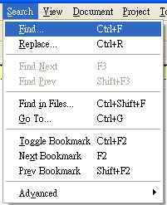
4.1 Source Code Auditing
The simplest way to do a source code auditing is probably by using the editor’s “search” function.
For example, to check if a Java program is vulnerable to SQL injection attack, we could search for execute(), prepareStatement() and prepareCall(), and then back trace the formation of their corresponding input query string to see if they contains unchecked/unescaped user input.
Can also performed in an automatic fashion

Slide 36
Automatic Source Code Scanner ^{[7]}
Mainly two technologies: static and runtime
A static scanner: analyzes a program without “running” the application. This is usually done through a pseudo compiling process to analyze the flow of the program, and then to locate and analyze the dangerous function as mentioned previously
A runtime analyzer: analyzes the code by “running” all or part of the program/function, send input to it, and then analyze the flow like a unit tester or debugger

Slide 37
4.2 Web Application Vulnerability Scanner
Hack (Assess) your own web application
Can be done manually or automatically
Mannually assess the web application by input “’ or 1=1 -–“ or input “1 union …..”, and check if the web application behaviour will be affected by these unexpected input.
Clearly, although the above test input is a valid test, this is not a thoughtful one. Many other test vectors have to be tried to verify the application.
And this is how an automatic tool can help. It works similar to a manual testing, just in a faster and an automatic fashion

Slide 38
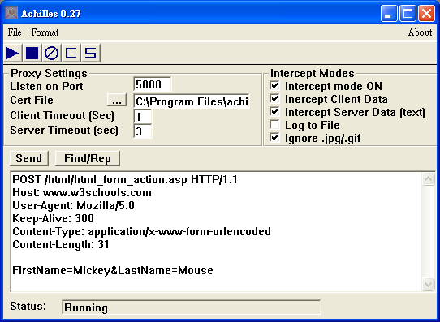
Semi-automatic tools: Web Proxy
Even if you hire an expert to test your application, a semi-automatic tool may help to speed-up the process.
There are tools that works like a proxy to intercept the HTTP traffic, and let you change the POST form data before it is sent to the web server, and it can screen out hidden fields, list JSP/ASP comments that may reveal some of the program flow.
Edit Post Data Before Send

Slide 39
Automatic Source Code Scanner vs Automatic Vulnerability Scanner
Although not directly related to SQL injection, automatic web application vulnerability scanner may do better in finding logic bugs.
Consider a web mail application, a logic bug may exists so that it will show emails even not belongs to the authenticated user, as long as you have login successfully and supplied a valid message id
http://www.your-domain.com/show_msg?msg_id=1234
<it won’t check if you own the message 1234>
While this would be quite difficult to be detected by automatic source code scanner, there is a higher chance that an automatic vulnerability scanner will be able to report this bug, provided that the vulnerability scanner will try to mutate the URL it crawled.

Slide 40
Conclusion
The most important factor for both source code auditing and vulnerability assessment is the false negative ratio.
This differs from vendor to vendor, from implementation to implementation or even from the people who perform the task
Although having passed source code auditing and assessment phase does not guarantee 100% security, these two methods are almost a mandatory if you really want to maintain quality on a sizable application.

Slide 41
Methods to prevent SQL Injection
Input Validation
Static query statement
Least Privilege
Code Verification
Web Application Gateway
SQL Driver Proxy
MISC Methods
Development
Phase
QA Phase
Production
Phase

Slide 42
Method 5: Web Application Gateway (WAG)
WAG works like a reverse web proxy, except that it is much more secure.
It can interpret more information in the HTTP protocol and HTML content, it checks
  Form inputs are within our expectation
  Hidden fields and cookies are unmodified
  Multiple choice (select/radio) input is one of the allowed option
  URL flow is according to the original design
  And many more
WAG protects more than just SQL injection.

Slide 43
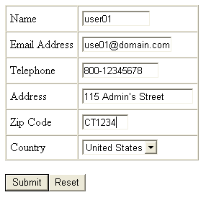
The downside of WAG
A new user register to a web portal application
Although WAG is very promising, it is difficult to configure it precisely, especially for protecting SQL injection attacks on free-format text input
Without proper configuration, the WAG (or even for human) cannot judge if the input should be allowed or blocked and return an error page to the browser.
Noted the apostrophe
But should we block this?

Slide 44
The downside of WAG (cont’d)
It is difficult to tell if the WAG should block the input just base on the input itself.
The WAG should, however, decide if it should be blocked base on the allowable input pattern of the backend application.
That is, if the backend application will escape the apostrophe properly before inserting into the database, or if the data is completely not SQL related, then the WAG may accept this input; otherwise, this input may cause exception in the server and hence should be blocked – even if it doesn’t look like a SQL injection!

Slide 45
The downside of WAP (cont’d)
Likewise, it is also difficult to tell if the backend application is vulnerable without testing it.
Can’t ask the programmer because the program may not behave as the programmer expected (and that’s why we have a bug),
Can’t determine by looking at the JavaScript of the form field to detect the format requirement because that may also be wrong.
The only reliable way to determine the allowable input format is to test it.

Slide 46

Solution
Basically two methods to make configuration much easier if we can accept certain amount of false alarms

Slide 47
To make configuration easier: 1st method
Default deny any text input with an apostrophe, but allow exceptional cases
We will block our example input “115 Admin’s Street”, and then generate an alert to notify the sys-admin or developer.
The sys-admin or developer then verifies if the program is vulnerable; if not, he/she then change the WAG configuration to allow the apostrophe in “this” form field next time.
But what about numeric field or column name injection?
Deny all input with space?

Slide 48
To make configuration easier: 2nd method
Deny input only if it really looks like a SQL injection attack
We will allow our example input “115 Admin’s Street”, because it really doesn’t look like a SQL injection attack.
In case the backend application doesn’t escape the input properly, (hopefully) this will generate an error but may not result in data lose.

Slide 49
To make configuration easier
Clearly, both are not perfect solutions
The first method results in higher false positive error
The second one results in higher false negative error and is susceptible to attack evasion
At first glance, the first method seems to be a better choice, however, for a well tested web application, the second method may be a more practical approach.

Slide 50
Methods to prevent SQL Injection
Input Validation
Static query statement
Least Privilege
Code Verification
Web Application Gateway
SQL Driver Proxy
MISC Methods
Development
Phase
QA Phase
Production
Phase

Slide 51
Method 6: SQL Driver Proxy
A SQL driver proxy ^{[8]} works like web application gateway, except that it intercepts API calls instead of network connections, and monitors database function calls instead of HTTP requests.
And same as web proxy, it will pass the request to the backend “original driver” if it is a legitimate request. The proxy nature enables these tools to monitor and block malicious SQL execution, as well as sanitizing error message send from database server back to the client application.
Sanitizing error message is import as the error message usually reveals information about the database schema.

Slide 52
Architecture of a SQL Driver Proxy
HTTP Client
HTTP Server
HTTP Server
HTTP Client
HTTP
Protocol
Analysis
HTTP
Protocol
HTTP Proxy
ODBC
JDBC
App
Original Driver
ODBC/JDBC Driver
ODBC/JDBC App
API
Calls
API
Calls
Analysis
ODBC/JDBC Proxy

Slide 53
How SQL Driver Proxy works?
For example, an online banking web application may only issue three SQL queries: query user table during authentication, query user owned bank accounts information, and transfer money between bank accounts.
The application may ONLY issue queries in the following forms
  SELECT * FROM tbl_user
  WHERE user_id = ‘<some thing>’
  AND password = ‘<some thing>’
  SELECT * FROM tbl_accounts
  WHERE user_id = ‘<some thing>’
  UPDATE tbl_accounts
  SET balance = balance + <some value>
  WHERE account_id = ‘<some thing>’

Slide 54
How SQL Driver Proxy works? (cont’d)
When the application is under SQL injection attack, it may issues queries as follows:
SELECT * FROM tbl_user
WHERE user_id = ‘<some thing>’
AND password = ‘<some thing>’ OR 1=1 --’
SELECT * FROM tbl_accounts
WHERE user_id = ‘<some thing>’ UNION …
UPDATE tbl_accounts
SET balance = balance + <some value>
WHERE account_id = ‘<some thing>’; DROP …

Slide 55
How SQL Driver Proxy works? (cont’d)
Because the “basic structure” of these query statements will not be the same as the three original queries, and hence can be detected.
Moreover, because all SQL queries are monitored, these tools can also prevent second order SQL injection attacks. For some implementations, the list of allowable SQL statements can be “auto-learned” which makes configuration easier.

Slide 56
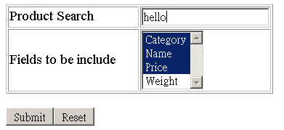
SQL Driver Proxy limitation
Like many other technologies, SQL driver proxy has it own limitation. Since the proxy has to determine if a SQL query is legitimate, the query can not have its structures varying depending on user’s input. Consider a web page allowing user to select the data fields to be reported by using a multi-line selection box as shown below

Slide 57
SQL Driver Proxy limitation (cont’d)
The client application may issue a SQL query as follows:
  SELECT p_cat, p_name, p_price FROM tbl_prod
  WHERE p_name LIKE ‘%hello%’
However, if the user selects 2 data fields only, then the SQL query will be different (only two column names after SELECT)
  SELECT p_name, p_price FROM tbl_prod
  WHERE p_name LIKE ‘%hello%’
Depending on the implementation and number of columns, the maximum number of queries it can “mutate” is n!, which may not be a trivial configuration task if n is large.

Slide 58
Methods to prevent SQL Injection
Input Validation
Static query statement
Least Privilege
Code Verification
Web Application Gateway
SQL Driver Proxy
MISC Methods
Development
Phase
QA Phase
Production
Phase

Slide 59
Intrusion Detection System (IDS)
Network Intelligence provides some Snort signatures for detecting SQL injection.
But of course, IDS technology is susceptible to detection evasion and can’t handle SSL traffic.
http://www.niiconsulting.com/resources/snort.html

Slide 60
Context-Sensitive String Evaluation ^{[9]}
The concept not only works for protecting SQL injection attack, but is also applicable for all general command injection attacks
The general ideal is to change the language design to distinguish user supplied strings with static strings, and depending on the usage of a string, impose some runtime meta-character restriction on the user supplied string.
For example, user supplied input can’t contain apostrophe if it is to be used in a SQL query statement, and can’t contain “&&” or “|” if it is to be used in a system() command.
A prototype implementation for PHP is currently available

Slide 61
Database Layer Protection
[10, 11, 12, 13, 14] describe methods to prevent SQL injection at the database layer
Techniques involves static (source code) analysis, run-time (query statement) analysis and/or provide another set of “Secured API”

Slide 62
Conclusion
SQL Injection is one of the most important problem in web application security
As shown in Table 1, the number of vulnerabilities reported increased more than triples from 2004 Jan-Jun to the same period in 2005, and it is expected that this figure will continue to increase in the near future.
The solutions for SQL injection are not very complicate but it requires good management to deploy properly
Don’t under estimate SQL injection and tackle the problem in a more holistic and systematic approach

Slide 63
Reference
SecuriTeam, SQL Injection Walkthrough, May 2002
http://www.securiteam.com/securityreviews/5DP0N1P76E.html
Steve Friedl, SQL Injection Attacks by Example, Dec 2004
http://www.unixwiz.net/techtips/sql-injection.html
Gunter Ollmann, “Second-order Code Injection Attacks” http://www.nextgenss.com/papers/SecondOrderCodeInjection.pdf
PHP Magic Quotes Manual http://www.php.net/manual/en/security.magicquotes.php
Oracle Invoker's Rights Procedures
http://www.stanford.edu/dept/itss/docs/oracle/10g/network.101/b10773/glossary.htm
Security Context of Dynamic SQL Statements Inside a Stored Procedure, http://support.microsoft.com/default.aspx?scid=kb;en-us;301299
Jeff Forristal, Source-Code Assessment Tools Kill Bugs Dead, Secure Enterprise, Dec 2005
http://www.secureenterprisemag.com/showArticle.jhtml?articleId=174402221
Sam M.S NG, SQLBlock: SQL Injection Protection by Variable Normalization of SQL Statement, May 2005
http://www.sqlblock.com/sqlblock.pdf

Slide 64
Reference - 2
T. Pietraszek and C. V. Berghe. Defending against Injection Attacks through Context-Sensitive String Evaluation. In Proceedings of the 8th International Symposium on Recent Advances in Intrusion Detection (RAID), Sept. 2005.
S. W. Boyd and A. D. Keromytis. SQLRand: Preventing SQL injection attacks, In Proceedings of the 2nd Applied Cryptography and Network Security (ACNS) Conference, pages 292{302. Springer-Verlag, June 2004.
Gregory T. Buehrer, Bruce W. Weide, and Paolo A. G. Sivilotti: Using Parse Tree Validation to Prevent SQL Injection Attacks, In Proceedings of the Fifth FSE International Workshop on Software Engineering and Middleware (SEM), September 2005
Zhendong Su and Gary Wassermann: The Essence of Command Injection Attacks in Web Applications, 33rd Annual Symposium on Principles of Programming Languages, Charleston, SC, Jan 11-13. p. 372-382.
W. G. Halfond and A. Orso. Combining static analysis and runtime monitoring to counter SQL-injection attacks. In Online Proceeding of the Third International ICSE Workshop on Dynamic Analysis (WODA 2005), pages 22-28, May 2005. http://www.csd.uwo.ca/woda2005/proceedings.html.
William G.J. Halfond and Alessandro Orso: AMNESIA: Analysis and Monitoring for NEutralizing SQLInjection Attacks, Proceedings of the IEEE and ACM International Conference on Automated Software Engineering (ASE 2005).

