Slide 1
Introduction to Cyber Security Lab
CS460 / ECE419
Spring 2019

Slide 2
Administrivia
Mondays are Lecture/Tutorial
1-3 pm / SC 1404
“Optional” videos for more background
Class recorded/Live-Streamed on echo360.org
Lab sections in 1129 SC
Available 24x7 for students in course
Please avoid being in lab during other scheduled lab sections, lab is shared with another course.
May be guest lecturers, will be announced

Slide 3
Staff
John Bambenek – Instructor
bambenek@illinois.edu / Skype: bambenek
TA: Hanyun Xu (hanyunx2@illinois.edu)
Yi Zhou (yizhou7@illinois.edu)
TBD Graders: (for now)
Please e-mail all of us with problems/issues
Office Hours TBA – Will be announced on Piazza and posted to Wiki

Slide 4
Means of Communication
Web site/wiki
Compass for assignments, lectures, etc.
Use Piazza for class discussion
Compass2g for assignments
The lab is self-supported, so course staff generally is responsible for resolving issues, start with Graders for tech support issues

Slide 5
Disclaimers
You should consider SC 1129 a hostile computing environment
More importantly, you will learn things in this class that WILL get you arrested if you are stupid.
Hold harmless agreement (up soon)
Sign it, submit via compass
Need it signed this week if you wish to continue
Will be mailed out to you and announced via piazza

Slide 6
Authorization, TL;DR version
If it is in SC 1129, it is fair game (unless part of networking lab class).
If off-campus, if its 192.17.19.128/25, it’s fair game.
Wireless is off limits unless we set up a class specific one
Using what’s gained here to access an account, service or computer outside of SC 1129 or 192.17.19.128/25 (i.e. a fellow student’s Facebook) is not fair game.

Slide 7
Cheating Policy
If you violate hold harmless agreement, you fail the class.
If you plagiarize your assignments, you fail the class.
If you cheat in any way, you fail the class.
I will tell you what are group assignments and what are individual. I may watermark assignments, if you simply copy others work, you fail.
If you don’t participate in group assignments (like attack-defend), you fail the assignment.

Slide 8
Cheating policy
If I see your picture on the following page for any computer crime related offense during this class, you fail.

Slide 9
Class Structure
Complements introductory security courses like Computer Security I
Teach computer and network security mechanisms used in the field
Teach design techniques
A sampling of security technologies
Class meetings
Lectures on background material
Class exercises

Slide 10
Class Non-Goal
Class will not make you expert in any particular security technology
If that is your goal, better to take a specific technology training course or self study
I can provide resources
Survey

Slide 11
Security Education
How I got into the field…
The Role of Convention

Slide 12
Class Lab Environment
Bring in personal laptops to access VMs
VMWare server
https://vmfarm.cs.illinois.edu:9443/vsphere-client/# uses campus AD for authentication
Only accessible from on campus
Separate networks
Things can get “funny”
Importance of troubleshooting skills

Slide 13
More on vCenter
This is dedicated for our use but still has finite resources.
i.e. don’t give yourself TB filesystems
You should have access to only your folder with whatever images you create.
Team folders may be created as needed.
If you wait until last minute, you may experience the system under heavy load and it will slow you down.
IMPORTANT: Name all images with your NetID in the name… (i.e. Bambenek-Ubuntu-Server)

Slide 14
Basic Lab Configuration
There are two primary VLANs
Classnet routes to internal campus network, behind a NAT and uses private IP addressing
Dirtynet, 192.17.19.128/25, is at the perimeter of campus and more or less fully exposed to internet
All “bad behavior” should be confined to dirtynet or on an internal VLAN to vCenter, nothing should hit the campus network

Slide 15
Tentative Outline
System and Server Defenses
Network Defenses
Secure Coding
Attack-Defend

Slide 16
Tentative Outline
End of class will be attack-defend lab.
You will get a broken environment
You will harden it
You will hack your fellow students
Then to ensure you have a proper level of humility, I will burn all your crap to the ground

Slide 17
Other topics
If you have something you’d really like to learn, let me know.

Slide 18
Course Evaluation
~Weekly exercises, labs – 40%
Security project – 30%
Final attack/defend project – 30%
No final, you’re welcome
4 credit hour students
A specifically assigned project

Slide 19
Course Evaluation
Rule to get an F:
Cheat, don’t do work, etc.

Slide 20
Late work
Generally, if you talk to me BEFORE the due date and have a reasonable excuse, I’m pretty liberal with extensions.
Otherwise you take a 10% hit and then additional 10% hits every 72 hours after that to a floor of 50% credit for excessively late work.
Takeaway: Contact me and course staff before the deadline.

Slide 21
Projects
By week 3, I want everyone to have a project picked out.
Solo and groups are fine
Free riders will get dealt with… severely
Some ideas… check the course github.com/uiucseclab

Slide 22
Why is security still broken?
What is the weakest link when it comes to computer security?

Slide 23
Why is security still broken?
What is the weakest link when it comes to computer security?
USERS!
There are people still falling for Nigerian General (419) scams…

Slide 24
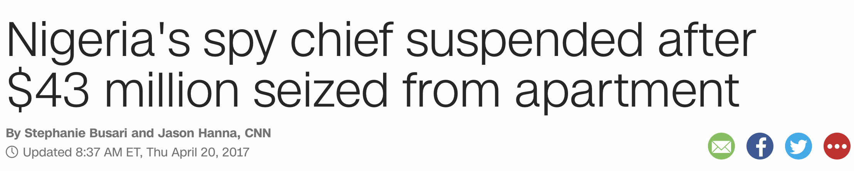
Speaking of Nigerian Generals

Slide 25
Three basic security attributes
Confidentiality
SQLi, bad permissions, etc
Integrity
XSS, RFI
Availability
DoS/DDoS

Slide 26
Two main defense principles
Lease privilege
Defense in depth

Slide 27
Top 5 Infosec problems
#1 - Authentication
No one, literally no one has figured this out yet
Passwords
Stolen, reused
Cookie theft
2FA Bypasses

Slide 28
Top 5 Infosec problems
#2 - Spoofing
Almost everything you see on Internet can be spoofed
E-mail
Spam has been around for 2 decades and still here
IP addresses
Domains
And the SSL racket will not save you…

Slide 29
Top 5 Infosec problems
#3 – Input validation
Most of you will keep me gainfully employed for the rest of my life
Buffer overflows
Why would you let a user write anything they want into memory
SQL Injection
Does “; DROP Tables” look like a real first name?
Unrestricted file upload
You mean I can upload anything I want to your server… I have this pretty webshell for you
Google dork example

Slide 30
Top 5 Infosec problems
#4 – Information Disclosure
Stop putting so much crap online…
File metadata
Social Media
Everything is a record

Slide 31
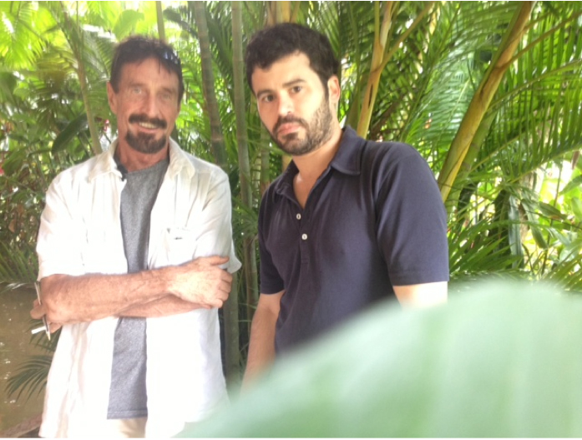
Top 5 Infosec problems
What can you tell from this image?

Slide 32
Top 5 Infosec problems
#5 – Insecure by Default & Patching
Users are stupid and won’t harden their crap
Why does your refrigerator run SNMP and Chargen?
That’s a pretty home wifi router with a default password…
Out of the box installs give users full admin rights

Slide 33
Top 5 Infosec problems
Most systems do not patch by default.
Java, Adobe, Flash, et al are not automatically patched and routinely used by exploit kits.
Web-based CMSs do not auto-update.
Simple patching cures overwhelming majority of risk, but there are risks (meltdown/spectre)

Slide 34
Before you leave
Attempt to access vCenter from web browser
Ensure you can create images and have permissions
Verify your i-Card works for SC 1129
Make sure you have access to class piazza and wiki

Slide 35
Questions
??

Slide 36
Lab #1
Due 11:59pm, 1/28/2016
Install Windows 10 and Ubuntu server in vCenter in your predefined directories. If your directory doesn’t exist in vCenter, talk to us BEFORE you leave.
Root/Admin password (for now) should be Class-Test-2018
Grading criteria: Is it done, fully installed and fully patched (to latest OS versions, i.e. Win 10).

