Slide 1
Air Pollution Web App

Slide 2
Introduction
Air Pollution System allows users to get details of the pollution of their city, state and country. Every year, across every border on this planet, air pollution causes more than 7 million premature deaths. The magnitude of the problem should inspire sweeping change, but it doesn’t.
Why? Because like new insights about our climate, the numbers are quick to cause anguish, but get quickly buried by the immediacy of daily life. Every new pollution peak causes new outrage, promptly extinguished into inaction as the news cycle rolls ahead. We care and hope for change, but feel ill-equipped to face a challenge too complex, bigger than us, like it should be a problem for another person or another time.
We see an information problem. We see that with the right information at the right time, wisdom can take over panic. And when wisdom has the upper hand, the urgency of the problem can be channeled into imagining solutions rather than endings.
Previously they had to be depend on the news television channels for the pollution information. Now user can easily find the details of current pollution details as per there requirement.
User can register to portal and easily access the pollution data. User needs to login and he gets option to check the details for pollution. He can check the details of the Air pollution of his/her specific city or will be able to check the Air pollution of specific state or will also be able to get details of Air Pollution of a specific country.

Slide 3
Microservices
1. JwtAuthService
2. AdminService
3. Pollution Service
4. Eureka
5.Api Gateway

Slide 4
3.Features
For User:
Search Air Pollution Details:
User can search and view air pollution details of their city.
They can also get information of specific state or countries pollution.

Slide 5
For Admin:
Login:
Admin has to login to admin panel for updating details.
Update Pollution Details:
Admin can add, update and delete the details of air pollution.
4.User Stories:
Admin for update data:
Admin will be able to add, update and delete data from air
pollution database

Slide 6
Air Pollution service database:
Air Pollution service database contains details of air pollution
of various countries. The data is stored according to cities .
UML Diagrams:
1. Use Case Diagram:

Slide 7
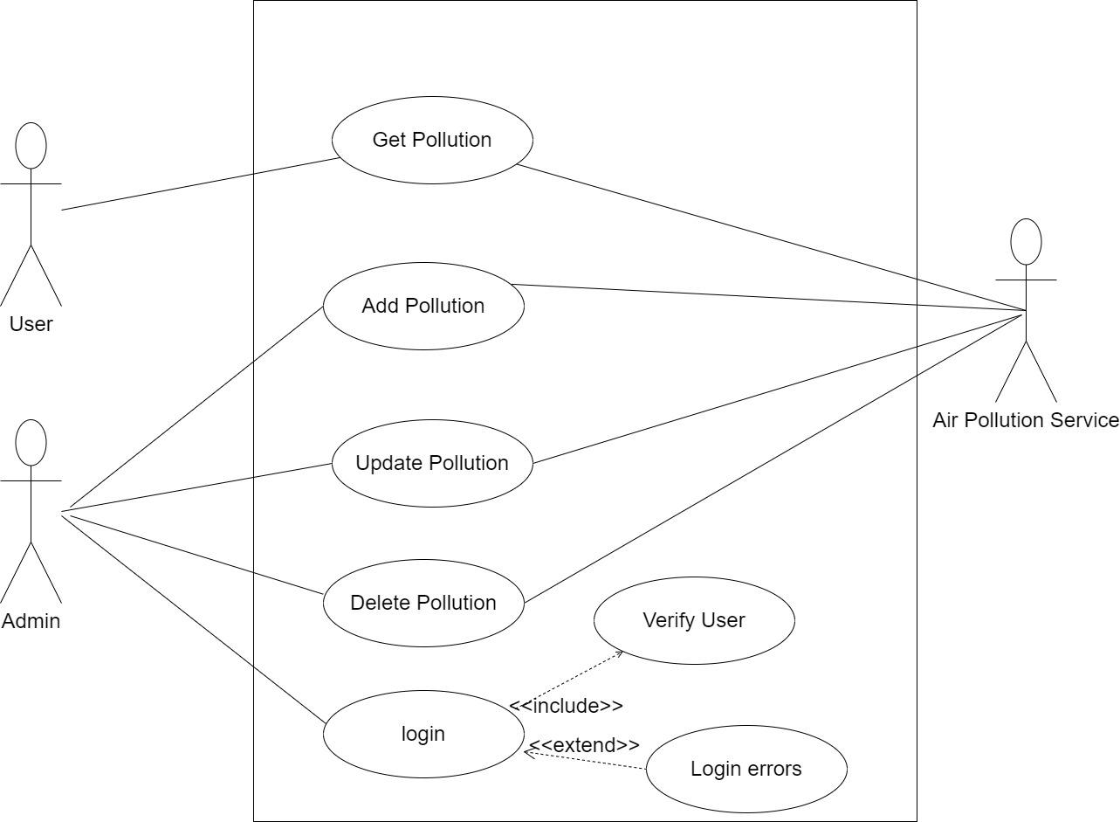

Slide 8
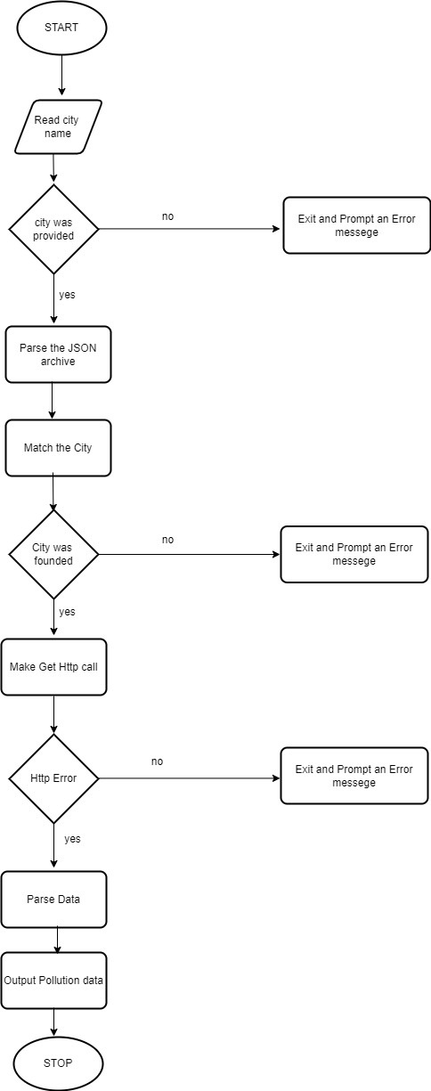
Flow Chart Diagram For User

Slide 9
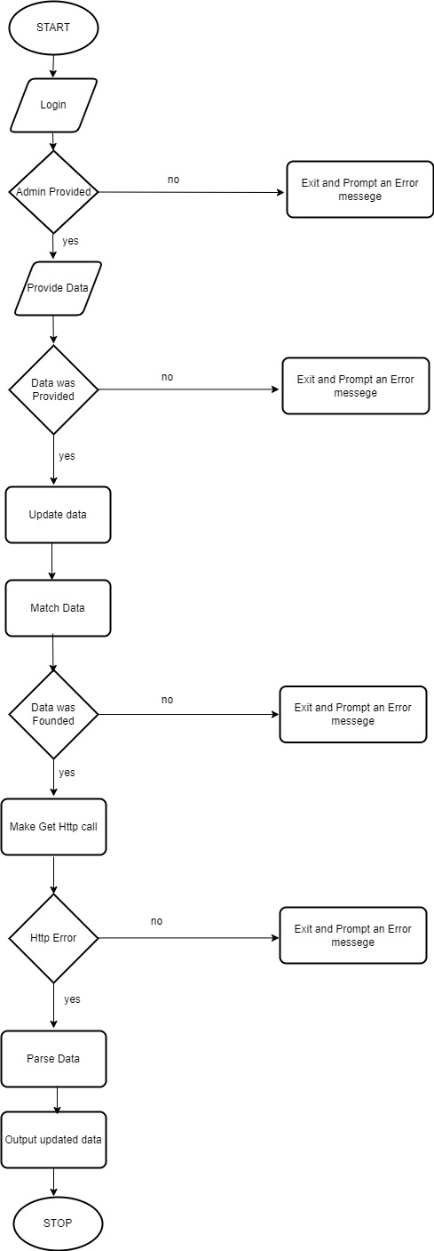
Flow Chart Diagram For Admin

Slide 10
Conclusion:
User can search and view air Pollution data according to their needs which helps them in different fields for taking action before any harm is done by pollution

