Slide 1

Security-aware Data Offloading and Optimization in Healthcare System
By:
Kashish Kaushal
Roll No.: 802332039
ME(CSE)
Supervisors:
Dr. Rajkumar Tekchandani
Dr. Anil Singh

Slide 2
Contents
Introduction
Literature Review
Research Gaps
Problem Statement
Objectives
Methodology
Result & Analysis
Conclusion & Future Scope
References

Slide 3
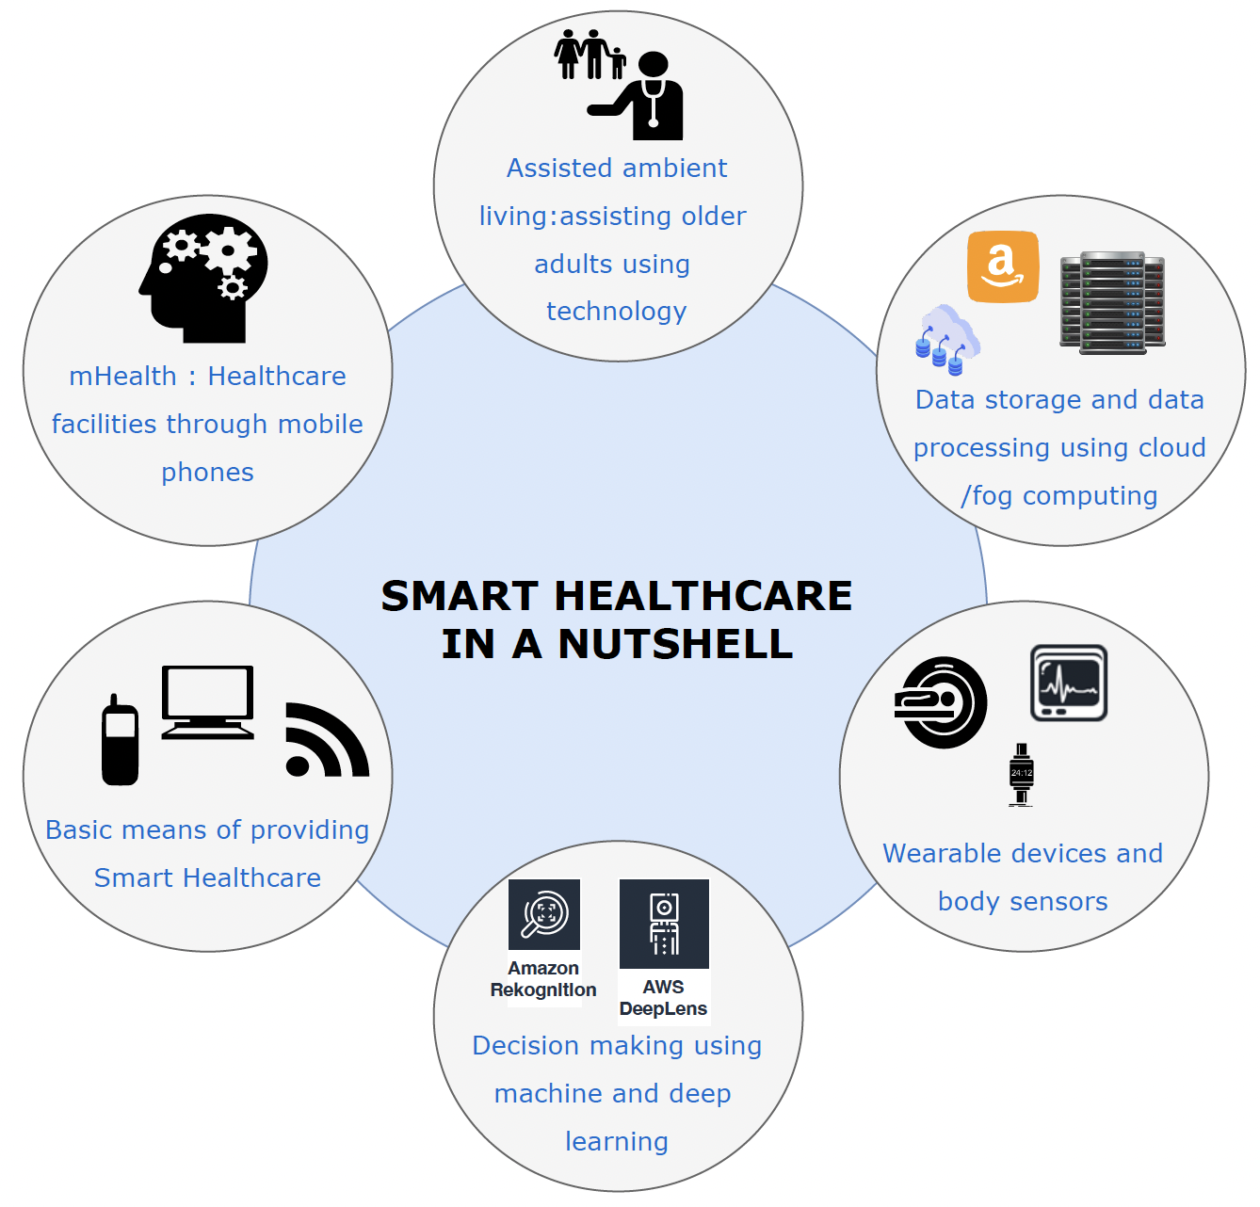
Introduction
01
02
03
Huge Data
Privacy Laws
Healthcare systems generates sensitive data like medical records, imaging, etc.
Sharing raw data violates privacy laws(e,g,. HIPAA)
04
Federated Learning
Data Handling
FL Enables model training without data sharing
Edge-Fog-Cloud continuum improves data handling and latency
Fig 1. Smart Healthcare System
Notes:
Large amount of hospital data is generated.
Edge–Fog–Cloud architecture helps in reducing delay by processing critical data close to source while allowing complex tasks to be handled at Fog or Cloud, achieving both speed and scalability.

Slide 4
Litrature Review
Authors | Methodology | Advantages | Limitations
Zhang et al. [1] | Comprehensive survey on FL | Covers a wide range of FL techniques | Not specific to healthcare
Arikumar et al. [4] | FL-PMI system for wearable device data | Smart healthcare integration | Limited to specific devices
Gupta et al. [11] | FogSim toolkit for edge/fog simulation | Useful for performance evaluation | Simulation-based; lacks real-time analysis

Slide 5
Litrature Review contd.
Authors | Methodology | Advantages | Limitations
Antunes et al. [3] | Systematic review on FL in healthcare | Architecture proposal | implementation details lacking
Nguyen et al. [2] | Survey on FL for smart healthcare | Detailed comparison | No new framework
Chauhan et al. [13] | SecDOAR architecture for security orchestration | Modular and semantic de-sign | Not healthcare-specific

Slide 6
Litrature Review contd.
Authors | Methodology | Advantages | Limitations
Guduri et al. [27] | Blockchain-enhanced FL for EHRs | Privacy-preserving architecture | Ethereum overhead
Shitharth et al. [30] | Blockchain-based offloading strategy | Enhanced security | High resource usage
Nguyen and Thai [28] | Survey on preserving FL privacy | Broad coverage | No comparative metrics

Slide 7
Litrature Review contd.
Authors | Methodology | Advantages | Limitations
Nguyen et al. [16] | BEdgeHealth using blockchain + MEC | Low-latency design | Architecture complexity
Siddiqui et al. [12] | Lightweight secure comms for IoT | Energy-efficient | Not FL-specific
Karatza [29] | Workflow scheduling with security constraints | Fog-cloud integration | No privacy in FL considered
Fan et al. [31] | Lightweight privacy frame-work for FL | Blockchain integration | Scalability concerns

Slide 8
Research gaps
Lack of Intelligent Data Classification in FL-Based Healthcare Systems
Absence of Unified Edge-Fog–Cloud FL Architectures for Cost Efficiency
Under-addressed Tradeoffs Between Offloading and Data Security
Inefficient Load Balancing Strategies in Federated Learning Environments
Limited Integration of Lightweight Security Mechanisms in FL Model

Slide 9
Problem statement
How can we offload healthcare data and tasks in FL while preserving sensitivity and security?
Federated Learning (FL) itself protects privacy by keeping raw patient data local. We categorize data by sensitivity and frequency, and route tasks to appropriate layers (Edge, Fog, Cloud) for secure and efficient processing.
How can we reduce latency and communication overhead while optimizing cost?
By offloading delay-sensitive tasks to edge/fog and less critical ones to underused or cheaper nodes, we reduce latency and cut execution cost
How can we ensure scalable performance, high success ratio, and real-time efficiency?
Our framework uses Kubernetes for real-time load balancing and job migration

Slide 10
Objectives
To develop strategies for classifying and storing data based on sensitivity, delay and frequency of use.
To develop a cost-efficient Federated Learning framework integrated with edge, Fog, and Cloud nodes for secure and efficient healthcare data processing
To emphasize on data offloading while ensuring data security by keeping the most sensitive patient data on local servers.
To design a framework for node load balancing in federated learning in order to handle node overload and underutilization.
To include advanced security features like lightweight encryption, Merkle tree hash in order to protect shared model updates from attacks.

Slide 11
Methodology
01
Data Dividing and Categories:
The healthcare data is separated into several categories based on sensitivity, frequency of access and security requirements:
Critical Patient-Centric Data (CPD)
Operational and Administrative Data (OAD)
Research and Public Health Data (RPD)
Educational and Reference Data (ERD)
Historical and Archived Data (HAD)
Frequently Used Operational Data (FOD)

Slide 12
Methodology contd.
02
Route them to Edge, Fog, or Cloud accordingly
Based on the data classification, each task is assigned a tag: Sensitivity (S), Size (Z), and Deadline (Δ)
Edge → time-sensitive & high-privacy data (CPD, FOD)
Fog → intermediate tasks (OAD, FOD)
Cloud → delay-tolerant, large or anonymized tasks (RPD, ERD, HAD

Slide 13
Methodology contd.
03
Job Offloading & Execution
Once routed, tasks are packaged into Docker containers
Containers are deployed using Kubernetes across the 9-node testbed.
        4 Edge nodes, 4 Fog nodes, 1 Cloud node
This ensures isolated, manageable execution of healthcare jobs

Slide 14
Methodology contd.
04
Load Balancing with Kubernetes
Kubernetes continuously monitors node load and status
If any node is overloaded or idle, Kubernetes migrates containers automatically
Ensures efficient use of resources and prevents bottlenecks

Slide 15
Methodology contd.
05
Performance Evaluation
The framework is compared with 3 baselines
RNS (Random Node Selector)
EHM (Edge-Heavy Method)
ELBO (Energy-Latency Balanced Offloading
Metrics compared: Execution time, Cost, Success ratio, Throughput

Slide 16
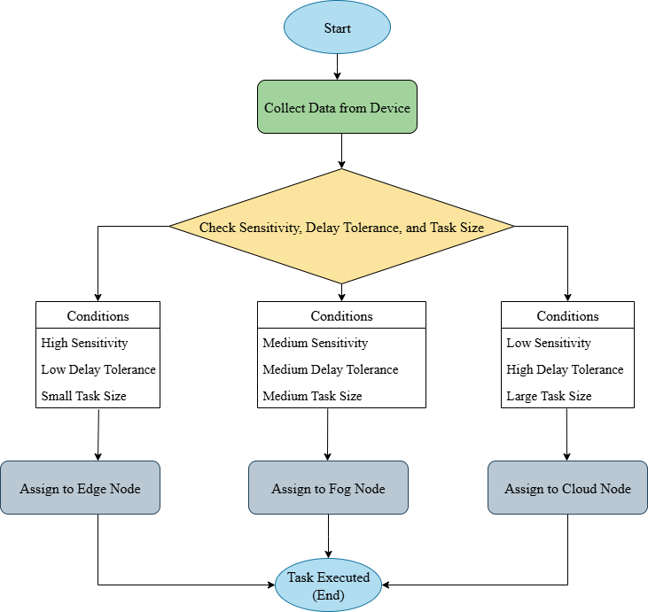
Proposed Framework
Dynamic Node Selection
The proposed FL framework in healthcare securely manages sensitive data and smartly routes tasks across Edge, Fog, and Cloud layers based on data sensitivity, task size, and delay tolerance, as illustrated below.
Dynamic Node Selection Based on Sensitivity, Delay Tolerance, and Task Size

Slide 17
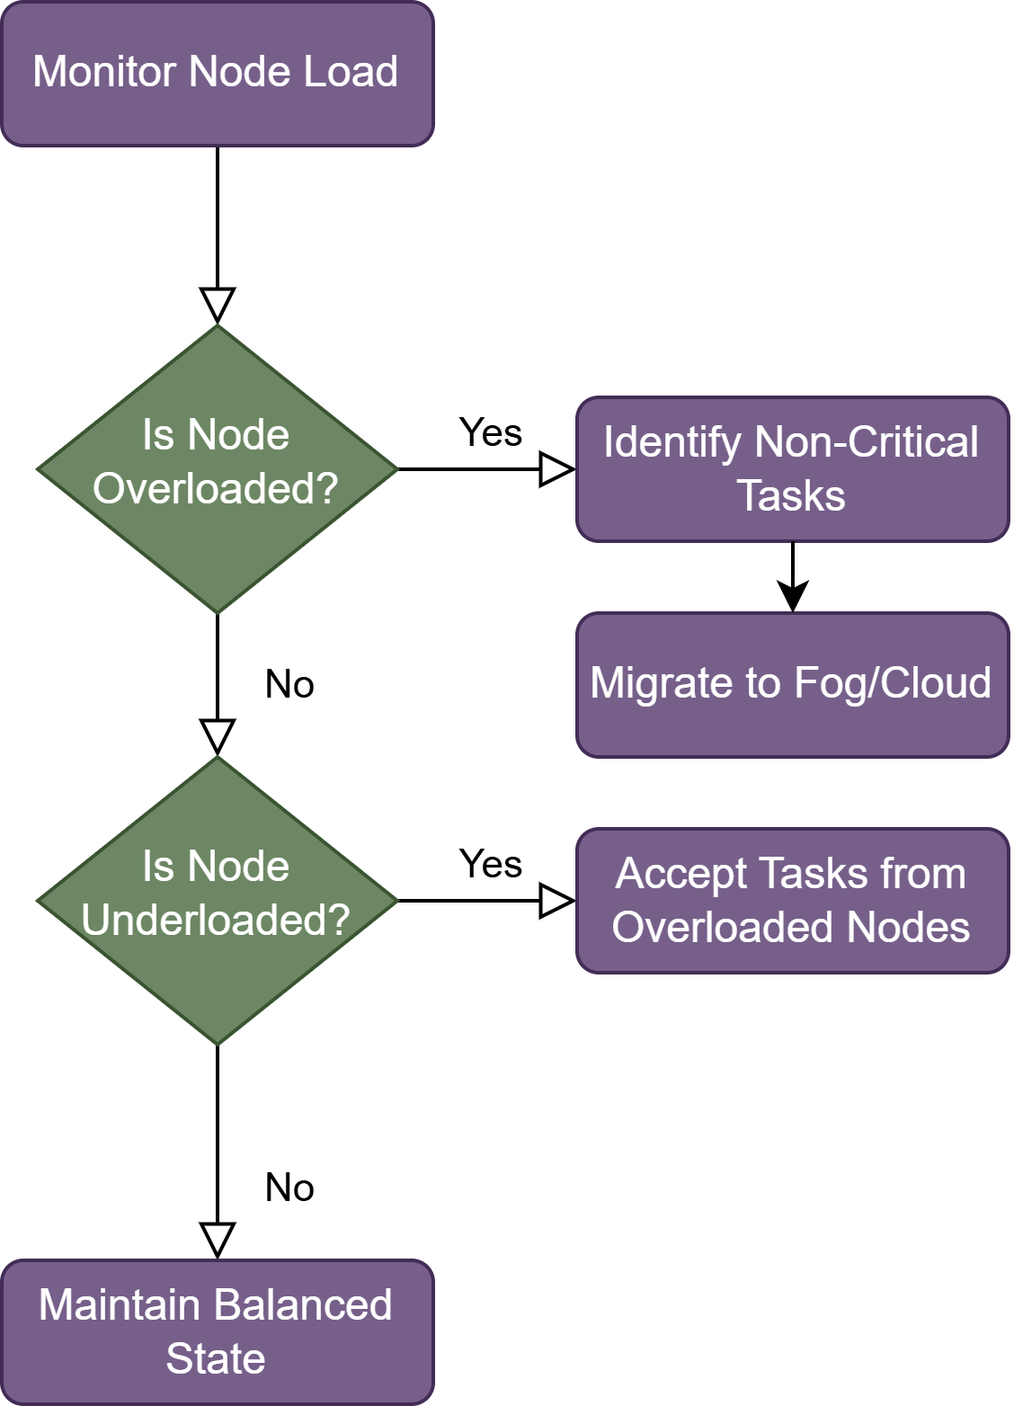
Proposed Framework contd.
Load Balancing
To reduce delays and optimize performance, the system uses load balancing to dynamically offload jobs from overloaded nodes to underutilized ones

Slide 18
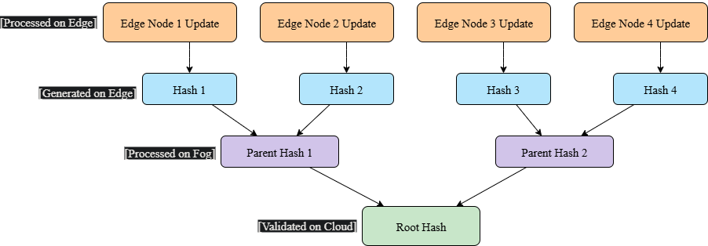
Proposed Framework contd.
Merkle Tree Hash
Organizes model updates in a tree structure using cryptographic hashes
Allows quick verification of data integrity
Detects any tampering with minimal computational overhead

Slide 19
Result & Analysis
Baseline Policies for Comparison
RNS (Random Node Selector): Selects nodes randomly without considering task urgency, cost, or load. Simple but inefficient under varying workloads
EHM (Edge-Heavy Method): Prefers assigning most jobs to edge nodes. Reduces latency but often leads to edge overload and failure
ELBO (Energy and Latency Balanced Offloading): Balances node selection by considering both energy consumption and latency constraints. More intelligent than RNS/EHM, but still lacks task sensitivity awareness
PM (Proposed Method): Routes tasks based on Sensitivity (S), Size (Z), and Deadline (Δ)Achieves better load distribution, lower cost, and higher success ratio

Slide 20
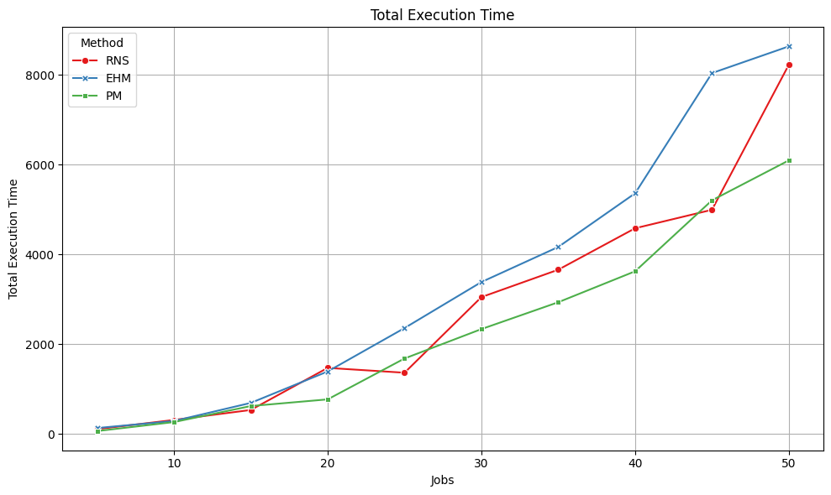
Result & Analysis contd.
Impact of Distributed Deployment
01
Total Execution Time
31.5% lower execution time vs. Edge-Heavy
16.6% faster than Random Node Selector
This confirms that effective scheduling and optimized data offloading significantly lower latency and improve responsiveness in distributed healthcare scenarios.

Slide 21
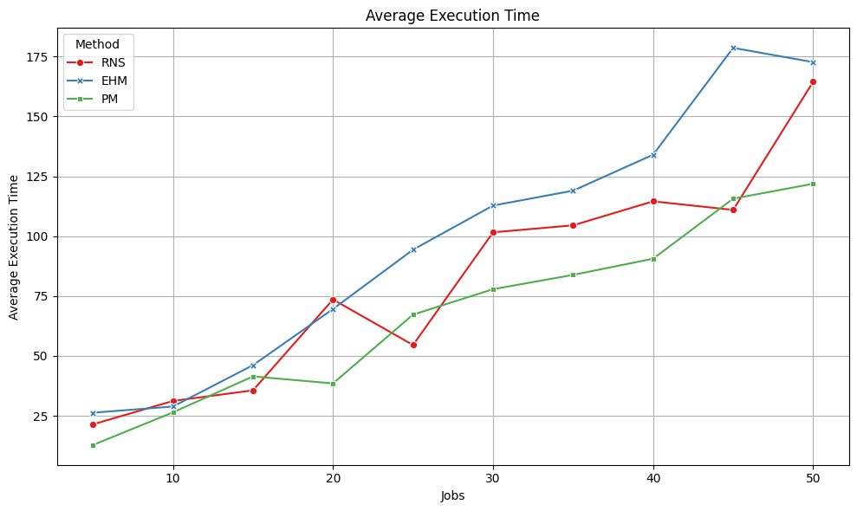
Result & Analysis contd.
02
Average Execution Time
31.2% lower average execution time vs. Edge-Heavy
16.8% faster than Random Node Selector
This confirms that effective scheduling and optimized data offloading significantly lower latency and improve responsiveness in distributed healthcare scenarios.

Slide 22
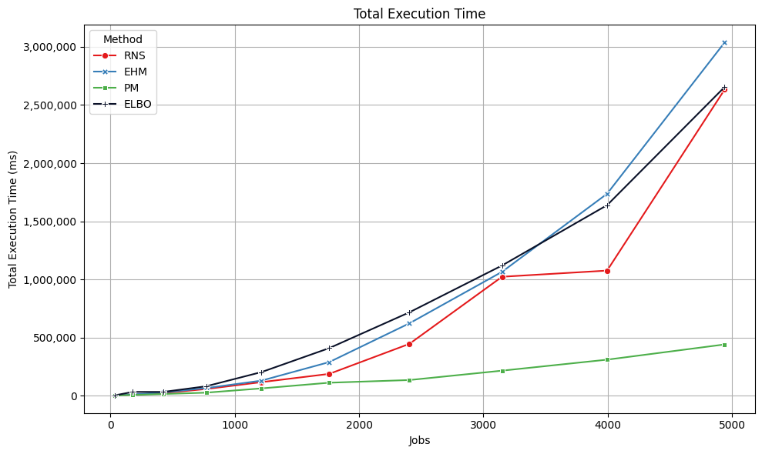
Result & Analysis contd.
Comparison with baseline policies
03
Total Execution Time
81.14% faster than Edge-Heavy Method (EHM)
76.34% faster than Random Node Selector (RNS)
80.87% faster than ELBO-based Offloading
The Proposed Method ensures optimal scheduling with minimal overhead, making it ideal for latency-sensitive healthcare systems

Slide 23
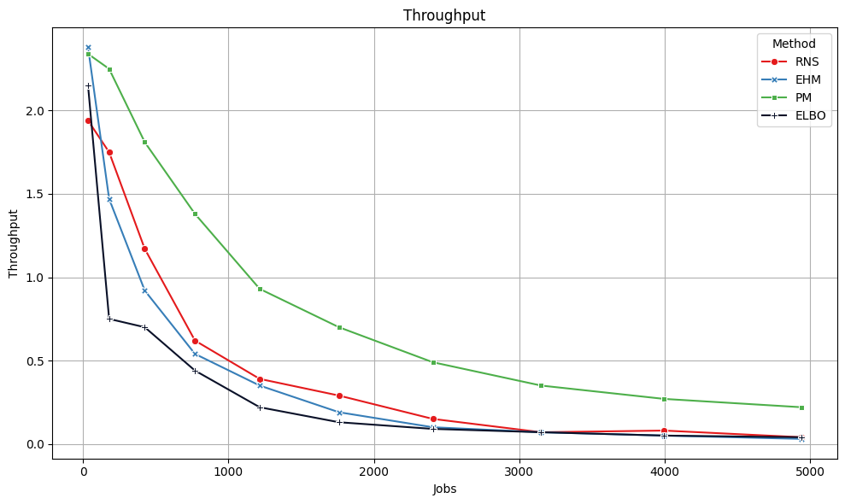
Result & Analysis contd.
04
Throughput Comparison
PM achieved 10.80 throughput, outperforming all baseline and SOTA methods
66.15% higher than RNS (6.50) due to intelligent job placement
76.78% higher than EHM (6.11), avoiding edge overload
147.71% higher than ELBO (4.36), offering better overall system efficiency
PM’s higher throughput proves its efficiency for high-load, time-critical healthcare tasks

Slide 24
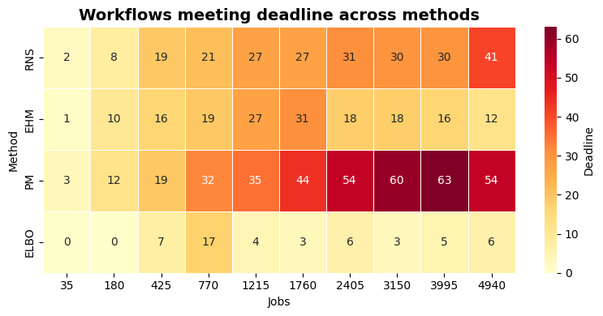
Result & Analysis contd.
05
Deadline Success Rate
PM consistently met more deadlines than all other methods across all workloads
Scaled up to 54–63 successful completions in heavy load (n = 70–100)
RNS plateaued at ~30–41 completions; EHM dropped to just 12 at n = 100
ELBO underperformed, with fewer than 7 completions in high-load scenarios

Slide 25
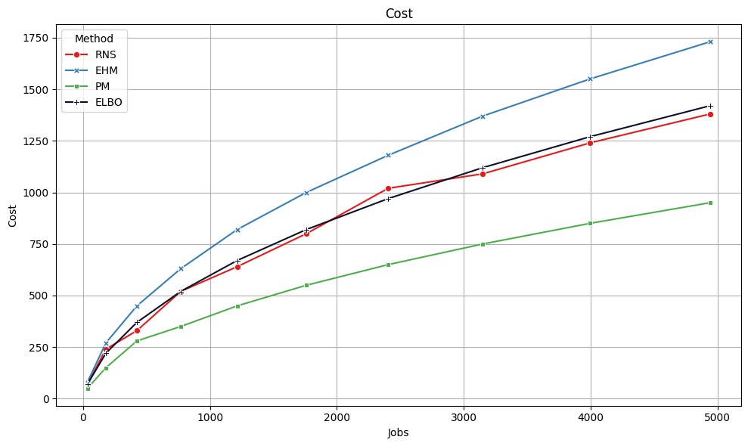
Result & Analysis contd.
06
Execution Cost
PM maintained lowest cost, scaling smoothly from 50 to 950 units as workload increased
EHM showed steepest rise, jumping from 80 to 1730 units due to edge overuse
RNS had inconsistent cost, reaching up to 1380 units because of random task distribution
ELBO incurred higher cost (up to 1420 units) due to security and communication overhead
PM outperformed all, proving ideal for resource-constrained healthcare settings

Slide 26
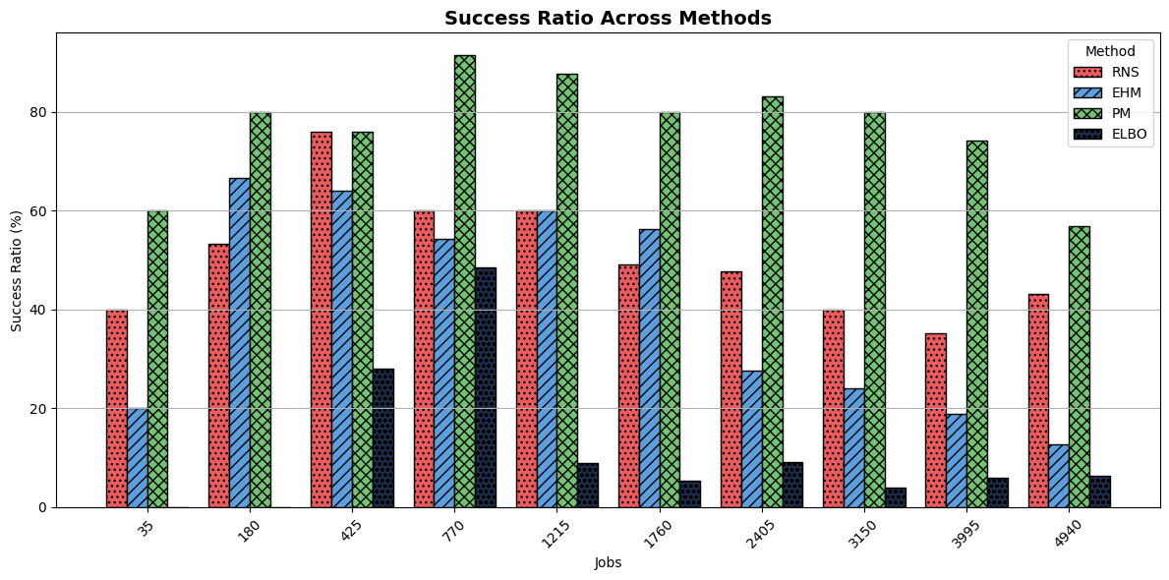
Result & Analysis contd.
07
Success Ratio
PM achieved up to 91.4% success rate, leading all methods across workload
Sustained 56.8% success even at high load (n = 100), showing strong scalability
RNS declined to 43.2%; EHM collapsed to 12.6% at n = 100 due to edge overload
ELBO stayed below 10% from n = 50 onward, showing poor adaptability

Slide 27
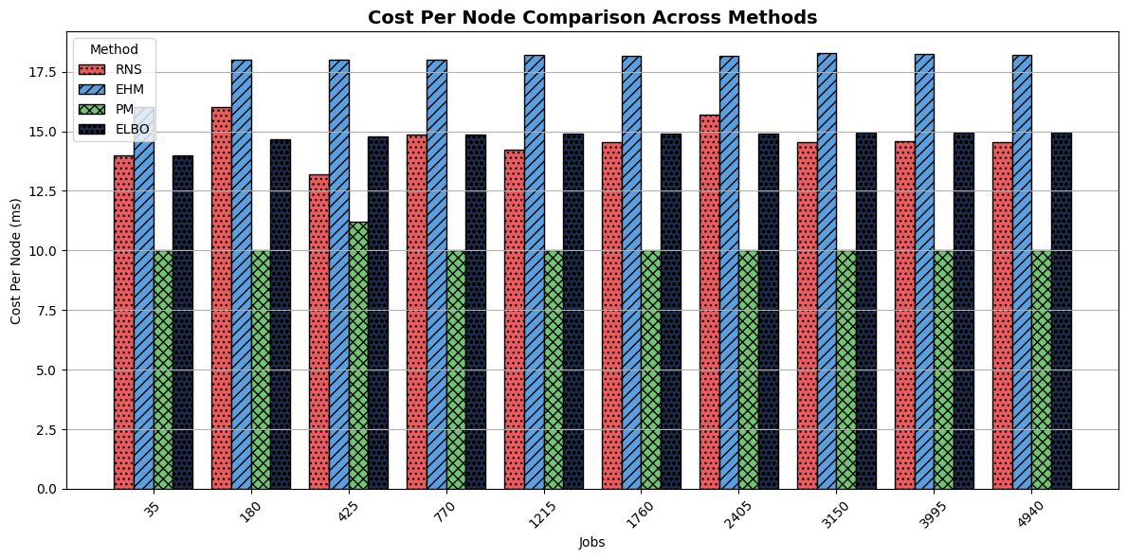
Result & Analysis contd.
08
Cost Per Node (CPN):
Proposed Method kept node-level costs lowest across all workload sizes
RNS was unstable, causing uneven node use and efficiency loss
EHM incurred the highest costs, overloading edge nodes by design
ELBO was slightly better than RNS, but still inefficient due to complex communication
PM demonstrated the best scalability and efficiency for low-cost FL deployments

Slide 28
Conclusion
Proposed FL-based framework addresses key challenges of privacy, security, and job offloading in healthcare
Dynamically routes tasks based on sensitivity, deadline, and size for optimal performance
Uses containerization for scalable execution, while FL inherently preserves privacy by keeping raw data local—ensuring compliance with regulations like HIPAA. Future enhancements include support for blockchain, merkle tree hash and lightweight encryption to further strengthen security.
Outperforms baseline and SOTA methods in execution time, cost, throughput, and success ratio
Well-suited for real-time, scalable healthcare applications in resource-constrained environments

Slide 29
Future Scope
Real-world deployment with diverse IoT devices in live healthcare environments
Integrate advanced security protocols like Fully Homomorphic Encryption
AI-driven task allocation for predicting node load and optimizing offloading
Scalability testing with larger datasets and more nodes
Cross-domain adaptation to finance, smart cities, and other privacy-critical sectors

Slide 30
Bibliographical references
[1] C. Zhang, Y. Xie, H. Bai, B. Yu, W. Li, and Y. Gao, “A survey on federated learning,” Knowledge-Based Systems, vol. 216, p. 106775, 2021.
[2] D. C. Nguyen, Q.-V. Pham, P. N. Pathirana, M. Ding, A. Seneviratne, Z. Lin, O. Dobre, and W.-J. Hwang, “Federated learning for smart healthcare: A survey,” ACM Computing Surveys (Csur), vol. 55, no. 3, pp. 1–37, 2022
[3] R. S. Antunes, C. Andre da Costa, A. K ´ uderle, I. A. Yari, and B. Eskofier, “Feder- ¨ ated learning for healthcare: Systematic review and architecture proposal,” ACM Transactions on Intelligent Systems and Technology (TIST), vol. 13, no. 4, pp. 1–23, 2022.
[4] K. Arikumar, S. B. Prathiba, M. Alazab, T. R. Gadekallu, S. Pandya, J. M. Khan, and R. S. Moorthy, “Fl- pmi: federated learning-based person movement identification through wearable devices in smart healthcare systems,” Sensors, vol. 22, no. 4, p. 1377, 2022.
[5] F. Zhao, Z. Shuai, K. Kuang, F. Wu, Y. Zhuang, and J. Xiao, “A survey on federated learning in the healthcare informatics: Model misconducts, security, challenges, applications, and future research directions,” Comprehensive Surveys on Federated Learning in Healthcare, 2024.

Slide 31
Bibliographical references contd.
[6] L. Liu, Y. Yu, and Q. Yang, “Privacy-preserving federated learning: A survey of inference and reconstruction attacks,” arXiv preprint, 2024.
[7] J. Ma, S.-A. Naas, S. Sigg, and X. Lyu, “Privacy-preserving federated learning based on multi-key homomorphic encryption,” Information Sciences, vol. 570, p. 183–196, 2021.
[8] P. Zhao and B. Li, “Model poisoning attacks in federated learning,” in Proceedings of the Neural Information Processing Systems (NeurIPS) SecML Workshop, 2019.
[9] L. Lyu, H. Yu, and Q. Yang, “Threats to federated learning: A survey,” arXiv preprint, 2020.
[10] H. Zhou, G. Yang, H. Dai, and G. Liu, “Pflf: Privacy-preserving federated learning framework for edge computing,” IEEE Transactions on Information Forensics and Security, vol. 17, pp. 1905–1918, 2022
[11] H. Gupta, A. Vahid Dastjerdi, S. K. Ghosh, and R. Buyya, “ifogsim: A toolkit for modeling and simulation of resource management techniques in the internet of things, edge and fog computing environments,” Software: Practice and Experience, vol. 47, no. 9, pp. 1275–1296, 2017.

Slide 32
Bibliographical references contd.
[12] F. Siddiqui, J. Beley, S. Zeadally, and G. Braught, “Secure and lightweight communication in heterogeneous iot environments,” Internet of Things, vol. 14, p.
100093, 2021.
[13] M. A. Chauhan, M. A. Babar, and F. Rabhi, “Secdoar: A software reference architecture for security data orchestration, analysis and reporting,” arXiv preprint arXiv:2408.12904, 2024.
[14] X. Li, J. Wang, and Q. Shi, “Reducing update communication overhead in federated learning via sparse compression,” IEEE Transactions on Parallel and Distributed Systems, vol. 34, no. 4, pp. 987–999, 2023.
[15] C. Wu, F. Huang, and L. Xu, “Optimization techniques to reduce latency in federated learning systems,” in Proceedings of the ACM Symposium on Edge Computing, 2023
[16] D. C. Nguyen, P. N. Pathirana, M. Ding, and A. Seneviratne, “Bedgehealth: A decentralized architecture for edge-based iomt networks using blockchain,” IEEE Internet of Things Journal, vol. 8, no. 14, pp. 11 743–11 757, 2021.
[17] X. Chen, Y. Zhang, and T. Li, “Gradient inference attacks on federated learning: A comprehensive review,” Journal of Information Security and Applications, vol. 70, pp. 103–115, 2023.

Slide 33
Bibliographical references contd.
[18] Y. Wan, Y. Qu, W. Ni, Y. Xiang, L. Gao, and E. Hossain, “Data and model poisoning backdoor attacks on wireless federated learning, and the defense mechanisms:
A comprehensive survey,” arXiv preprint, 2023.
[19] M. Armbrust, A. Fox, R. Griffith, A. D. Joseph, R. Katz, A. Konwinski, G. Lee, D. Patterson, A. Rabkin, I. Stoica, and M. Zaharia, “A view of cloud computing,” Communications of the ACM, vol. 53, no. 4, pp. 50–58, 2010.
[20] N. Boyko and N. Shakhovska, “Prospects for using cloud data warehouses in information systems,” in 2018 IEEE 13th International Scientific and Technical Conference on Computer Sciences and Information Technologies (CSIT), vol. 2, 2018, pp. 136–139.
[21] D. Golec, I. Strugar, and D. Belak, “The benefits of enterprise data warehouse implementation in cloud vs. on-premises,” ENTRENOVA- ENTerprise REsearch InNOVAtion, vol. 7, no. 1, pp. 66–74, 2021.
[22] G. Anderson, J. Hardwick, and R. Freeman, “Security and privacy issues in cloudbased ehr systems,” Health Informatics Journal, vol. 25, no. 3, pp. 724–740, 2019.

Slide 34
Bibliographical references contd.
[23] W. Shi, J. Cao, Q. Zhang, Y. Li, and L. Xu, “Edge computing: Vision and challenges,” IEEE Internet of Things Journal, vol. 3, no. 5, pp. 637–646, 2016.
[24] P. Kairouz, H. B. McMahan, B. Avent, and et al., “Advances and open problems in federated learning,” Foundations and Trends® in Machine Learning, vol. 14, no. 1–2, pp. 1–210, 2021.
[25] Q. Yang, Y. Liu, T. Chen, and Y. Tong, “Federated machine learning: Concept and applications,” ACM Transactions on Intelligent Systems and Technology, vol. 10, no. 2, pp. 12:1–12:19, 2019.
[26] P. Kairouz, H. B. McMahan, B. Avent, and ..., “Advances and open problems in federated learning,” Foundations and Trends® in Machine Learning, vol. 14, no. 1–2, pp. 1–210, 2021.
[27] M. Guduri, C. Chakraborty, U. Maheswari, and M. Margala, “Blockchain-based federated learning technique for privacy preservation and security of smart electronic health records,” IEEE Transactions on Consumer Electronics, vol. 70, no. 1, pp. 2608–2617, 2024.
[28] T. Nguyen and M. T. Thai, “Preserving privacy and security in federated learning,” IEEE/ACM Transactions on Networking, 2023

Slide 35
Bibliographical references contd.
[29] H. D. Karatza, “Allocation and scheduling of linear workflows incorporating security constraints across fog and cloud infrastructures,” in 2024 International
Conference on Computer, Information and Telecommunication Systems (CITS).
IEEE, 2024, pp. 1–8.
[30] S. Shitharth, H. Manoharan, A. Shankar, R. A. Alsowail, S. Pandiaraj, S. A. Edalatpanah, and W. Viriyasitavat, “Federated learning optimization: A computational blockchain process with offloading analysis to enhance security,” Egyptian informatics journal, vol. 24, no. 4, p. 100406, 2023.
[31] M. Fan, K. Ji, Z. Zhang, H. Yu, and G. Sun, “Lightweight privacy and security computing for blockchained federated learning in iot,” IEEE Internet of Things Journal, vol. 10, no. 18, pp. 16 048–16 060, 2023.
[32] B. Neha, S. K. Panda, P. K. Sahu, and D. Taniar, “Energy and latency-balanced osmotic-offloading algorithm for healthcare systems,” Internet of Things, vol. 26, p. 101176, 2024.

Slide 36
Publications
Journal Paper
Journal: A Privacy-Preserving Cloud–Edge Continuum Model for Optimized Healthcare Delivery
Status: Soon to be submitted in IEEE Internet of things Journal

Slide 37


