Slide 1

#LifeKoKaroLift
Android

Slide 2


Course : Android
Lecture On : Fragments & Adapters
Instructor : Rohit Jain

Slide 3
Today’s Agenda
Fragments
Adapters
List View

Slide 4
In Last Class, we covered….
Fragments
Custom Toast
Snackbars

Slide 5
Fragments
Defining a Fragment
A fragment, like an activity, has an XML layout file and a Java class that represents the Fragment controller.
<?xml version="1.0" encoding="utf-8"?> <LinearLayout xmlns:android="http://schemas.android.com/apk/res/android" android:layout_width="match_parent" android:layout_height="match_parent" android:orientation="vertical" > <TextView android:id="@+id/textView1" android:layout_width="wrap_content" android:layout_height="wrap_content" android:text="TextView" /> <Button android:id="@+id/button1" android:layout_width="wrap_content" android:layout_height="wrap_content" android:text="Button" /> </LinearLayout>

Slide 6
Fragments
The Java controller for a fragment looks like:
import android.support.v4.app.Fragment; public class FooFragment extends Fragment { // The onCreateView method is called when Fragment should create its View object hierarchy, // either dynamically or via XML layout inflation. @Override public View onCreateView(LayoutInflater inflater, ViewGroup parent, Bundle savedInstanceState) { // Defines the xml file for the fragment return inflater.inflate(R.layout.fragment_foo, parent, false); } // This event is triggered soon after onCreateView(). // Any view setup should occur here. E.g., view lookups and attaching view listeners. @Override public void onViewCreated(View view, Bundle savedInstanceState) { // Setup any handles to view objects here // EditText etFoo = (EditText) view.findViewById(R.id.etFoo); } }

Slide 7
Adding a Fragment to Activity
There are two ways to add a fragment to an activity
dynamically using Java
statically using XML
<?xml version="1.0" encoding="utf-8"?> <LinearLayout xmlns:android="http://schemas.android.com/apk/res/android" android:layout_width="match_parent" android:layout_height="match_parent" android:orientation="vertical" > <fragment android:name="com.example.android.FooFragment" android:id="@+id/fooFragment" android:layout_width="match_parent" android:layout_height="match_parent" /> </LinearLayout>

Slide 8
Demo Fragments

Slide 9
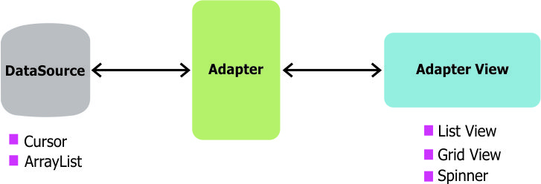
ListView & Adapter
In Android development, any time we want to show a vertical list of scrollable items we will use a ListView which has data populated using an Adapter. The simplest adapter to use is called an ArrayAdapter because the adapter converts an ArrayList of objects into View items loaded into the ListView container.

Slide 10
Types of Adapters
Base Adapter
Array Adapter
Simple Adapter
Cursor Adapter

Slide 11
Types of Adapters
BaseAdapter is a common base class of a general implementation of an Adapter that can be used in ListView, GridView, Spinner etc.
Whenever you need a customized list in a ListView or customized grids in a GridView you create your own adapter and extend base adapter in that.
Base Adapter can be extended to create a custom Adapter for displaying a custom list item.

Slide 12
Methods
getCount()
getView(int i, View view, ViewGroup viewGroup)
getItem(int i)
getItemId(int i)

Slide 13
Demo ListView

Slide 14
#LifeKoKaroLift
Thank You!

