Slide 1

#LifeKoKaroLift
Android

Slide 2


Course : Android
Lecture On : Basics of Android and Architeture
Instructor : Rohit Jain

Slide 3
In Last Class, we covered….
1
Inheritance
2
Overriding
3
Exception
4
Java Data Structures

Slide 4
Today’s Agenda
What is Android?
Overview of Android Stack
Android Runtime
Application Framework
Dalvik VM & .apk file extension
Installation of android studio
Setup emulator
SDK manager concepts
Running your app on Emulator

Slide 5
What is Android
Android is an open source operating system, created by Google specifically for use on mobile devices (cell phones and tablets)
Linux based (2.6 kernel)
Can be programmed in C/C++ but most app development is done in Java (Java access to C Libraries via JNI (Java Native Interface))
Supports Bluetooth, Wi-Fi, and 3G and 4G networking

Slide 6
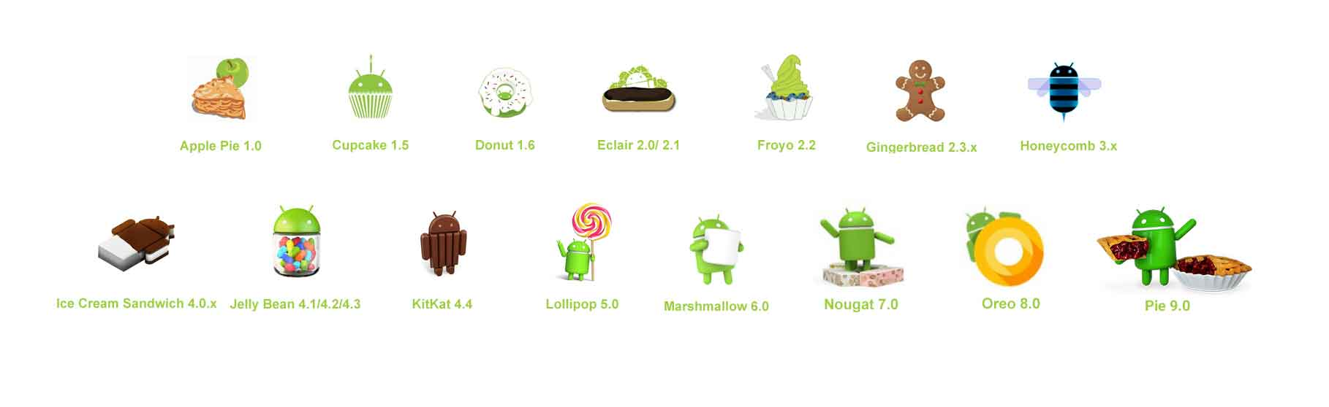
Versions of Android

Slide 7
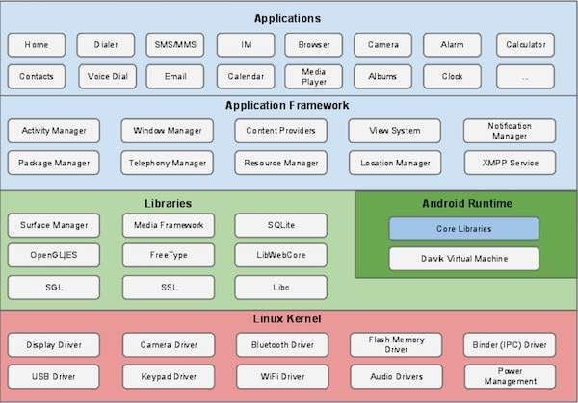
Architecture

Slide 8
Architecture
Linux kernel
At the bottom of the layers is Linux - Linux 3.6 with approximately 115 patches. This provides a level of abstraction between the device hardware and it contains all the essential hardware drivers like camera, keypad, display etc. Also, the kernel handles all the things that Linux is really good at such as networking and a vast array of device drivers, which take the pain out of interfacing to peripheral hardware.
Libraries
On top of Linux kernel there is a set of libraries including open-source Web browser engine WebKit, well known library libc, SQLite database which is a useful repository for storage and sharing of application data, libraries to play and record audio and video, SSL libraries responsible for Internet security etc.

Slide 9
Android Libraries
android.app − Provides access to the application model and is the cornerstone of all Android applications.
android.content − Facilitates content access, publishing and messaging between applications and application components.
android.database − Used to access data published by content providers and includes SQLite database management classes.
android.opengl − A Java interface to the OpenGL ES 3D graphics rendering API.
android.os − Provides applications with access to standard operating system services including messages, system services and inter-process communication.
android.text − Used to render and manipulate text on a device display.
android.view − The fundamental building blocks of application user interfaces.
android.widget − A rich collection of pre-built user interface components such as buttons, labels, list views, layout managers, radio buttons etc.
android.webkit − A set of classes intended to allow web-browsing capabilities to be built into applications.

Slide 10
Android Runtime
This is the third section of the architecture and available on the second layer from the bottom. This section provides a key component called Dalvik Virtual Machine which is a kind of Java Virtual Machine specially designed and optimized for Android.
The Dalvik VM makes use of Linux core features like memory management and multi-threading, which is intrinsic in the Java language. The Dalvik VM enables every Android application to run in its own process, with its own instance of the Dalvik virtual machine.
The Android runtime also provides a set of core libraries which enable Android application developers to write Android applications using standard Java programming language.

Slide 11
Application FrameWork
The Application Framework layer provides many higher-level services to applications in the form of Java classes. Application developers are allowed to make use of these services in their applications.
Activity Manager − Controls all aspects of the application lifecycle and activity stack.
Content Providers − Allows applications to publish and share data with other applications.
Resource Manager − Provides access to non-code embedded resources such as strings, color settings and user interface layouts.
Notifications Manager − Allows applications to display alerts and notifications to the user.
View System − An extensible set of views used to create application user interfaces.

Slide 12
Installation of Android Studio

Slide 13
Setup Emulator

Slide 14
SDK Manager

Slide 15
Running The APp

Slide 16
Next Class
1
Activity
2
Basic Building Blocks
3
Android LifeCycle

Slide 17
#LifeKoKaroLift
Thank You!

