Slide 1

#LifeKoKaroLift
Android

Slide 2


Course : Android
Lecture On : Basics of Android Architecture II
Instructor : Rohit Jain

Slide 3
In Last Class, we covered….
What is Android?
Overview of Android Stack
Android Runtime
Application Framework
Dalvik VM & .apk file extension
Installation of android studio
Setup emulator
SDK manager concepts
Running your app on Emulator

Slide 4
Today’s Agenda
What is activity?
Android activity lifecycle
Basic Building blocks - Activities, Fragments, Services, Broadcast Receivers & Content providers
R.java, Manifest.xml & String.xml
Uses-permission

Slide 5
What is Activity
An Android activity is one screen of the Android app's user interface.
In that way an Android activity is very similar to windows in a desktop application. An Android app may contain one or more activities, meaning one or more screens.
The Android app starts by showing the main activity, and from there the app may make it possible to open additional activities.

Slide 6
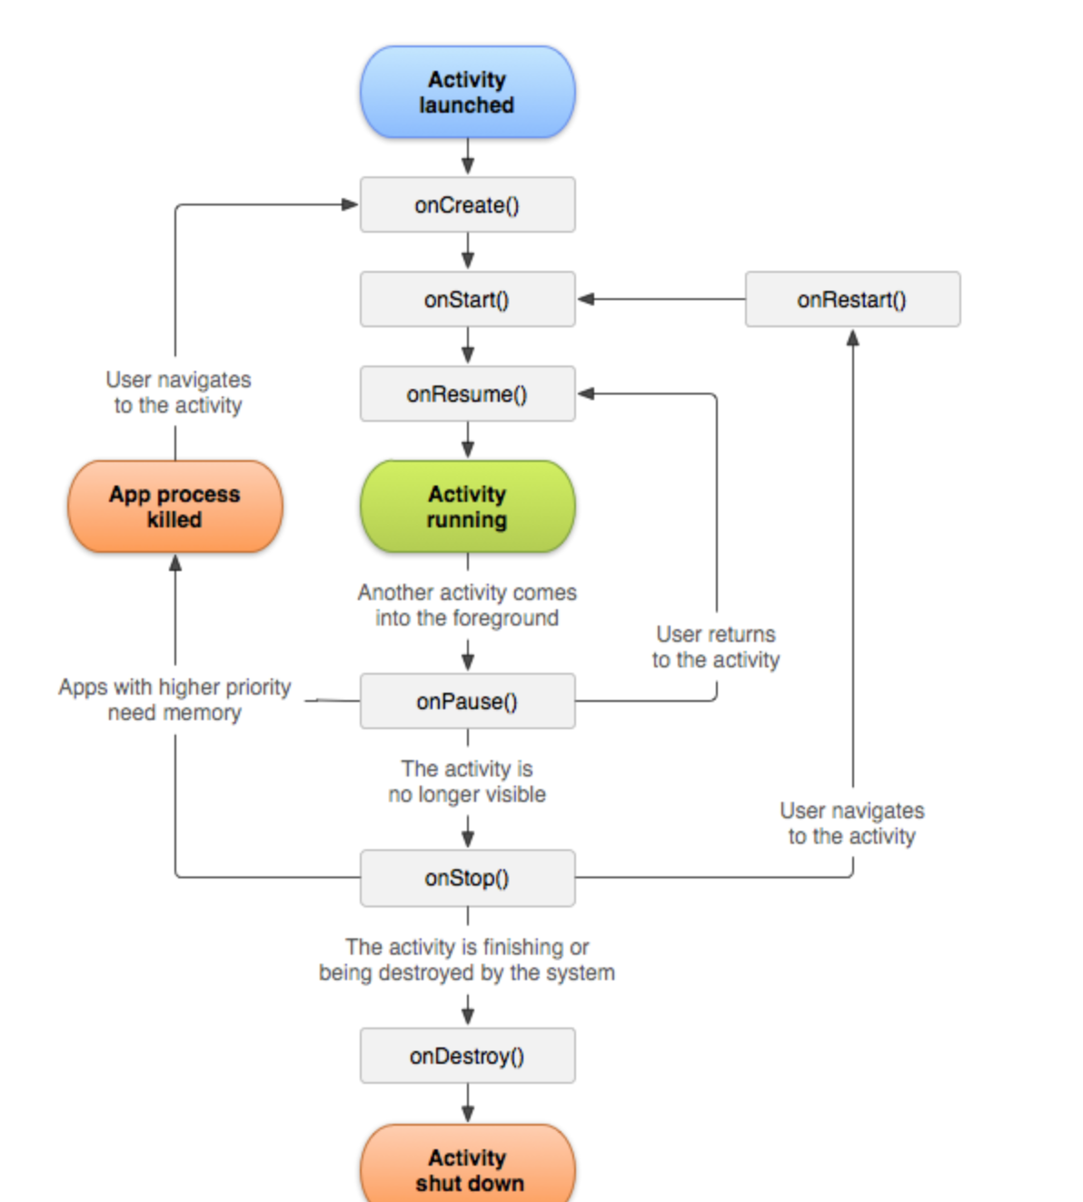
Android Activity Lifecycle

Slide 7
Android Activity Lifecycle
Lifecycle Method | Description | Common Uses
onCreate() | The activity is starting (but not visible to the user) | Most of the activity initialization code goes here. This is where you setContentView() for the activity, initialize views, set up any adapters, etc.
onStart() | The activity is now visible (but not ready for user interaction) | This lifecycle method isn't used much, but can come in handy to register a BroadcastReceiver to monitor for changes that impact the UI (since the UI is now visible to the user).
onResume() | The activity is now in the foreground and ready for user interaction | This is a good place to start animations, open exclusive-access devices like the camera, etc.
onPause() | Counterpart to onResume(). The activity is about to go into the background and has stopped interacting with the user. This can happen when another activity is launched in front of the current activity. | It's common to undo anything that was done in onResume() and to save any global state (such as writing to a file).
onStop() | Counterpart to onStart(). The activity is no longer visible to the user. | It's common to undo anything that was done in onStart().
onDestroy() | Counterpart to onCreate(...). This can be triggered because finish() was called on the activity or the system needed to free up some memory. | It's common to do any cleanup here. For example, if the activity has a thread running in the background to download data from the network, it may create that thread in onCreate() and then stop the thread here in onDestroy()
onRestart() | Called when the activity has been stopped, before it is started again | It isn't very common to need to implement this callback.

Slide 8
Android Activity Lifecycle
Calling the super class
When overriding any of the methods, you may need to call the superclass implementation. The rule of thumb is that during initialization, you should always call the superclass first:
public void onCreate()
{
super.onCreate(); // do work after super class function // setContentView(R.layout.main);
}

Slide 9
Android Activity Lifecycle
Calling the super class
During de-initialization, you should do the work first before calling the super class:
public void onPause()
{
// do work here first before super class function //
super.onPause();
}

Slide 10
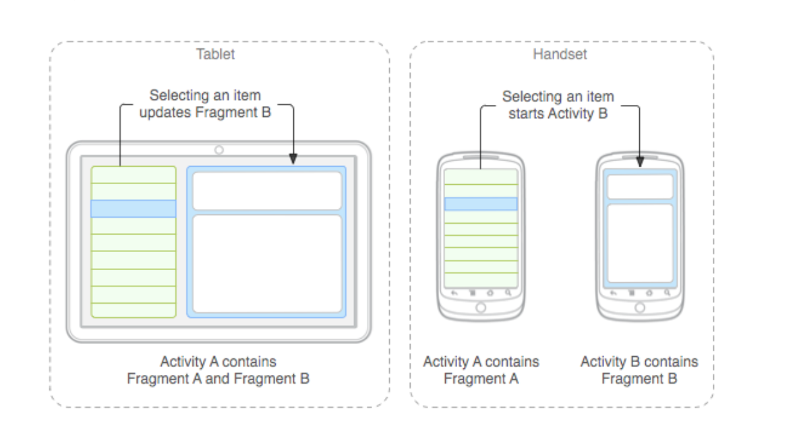
Fragments
A fragment is a reusable class implementing a portion of an activity. A Fragment typically defines a part of a user interface. Fragments must be embedded in activities; they cannot run independently of activities.

Slide 11
Fragments
Understanding Fragments
Here are the important things to understand about fragments:
A Fragment is a combination of an XML layout file and a java class much like an Activity.
Using the support library, fragments are supported back to all relevant Android versions.
Fragments encapsulate views and logic so that it is easier to reuse within activities.
Fragments are standalone components that can contain views, events and logic.

Slide 12
Fragments
Importance of Fragments
There are many use cases for fragments but the most common use cases include:
Reusing View and Logic Components - Fragments enable re-use of parts of your screen including views and event logic over and over in different ways across many disparate activities. For example, using the same list across different data sources within an app.
Tablet Support - Often within apps, the tablet version of an activity has a substantially different layout from the phone version which is different from the TV version. Fragments enable device-specific activities to reuse shared elements while also having differences.
Screen Orientation - Often within apps, the portrait version of an activity has a substantially different layout from the landscape version. Fragments enable both orientations to reuse shared elements while also having differences.

Slide 13
Fragment LifeCycle
Fragment has many methods which can be overridden to plug into the lifecycle:
onAttach() is called when a fragment is connected to an activity.
onCreate() is called to do initial creation of the fragment.
onCreateView() is called by Android once the Fragment should inflate a view.
onViewCreated() is called after onCreateView() and ensures that the fragment's root view is non-null. Any view setup should happen here. E.g., view lookups, attaching listeners.
onActivityCreated() is called when host activity has completed its onCreate() method.
onStart() is called once the fragment is ready to be displayed on screen.
onResume() - Allocate “expensive” resources such as registering for location, sensor updates, etc.
onPause() - Release “expensive” resources. Commit any changes.
onDestroyView() is called when fragment's view is being destroyed, but the fragment is still kept around.
onDestroy() is called when fragment is no longer in use.
onDetach() is called when fragment is no longer connected to the activity.

Slide 14
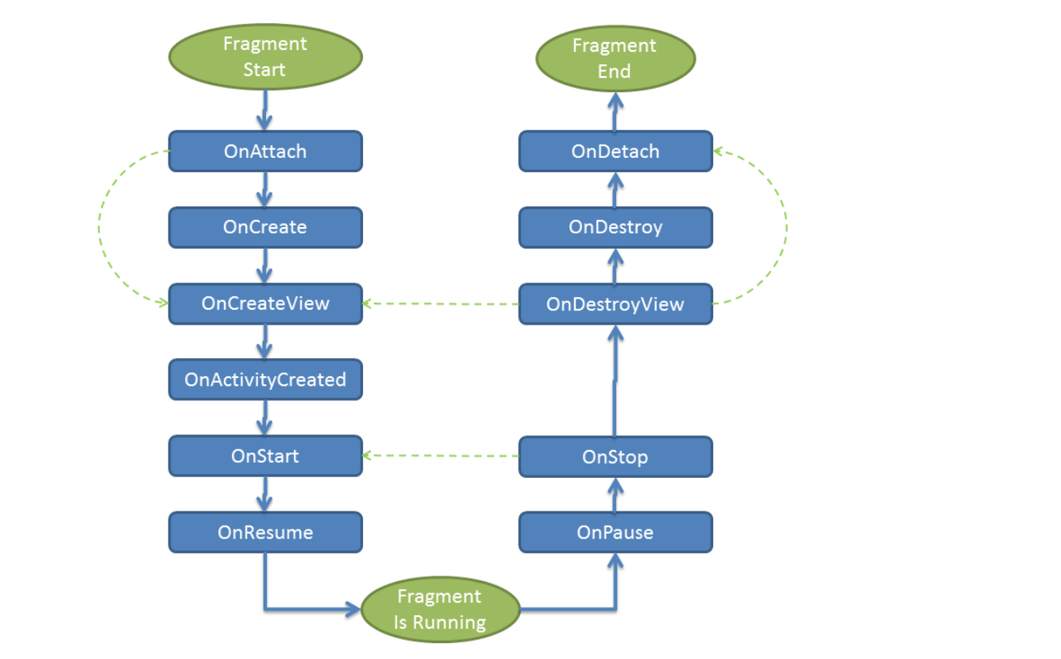
Fragment LifeCycle

Slide 15
Services
Android service is a component that is used to perform operations on the background such as playing music, handle network transactions, interacting content providers etc. It doesn't has any UI (user interface).
The service runs in the background indefinitely even if application is destroyed.
service can be bounded by a component to perform interactivity and inter process communication (IPC).
The android.app.Service is subclass of ContextWrapper class.

Slide 16
Services
Life Cycle of Android Service
There can be two forms of a service.The lifecycle of service can follow two different paths: started or bound.
Started
Bound
1) Started Service
A service is started when component (like activity) calls startService() method, now it runs in the background indefinitely. It is stopped by stopService() method. The service can stop itself by calling the stopSelf() method.
2) Bound Service
A service is bound when another component (e.g. client) calls bindService() method. The client can unbind the service by calling the unbindService() method.
The service cannot be stopped until all clients unbind the service.

Slide 17
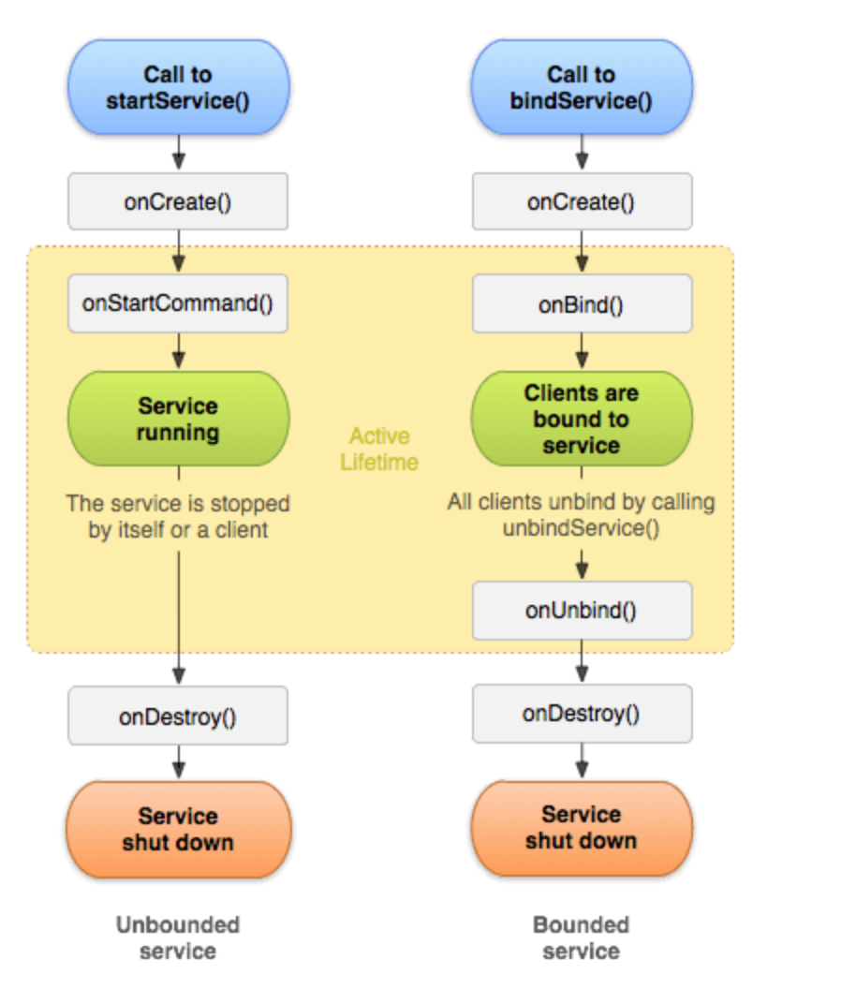
Services

Slide 18
Broadcast Receivers
Broadcast Receivers simply respond to broadcast messages from other applications or from the system itself. These messages are sometime called events or intents. For example, applications can also initiate broadcasts to let other applications know that some data has been downloaded to the device and is available for them to use, so this is broadcast receiver who will intercept this communication and will initiate appropriate action.

Slide 19
Broadcast Receivers
Creating the Broadcast Receiver
A broadcast receiver is implemented as a subclass of BroadcastReceiverclass and overriding the onReceive() method where each message is received as a Intent object parameter.
public class MyReceiver extends BroadcastReceiver {
@Override
public void onReceive(Context context, Intent intent)
{
Toast.makeText(context, "Intent Detected.", Toast.LENGTH_LONG).show();
} }

Slide 20
Broadcast Receivers
An application listens for specific broadcast intents by registering a broadcast receiver in AndroidManifest.xml file. Consider we are going to register MyReceiver for system generated event ACTION_BOOT_COMPLETED which is fired by the system once the Android system has completed the boot process.
<application android:icon="@drawable/ic_launcher" android:label="@string/app_name" android:theme="@style/AppTheme" > <receiver android:name="MyReceiver"> <intent-filter> <action android:name="android.intent.action.BOOT_COMPLETED"> </action> </intent-filter> </receiver> </application>

Slide 21
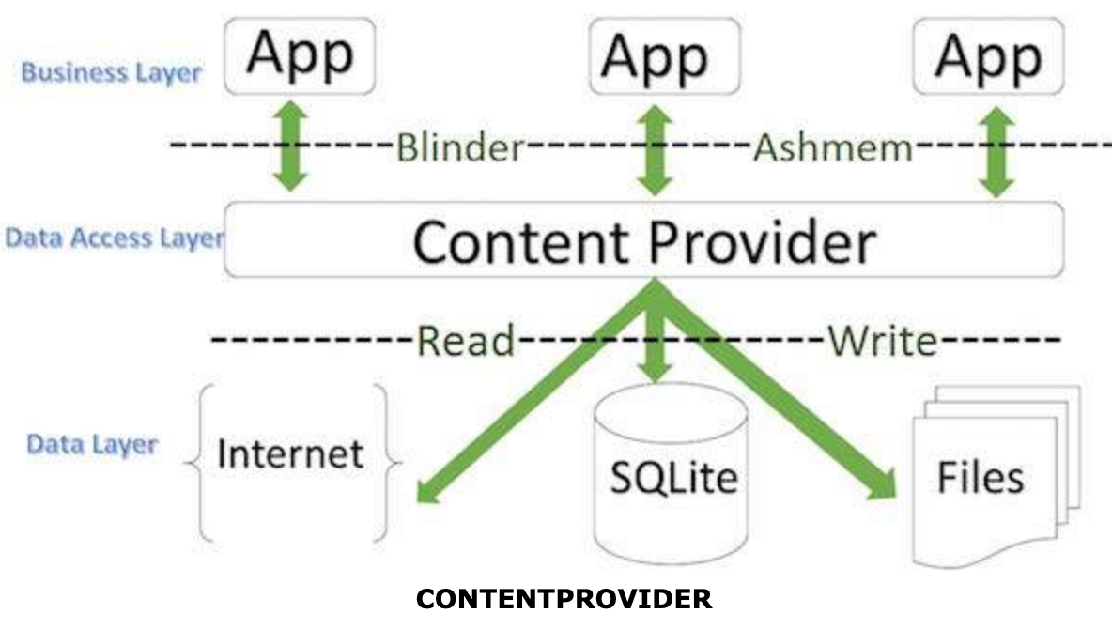
Content Providers
A content provider component supplies data from one application to others on request. Such requests are handled by the methods of the ContentResolver class. A content provider can use different ways to store its data and the data can be stored in a database, in files, or even over a network.

Slide 22
Manifest.XML
The AndroidManifest.xml file contains information of your package, including components of the application such as activities, services, broadcast receivers, content providers etc.
It performs some other tasks also:
It is responsible to protect the application to access any protected parts by providing the permissions.
It also declares the android api that the application is going to use.
It lists the instrumentation classes. The instrumentation classes provides profiling and other informations. These informations are removed just before the application is published etc.
This is the required xml file for all the android application and located inside the root directory.

Slide 23
Strings.XML
A single string that can be referenced from the application or from other resource files (such as an XML layout).
file location:res/values/filename.xml The filename is arbitrary. The <string> element's name is used as the resource ID.compiled resource datatype:Resource pointer to a String.
resource reference:
In Java: R.string.string_name In XML:@string/string_name

Slide 24
Next Class
1
UI Elements
2
Gradle Dependencies
3
Layouts eg. Relative and Linear Layout

Slide 25
#LifeKoKaroLift
Thank You!

