Slide 1

#LifeKoKaroLift
Basics of Java for Android

Slide 2


Course : Java | Android
Lecture On : OOPS & Adv. Java
Instructor : Rohit Jain

Slide 3
In Last Class, we covered….
1
Concept of Java
2
Examples of Classes, Constructor, Methods, Scopes
3
Types of loops
4
Conditional Statements

Slide 4
Today’s Agenda
1
Inheritance
2
Overriding
3
Exception
4
Java Data Structures

Slide 5
Inheritance in Java
Inheritance in Java is a mechanism in which one object acquires all the properties and behaviors of a parent object.
Class: A class is a group of objects which have common properties. It is a template or blueprint from which objects are created.
Sub Class/Child Class: Subclass is a class which inherits the other class. It is also called a derived class, extended class, or child class.
Super Class/Parent Class: Superclass is the class from where a subclass inherits the features. It is also called a base class or a parent class.
Reusability: As the name specifies, reusability is a mechanism which facilitates you to reuse the fields and methods of the existing class when you create a new class. You can use the same fields and methods already defined in the previous class.

Slide 6
class Subclass-name extends Superclass-name
{
//methods and fields
}

Slide 7
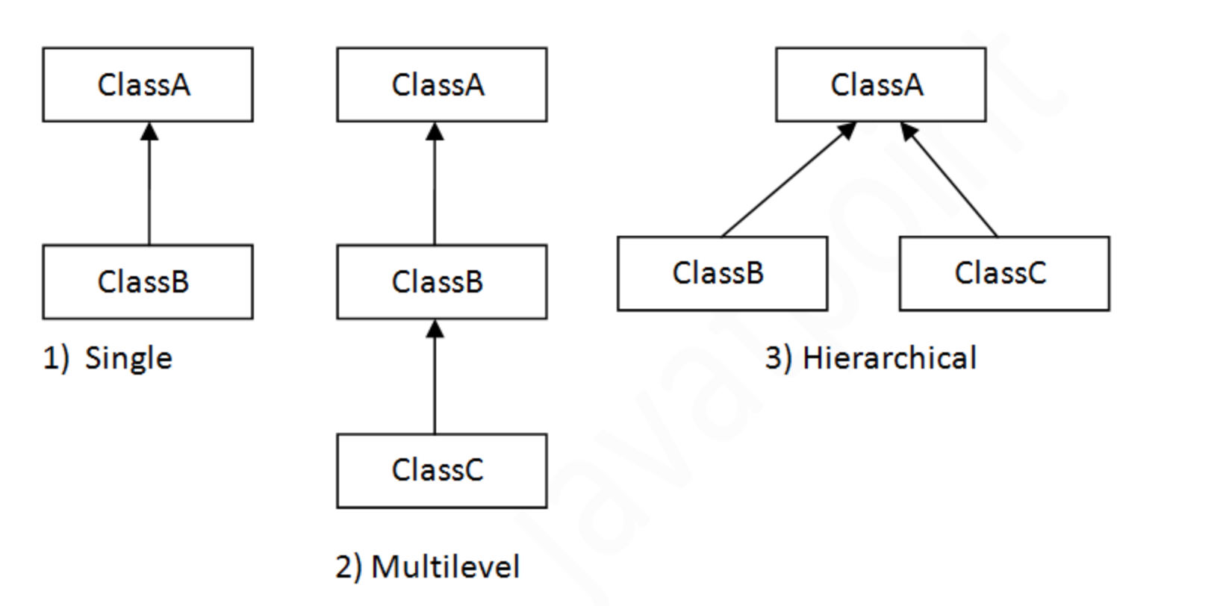
Types of Inheritance in Java
Single
Multilevel
Hierarchical

Slide 8
Method Overloading
If a class has multiple methods having same name but different in parameters, it is known as Method Overloading.
There are two ways to overload the method in java
By changing number of arguments
By changing the data type

Slide 9
Method Overriding
If subclass (child class) has the same method as declared in the parent class, it is known as method overriding in Java.
Usage of Java Method Overriding
Method overriding is used to provide the specific implementation of a method which is already provided by its superclass.
Method overriding is used for runtime polymorphism

Slide 10
Abstract class in Java
A class which is declared with the abstract keyword is known as an abstract class in Java. It can have abstract and non-abstract methods.
A class which is declared as abstract is known as an abstract class. It can have abstract and non-abstract methods. It needs to be extended and its method implemented. It cannot be instantiated.

Slide 11
Interface In Java
An interface in java is a blueprint of a class. It has static constants and abstract methods.
Java Interface also represents the IS-A relationship.
It cannot be instantiated just like the abstract class.
Since Java 8, we can have default and static methods in an interface.
Since Java 9, we can have private methods in an interface.

Slide 12
Exception Handling
The Exception Handling in Java is one of the powerful mechanism to handle the runtime errors so that normal flow of the application can be maintained.
Types of Java Exceptions
There are mainly two types of exceptions: checked and unchecked. Here, an error is considered as the unchecked exception. According to Oracle, there are three types of exceptions:
Checked Exception
Unchecked Exception
Error

Slide 13
Difference between Checked and Unchecked Exceptions
1) Checked Exception
The classes which directly inherit Throwable class except RuntimeException and Error are known as checked exceptions e.g. IOException, SQLException etc. Checked exceptions are checked at compile-time.
2) Unchecked Exception
The classes which inherit RuntimeException are known as unchecked exceptions e.g. ArithmeticException, NullPointerException, ArrayIndexOutOfBoundsException etc. Unchecked exceptions are not checked at compile-time, but they are checked at runtime.
3) Error
Error is irrecoverable e.g. OutOfMemoryError, VirtualMachineError, AssertionError etc.

Slide 14
Java Exception Keywords
Keyword | Description
try | The "try" keyword is used to specify a block where we should place exception code. The try block must be followed by either catch or finally. It means, we can't use try block alone.
catch | The "catch" block is used to handle the exception. It must be preceded by try block which means we can't use catch block alone. It can be followed by finally block later.
finally | The "finally" block is used to execute the important code of the program. It is executed whether an exception is handled or not.
throw | The "throw" keyword is used to throw an exception.
throws | The "throws" keyword is used to declare exceptions. It doesn't throw an exception. It specifies that there may occur an exception in the method. It is always used with method signature.

Slide 15
Collections in Java
The Collection in Java is a framework that provides an architecture to store and manipulate the group of objects.
Java Collections can achieve all the operations that you perform on a data such as searching, sorting, insertion, manipulation, and deletion.
Java Collection means a single unit of objects. Java Collection framework provides many interfaces (Set, List, Queue, Deque) and classes (ArrayList, Vector, LinkedList, PriorityQueue, HashSet, LinkedHashSet, TreeSet).

Slide 16
List Interface
List <data-type> list1= new ArrayList();
List <data-type> list2 = new LinkedList();
List <data-type> list3 = new Vector();
List <data-type> list4 = new Stack();

Slide 17
Demo Array List

Slide 18
Next Class
1
Android OS
2
Architecture
3
Android LifeCycle

Slide 19
#LifeKoKaroLift
Thank You!

