Slide 1
EXPLORATORY DATA ANALYSIS
Retail Transactions Dataset
Univariate · Bivariate · Multivariate Analysis on 100,000 Orders
Prepared with pandas · numpy · matplotlib · seaborn
September 2026

Slide 2
OVERVIEW
What We'll Cover
1
Dataset Overview
5
Correlation Matrix
Scale, structure, and data quality
How the numerical variables move together
2
Univariate Analysis
6
Multivariate Analysis
Numerical statistics and categorical frequencies
Three-way interactions across key variables
3
Outlier Detection
7
Key Findings
Boxplots, IQR method, and Z-score method
Business takeaways and conclusion
4
Bivariate Analysis
Numerical-numerical and numerical-categorical relationships
EDA · RETAIL DATASET
2

Slide 3
SECTION 1
Dataset Overview
100,000
18
6
Transactions
Columns
Product Categories
9
3
4
States Covered
Customer Segments
Payment Methods
Each row is a single order line: who bought it (customer demographics), what was bought (product category, subcategory, price), and how it was fulfilled (payment, shipping, delivery time, and return outcome).
EDA · RETAIL DATASET
3

Slide 4
SECTION 1
Data Quality Check
Column group | Columns | Missing values
Customer info | customer_id, age, gender, city, state, segment | 1 (customer_id only)
Order info | order_id, order_date | 0
Product info | category, subcategory, price, quantity, discount | 0
Fulfillment info | payment_method, shipping_type, delivery_days, return_status | 0
99.999%
of records are fully complete
Out of 100,000 rows, only a single customer_id is missing — no columns required imputation or row removal.
EDA · RETAIL DATASET
4

Slide 5
SECTION 2 · UNIVARIATE ANALYSIS
Numerical Variables — Summary Statistics
Variable | Mean | Median | Std Dev | Min | Max | Skew | Kurtosis
age | 41.56 | 42.00 | 13.85 | 18 | 65 | -0.00 | -1.20
product_price | 30,164.53 | 30,148.00 | 17,139.68 | 500 | 59,998 | 0.00 | -1.20
quantity | 2.50 | 3.00 | 1.12 | 1 | 4 | -0.00 | -1.36
discount_percentage | 15.01 | 15.00 | 8.95 | 0 | 30 | -0.00 | -1.20
final_price | 64,165.72 | 49,752.39 | 49,969.28 | 357 | 239,980 | 0.93 | 0.17
delivery_days | 5.51 | 5.00 | 2.87 | 1 | 10 | 0.00 | -1.22
Reading the table: final_price is the only variable with meaningful skew (0.93, right-skewed) and positive kurtosis (0.17) — a small number of large-value orders pull the distribution's tail out. Every other numerical variable is close to symmetric with flat (platykurtic) tails.
UNIVARIATE ANALYSIS
5

Slide 6
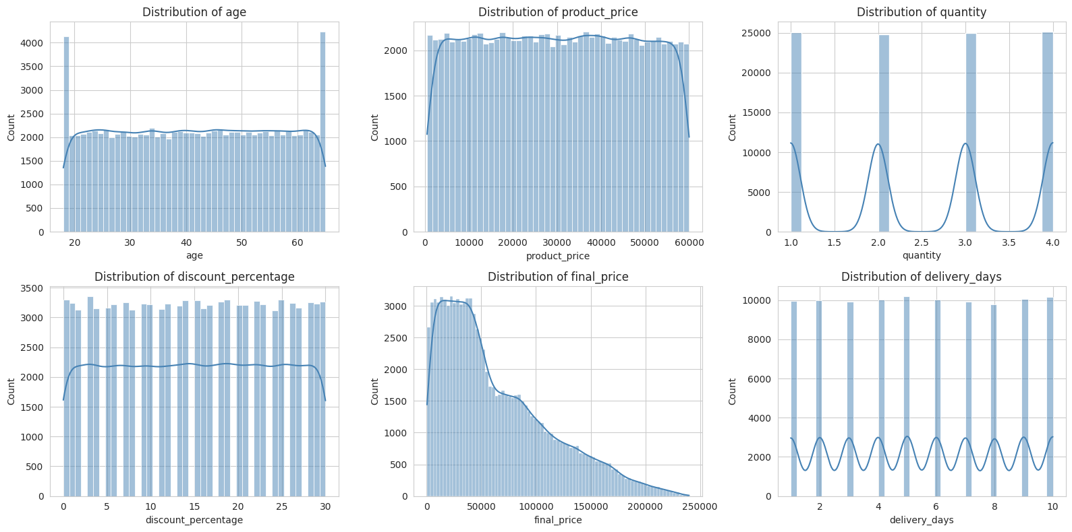
SECTION 2 · UNIVARIATE ANALYSIS
Numerical Distributions
Distribution shapes
age, product_price, quantity, and discount_percentage all look close to uniform across their range
final_price is right-skewed — most orders cluster low, with a long tail of high-value baskets
delivery_days spreads fairly evenly from 1 to 10 days
UNIVARIATE ANALYSIS
6

Slide 7
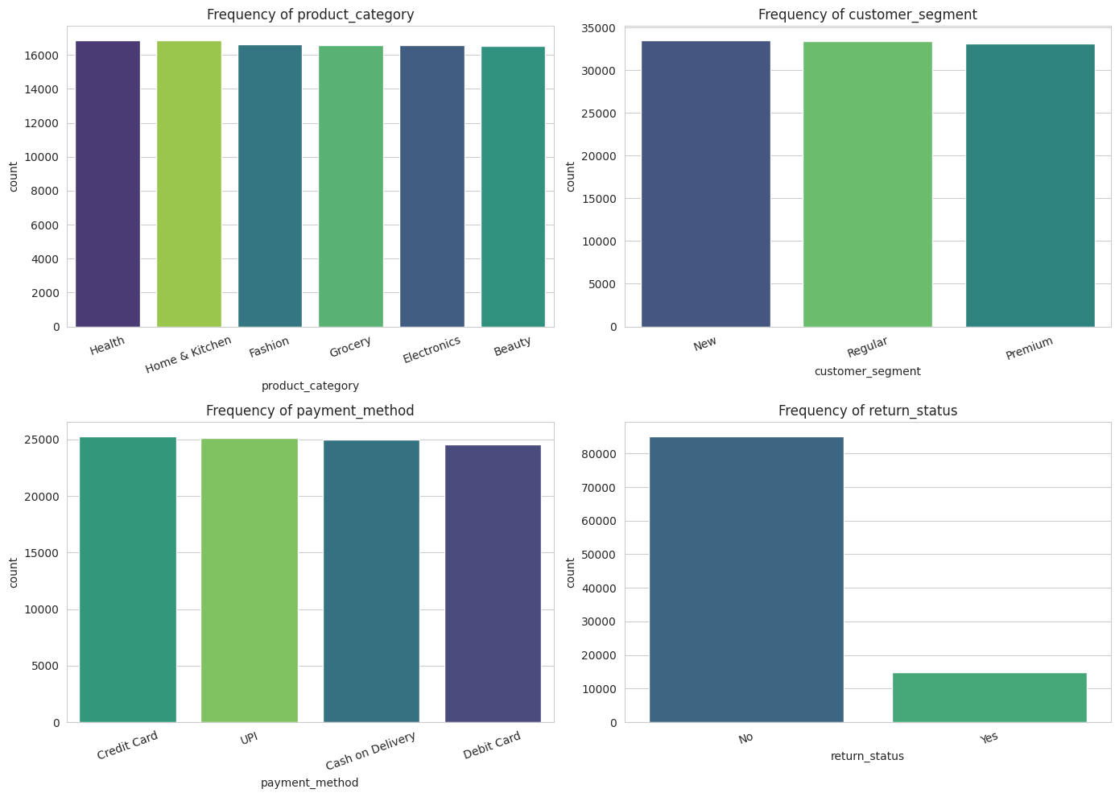
SECTION 2 · UNIVARIATE ANALYSIS
Categorical Frequencies
Category mix
Health
16.9% of orders — top category
New segment
33.5% of customers
Credit Card
25.3% of payments — most used
No return
85.2% of orders keep their items
UNIVARIATE ANALYSIS
7

Slide 8
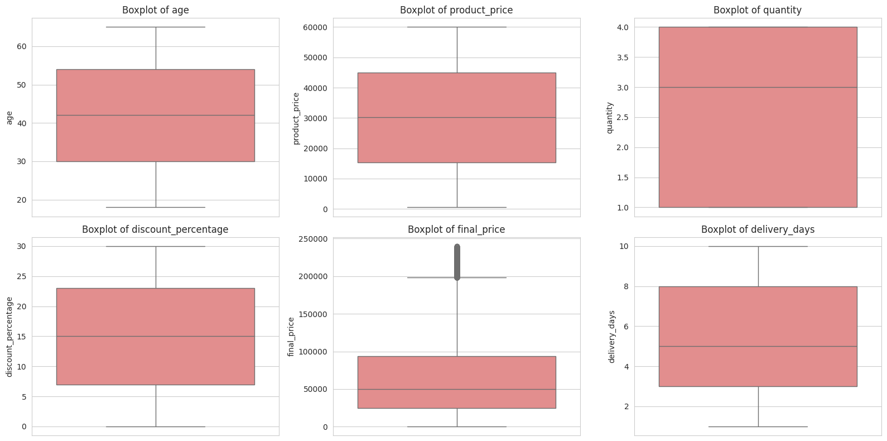
SECTION 3 · OUTLIER DETECTION
Spotting Outliers with Boxplots
Outliers were not removed — they may represent genuine high-value or bulk transactions rather than data errors.
OUTLIER DETECTION
8

Slide 9
SECTION 3 · OUTLIER DETECTION
IQR & Z-Score Results
1,335
503
0
final_price outliers via IQR method (1.5×IQR rule)
final_price outliers via Z-score method (|z| > 3)
Outliers detected in age, price, quantity, discount, or delivery_days
Variable | Outliers (IQR) | Outliers (Z-score)
age | 0 | 0
product_price | 0 | 0
quantity | 0 | 0
discount_percentage | 0 | 0
final_price | 1,335 | 503
delivery_days | 0 | 0
Takeaway
final_price is the only variable with real outliers. High values line up with high quantity and premium-category purchases — genuine bulk or big-ticket orders, not data errors.
OUTLIER DETECTION
9

Slide 10
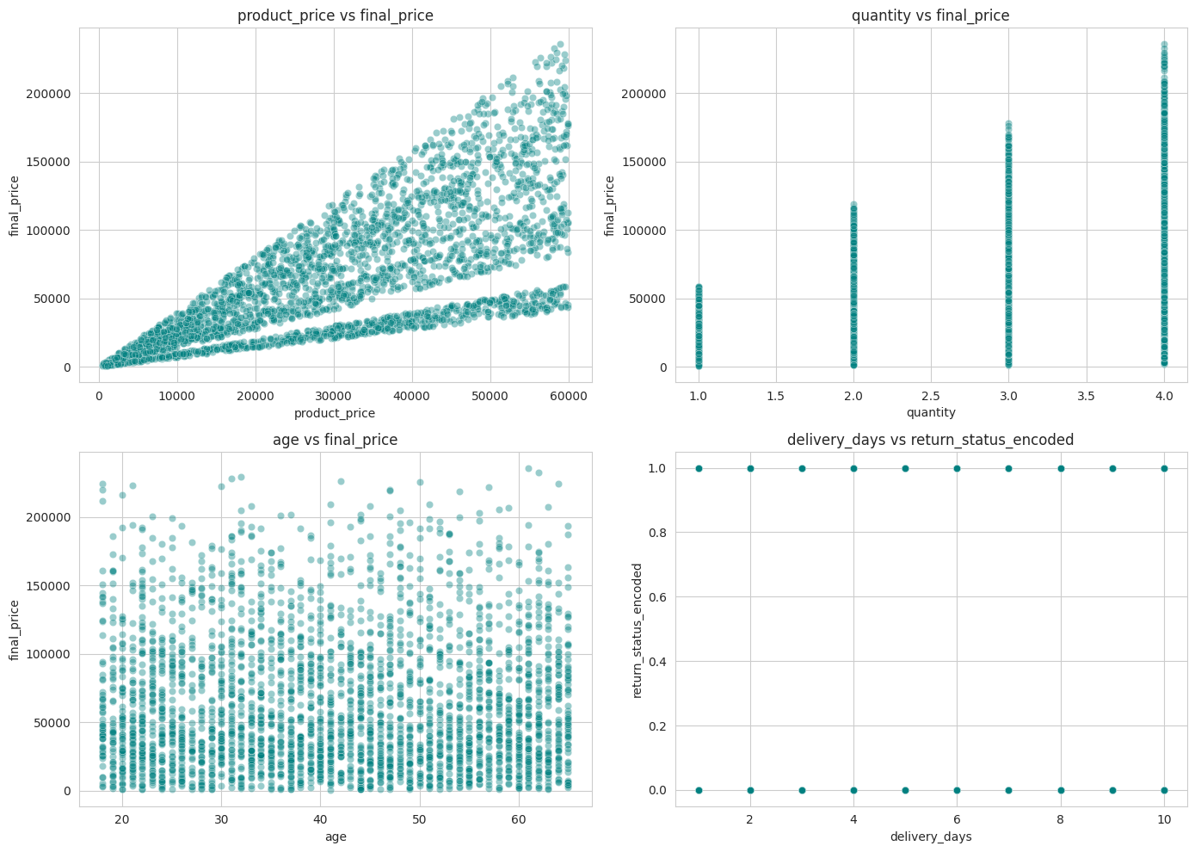
SECTION 4 · BIVARIATE ANALYSIS
Numerical vs Numerical
Pair | Pearson r
product_price vs final_price | 0.731
quantity vs final_price | 0.575
age vs final_price | -0.001
delivery_days vs return_status | 0.001
product_price and quantity both drive final_price strongly and positively. age and delivery_days show essentially no linear relationship with spending or returns.
BIVARIATE ANALYSIS
10

Slide 11
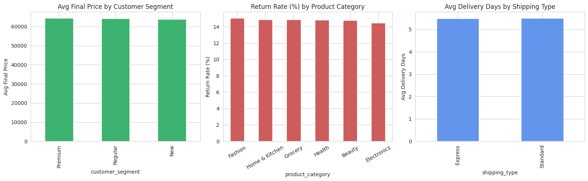
SECTION 4 · BIVARIATE ANALYSIS
Numerical vs Categorical
Premium
Fashion
Express
₹64,430 avg order — highest-spending segment
15.1% return rate — highest of all categories
5.50 days avg delivery vs 5.51 for Standard
BIVARIATE ANALYSIS
11

Slide 12
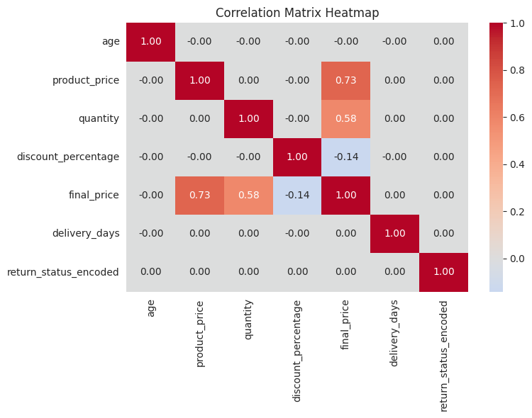
SECTION 5 · CORRELATION ANALYSIS
Correlation Matrix
What stands out
final_price correlates strongly with product_price (0.73) and quantity (0.58) — the two direct drivers of order value
discount_percentage has a mild negative correlation with final_price (-0.14): heavier discounts trend with smaller final baskets
No pair of independent features is highly correlated with another — no multicollinearity concerns
age, delivery_days, and return_status are essentially uncorrelated with everything else
CORRELATION ANALYSIS
12

Slide 13
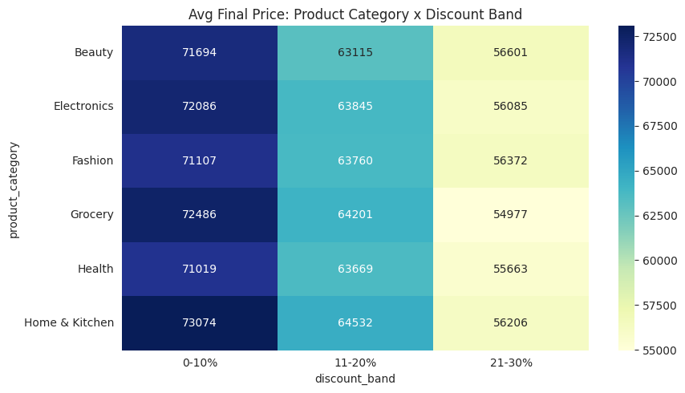
SECTION 6 · MULTIVARIATE ANALYSIS
Category × Discount × Final Price
₹73,074
Home & Kitchen at 0-10% discount — the single highest average final price of any category/discount combination.
The pattern holds across every category: average final price steps down consistently as the discount band rises from 0-10% to 21-30%.
MULTIVARIATE ANALYSIS
13

Slide 14
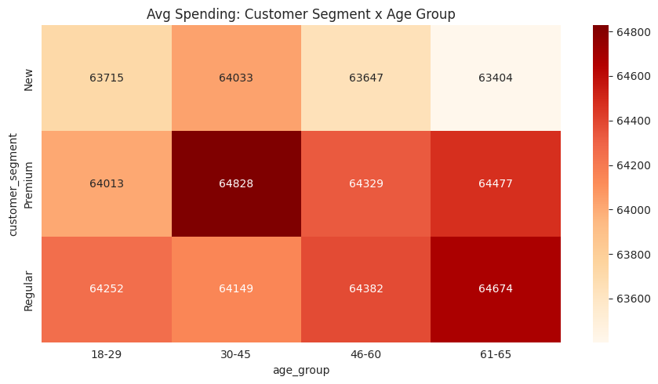
SECTION 6 · MULTIVARIATE ANALYSIS
Customer Segment × Age Group × Spending
₹64,828
Premium customers aged 30-45 spend the most of any segment/age combination.
Spending differences across segments and age groups are modest overall (roughly ₹63.4K-₹64.8K) — segment and age group alone don't strongly separate basket size.
MULTIVARIATE ANALYSIS
14

Slide 15
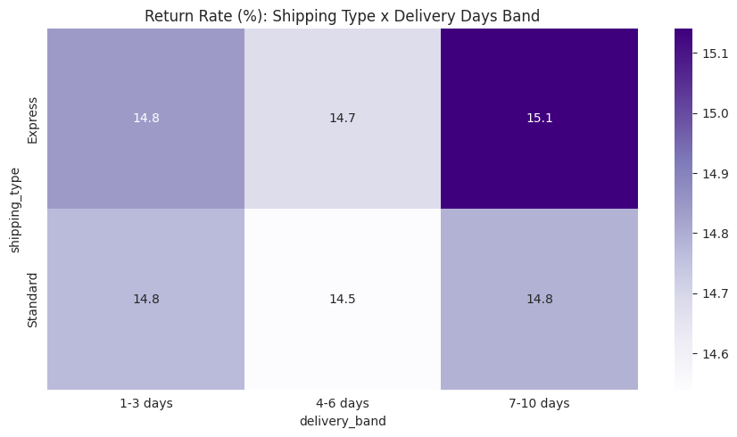
SECTION 6 · MULTIVARIATE ANALYSIS
Delivery Days × Shipping Type × Returns
14.5%–15.1%
Return rate range across every shipping type / delivery band combination — a narrow spread.
In this dataset, neither shipping type nor delivery time meaningfully moves the return rate — returns look driven by other factors, not fulfillment speed.
MULTIVARIATE ANALYSIS
15

Slide 16
SECTION 7 · CONCLUSION
Key Findings
1
Revenue (final_price) is right-skewed — a limited number of high-value orders pull the distribution's tail out
2
"Health" is the highest-volume product category at 16.9% of all orders
3
The "New" customer segment is the largest at 33.5% of customers
4
The overall return rate is approximately 14.8% of orders
5
Express shipping delivers marginally faster than Standard (5.50 vs 5.51 days)
6
product_price and quantity are the strongest drivers of final_price; discounting trends with smaller baskets
CONCLUSION
16

Slide 17
Thank You
Exploratory Data Analysis — Retail Transactions Dataset
Prepared by Ashish Kumar

