Slide 1

Suicide Rate Analysis
Presented by Ashish Sahu

Slide 2
DataSet Overview
- Data set of 27,820 incident of suicide over last 31 years. The data fields included are:
country, year, sex, age, suicides_no, population, suicides/100k pop, country-year , HDI for year, gdp_for_year ($), gdp_per_capita ($), generation

Slide 3
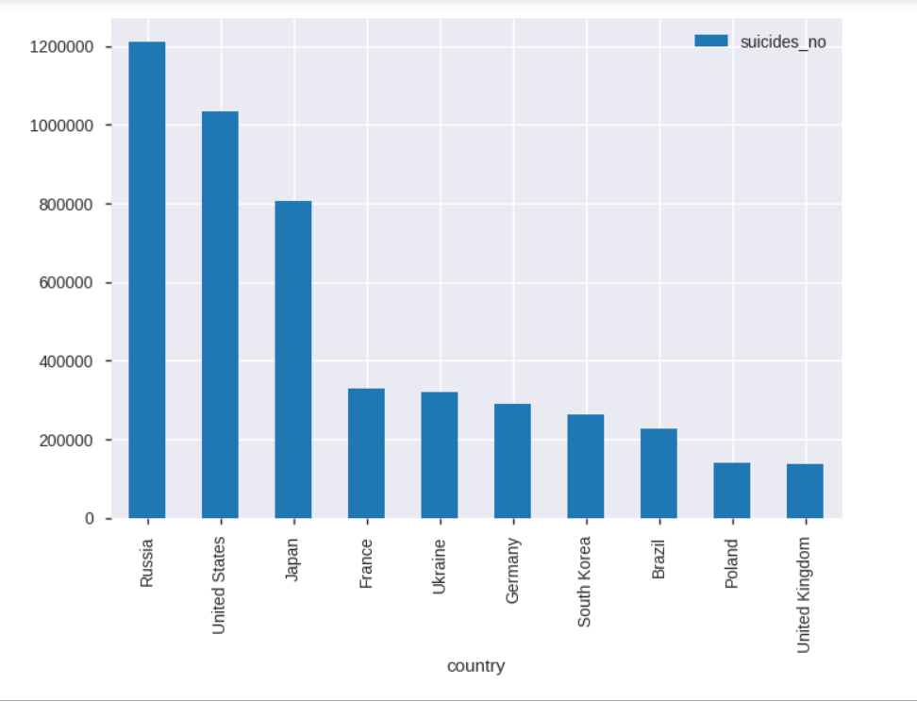
Top 10 countries with maximum number of suicides
Tracked in Google Analytics
Russia, United States and japan have highest number of suicide.

Slide 4
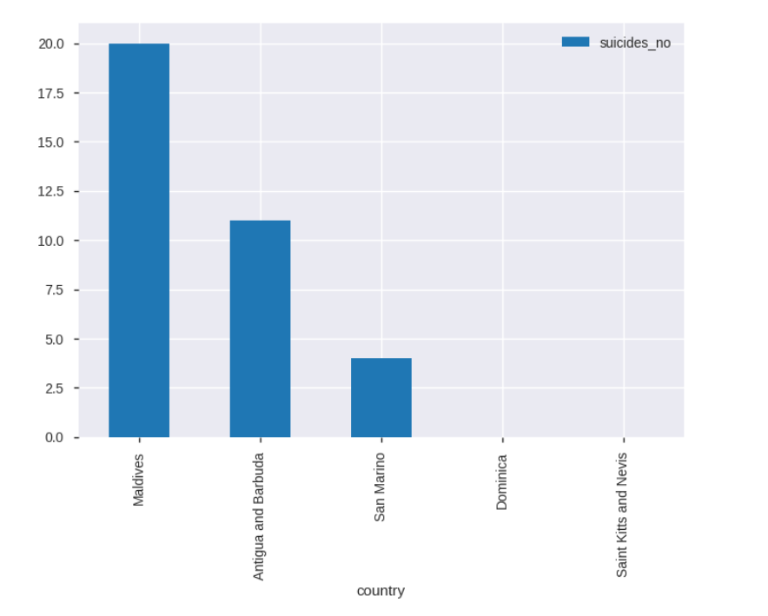
Top 5 countries with minimum number suicide
Tracked in Google Analytics
Maldives, Antigua and Barbuda and San Marino has least number of suicide numbers.

Slide 5
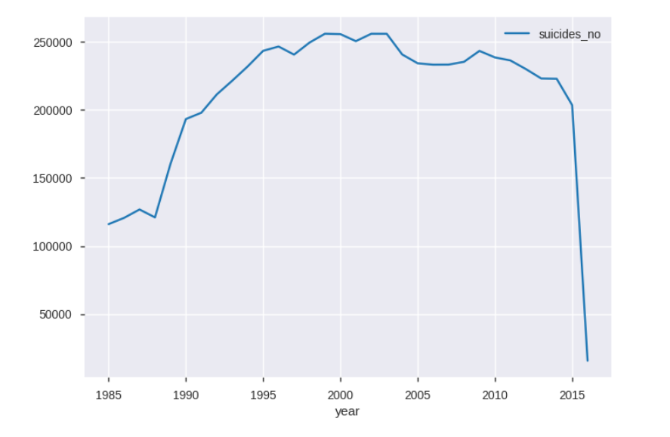
Suicide trend over years?
Tracked in Google Analytics
Suicide numbers increased from 1 m to 2.5 m from 1985 to 2014 and shown a steep decrease in year 2014-2015.

Slide 6
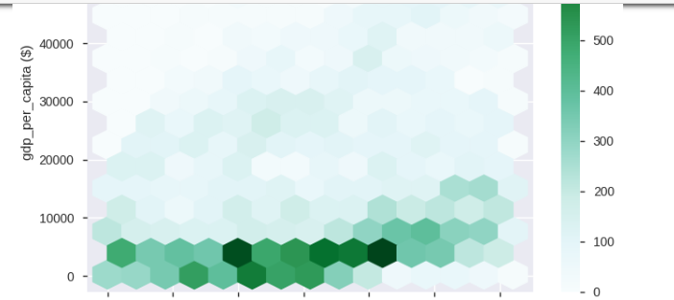
GDP per capita trend over years
Tracked in Google Analytics
GDP per capita is inversly proportion to number of suicide over years.

Slide 7
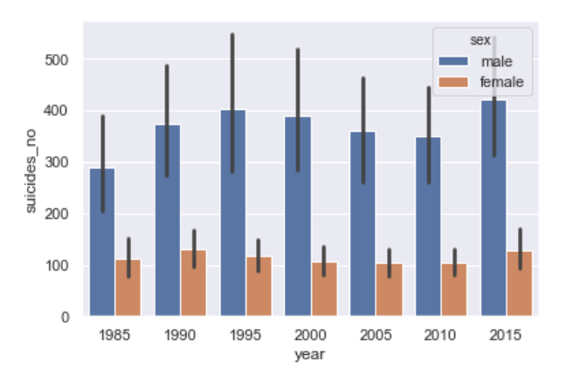
Who is more likely to Suicide, Male or Female?
Tracked in Google Analytics
Male are most likely to commit suicide, also number of males committing suicide is almost three times that of women.

Slide 8
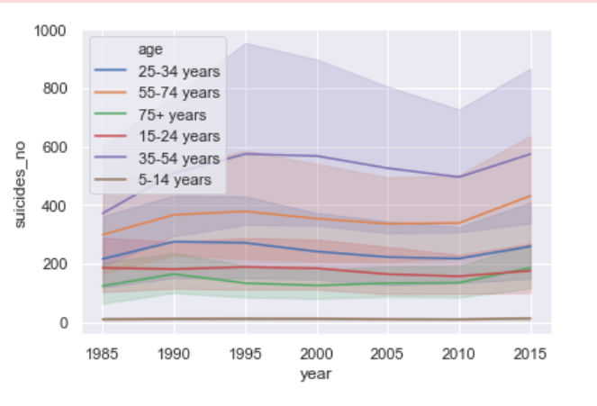
Which age group is more likely to commit suicide?
Tracked in Google Analytics
Age group (35-54 years) has maximum suicidal tendency.

Slide 9
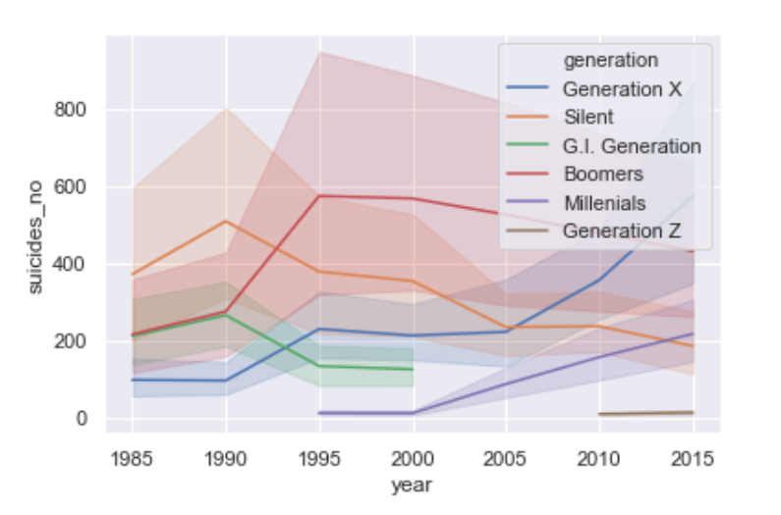
Which generation has higher tendency to commit suicide?
Tracked in Google Analytics
Silent has maximum suicidal tendency for suicide till 1993 post that we have seen increase in suicidal tendency in Boomers , which was over taken by generation X in 2013.

Slide 10
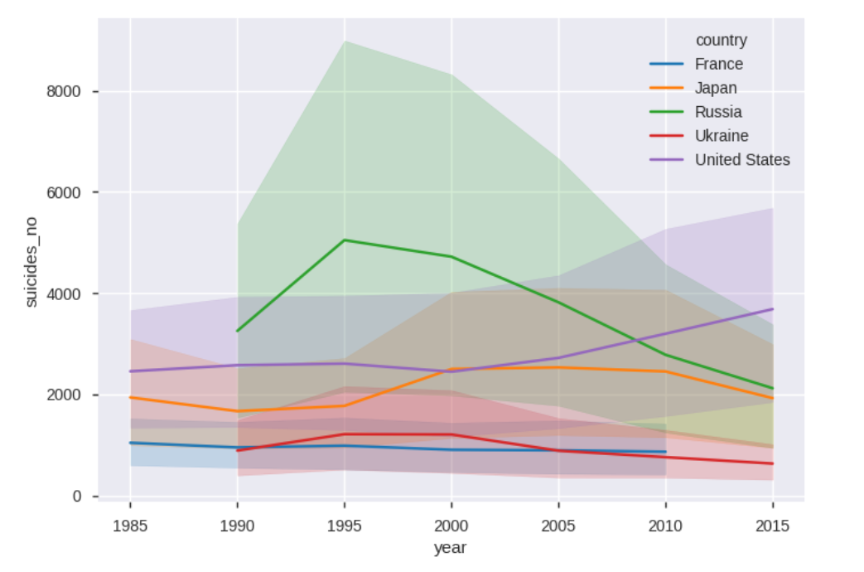
Comparison of suicide trend in top 5 countries with maximum suicide.
Tracked in Google Analytics
Since 1990 Russia was having maximum suicide numbers which was over taken by United states in 2009

Slide 11
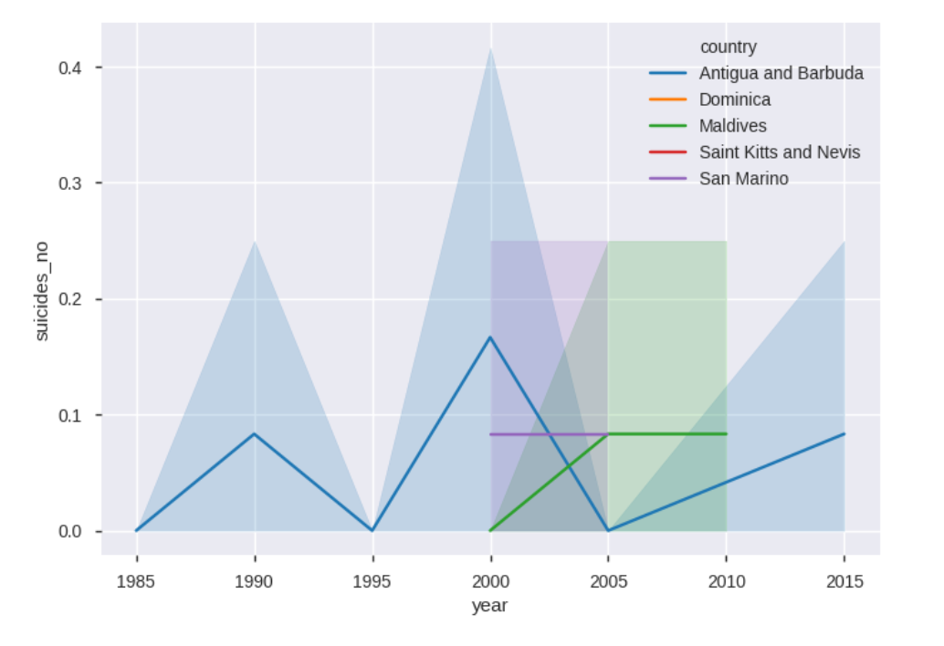
Comparison of suicide trend in 5 countries with minimum suicide.
Tracked in Google Analytics
Antigua and Barduda has shown steep increase and decrease in every 5 years, Maldives has observed steep increase from 2000 to 2005 and then was constant for next five years.

Slide 12
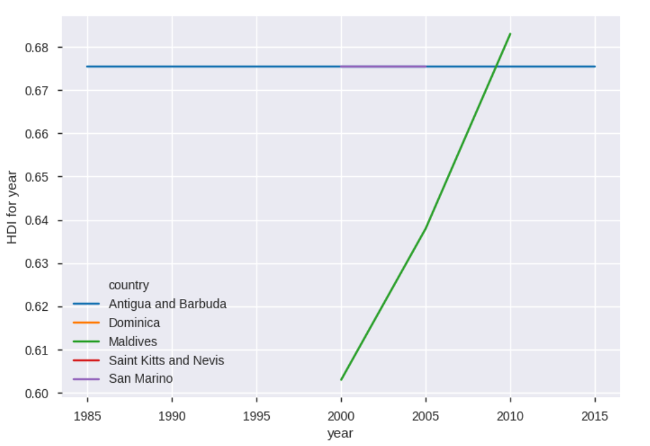
HDI over years in 5 countries with minimum suicide.
Tracked in Google Analytics
There is an steep increase of HDI in Maldives from 2000 for next 10 years.

Slide 13
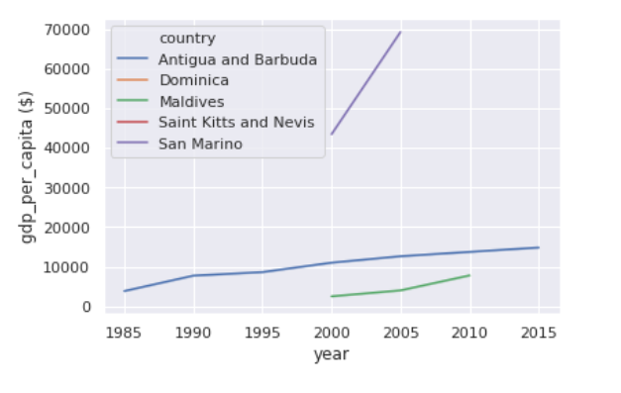
GDP per capital over years in top 5 countries with minimum suicide.
Tracked in Google Analytics
An increase in GDP per capita has been observed which indicates increase in socio-economic status.

Slide 14
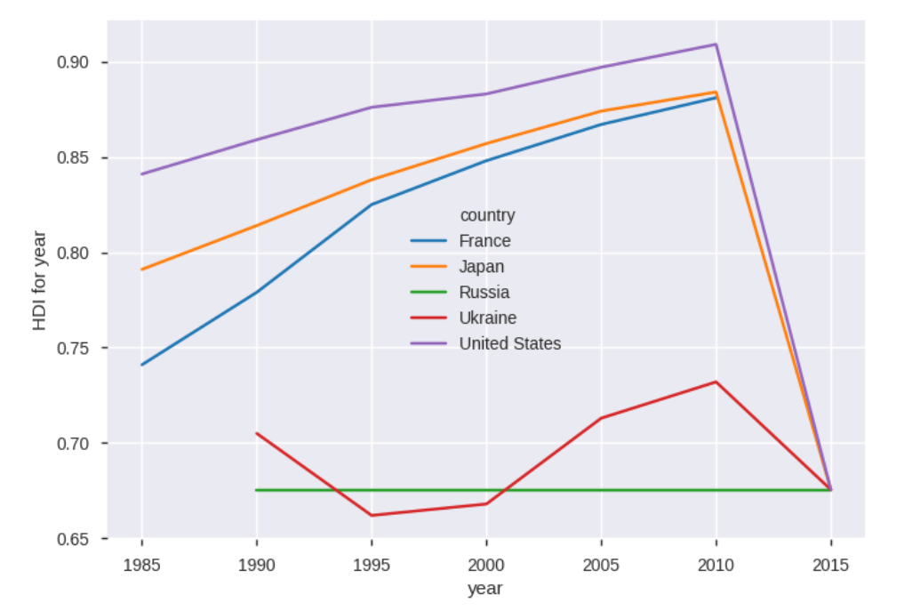
HDI trend over years for top five countries having highest suicide cases.
Tracked in Google Analytics
Russia is having flat HDI over years, this can be due to socialist government in that country. we have seen that was an increase in suicide numbers around 2010 in United States, which can be cause of steep fall in HDI.

Slide 15
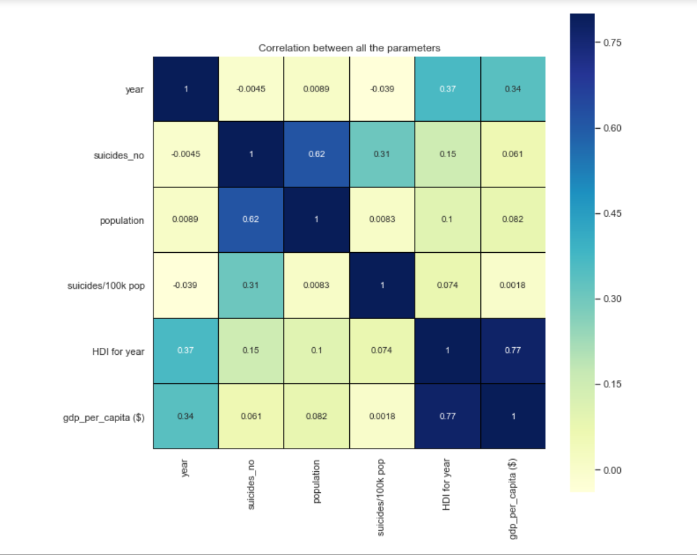
Co-relation between all the features using heatmap.
Tracked in Google Analytics
There is a high positive co-relation between population and suicide number and HDI and gdp per capita

Slide 16
Conclusion
Suicide rate is high in developed countries and least in third world countries
Male in 35-54 age group, are more likely to suicide.
Most of the population in age group 35-54 are married and working members and they have responsibility to earn for their family and at the same time they want to fulfil there expectations in terms of career growth, social status, etc. If they fail in their expectations and looses hope then they tend to commit suicide. Apart from that financial stability, loss of job, unemployment, mental health also contributes to Suicidal tendency.

Slide 17
Recommendation for reducing suicide rate
Increase in job opportunities.
Free counselling session conducted by employer/Government/NGO for Mental health.
Weekend skill training for middle age professionals.
Social Security scheme for unemployment for reducing insecurity in society.
Working on stress relieving technique like yoga, meditation, etc.
National monitoring of suicide and suicidality should be improved, and consolidated data should be available for future study and improvement.

