Slide 1

Spam Detection
by Ashish Sahu

Slide 2
1. Introduction
Now a days every one is using email as mode of communication, lots of marketing agencies are also using that for selling there product, idea, etc.. Imagine the number of mails you have to go through every day for identifying genuine mail.
Have you ever looked into your spam folder of your mailbox. Imagine the time you need to spend to find out an important mail in your inbox.
Let’s build a spam classifier program in python which can tell whether a given message is spam or not! We can do this by using a simple, yet powerful theorem from probability theory called Baye’s Theorem.

Slide 3
DataSet Overview
The SMS Spam Collection is a set of SMS tagged messages that have been collected for SMS Spam research. It contains one set of SMS messages in English of 5,574 messages, tagged according being ham (legitimate) or spam.
- The dataset contain one message per line. Each line is composed by two columns: v1 contains the label (ham or spam) and v2 contains the raw text.

Slide 4
Columns
v1 | Spam or ham
v2 | message

Slide 5
Problem Statement
We all face the problem of spams in our inboxes, in order to work efficiently and reduce probability of missing any important mails this solution is built, which will hep in identification of spam emails using simple yet powerful naive baye’s algorithm.

Slide 6
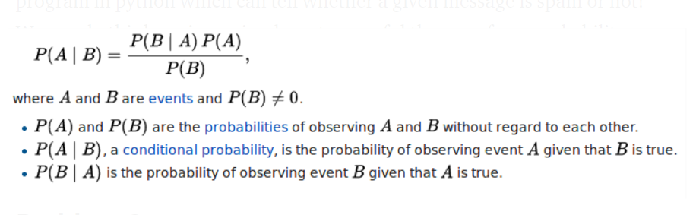

Baye’s Theorem
If we assume that occurrence of a word are independent of all other words, we can simplify the above expression to

Slide 7
In order to classify we have to determine which is greater
Baye’s Theorem

Slide 8

Most repeated words in spam mails

Slide 9
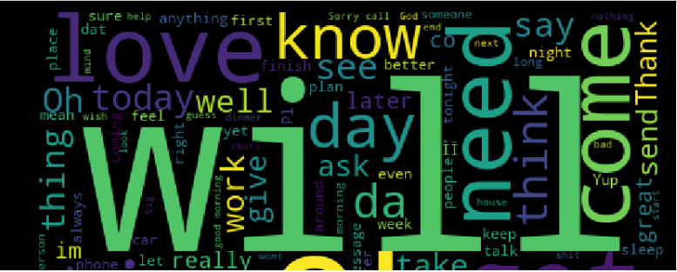
Most repeated words in ham mails

Slide 10
Techniques used for spam classifier
TD-IF method : Tf-idf stands for term frequency-inverse document frequency
Bag of words method : Bag of Words model is used to preprocess the text by converting it into a bag of words, which keeps a count of the total occurrences of most frequently

Slide 11
Bag of Words
Tracked in Google Analytics
In Bag of words model we find the ‘term frequency’, i.e. number of occurrences of each word in the dataset. Thus for word w,
P(w)= (Total number of occurrence of w in dataset)/(Total number word in data sheet)

Slide 12



TF-IDF
Tracked in Google Analytics
TF-IDF stands for Term Frequency-Inverse Document Frequency. In addition to Term Frequency we compute Inverse document frequency.
For example, there are two messages in the dataset. ‘hello world’ and ‘hello foo bar’. TF(‘hello’) is 2. IDF(‘hello’) is log(2/2). If a word occurs a lot, it means that the word gives less information.
In this model each word has a score, which is TF(w)*IDF(w). Probability of each word is counted as:

Slide 13
Conclusion
With TD - IF method
Precision: 0.8888888888888888
Recall: 0.718562874251497
F-score: 0.794701986754967
Accuracy: 0.9538690476190477

Slide 14
0.5538461538461539
0.5538461538461539
0.5538461538461539
Conclusion
2. With Bag of word method
Precision: 0.864
Recall: 0.5538461538461539
F-score: 0.6749999999999999
Accuracy: 0.9268121041520057

Slide 15
0.5538461538461539
0.5538461538461539
0.5538461538461539
Conclusion
** precision, recall, F-score and Accuracy is greater with TD - IF method
In email spam detection, a false positive means that an email that is non-spam (actual negative) has been identified as spam (predicted spam). The email user might lose important emails if the precision is not high for the spam detection model.
In our case precision is more in case of TD - IF method

Slide 16
0.5538461538461539
0.5538461538461539
0.5538461538461539
Recommendation
In order to create a spam detector most recommended model is TD-IF method. This model can be used to build a spam detector with high precision.

