Slide 1
IAND

Slide 2
First time?
Immigration
Upcoming events
Join the team

Slide 3

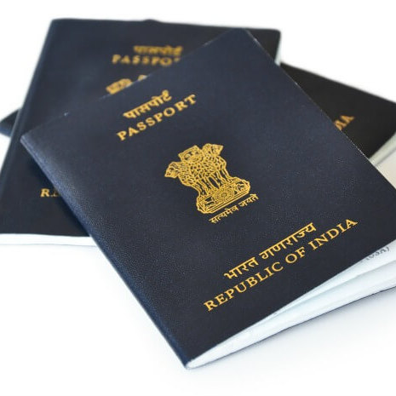
INCOMING STUDENT?
IMMIGRATION ISSUES

Slide 4
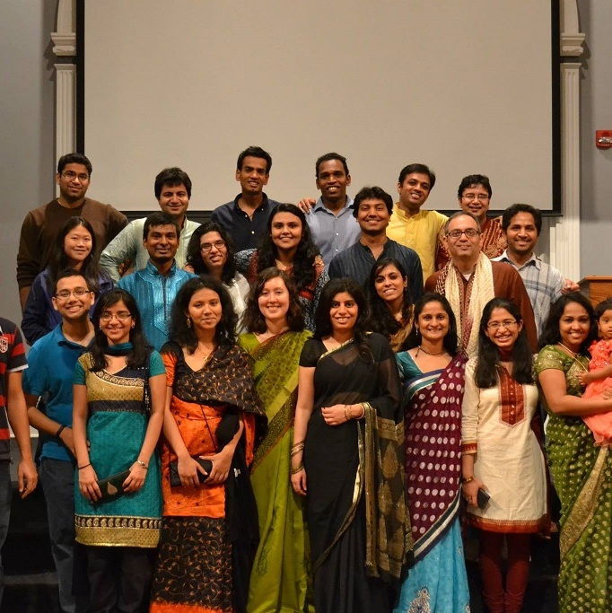

UPCOMING EVENTS
JOIN THE TEAM

