Slide 1



HydroSafe Monitor

Slide 2


Problem Statement and Rationale
Develop a machine learning model to monitor water quality in real-time using sensor data from various sources. The solution aims to detect contaminants early and provide timely warnings to prevent waterborne diseases, ensuring access to safe drinking water.
Rationale: Water quality monitoring is crucial for public health. Contaminants in water can lead to serious health issues and outbreaks of waterborne diseases. Traditional methods of water quality testing are time-consuming and often fail to provide real-time data, which delays the response to potential hazards. By leveraging machine learning, we can automate the detection process, allowing for real-time monitoring and prompt action to ensure water safety.

Slide 3
Why We Chose This Problem?
Why This Problem?
Public Health Impact: Ensuring safe drinking water can significantly reduce the incidence of waterborne diseases.
Technological Feasibility: Advances in sensor technology and machine learning provide an opportunity to develop a real-time monitoring system.
Scalability: A machine learning model can be scaled to monitor multiple water sources and regions, providing widespread benefits.
Preventive Measures: Early detection of contaminants allows for timely intervention, reducing potential health risks.

Slide 4

Tools Used
IBM Watson Studio: For developing, training, and deploying the machine learning model.
AutoAI: For automated machine learning model generation, including hyperparameter optimization and model selection.
IBM Watson Machine Learning: For managing and deploying the machine learning model in a scalable and secure environment.

Slide 5
Model Overview and Solution
How This Model Solves the Problem:
Real-Time Data Processing: The model processes real-time sensor data to monitor water quality continuously.
Contaminant Detection: Using machine learning algorithms like XGBoost, the model identifies patterns and detects contaminants effectively.
Early Warnings: By analyzing trends and anomalies in the data, the model provides early warnings to relevant authorities, enabling swift action to mitigate risks.
Reliability and Accuracy: Despite achieving an accuracy of 67%, the model's performance can be improved with additional data and fine-tuning, making it a reliable tool for water quality monitoring.

Slide 6
Model Overview and Solution
Why It Will Work:
Data-Driven Approach: Leveraging large datasets for training enhances the model's ability to generalize and detect contaminants. Scalable Infrastructure:
IBM Cloud provides a robust and scalable platform to deploy and manage the model, ensuring it can handle large volumes of data.
Continuous Improvement: The model can be continually updated with new data and re-trained to improve accuracy and adapt to new types of contaminants.

Slide 7

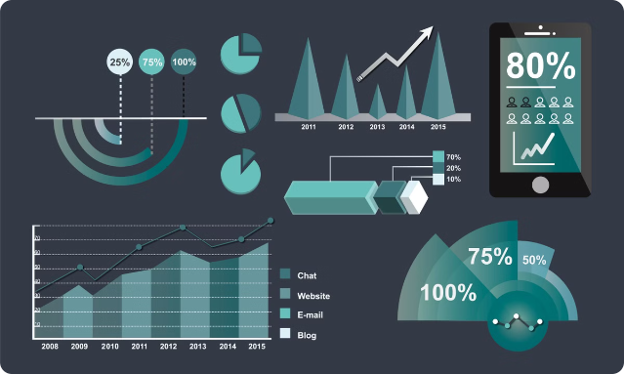
Data Sources
Dataset: Kaggle Water Quality Analysis Dataset
Description: The dataset includes various water quality parameters such as pH, turbidity, conductivity, dissolved oxygen, and presence of contaminants. Usage: The dataset was used to train the machine learning model, providing a comprehensive basis for detecting water quality issues.
Data Link: Kaggle Water Quality Analysis Dataset

Slide 8
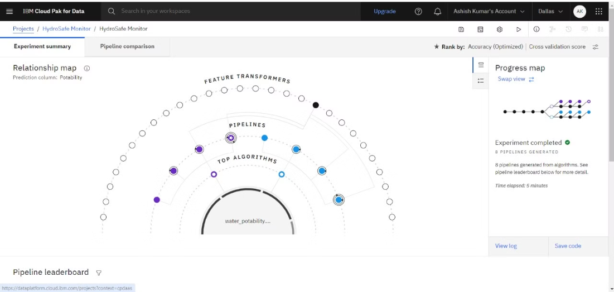
Model Link and Screenshots
Model Link:
IBM Cloud Model Link: https://private.us-south.ml.cloud.ibm.com/ml/v4/deployments/d7f8abb5-e033-4032-b8c7-47814a342b1d/predictions?version=2021-05-01https://private.us-south.ml.cloud.ibm.com/ml/v4/deployments/d7f8abb5-e033-4032-b8c7-47814a342b1d/predictions?version=2021-05-01
Screenshots:
Model Training Interface:

Slide 9
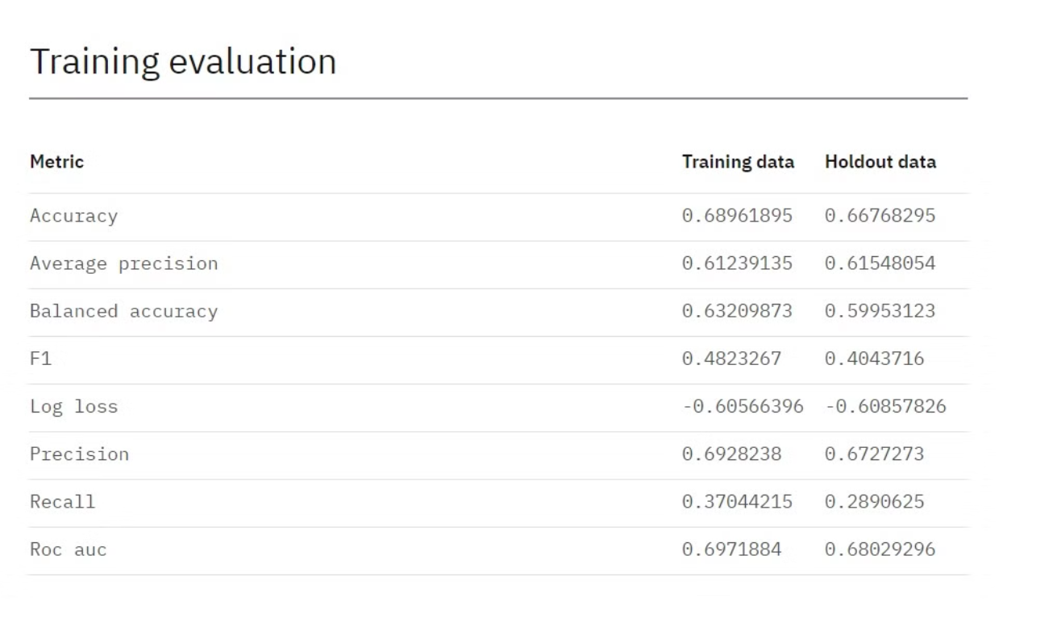
Model Performance Metrics:

Slide 10
Thank You
BY TEAM PERFORMER

