Slide 1
MANUFACTURING ANALYTICS DASHBOARD Group-3
Sujata sidray karoli
Atharv Rajesh Kinjawadekar
Ashish Kumar
Dhareppa suresh Maranur
Sangamesh RAKSHE
Nitin kumar namdeo
Reshma Bollineni

Slide 2
Contents:
1. Overview
2. List of KPI’s
3. Dashboard
4. Insights
5. Recommendations
6. Conclusion

Slide 3
Overview:
Operational Timeframe: November 1, 2015, to November 27, 2015.
Total Volume Monitored: Over 86.72 Million units manufactured across core product lines.
Business Problem: Identifying operational friction points, tracking high-volume rejections, and pointing out material wastage to stabilize production margins.
Primary Goal: To bridge the gap between production quantities and quality benchmarks through targeted data insights.

Slide 4
List of KPIs:
Total Manufactured Quantity: The baseline metric capturing the total units pushed into production.
Total Processed Quantity: The total volume of units that successfully completed their operational stage (e.g., cutting, folding).
Total Rejected Quantity: The sum of all units flagged as defective or out-of-specification during quality checks.
Overall Rejection Rate (%): The primary quality health scorecard metric.
Wastage Gap: The volume difference between scheduled Work Orders (WO Qty) and actual completed output.

Slide 5
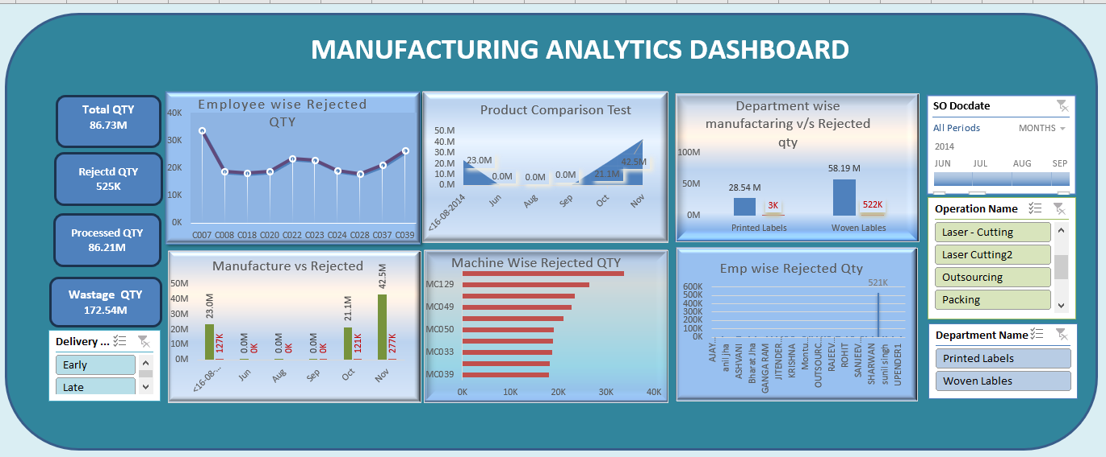
Excel Dashboard

Slide 6
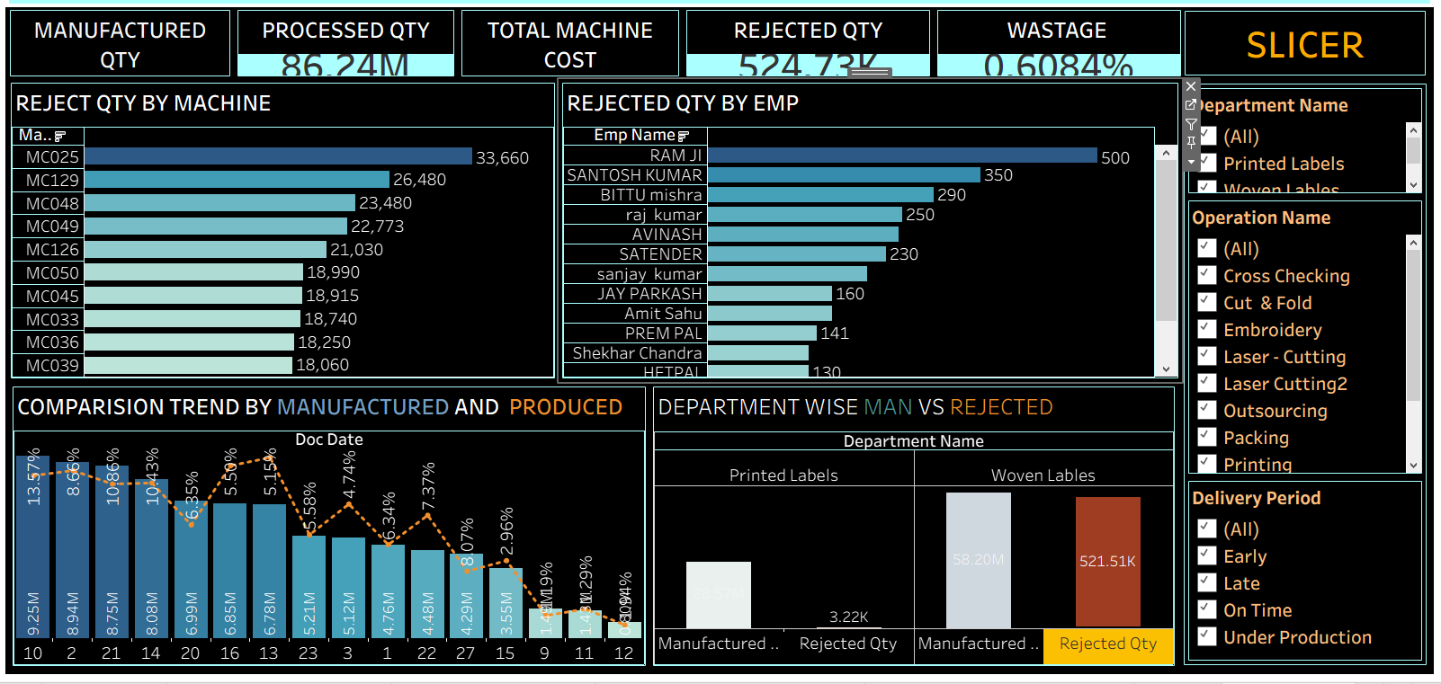
Tableau Dashboard

Slide 7
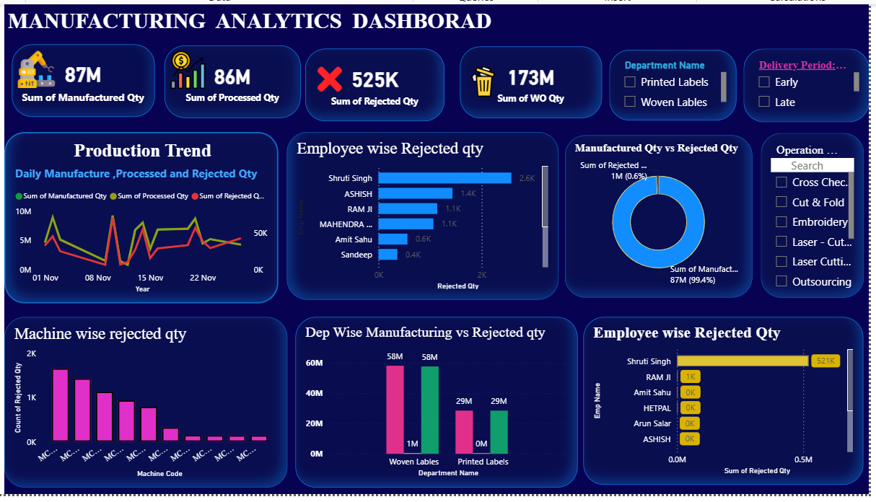
Power bi dashboard

Slide 8
Insights:
Departmental Disparity: The quality problem is heavily isolated. The Woven Labels department accounts for 521,508 rejections (a 0.90% rejection rate on 58.18M units), whereas Printed Labels operates at an exceptionally clean 0.01% rejection rate (only 3,221 rejections on 28.53M units).
Extreme Employee Outlier: Employee Shruti Singh is tied to 520,867 rejections out of the total 524,729 rejections in the entire factory dataset. This indicates an extreme process anomaly, mislogging, or machine-assignment issue unique to this operator profile.
Machine Wear & Tear: Rejections are heavily driven by specific assets on the shop floor. Machines C007 (33.6k rejections), C039 (26.4k rejections), and C022 (23.4k rejections) are the top three contributors to quality failures.

Slide 9
Recommendations:
Targeted Operator Intervention: Conduct an immediate process audit on Employee Shruti Singh's shift. Investigate if this massive rejection footprint is due to data entry errors, faulty equipment configuration, or a critical need for technical retraining.
Predictive Machine Maintenance: Pull machines C007, C039, and C022 offline for mechanical calibration and component inspection. Focus heavily on checking their cutting and weaving alignment modules.
Standardizing Woven Process Frameworks: Take the quality control frameworks and machine maintenance schedules utilized in the Printed Labels department and adapt them to optimize the Woven Labels production floor.

Slide 10
Conclusion:
Final Takeaway: While the factory maintains an excellent overall rejection rate of 0.61%, keeping it well below a standard 1% threshold, a deep dive proves that this is artificially low due to the flawless execution of the Printed Labels line. The Woven Labels line carries substantial risk.
Next Steps: Implement the machine calibration plan immediately and refresh the dashboard data weekly to monitor if the targeted recommendations successfully drive the Woven Labels rejection rate down toward the 0.05% baseline.

