Slide 1
Data science with python
Project Presentation
Team: PyNerds
Ashish Kumar Doke
Ajay Babu Addagadda
Rahul Kumar Thatikonda
Srikanth Kyatham
Wendy Bernard

Slide 2
Agenda
Problem Statement
Data Description
Data Pre-Processing and Feature engineering
Data Modeling
Model Evaluation and Implementation
Recommendations

Slide 3
Problem statement
Memorial​ ​Sloan​ ​Kettering​ ​Cancer​ ​Center​ ​(MSKCC)​ ​launched​ ​this​ ​competition,​ ​accepted​ ​by ​ ​NIPS​ ​2017​ ​Competition.
​The​ ​goal​ ​of​ ​the​ ​competition​ ​is​ ​to​ ​use​ ​genetic​ ​information available​ ​in​ ​text​ ​to​ ​understand​ ​the​ ​genetic​ ​mutations​ ​contributing​ ​to​ ​Cancer​ ​tumor.
To​ ​put​ ​it​ ​in​ ​Data​ ​Science​ ​terms​ ​we​ ​need to use​ ​text based​ ​clinical​ ​literature​ ​to​ ​classify​ ​every​ ​single genetic​ ​mutation.
​ ​For​ ​this​ ​competition​ ​MSKCC​ ​has​ ​released​ ​an​ ​expert-annotated​ ​knowledge base​ ​where​ ​​ ​researchers​ ​have​ ​manually​ ​annotated​ thousands​ ​of mutations.​

Slide 4
Data Description
There are nine different classes a genetic mutation can be classified on.
Train Data was provided in two different files :
Training_variants: Description of the genetic mutations
Training_Text: file: Clinical evidence (text) used to classify mutations.
Train set had 3321 observations with Gene, Variations and Text info as features. Test set had 5668 observations.

Slide 5
Data Preprocessing:
Text data Cleaning:
Decoding text to ‘utf-8’
Personal Pronouns
Stop words
Punctuation Stemming
Lemmatization
Split text into words/sentences

Slide 6
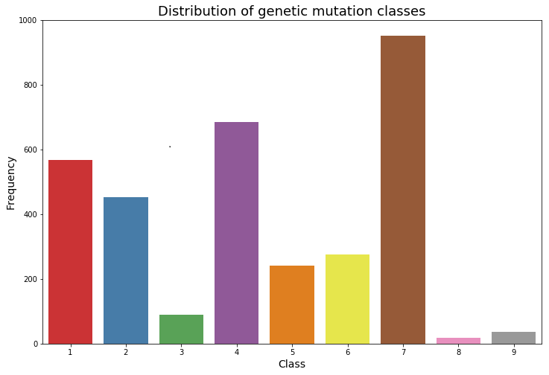
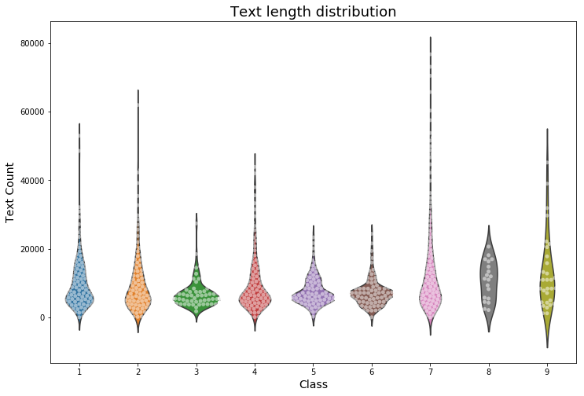
Exploratory Analysis:

Slide 7
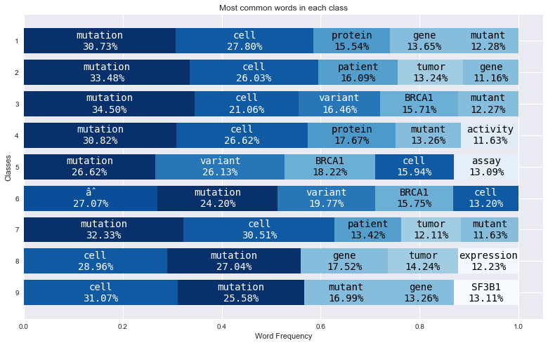

Slide 8
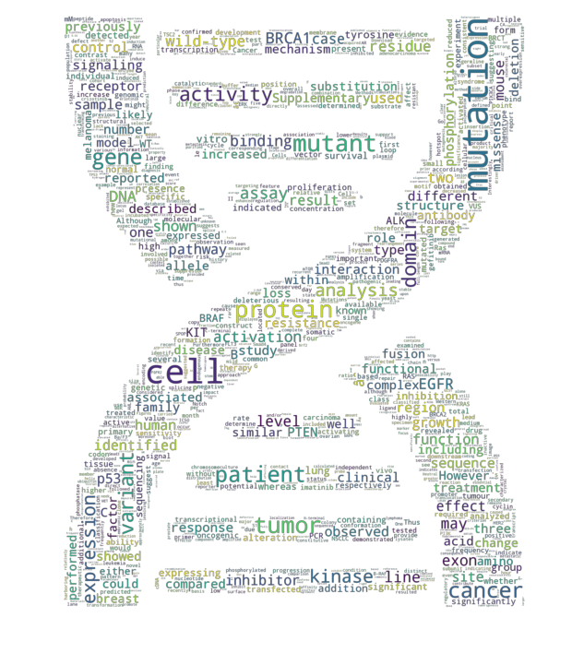
Word Cloud:

Slide 9
Feature Engineering (without domain knowledge)
We feature engineered some variables:
Length of the Text
Count of unique words
Count of words which were not stopped
Average word length
No of Commas/ No of Sentences

Slide 10
Feature Engineering (with Domain knowledge)
Classifying variation patterns
Extract amino acid letters and positions from variation*
Amino acid Group -functional subfamilies
Genes frequency of occurring per class: Extract top genes
*not all variations in this format.

Slide 11
Machine Algorithms Implemented: Metric: log loss
Model | Train | Validation
Tf-Idf + Logistic Regression | 1.511 | 1.753
Tf-idf+GloVe+Logistic | 1.174 | 1.346
Tf-idf+GloVe+XGB classifier | 1.230 | 1.421

Slide 12
Deep Learning Algorithms
*GloVe+Drop out +Batch Norm
Model | Train | Validation
3 Layer MLP for 5 epochs 64/batch | 0.9966 | 1.0926
5 Layer MLP for 10 epochs 64/batch | 0.9021 | 1.1740
2 Layer LSTM with relu and adam 512/batch | 1.3950 | 1.5218
2 Layer Bidirectional LSTM | 1.1914 | 1.2786

Slide 13
Final Model with Domain Knowledge
features selected : Gene, Variation, Variation_pattern_type, Variation first and last letters, Amino acid Sub_groups ofer8 first and last letters, sdm12 features, p5 features
Logistic regression with regularization was implemented as final model.
Validation log loss of the model : 1.1890
Features with highest importance :
BRCA1 gene
BRCA2 gene
PTEN gene: common tumor suppressor
Variation: Truncating mutations* mRNA termination
Repair Damaged DNA
* Ofer8 is used for dibasic cleavage prediction (enzyme splitting the DNA) * A change in amino acid sequence at the protease cleavage site of the fusion is studied for causes of different diseases.

Slide 14
Conclusion and Further steps:
Capturing information from Gene and Variation features is the key .
Based on our analysis
Class 1,4,6 have a common characteristic : lack of Tumor suppressor
Class 3 and 5: BRCA 1 gene has the highest prediction importance
Class 7 : Truncated mutations most likely cause
Class 2: KRAS gene Structural mutation
Pre Trained GloVe model on Biological corpus with Genes & Mutation families information
Hyper parameter optimization of the Deep learning architectures with stacked ensembling can improve the prediction results.

Slide 15

Questions?

Slide 16
References:
Neuro PID: https://www.ncbi.nlm.nih.gov/pubmed/24336809
NIPS :https://nips.cc/Conferences/2017/CompetitionTrack
ProFET: Dan ofer: https://github.com/ddofer/ProFET/blob/master/ProFET

