Slide 1

Artificial Intelligence & Data Analytics
Summer Internship / Learning Program Presentation
Student Details
Ashish Kumar Patel
Class: 3CSE21
Roll No.: 2410030658
IILM University, Greater Noida
Internship / Learning Provider
Cisco Networking Academy program, offered by IILM University
Completion Period
06 June 2026 – 11 June 2026
Credentials
3 course completion certificates

Slide 2
Internship Overview
A structured learning experience across AI and Data Analytics
Domain
Artificial Intelligence and Data Analytics
Organization / Provider
Cisco Networking Academy program, offered by IILM University
Credentials
Three successfully completed learning modules
Certified Modules
Introduction to Modern AI | Apply AI: Analyze Customer Reviews | Data Analytics Essentials
Ashish Kumar Patel | AI & Data Analytics Internship
2

Slide 3
Internship Objectives
Key learning goals derived from the three completed certificates
• Build a foundational understanding of modern Artificial Intelligence concepts.
• Understand how AI can be applied to the analysis of customer-review information.
• Develop awareness of essential Data Analytics concepts.
• Connect AI and data analysis with practical information-analysis problems.
• Strengthen analytical thinking and technical problem interpretation.
• Identify areas for further learning in intelligent systems and data-driven applications.
Ashish Kumar Patel | AI & Data Analytics Internship
3

Slide 4
Learning Journey
Progression across the three certified learning modules
1
Introduction to Modern AI
2
AI Application Context
3
Analyze Customer Reviews
4
Data Analytics Essentials
5
Integrated Learning Outcome
Overall Progression
Modern AI concepts → AI application to customer-review analysis → essential data analytics knowledge
Ashish Kumar Patel | AI & Data Analytics Internship
4

Slide 5
Introduction to Modern AI
Foundation of the Artificial Intelligence learning component
Certified Learning Area
The certificate confirms successful completion of the course “Introduction to Modern AI.”
Learning Focus
Foundational exposure to modern Artificial Intelligence concepts and their relevance to contemporary computing.
Academic Relevance
Supports further study in intelligent systems, machine learning, and AI-related computing applications.
Completion Evidence
Completion Date: 06 Jun 2026 | Certificate ID: 600f399d-0f59-42dc-921c-0a03d89cd9c6
Ashish Kumar Patel | AI & Data Analytics Internship
5

Slide 6
Apply AI: Analyze Customer Reviews
Application-oriented learning in an AI analysis context
Application Context
The course title identifies customer-review analysis as the application area for learning about AI.
Learning Perspective
Explores how AI can support the analysis and interpretation of customer-review information.
Reporting Limitation
The supplied certificate does not specify datasets, software tools, source code, architecture, or individual implementation results.
Completion Evidence
Completion Date: 07 Jun 2026 | Certificate ID: 119691b0-550b-4615-908e-af08348f084a
Ashish Kumar Patel | AI & Data Analytics Internship
6

Slide 7
Data Analytics Essentials
From data to useful information and analytical understanding
Certified Learning Area
The certificate confirms successful completion of the course “Data Analytics Essentials.”
Learning Focus
Foundational awareness of examining data, identifying patterns, and deriving useful insights.
CSE Relevance
Supports analytical thinking and provides a base for future data-driven computing and decision-support applications.
Completion Evidence
Completion Date: 11 Jun 2026 | Certificate ID: 541064d1-8ed9-49d2-b81f-19eb7c2135d6
Ashish Kumar Patel | AI & Data Analytics Internship
7

Slide 8
Integrated Learning Perspective
Connecting the three certificates into one coherent learning domain
Modern AI
Foundational AI concepts
Customer Reviews
Application-oriented AI context
Data Analytics
Essential analytical concepts
Learning Outcome
AI and data-driven problem awareness
Key Takeaway
The three certificates collectively provide a foundation for understanding AI concepts, an example AI application area, and essential data analytics.
Ashish Kumar Patel | AI & Data Analytics Internship
8

Slide 9
Learning Methodology
A conservative progression based on the scope of the completed modules
9
Fundamentals
Modern AI concepts
9
Core Concepts
AI and data analytics awareness
9
Application Context
Customer-review analysis
9
Integration
Connecting AI with information analysis
9
Learning Outcome
Foundation for future study
Ashish Kumar Patel | AI & Data Analytics Internship
9

Slide 10
Practical Application Context
Customer-review analysis is the documented application-oriented area
Information Source
Customer-review information is the context named by the certified AI application course.
AI-Oriented Analysis
The learning focus concerns applying AI in the analysis of review information.
Analytical Understanding
Data analytics concepts support the interpretation of information and identification of useful insights.
Important Note
No separate capstone project, software architecture, implementation workflow, or observed project result is explicitly documented in the supplied certificates.
Ashish Kumar Patel | AI & Data Analytics Internship
10

Slide 11
Technologies & Learning Areas
Only areas explicitly supported by the three certificates
Artificial Intelligence
Modern AI concepts
AI-based Customer Review Analysis
Application-oriented AI learning
Data Analytics
Essential analytical concepts
Source Limitation
The certificates do not explicitly name programming languages, software packages, frameworks, cloud platforms, or datasets; these are therefore not claimed as internship technologies.
Ashish Kumar Patel | AI & Data Analytics Internship
11

Slide 12
Skills & Learning Outcomes
Technical and professional development supported by the completed modules
Technical Skills
• Foundational understanding of modern AI concepts. • Awareness of AI applications involving customer-review analysis. • Foundational understanding of data analytics concepts. • Ability to connect information analysis with practical computing problems. • Awareness of AI and data-driven application areas.
Professional Skills
• Structured and self-directed learning. • Analytical thinking and problem interpretation. • Technical reading and understanding of domain-oriented content. • Evidence-based technical reporting. • Ability to connect academic CSE learning with contemporary technology domains.
Ashish Kumar Patel | AI & Data Analytics Internship
12

Slide 13
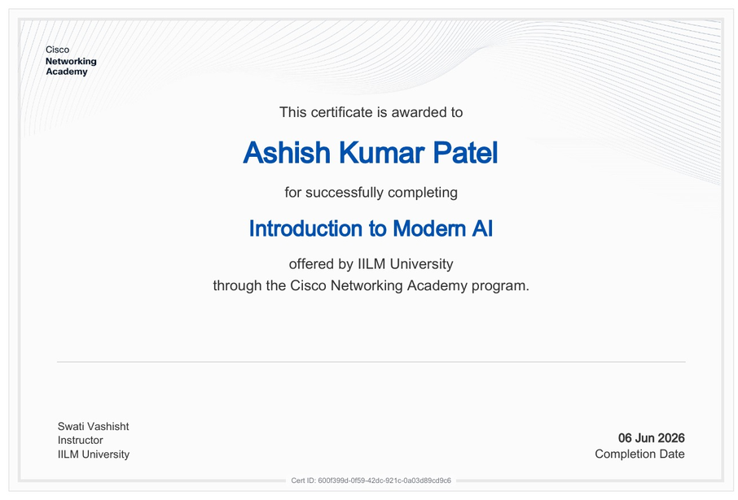
Introduction to Modern AI
Certificate of Completion | Completion Date: 06 Jun 2026
Certificate ID: 600f399d-0f59-42dc-921c-0a03d89cd9c6
Ashish Kumar Patel | AI & Data Analytics Internship
13

Slide 14
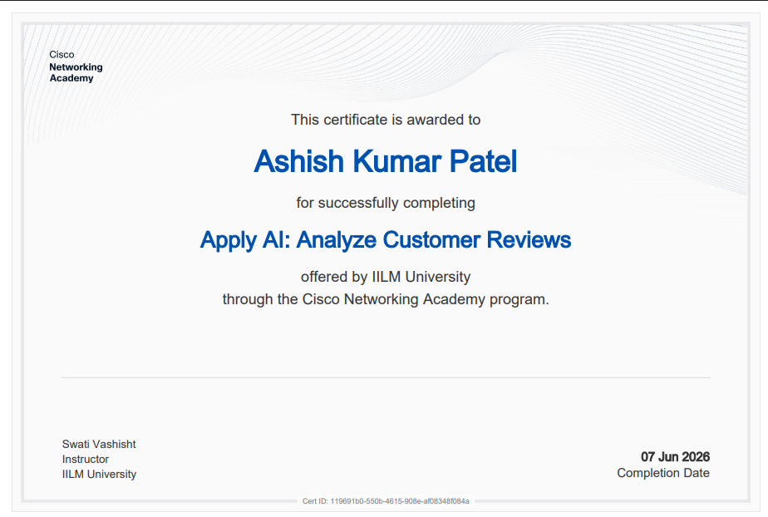
Apply AI: Analyze Customer Reviews
Certificate of Completion | Completion Date: 07 Jun 2026
Certificate ID: 119691b0-550b-4615-908e-af08348f084a
Ashish Kumar Patel | AI & Data Analytics Internship
14

Slide 15
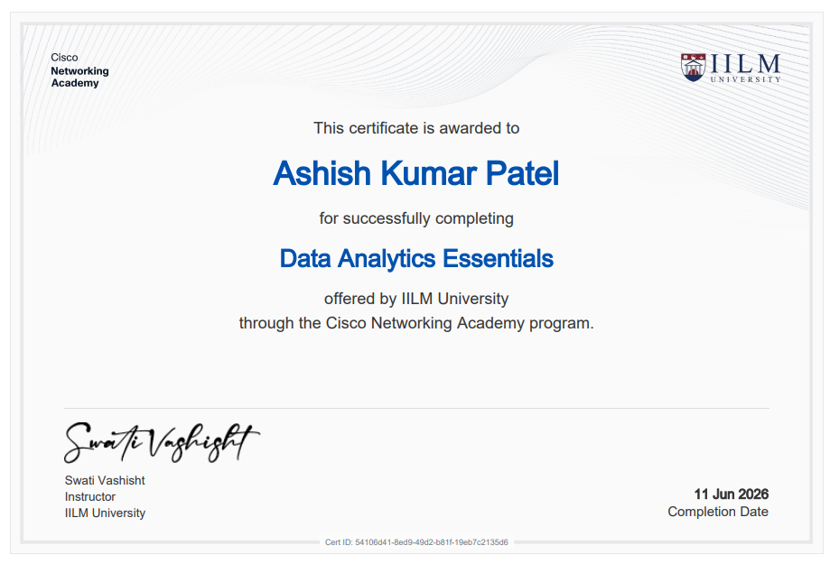
Data Analytics Essentials
Certificate of Completion | Completion Date: 11 Jun 2026
Certificate ID: 541064d1-8ed9-49d2-b81f-19eb7c2135d6
Ashish Kumar Patel | AI & Data Analytics Internship
15

Slide 16
Thank You
Thank you for your time and consideration.
Ashish Kumar Patel | AI & Data Analytics Internship
16

