Slide 1
HARDWARE
DEFINATION:- HARDWARE is physical component of a device that is used to store data and
perform real world activities that can interact with user.
In our project we are using different hardware as our project is based on smart home system so we are using 1. Arduino
2. Datalogger Shield
3. Motion Sensors
4. LDR Sensor
5. Temperature Sensor
6. LED, Jumper wires and Data Cable
In further slides I am going to discuss about each hardware that we are using in our group project.

Slide 2
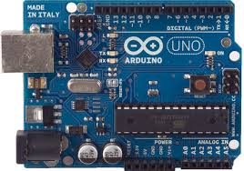
ARDUINO:-
In our project we are using Arduino Uno which is a microcontroller board based on ATmega328P. It has 14 digital input output pins, a 16 MHz quartz crystal, a power jack, an ICSP header and a reset button. It contains everything needed to support the microcontroller as we only have to connect it to the computer through the USB cable or with the battery to get started. As this hardware works in the software named as Arduino IDE 1.0.

Slide 3
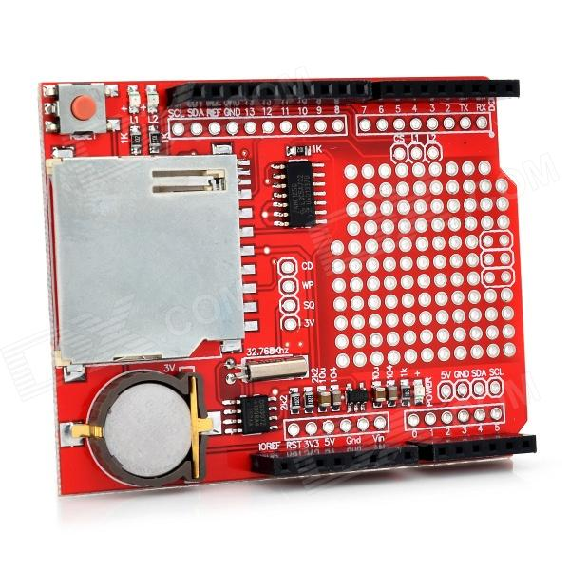
DATALOGGER SHIELD
In our project we are using the red color data logger shield it is as same as that one which we have used in the studio or our pracs but the difference is in their libraries as both of them hold different libraries to store data in the SD card.
As this device is used to store the data from the Arduino in the form of csv files. It has features like RTC(real time clock) which keeps time going even if the Arduino is unplugged as this happens due to a coin cell battery whose battery backup lasts for years. It has 2 configurable indicatorcLEDs.

Slide 4
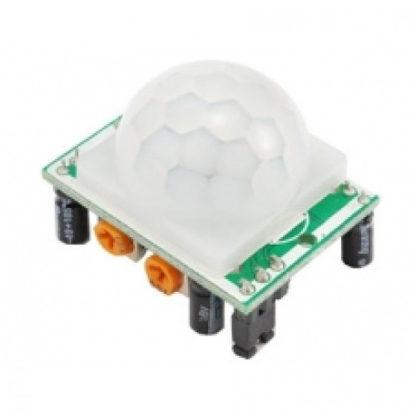
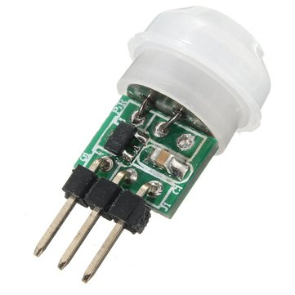
MOTION SENSORS
In our project we are using 2 motion sensor which are used to detect that is any one enter in the house with the count of the number of people.
Basically motion sensor is a device that is used to detect the motion or moving objects. The specified name of sensor that we are using in our group is PIR Motion sensor where PIR is Passive Infrared. As it is an electronic sensor that measures infrared light radiating from objects in its field of view.

Slide 5
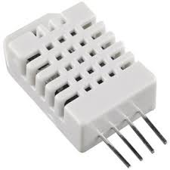
TEMPERATURE SENSOR:-
In our group project we are using DHT-22 temperature humidity sensor as it gives digital output it is basically used as capacitive humidity sensor and a thermistor to measure the surrounding air.
We are using this sensor to measure the temperature of the house inside as if the temperature goes up a particular value it will lead to operate the ACs or coolers.

Slide 6
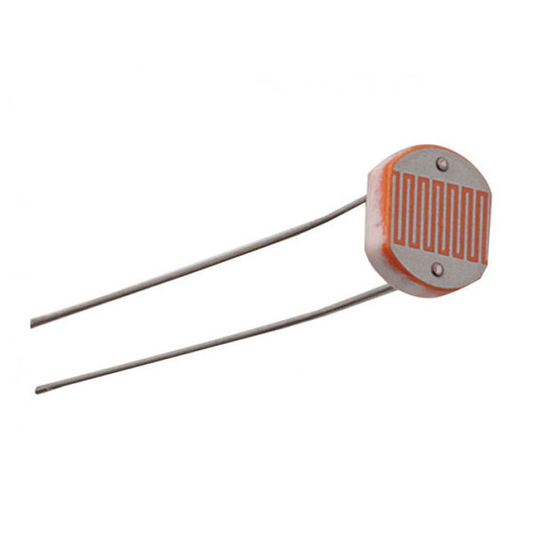
LDR SENSOR:-
In our group we are using a LDR sensor whose work is to turn on the light if the intensity of the light goes down to a desired value.
Basically LDR(Light Dependent Resistor) is a component that has variable resistance that changes with the light intensity that falls upon it. This function allows them to be used in light sensing circuits.

Slide 7
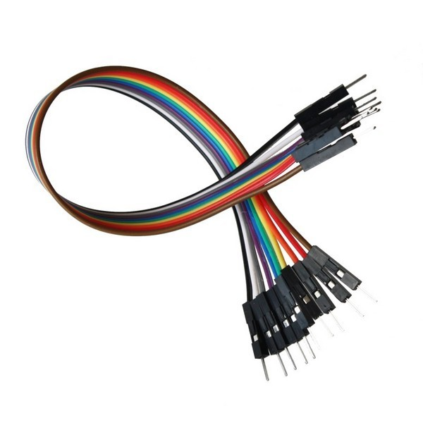
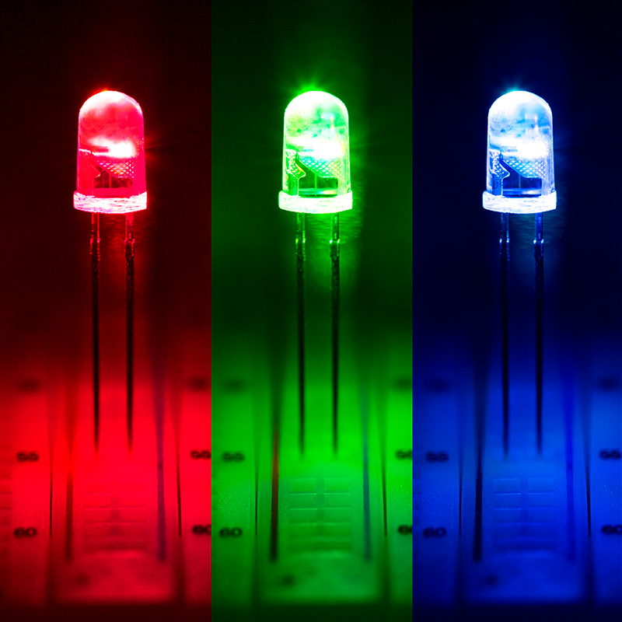
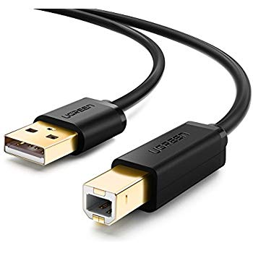
LED, JUMPER WIRES AND DATA CABLE
In the project we are using a LED to turn on the light if the light goes down to a particular intensity as discussed in LDR sensor whereas jumper wires and USB cables are used to make the connections between sensors and Arduino with the laptop

