Slide 1
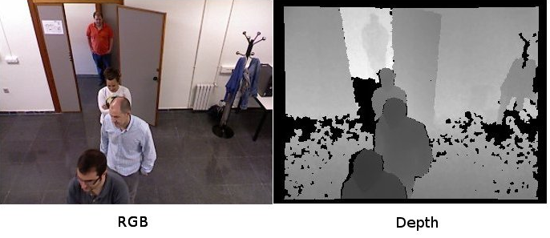
RGB Depth

Slide 2
Analysis of RGB Depth
The Kinect sensor was the first to use the RGB-D values for its analysis. One particularly interesting aspect of the Kinect sensor is that it makes it relatively easy to acquire color and depth images that are registered to a common viewpoint. The RGB image contains a number of cues that can be used to break the scene into regions.
In contrast, while the depth image provides us with a sense of the geometry of the scene it is relatively featureless which can make interpretation more difficult. However if we segment the scene geometry into salient planar regions then it will serve as a useful step towards semantic interpretation of indoor scenes.

Slide 3
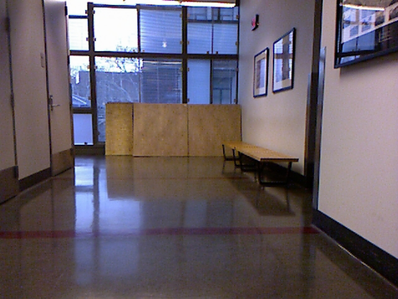
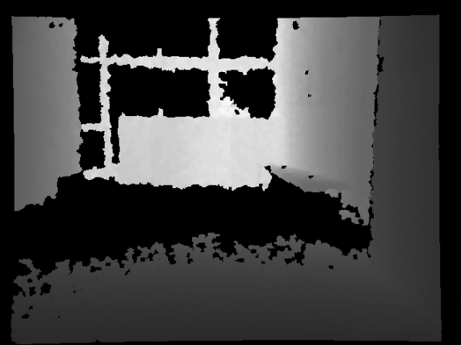
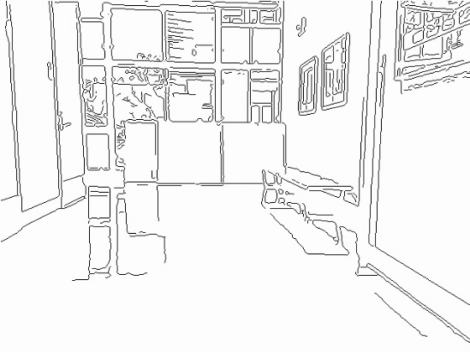
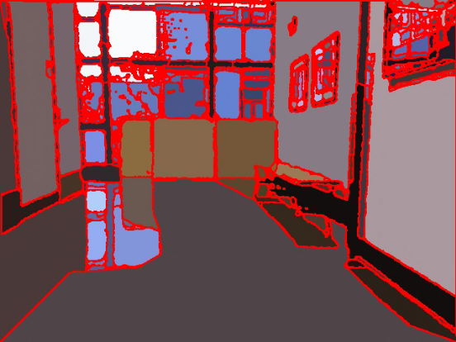
(a)
(b)
(c)
(d)
Fig. 1. a. RGB image b. Depth image c. Extracted Intensity Edges
d. Image segmentation

Slide 4
The first step in our analysis is an edge accurate segmentation scheme that breaks the RGB imagery into coherent, disjoint regions.
After that a depth image is being generated which will be used so as to achieve the segmentation of the image.
This segmentation is then used as a prior to subdivide the associated depth image.
The image segmentation procedure begins with a standard edge extraction step which finds significant discontinuities in the intensity image.
Lastly a Normalization Cut algorithm is being applied so as to obtain a segmented image.

Slide 5
Applications of RGB Depth
People Detection in RGB-D Data: It takes inspiration from the Histogram of Oriented Gradients (HOG) to design a robust method to detect people in dense depth data known as the histogram of oriented depths.
3D Reconstruction from RGB and Depth Video: Uses the approach of reconstruction rigid objects from RGB and depth video sequences.
User Identification and Object Recognition Clutter Scenes Based on RGB-Depth Proposes a system for user identification and object recognition based on multi-modal RGB-Depth data analysis. It model a RGBD environment learning a pixel-based background Gaussian distribution.

Slide 6
Human Behaviour Analysis from Depth Maps: Pose Recovery (PR) and Human Behaviour Analysis (HBA) have been a main focus of interest from the beginnings of Computer Vision and Machine Learning. PR and HBA were originally addressed by the analysis of still images and image sequences.
Human Object Recognition Using Colour and Depth Information: Human object recognition and tracking is important in robotics and automation. The Kinect sensor and its SDK have provided a reliable human tracking solution where a constant line of sight is maintained.
Face Reconstruction using RGB-Depth data: A multiple regression method based on Canonical Correlation Analysis (CCA) to face data modelling.

Slide 7
THANK YOU

