Slide 1

Module 10 – ML Classification
CS 620 / DASC 600
Introduction to Data Science & Analytics
Dr. Sampath Jayarathna
Old Dominion University

Slide 2
Overview
Classification is the process of predicting the class of given data points. Classes are sometimes called as targets/ labels or categories. A classification model attempts to draw some conclusion from observed values. Given one or more inputs a classification model will try to predict the value of one or more outcomes. Outcomes are labels that can be applied to a dataset.
In this module we will learn Classification, which belongs to the category of supervised learning under Machine Learning where the targets also provided with the input data. There are many applications in classification in many domains such as in credit approval, medical diagnosis, target marketing etc.

Slide 3
Objectives
understand the difference between Supervised and Unsupervised training
understand business use cases and scenarios that can benefit from using the Machine Learning
explain K-Nearest Neighbors and Rocchio classification algorithms
describe the formal properties of models and algorithms for learning and explain the practical implications of those results

Slide 4
Relevance
Classification requires data. It involves looking for patterns, and to find patterns, you need data. That’s where the data science comes in. In particular, we’re going to assume that we have access to training data: a bunch of observations, where we know the class of each observation. The collection of these pre-classified observations is also called a training set. A classification algorithm is going to analyze the training set, and then come up with a classifier: an algorithm for predicting the class of future observations.

Slide 5
11.1 Machine Learning

Slide 6
11.1.1 Machine Learning
The ultimate goal of machine learning is the creation and understanding of machine intelligence
Teach a computer to learn concepts using data or interactions with an environment– without being explicitly programmed
Machine learning is a type of artificial intelligence that provides computers with the ability to learn. It focuses on the development of computer programs that can change when exposed to new data

Slide 7
11.1.2 Classification Vs Clustering
In general, in classification you have a set of predefined classes (categories) and want to know which class a new object belongs to.
Clustering tries to group a set of objects (no pre-existing labels) and find whether there is some relationship between the objects.
In the context of machine learning, classification is supervised learning and clustering is unsupervised learning.

Slide 8
11.1.3 Shopping on the Web
Suppose you want to buy a cappuccino maker as a gift
try Google for “cappuccino maker”
What do you expect to see?
Search List….
Anything else?

Slide 9
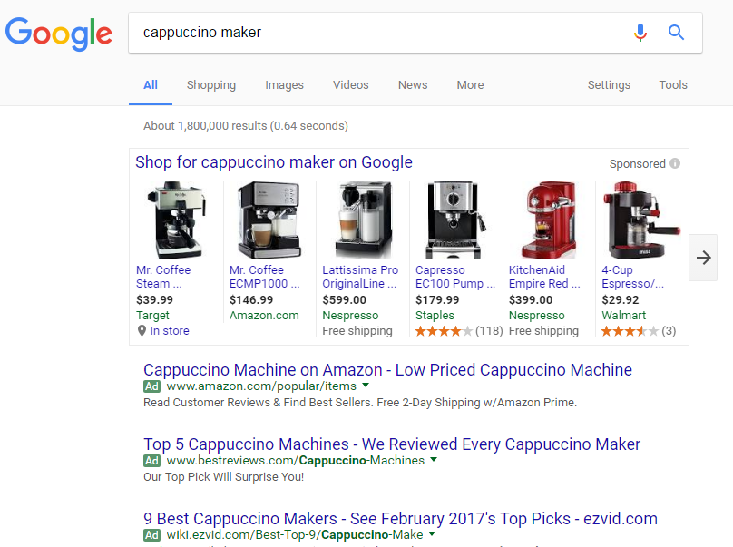

Slide 10
11.1.3 Observations
Broad indexing & speedy search alone are not enough.
Organizational view of data is critical need.
Categorized data are easy for user to browse.
Category taxonomies become most central in well-known web sites.

Slide 11
11.1.4 Text Categorization Applications
Web pages organized into category hierarchies
Journal articles indexed by subject categories (e.g., the Library of Congress, MEDLINE, etc.)
Responses to Census Bureau occupations
Patents archived using International Patent Classification
Patient records coded using international insurance categories
E-mail message filtering
News events tracked and filtered by topics

Slide 12
11.1.5 Cost of Manual Text Categorization
MEDLINE (National Library of Medicine)
$2 million/year for manual indexing of journal articles
using MEdical Subject Headings (18,000 categories)
Mayo Clinic
$1.4 million annually for coding patient-record events
using the International Classification of Diseases (ICD) for billing insurance companies
US Census Bureau decennial census (1990: 22 million responses)
232 industry categories and 504 occupation categories
$15 million if fully done by hand
Notes:
Why not simply categorize by hand? Too time and resource intensive.

Slide 13
11.1.6 What does it take to compete?
Suppose you were starting a web search company, what would it take to compete with established engines?
You need to be able to establish a competing hierarchy fast.
You will need a relatively cheap solution. (Unless you have investors that want to pay millions of dollars just to get off the ground.)

Slide 14
11.1.6 Why not a semi-automatic text categorization tool?
Humans can encode knowledge of what constitutes membership in a category.
This encoding can then be automatically applied by a machine to categorize new examples.
For example...
https://www.planethunters.org
Open Directory Project?
DMOZ was the largest, most comprehensive human-edited directory of the Web until 2017. It was constructed and maintained by a passionate, global community of volunteer editors. It was historically known as the Open Directory Project (ODP).

Slide 15
11.2 Rule-based Classification

Slide 16
11.2.1 Rule-based Approach to TC
Text in a Web Page “Saeco revolutionized espresso brewing a decade ago by introducing Saeco Super Automatic machines, which go from bean to coffee at the touch of a button. The all-new Saeco Vienna Super-Automatic home coffee and cappuccino machine combines top quality with low price!”
Rule (espresso or coffee or cappuccino ) and machine* Coffee Maker

Slide 17
11.2.2 Predicting Topics of News Stories
Given: Collection of example news stories already labeled with a category (topic).
Task: Predict category for news stories not yet labeled.
For our example, we’ll only get to see the headline of the news story.
We’ll represent categories using colors. (All examples with the same color belong to the same category.)

Slide 18
11.2.3 Our Labeled Examples
Amatil Proposes Two-for-Five Bonus Share Issue
Citibank Norway Unit Loses Six Mln Crowns in 1986
Japan Ministry Says Open Farm Trade Would Hit U.S.
Vieille Montagne Says 1986 Conditions Unfavourable
Jardine Matheson Said It Sets Two-for-Five Bonus Issue Replacing “B” Shares
Anheuser-Busch Joins Bid for San Miguel
Italy’s La Fondiaria to Report Higher 1986 Profits
Isuzu Plans No Interim Dividend
Senator Defends U.S. Mandatory Farm Control Bill
Bowater Industries Profit Exceed Expectations

Slide 19
11.2.3 What to predict before seeing the document?
?
Amatil Proposes Two-for-Five Bonus Share Issue
Citibank Norway Unit Loses Six Mln Crowns in 1986
Japan Ministry Says Open Farm Trade Would Hit U.S.
Vieille Montagne Says 1986 Conditions Unfavourable
Jardine Matheson Said It Sets Two-for-Five Bonus Issue Replacing “B” Shares
Anheuser-Busch Joins Bid for San Miguel
Italy’s La Fondiaria to Report Higher 1986 Profits
Isuzu Plans No Interim Dividend
Senator Defends U.S. Mandatory Farm Control Bill
Bowater Industries Profit Exceed Expectations

Slide 20
11.2.3 Predict with Evidence
Senate Panel Studies Loan Rate, Set Aside Plans
Amatil Proposes Two-for-Five Bonus Share Issue
Citibank Norway Unit Loses Six Mln Crowns in 1986
Japan Ministry Says Open Farm Trade Would Hit U.S.
Vieille Montagne Says 1986 Conditions Unfavourable
Jardine Matheson Said It Sets Two-for-Five Bonus Issue Replacing “B” Shares
Anheuser-Busch Joins Bid for San Miguel
Italy’s La Fondiaria to Report Higher 1986 Profits
Isuzu Plans No Interim Dividend
Senator Defends U.S. Mandatory Farm Control Bill
Bowater Industries Profit Exceed Expectations

Slide 21
11.2.3 The Actual Topic
Senate Panel Studies Loan Rate, Set Aside Plans
Amatil Proposes Two-for-Five Bonus Share Issue
Citibank Norway Unit Loses Six Mln Crowns in 1986
Japan Ministry Says Open Farm Trade Would Hit U.S.
Vieille Montagne Says 1986 Conditions Unfavourable
Jardine Matheson Said It Sets Two-for-Five Bonus Issue Replacing “B” Shares
Anheuser-Busch Joins Bid for San Miguel
Italy’s La Fondiaria to Report Higher 1986 Profits
Isuzu Plans No Interim Dividend
Senator Defends U.S. Mandatory Farm Control Bill
Bowater Industries Profit Exceed Expectations

Slide 22
11.2.4 Representing Documents
Usually, an example is represented as a series of feature-value pairs. The features can be arbitrarily abstract (as long as they are easily computable) or very simple.
For example, the features could be the set of all words and the values, their number of occurrences in a particular document.
Japan Firm Plans to Sell U.S. Farmland to Japanese
Farmland:1
Firm:1
Japan:1
Japanese:1
Plans:1
Sell:1
To:2
U.S.:1
Representation

Slide 23
11.3 Classification General Idea

Slide 24
11.3.1 1-Nearest Neighbor
Looking back at our example
Did anyone try to find the most similar labeled item and then just guess the same color?
This is 1-Nearest Neighbor
Senate Panel Studies Loan Rate, Set Aside Plans
Amatil Proposes Two-for-Five Bonus Share Issue
Citibank Norway Unit Loses Six Mln Crowns in 1986
Japan Ministry Says Open Farm Trade Would Hit U.S.
Vieille Montagne Says 1986 Conditions Unfavourable
Jardine Matheson Said It Sets Two-for-Five Bonus Issue Replacing “B” Shares
Anheuser-Busch Joins Bid for San Miguel
Italy’s La Fondiaria to Report Higher 1986 Profits
Isuzu Plans No Interim Dividend
Senator Defends U.S. Mandatory Farm Control Bill
Bowater Industries Profit Exceed Expectations

Slide 25
11.3.2 Example of Classification Learning
Instance language: <size, color, shape>
size ∈ {small, medium, large}
color ∈ {red, blue, green}
shape ∈ {square, circle, triangle}
Category C = {positive, negative}
D:
Hypotheses?
Small, red, circle → positive?
Large, blue, circle → negative?
Example | Size | Color | Shape | Category
1 | small | red | circle | positive
2 | large | red | circle | positive
3 | small | red | triangle | negative
4 | large | blue | circle | negative

Slide 26
11.3.3 General Learning Issues
Many hypotheses are usually consistent with the training data.
Classification accuracy (% of instances classified correctly).
Measured on independent test data.
Training time (efficiency of training algorithm).
Testing time (efficiency of subsequent classification).

Slide 27
11.3.4 Generalization
Hypotheses must generalize to correctly classify instances not in the training data.
Simply memorizing training examples is a consistent hypothesis that does not generalize.

Slide 28
11.3.5 Learning for Text Categorization
Manual development of text categorization functions is difficult.
Learning Algorithms:
Neural network
Relevance Feedback (Rocchio)
Rule based (Ripper)
Nearest Neighbor (case based)
Support Vector Machines (SVM)
Bayesian (naïve)

Slide 29
11.4 Rocchio

Slide 30
11.4.1 Using Relevance Feedback (Rocchio)
Relevance feedback methods can be adapted for text categorization.
Use standard TF/IDF weighted vectors to represent text documents (normalized by maximum term frequency).
For each category, compute a prototype vector by summing the vectors of the training documents in the category.
Assign test documents to the category with the closest prototype vector based on cosine similarity.

Slide 31
11.4.2 Illustration of Rocchio Text Categorization
Unknown (test) sample category.
Category: Red or Green?

Slide 32
11.4.3 Rocchio Properties
Does not guarantee a consistent hypothesis.
Forms a simple generalization of the examples in each class (a prototype).
Prototype vector does not need to be averaged or otherwise normalized for length since cosine similarity is insensitive to vector length.
Classification is based on similarity to class prototypes.

Slide 33
Nearest Neighbor Classification
Also known as, Instance-Based, Lazy Learning, Memory-based, Case-based learning
well-known approach to pattern recognition
initially by Fix and Hodges (1951)
applied to text categorization in early 90’s
strong baseline in benchmark evaluations
among top-performing methods in TC evaluations
scalable to large TC applications

Slide 34
11.5 KNN

Slide 35
11.5.1 Nearest-Neighbor Learning Algorithm
Learning is just storing the representations of the training examples in D.
Testing instance x:
Compute similarity between x and all examples in D.
Assign x the category of the most similar example in D.
Does not explicitly compute a generalization or category prototypes.

Slide 36
11.5.2 Key Components of Nearest Neighbor
“Similar” item: We need a functional definition of “similarity” if we want to apply this automatically.
How many neighbors do we consider?
Does each neighbor get the same weight?
All categories in neighborhood? Most frequent only? How do we make the final decision?

Slide 37
11.5.3 K Nearest-Neighbor
Using only the closest example to determine categorization is subject to errors due to:
A single atypical example.
Noise (i.e. error) in the category label of a single training example.
More robust alternative is to find the k most-similar examples and return the majority category of these k examples.
Value of k is typically odd to avoid ties, 3 and 5 are most common.

Slide 38
11.5.4 Similarity Metrics
Nearest neighbor method depends on a similarity (or distance) metric.
Simplest for continuous m-dimensional instance space is Euclidian distance.
For text, cosine similarity of TF-IDF weighted vectors is typically most effective.

Slide 39
11.5.5 Three Nearest Neighbor Illustration (Euclidian Distance)
.
.
Unknown (test) sample category.
Category: Red or Green?
.
.
.
.
.
.
.
.
.

Slide 40
11.5.5 Illustration of 3 Nearest Neighbor for Text

Slide 41
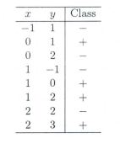
Activity 22
Suppose, you have given the following data where x and y are the 2 input variables and Class is the dependent variable.
Suppose, you want to predict the class of new data point x=1 and y=1 using Euclidian distance in 3-NN. In which class this data point belong to?
You are now wants use 7-NN instead of 3-KNN which of the following x=1 and y=1 will belong to?
Submit your solution to piazza Activity 24 thread.

Slide 42
11.6 Classification Considerations

Slide 43
11.6.1 Rocchio Anomaly
Prototype models have problems with polymorphic (disjunctive) categories.
In this example, the category of the new document will be red based on cosine similarity between document and prototypes (big red arrow and big green arrow)

Slide 44
3 Nearest Neighbor Comparison
Nearest Neighbor tends to handle polymorphic categories better.
This will assign black to the document category because 2 closest neighbors among 3 Nearest Neighbors are in black category.

Slide 45
11.6.2 Picking the Right Value of K
A low value of k leads to a very sensitive model. Small values for K can be noisy and subject to the effects of outliers
As K approaches n (number of instances in your training dataset), your classifier might be less sensitive, but finding k closest points will become computationally expensive
Option 1
Cross validation
Take the small portion from the training dataset and call it a validation dataset, and then use the same to evaluate different possible values of K. This way we are going to predict the label for every instance in the validation set using with K equals to 1, K equals to 2, K equals to 3.. and then we look at what value of K gives us the best performance on the validation set and then we can take that value and use that as the final setting of our algorithm so we are minimizing the validation error .
Option 2
In general, practice, choosing the value of k is k = sqrt(N) where N stands for the number of samples in your training dataset.

Slide 46
11.6.3 Evaluating Categorization
Evaluation must be done on test data that are independent of the training data (usually a disjoint set of instances).
Classification accuracy: c/n where n is the total number of test instances and c is the number of test instances correctly classified by the system.
Results can vary based on sampling error due to different training and test sets.
Average results over multiple training and test sets (splits of the overall data) for the best results.

Slide 47
Activity 25
Let's try calculating classifier accuracy for the following model that classified 100 tumors as malignant (the positive class) or benign (the negative class).
Of the 100 tumor examples, ML model correctly predicted 1 sample as malignant and 90 samples as benign.
It incorrectly predicted 8 samples as benign (in reality they were malignant) and 1 sample as malignant (in reality it was benign).
Calculate the classifier accuracy of this ML model.
Submit your solution to piazza Activity 25 thread.

Slide 48
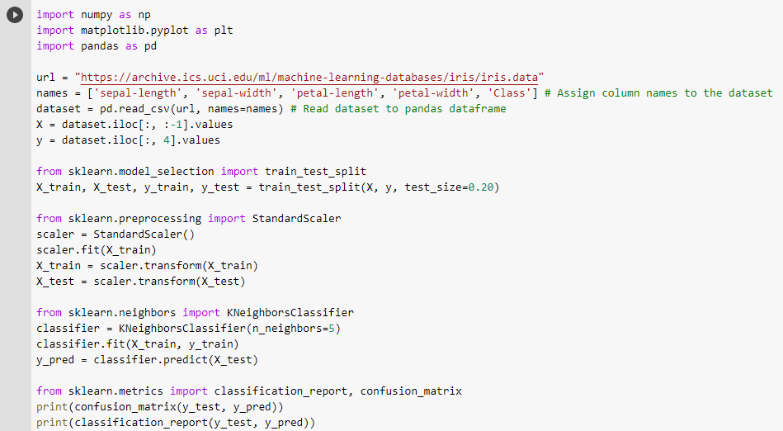
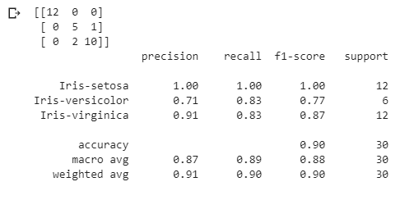
11.6.4 Nearest Neighbor Python Example
Notes:
A macro-average will compute the metric independently for each class and then take the average (hence treating all classes equally), whereas a micro-average will aggregate the contributions of all classes to compute the average metric. In a multi-class classification setup, micro-average is preferable if you suspect there might be class imbalance (i.e you may have many more examples of one class than of other classes).
Supprot: the number of occurrences of each particular class in the true responses

Slide 49
Summary
Many machine learning problems are directed toward a specialized goal that is sometimes represented by the value of a particular feature in the data. This particular feature is referred to as the class label. Therefore, such problems are supervised, wherein the relationships of the remaining features in the data with respect to this special feature are learned. The data used to learn these relationships is referred to as the training data. The learned model may then be used to determine the estimated class labels for records, where the label is missing referred to as testing the model. This module introduces two ML classification algorithms, Rocchio and KNN and techniques to picking ideal K value.

