Slide 1

Module 9 – Pattern Mining
CS 620 / DASC 600
Introduction to Data Science & Analytics
Dr. Sampath Jayarathna

Slide 2
Overview
Pattern Mining, as the name suggests, is finding patterns as association rules as simple as If/Then statements that help discover relationships between seemingly independent relational databases or other data repositories.
Most machine learning algorithms work with numeric datasets and hence tend to be mathematical. However, association rule mining is suitable for non-numeric, categorical data and requires just a little bit more than simple counting.
In this module, we will learn Association rule mining which aims to observe frequently occurring patterns, correlations, or associations from datasets found in various kinds of databases such as relational databases, transactional databases, and other forms of repositories.

Slide 3
Objectives
describe the theoretical constructs and core processes of data mining
recall important pattern discovery concepts, methods, and applications, in particular, the basic concepts of pattern discovery, such as frequent pattern, support, confidence and association rules.
explain what market basket data are
identify efficient pattern mining methods, such as Apriori

Slide 4
Relevance
Association rule mining is primarily focused on finding frequent co-occurring associations among a collection of items. It is sometimes referred to as “Market Basket Analysis”, since that was the original application area of association mining. The goal is to find associations of items that occur together more often than you would expect from a random sampling of all possibilities.
With the massive quantities of big data that are now available, and with powerful technologies to perform analytics on those data, as a data scientist, one can only imagine what surprising and useful associations are waiting to be discovered that can boost your bottom line.

Slide 5
10.1 Patterns

Slide 6
10.1.1 What Is Pattern Discovery?
What are patterns?
Patterns: A set of items, subsequences, or substructures that occur frequently together (or strongly correlated) in a data set
Patterns represent intrinsic and important properties of datasets
Pattern discovery: Uncovering patterns from massive data sets
Motivation examples:
What products were often purchased together?
What are the subsequent purchases after buying an iPad?
What code segments likely contain copy-and-paste bugs?
What word sequences likely form phrases in this corpus?

Slide 7
10.1.2 Pattern Discovery: Why Is It Important?
Finding inherent regularities in a data set
Foundation for many essential data mining tasks
Association, correlation, and causality analysis
Mining sequential, structural (e.g., sub-graph) patterns
Pattern analysis in spatiotemporal, multimedia, time-series, and stream data
Classification: Discriminative pattern-based analysis
Cluster analysis: Pattern-based subspace clustering
Broad applications
Market basket analysis, sale campaign analysis, Web log analysis, biological sequence analysis

Slide 8
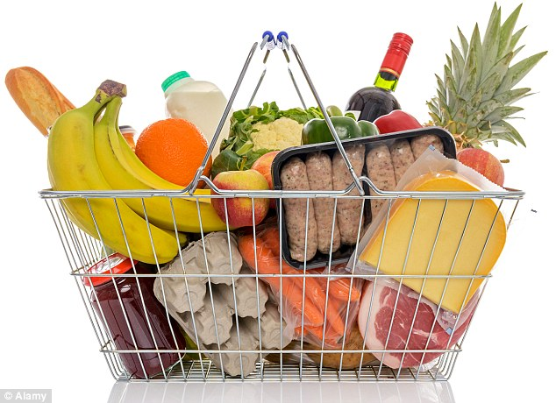
10.1.3 `Basket data’
A very common type of data; often also called transaction data.
Next slide shows example transaction database, where each record represents a transaction between (usually) a customer and a shop. Each record in a supermarket’s transaction DB, for example, corresponds to a basket of specific items.

Slide 9
ID apples, beer, cheese, dates, eggs, fish, glue, honey, ice-cream
1 | 1 | 1 |  | 1 |  |  | 1 | 1
2 |  |  | 1 | 1 | 1
3 |  | 1 | 1 |  |  | 1
4 |  | 1 |  |  |  | 1 |  |  | 1
5 |  |  |  |  | 1 |  | 1
6 |  |  |  |  |  | 1 |  |  | 1
7 | 1 |  |  | 1 |  |  |  | 1
8 |  |  |  |  |  | 1 |  |  | 1
9 |  |  | 1 |  | 1
10 |  | 1 |  |  |  |  | 1
11 |  |  |  |  | 1 |  | 1
12 | 1
13 |  |  | 1 |  |  | 1
14 |  |  | 1 |  |  | 1
15 |  |  |  |  |  |  |  | 1 | 1
16 |  |  |  | 1
17 | 1 |  |  |  |  | 1
18 | 1 | 1 | 1 | 1 |  |  |  | 1
19 | 1 | 1 |  | 1 |  |  | 1 | 1
20 |  |  |  |  | 1

Slide 10
10.1.4 Numbers
Our example transaction DB has 20 records of supermarket transactions, from a supermarket that only sells 9 things
One month in a large supermarket with five stores spread around a reasonably sized city might easily yield a DB of 20,000,000 baskets, each containing a set of products from a pool of around 1,000

Slide 11
10.1.5 Interesting/Useful rules
Statistically, anything that is interesting is something that happens significantly more than you would expect by chance.
E.g. basic statistical analysis of basket data may show that 10% of baskets contain bread, and 4% of baskets contain washing-up powder.
i.e: if you choose a basket at random:
There is a probability 0.1 that it contains bread.
There is a probability 0.04 that it contains washing-up powder.

Slide 12
What is the probability of a basket containing both bread and washing-up powder? The laws of probability say:
If these two things are independent, chance is 0.1 * 0.04 = 0.004
That is, we would expect 0.4% of baskets to contain both bread and washing up powder

Slide 13
10.1.7 Interesting means surprising
We therefore have a prior expectation that just 4 in 1,000 baskets should contain both bread and washing up powder.
If we investigate, and discover that really it is 20 in 1,000 baskets, then we will be very surprised. It tells us that:
Something is going on in shoppers’ minds: bread and washing-up powder are connected in some way.
There may be ways to exploit this discovery … put the powder and bread at opposite ends of the supermarket?

Slide 14
10.2 Association Rules

Slide 15
10.2.1 Association Rule Mining
Given a set of transactions, find rules that will predict the occurrence of an item based on the occurrences of other items in the transaction
Market-Basket transactions
Example of Association Rules
{Diaper} → {Beer}, {Milk, Bread} → {Eggs,Coke}, {Beer, Bread} → {Milk},

Slide 16
10.2.2 Definition: Frequent Itemset
Itemset
A collection of one or more items
Example: {Milk, Bread, Diaper}
k-itemset
An itemset that contains k items
Support count (σ)
Frequency of occurrence of an itemset
E.g. σ({Milk, Beer,Diaper}) = 2
Support
Fraction of transactions that contain an itemset
E.g. s({Milk, Beer, Diaper}) = 2/5
Frequent Itemset
An itemset whose support is greater than or equal to a minsup threshold

Slide 17
10.2.3 Definition: Association Rule
Association Rule
An implication expression of the form X → Y, where X and Y are itemsets
Example: {Milk, Diaper} → {Beer}
Rule Evaluation Metrics
Support (s)
Fraction of transactions that contain both X and Y
Confidence (c)
Measures how often items in Y appear in transactions that contain X
Example:

Slide 18
Activity 20
Calculate the support (s) and confidence (c) for following Itemsets and report similar to below example
{Milk,Diaper} → {Beer} (s=0.4, c=0.67)
{Milk} → {Diaper,Coke} (s=?, c=0?)
{Milk,Beer} → {Bread} (s=?, c=0?)
{Diaper,Beer} → {Bread} (s=?, c=0?)
{Diaper} → {Milk,Beer} (s=?, c=0?)
Submit your solution to piazza Activity 20 thread.

Slide 19
10.2.4 Association Rule Mining Task
Given a set of transactions T, the goal of association rule mining is to find all rules having
support ≥ minsup threshold
confidence ≥ minconf threshold
Brute-force approach:
List all possible association rules
Compute the support and confidence for each rule
Prune rules that fail the minsup and minconf thresholds
⇒ Computationally prohibitive!

Slide 20
10.2.5 Mining Association Rules
Example of Rules:
{Milk,Diaper} → {Beer} (s=0.4, c=0.67) {Milk,Beer} → {Diaper} (s=0.4, c=1.0)
{Diaper,Beer} → {Milk} (s=0.4, c=0.67)
{Beer} → {Milk,Diaper} (s=0.4, c=0.67) {Diaper} → {Milk,Beer} (s=0.4, c=0.5)
{Milk} → {Diaper,Beer} (s=0.4, c=0.5)
Observations:
All the above rules are binary partitions of the same itemset: {Milk, Diaper, Beer}
Rules originating from the same itemset have identical support but can have different confidence
Thus, we may decouple the support and confidence requirements

Slide 21
10.3 Mining Rules

Slide 22
10.3.1 Mining Association Rules
Two-step approach:
Frequent Itemset Generation
Generate all itemsets whose support ≥ minsup
Rule Generation
Generate high confidence rules from each frequent itemset, where each rule is a binary partitioning of a frequent itemset
Frequent itemset generation is still computationally expensive

Slide 23
10.3.2 Frequent Itemset Generation
Given d items, there are 2^{d} possible candidate itemsets

Slide 24
10.3.3 Frequent Itemset Generation
Brute-force approach:
Each itemset in the lattice is a candidate frequent itemset
Count the support of each candidate by scanning the database
Match each transaction against every candidate
Expensive since M = 2^{d} !!!

Slide 25
10.3.4 Algorithms to find frequent pattern
Apriori: uses a generate-and-test approach – generates candidate itemsets and tests if they are frequent
Generation of candidate itemsets is expensive (in both space and time)
Support counting is expensive
Subset checking (computationally expensive)
Multiple Database scans (I/O)
FP-Growth: allows frequent itemset discovery without candidate generation. Two step:
1.Build a compact data structure called the FP-tree
2 passes over the database
2.extracts frequent itemsets directly from the FP-tree
Traverse through FP-tree
Notes:
FP: Frequent Pattern

Slide 26
10.4 Apriori Algorithm

Slide 27
10.4.1 The Apriori Algorithm
There is nothing very special or clever about Apriori; but it is simple, fast, and very good at finding interesting rules of a specific kind in baskets or other transaction data, using operations that are efficient in standard database systems.
It is used a lot in the R&D Depts of retailers in industry (or by consultancies who do work for them).
But note that we will now talk about itemsets instead of rules.
Don’t get confused!

Slide 28
10.4.2 Apriori Principle
If an itemset is frequent, then all of its subsets must also be frequent
If an itemset is infrequent, then all of its supersets must be infrequent too
frequent
frequent
infrequent
infrequent

Slide 29
10.4.3 Illustrating Apriori Principle
Found to be Infrequent
Pruned supersets

Slide 30
10.4.4 Apriori Algorithm
Method:
Let k=1
Generate frequent itemsets of length 1
Repeat until no new frequent itemsets are identified
Generate length (k+1) candidate itemsets from length k frequent itemsets
Prune candidate itemsets containing subsets of length k that are infrequent
Count the support of each candidate by scanning the Database
Eliminate candidates that are infrequent, leaving only those that are frequent

Slide 31
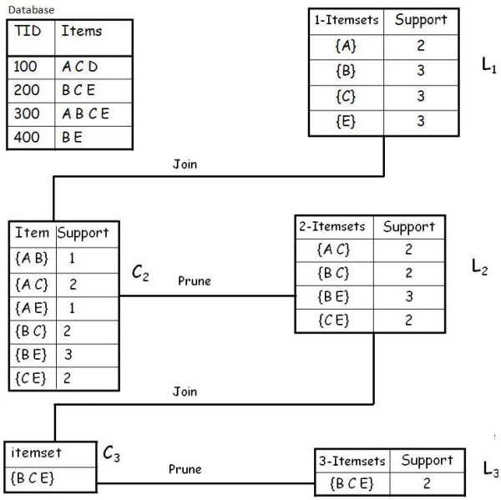
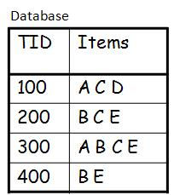
10.4.5 Step 1: Find frequent Itemsets
Example
A database has 4 transactions. Let the min sup freq = 2 and min conf = 80%.
Solution
Step 1: Find all Frequent Itemsets
Frequent Itemset:
{A} {B} {C} {E} {A C} {B C} {B E} {C E} {B C E}
Notes:
C1 – 1 frequent itemset
C2 – 2 frequent itemset (ignore 3 itemsets when creating candidates)
C3 – 3 frequent itemset (ignore 4 itemset when creating candidates)
L represents the candidates with minimum support count satisfied from database

Slide 32
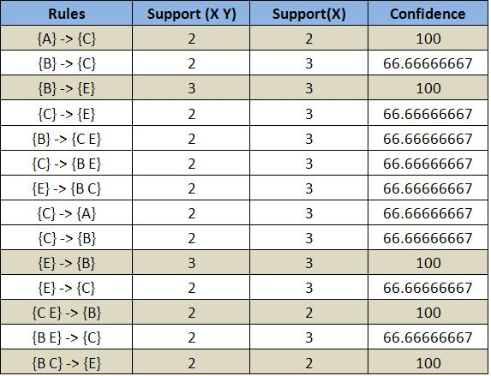
Step 2: Generate Strong Association Rules
Step 2: Generate strong association rules from the frequent itemsets
Frequent Itemset:
{A} {B} {C} {E} {A C} {B C} {B E} {C E} {B C E}
Example
A database has five transactions. Let the min sup = 2 and min conf = 80%.

Slide 33
10.4.6 Apriori : Python implementation
dataset = [['Milk', 'Onion', 'Nutmeg', 'Kidney Beans', 'Eggs', 'Yogurt'],
['Dill', 'Onion', 'Nutmeg', 'Kidney Beans', 'Eggs', 'Yogurt'],
['Milk', 'Apple', 'Kidney Beans', 'Eggs'],
['Milk', 'Unicorn', 'Corn', 'Kidney Beans', 'Yogurt'],
['Corn', 'Onion', 'Onion', 'Kidney Beans', 'Ice cream', 'Eggs']]
import pandas as pd
from mlxtend.preprocessing import TransactionEncoder
te = TransactionEncoder()
te_ary = te.fit(dataset).transform(dataset)
df = pd.DataFrame(te_ary, columns=te.columns_)
print(df)
from mlxtend.frequent_patterns import apriori
frequent_itemsets = apriori(df, min_support=0.6, use_colnames=True)
from mlxtend.frequent_patterns import association_rules
association_rules(frequent_itemsets, metric="confidence", min_threshold=0.5)

Slide 34
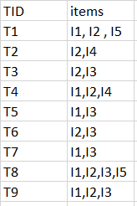
Activity 21
For the following market basket, generate frequent itemset for min sup count =2
Submit your solution to piazza Activity 21 thread.

Slide 35
Summary
The problem of association rule mining is used to identify relationships between different attributes. Association rules are typically generated using a two-phase framework. In the first phase, all the patterns that satisfy the minimum support requirement are determined. In the second phase, rules that satisfy the minimum confidence requirement are generated from the patterns.
Market Basket Analysis is one of the key techniques used by large retailers to uncover associations between items. It works by looking for combinations of items that occur together frequently in transactions. This module introduces the Apriori algorithm which is one of the earliest and most well known methods for frequent pattern mining.

