Slide 1
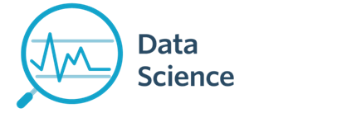
Module 12 – ML Clustering
CS 620 / DASC 600
Introduction to Data Science & Analytics
Dr. Sampath Jayarathna
Old Dominion University

Slide 2
Overview
The algorithms we have described in the previous module (classification) are examples of a general approach referred to as supervised machine learning or classification. The name comes from the fact that we use the outcomes in a training set to supervise the creation of our prediction algorithm.
In this module, we will learn another subset of machine learning referred to as unsupervised. In this subset we do not necessarily know the outcomes and instead are interested in discovering groups. These algorithms are also referred to as clustering algorithms since predictors are used to define clusters.

Slide 3
Objectives
Describe a case where clustering is appropriate, and what insight it might extract from the data.
Explain the K-means clustering algorithm.
Use the elbow method to choose the number of clusters for K-means.
Interpret evaluations of cluster analysis.
Describe the state of the art LDA clustering algorithm.

Slide 4
Relevance
The purpose of clustering algorithms is to make sense of and extract value from large sets of structured and unstructured data. As a data scientist, if you’re working with huge volumes of unstructured data, it only makes sense to try to partition the data into some sort of logical groupings before attempting to analyze it.
Clustering allows you to take a sweeping glance of your data en-masse, and then form some logical structures based on what you find there before going deeper into the nuts-and-bolts analysis. When you use clustering algorithms, you have no predefined concept for how many clusters are appropriate for your data, and you rely upon the clustering algorithms to sort and cluster the data in the most appropriate way. With clustering techniques, you’re learning from unlabeled data.

Slide 5
12.1 Clustering Overview

Slide 6
12.1.1 Clustering: Definition
(Document) clustering is the process of grouping a set of documents into clusters of similar documents.
Documents within a cluster should be similar.
Documents from different clusters should be dissimilar.
Clustering is the most common form of unsupervised learning.
Unsupervised = there are no labeled or annotated data.
6

Slide 7
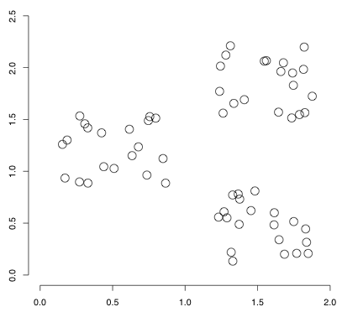
12.1.2 Data set with clear cluster structure
How would you design an algorithm for finding these three clusters?
7

Slide 8
12.1.3 Classification vs. Clustering
Classification: supervised learning
Clustering: unsupervised learning
Classification: Classes are human-defined and part of the input to the learning algorithm.
Clustering: Clusters are inferred from the data without human input.
However, there are many ways of influencing the outcome of clustering: number of clusters, similarity measure, representation of documents, . .
8

Slide 9
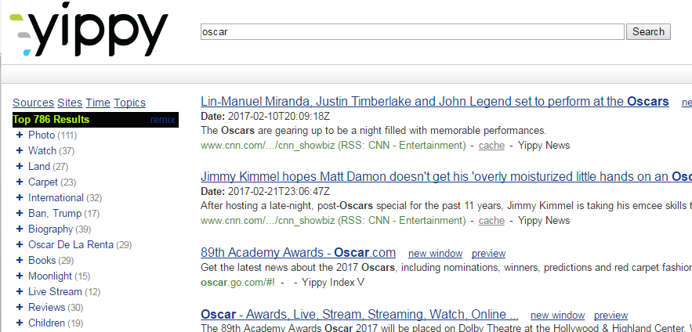
12.1.4 Clustering in Web Search
Result set clustering for better navigation
Yippy (formally Clusty): For grouping search results thematically
9

Slide 10
For improving search recall
Sec. 16.1
Cluster hypothesis - Documents in the same cluster behave similarly with respect to relevance to information needs
Therefore, to improve search recall:
When a query matches a doc D, also return other docs in the cluster containing D
Hope if we do this: The query “car” will also return docs containing automobile
Because clustering grouped together docs containing car with those containing automobile.

Slide 11
12.1.5 Issues for Clustering
Sec. 16.1
Representation for clustering
Document representation
Vector space? Normalization?
Need a notion of similarity/distance
How many clusters?
Completely data driven?
Avoid “trivial” clusters - too large or small
In an application, if a cluster's too large, then for navigation purposes you've wasted an extra user click without whittling down the set of documents much.

Slide 12
12.1.6 Flat vs. Hierarchical clustering
Flat algorithms
Usually start with a random (partial) partitioning of docs into groups
Refine iteratively
Main algorithm: K-means clustering
Hierarchical algorithms
Create a hierarchy
Bottom-up, agglomerative
Top-down, divisive
12

Slide 13
12.1.7 Hard vs. Soft clustering
Hard clustering: Each document belongs to exactly one cluster.
More common and easier to do
Soft clustering: A document can belong to more than one cluster.
Makes more sense for applications like creating browsable hierarchies
You may want to put sneakers in two clusters:
sports apparel
shoes
13

Slide 14
12.2 K-means Clustering

Slide 15
12.2.1 Flat algorithms
Flat algorithms compute a partition of N documents into a set of K clusters.
Given: a set of documents and the number K
Find: a partition into K clusters that optimizes the chosen partitioning criterion
Global optimization: exhaustively enumerate partitions, pick optimal one
Effective heuristic method: K-means algorithm
15

Slide 16
12.2.2 K-means (Hard, flat clustering)
Perhaps the best known clustering algorithm
Simple, works well in many cases
Use as default / baseline for clustering documents
Vector space model
As in vector space classification, we measure relatedness between vectors by Euclidean distance . . .
. . .which is almost equivalent to cosine similarity.
16

Slide 17

K-means
Each cluster in K-means is defined by a centroid.
Objective/partitioning criterion: minimize the average squared difference from the centroid
Definition of centroid:
where we use ω to denote a cluster.
We try to find the minimum average squared difference by iterating two steps:
reassignment: assign each vector to its closest centroid
recomputation: recompute each centroid as the average of the vectors that were assigned to it in reassignment
17
Notes:
Google numerical example: https://people.revoledu.com/kardi/tutorial/kMean/NumericalExample.htm

Slide 18
12.2.3 Example of k-means
Start with random cluster centers C1 than to C2
x2
x1
x4
x3
C1
C2
x5
x6
x7

Slide 19
Example of k-means
Identify the points that are closer to C1 than to C2
x2
x1
x4
x3
C1
C2
x5
x6
x7

Slide 20
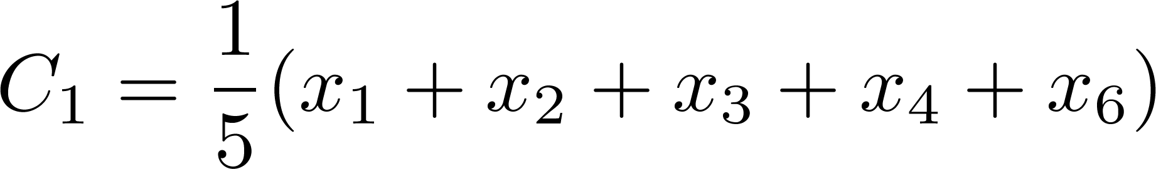
Example of k-means
Update C1
x2
x1
x4
x3
C1
C2
x5
x6
x7

Slide 21
Example of k-means
Identify the points that are closer to C2 than to C1
x2
x1
x4
x3
C1
C2
x5
x6
x7

Slide 22
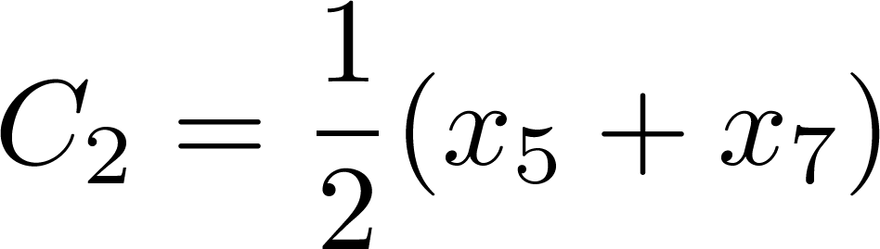
Example of k-means
Identify the points that are closer to C2 than to C1
x2
x1
x4
x3
C1
x5
x6
C2
x7

Slide 23
Example of k-means
Identify the points that are closer to C2 than C1, and points that are closer to C1 than to C2
x2
x1
x4
x3
C1
x5
x6
C2
x7

Slide 24
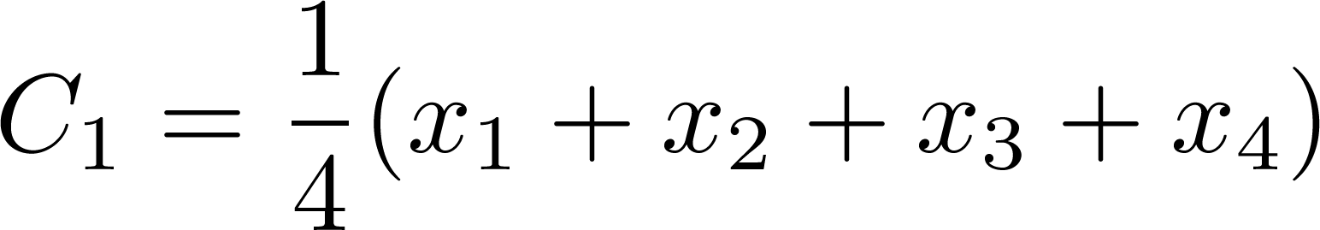
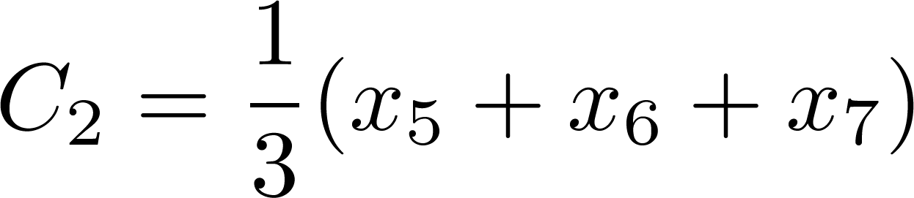
Example of k-means
Identify the points that are closer to C2 than C1, and points that are closer to C1 than to C2
Update C1 and C2
x2
x1
C1
x4
x3
x5
x6
C2
x7

Slide 25
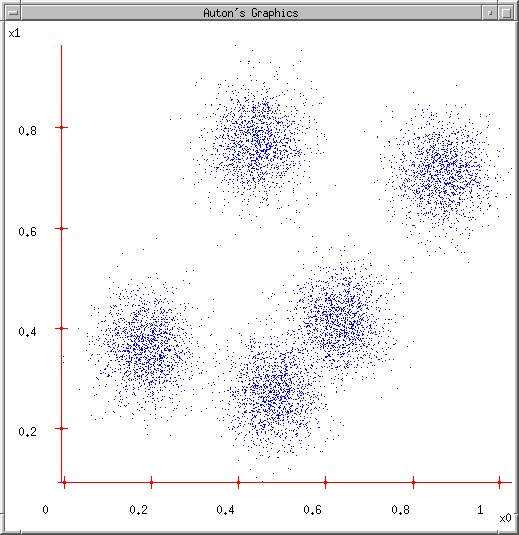
12.2.4 K-means for Clustering
K-means
Start with a random guess of cluster centers
Determine the membership of each data points
Adjust the cluster centers

Slide 26
12.2.5 Optimality of K-means
K-means is guaranteed to converge
But we don’t know how long convergence will take!
If we don’t care about a few docs switching back and forth, then convergence is usually fast (< 10-20 iterations).
However, complete convergence can take many more iterations.
Convergence does not mean that we converge to the optimal clustering!
This is the great weakness of K-means.
If we start with a bad set of seeds, the resulting clustering can be horrible.
26

Slide 27
12.2.6 Initialization of K-means
Random seed selection is just one of many ways K-means can be initialized.
Random seed selection is not very robust: It’s easy to get a suboptimal clustering.
Better ways of computing initial centroids:
Select seeds not randomly, but using some heuristic (e.g., document similar to any existing mean)
Try out multiple starting points
Initialize with the results of another method (Use hierarchical clustering to find good seeds)
27

Slide 28
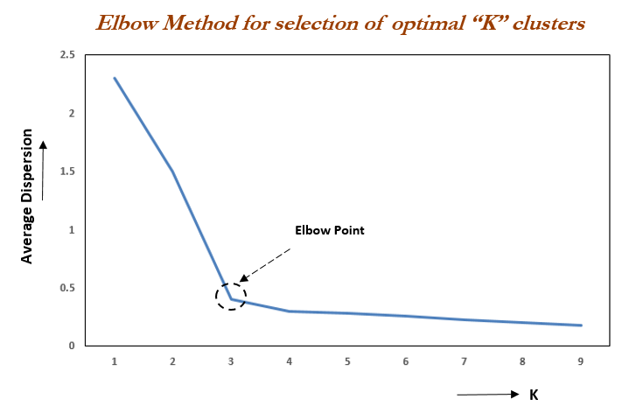
12.2.7 How many clusters?
Number of clusters K is given in many applications.
What if there is no external constraint? Is there a “right” number of clusters?
One way to go: define an optimization criterion.
Elbow method (plotting SSE vs K)
Given docs, find K for which the optimum is reached.
28
Notes:
SSE: sum of the squared differences between each observation and its group's mean/centroid.
https://www.dummies.com/education/math/business-statistics/find-the-error-sum-of-squares-when-constructing-the-test-statistic-for-anova/

Slide 29
Activity 24
We have the following points A(2,2), B(3,2), C(1,1), D(3,1) and E(1.5,1.5).
Using K-means clustering algorithm, find the cluster assignments and new cluster centers after iteration-1.
Use Euclidian distance to calculate the distance between each point and centroid.
Assume 2 clusters with initial cluster centers A(2,2) and C(1,1)
Follow the numerical example https://people.revoledu.com/kardi/tutorial/kMean/NumericalExample.htm
Submit your solution (not a coding problem, solve it by hand) to piazza activity 24.

Slide 30
12.3 Cluster Evaluation

Slide 31
12.3.1 What Is A Good Clustering?
Sec. 16.3
Internal criterion: A good clustering will produce high quality clusters in which:
the intra-class (that is, intra-cluster) similarity is high
the inter-class similarity is low
The measured quality of a clustering depends on both the document representation and the similarity measure used

Slide 32
12.3.2 External criteria for clustering quality
Sec. 16.3
Quality measured by its ability to discover some or all of the hidden patterns or latent classes in gold standard data
Assesses a clustering with respect to ground truth … requires labeled data
Assume documents with C gold standard classes, while our clustering algorithms produce K clusters, ω₁, ω₂, …, ω_{K} with n_{i} members.

Slide 33
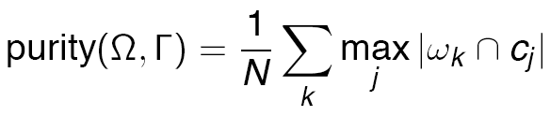

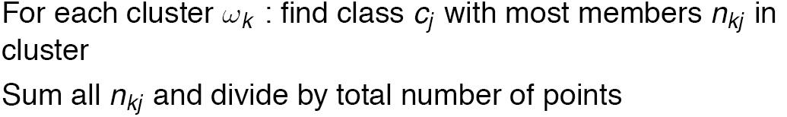
12.3.3 External Evaluation of Cluster Quality
Sec. 16.3
Simple measure: purity, the ratio between the dominant class in the cluster c_{j} and the size of cluster ω_{i}

Slide 34
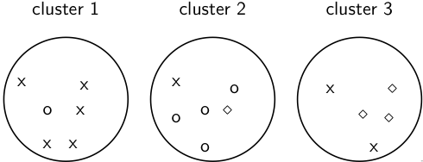
12.3.3 Example for computing purity
good_docs(ω₁) = max(5,1,0) = 5
good_docs(ω₂) = max(1,4,1) = 4
good_docs(ω₃) = max(2,0,3) = 3
Purity(Ω) = (1/17) × (5 + 4 + 3) = 12/17 ≈ 0.71.
Learning Check: In which case you get Purity 1?
34

Slide 35





12.3.4 Rand index
Definition:
Based on 2x2 contingency table of all pairs of documents:
TP+FN+FP+TN is the total number of pairs.
There are pairs for N documents.
Example: = 136 in o/⋄/x example
Each pair is either positive or negative (the clustering puts the two documents in the same or in different clusters) . . .
. . . and either “true” (correct) or “false” (incorrect): the clustering decision is correct or incorrect.
35

Slide 36
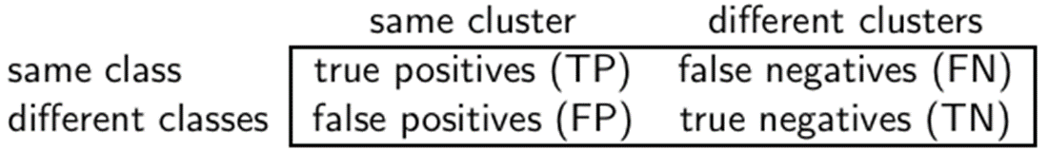


Rand Index: Example
As an example, we compute RI for the o/⋄/x example. We first
compute TP + FP. The three clusters contain 6, 6, and 5 points,
respectively, so the total number of “positives” or pairs of
documents that are in the same cluster is:
Of these, the x pairs in cluster 1, the o pairs in cluster 2, the ⋄
pairs in cluster 3, and the x pair in cluster 3 are true positives:
Thus, FP = 40 − 20 = 20.
How to calculate FN and TN?
36

Slide 37

Rand measure for the o/⋄/x example
TP + FP + TN + FN = 136
TN + FN = 136- 40 = 96
Same Classes = TP + FN = $\left({8 \atop 2}\right)$ + $\left({5 \atop 2}\right)$ + $\left({4 \atop 2}\right)$ = 44
FN = 44- TP = 24
TN = 96 – FN = 72
37

Slide 38
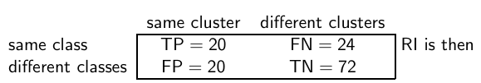
Rand measure for the o/⋄/x example
RI = (20 + 72)/(20 + 20 + 24 + 72) ≈ 0.68.
38

Slide 39
12.3.5 F measure
F measure
Like Rand, but “precision” and “recall” can be weighted
P = tp/(tp + fp) = 20/40 = 0.5
R = tp/(tp + fn) = 20/44 = 0.45
F_{β=1} = 2*P*R/(P+R) = 0.45/0.95 = 0.47
39

Slide 40
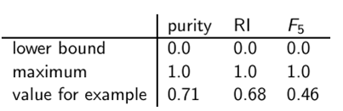
12.3.6 Evaluation Results
All 3 measures range from 0 (really bad clustering) to 1 (perfect clustering)
40

Slide 41
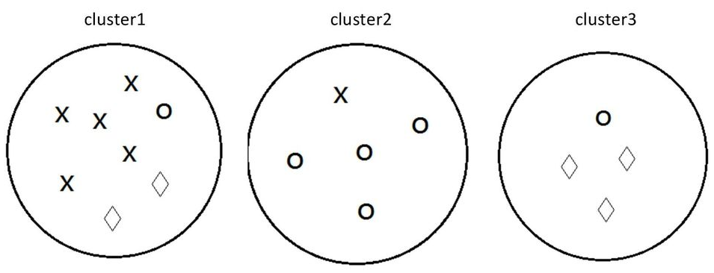
Activity 25
Calculate (by hand) the Purity and Rand Index of these Clusters
Submit your solution (show detailed calculations to your answer) to the Piazza Activity 25 thread.
41

Slide 42
12.4 Topic Modeling

Slide 43
12.4.1 Overview
Motivation:
Model the topic/subtopics in text collections
Basic Assumptions:
There are k topics in the whole collection
Each topic is represented by a multinomial distribution over the vocabulary (language model)
Each document can cover multiple topics
Applications
Summarizing topics
Predict topic coverage for documents
Model the topic correlations
Classification, Clustering

Slide 44
12.4.2 Basic Topic Models
Unigram model
Mixture of unigrams
Probabilistic LSI
Latent Dirichlet Allocation (LDA)
Correlated Topic Models

Slide 45
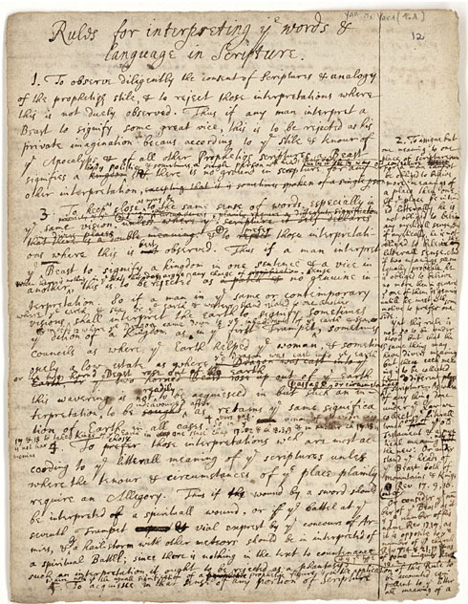
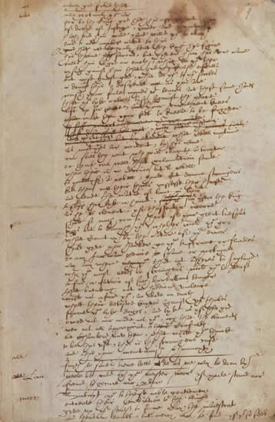
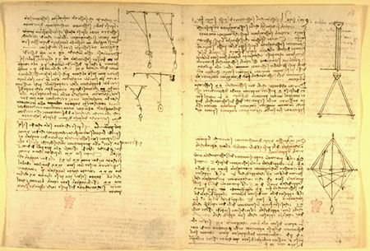
12.4.3 What is a “topic”?
Representation: a probabilistic distribution over words.
retrieval 0.2
information 0.15
model 0.08
query 0.07
language 0.06
feedback 0.03
……
Topic: A broad concept/theme, semantically coherent, which is hidden in documents
e.g., politics; sports; technology; entertainment; education etc.

Slide 46
12.4.4 Document as a mixture of topics
government 0.3 response 0.2 ...
[ Criticism of government response to the hurricane primarily consisted of criticism of its response to the approach of the storm and its aftermath, specifically in the delayed response ] to the [ flooding of New Orleans. … 80% of the 1.3 million residents of the greater New Orleans metropolitan area evacuated ] …[ Over seventy countries pledged monetary donations or other assistance]. …
Topic θ₁
city 0.2 new 0.1 orleans 0.05 ...
Topic θ₂
…
How can we discover these topic-word distributions?
Many applications would be enabled by discovering such topics
Summarize themes/aspects
Facilitate navigation/browsing
Retrieve documents
Segment documents
Many other text mining tasks
donate 0.1 relief 0.05 help 0.02 ...
Topic θ_{k}
is 0.05 the 0.04 a 0.03 ...
Background θ_{k}

Slide 47
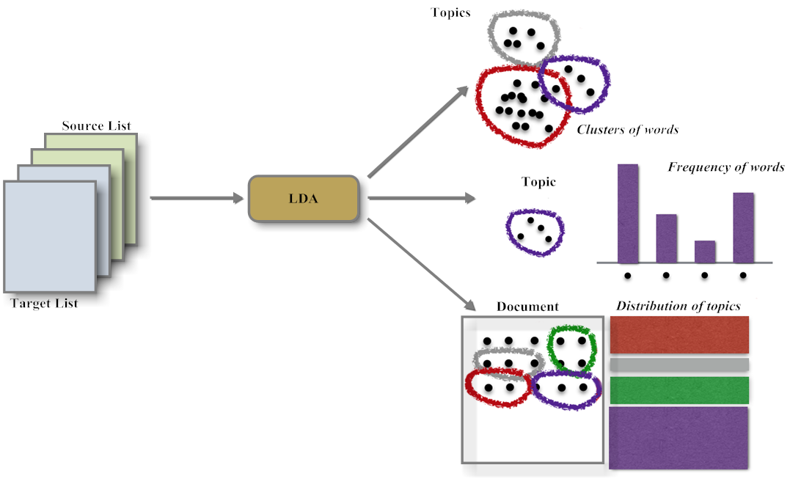
12.4.5 Latent Dirichlet Allocation

Slide 48
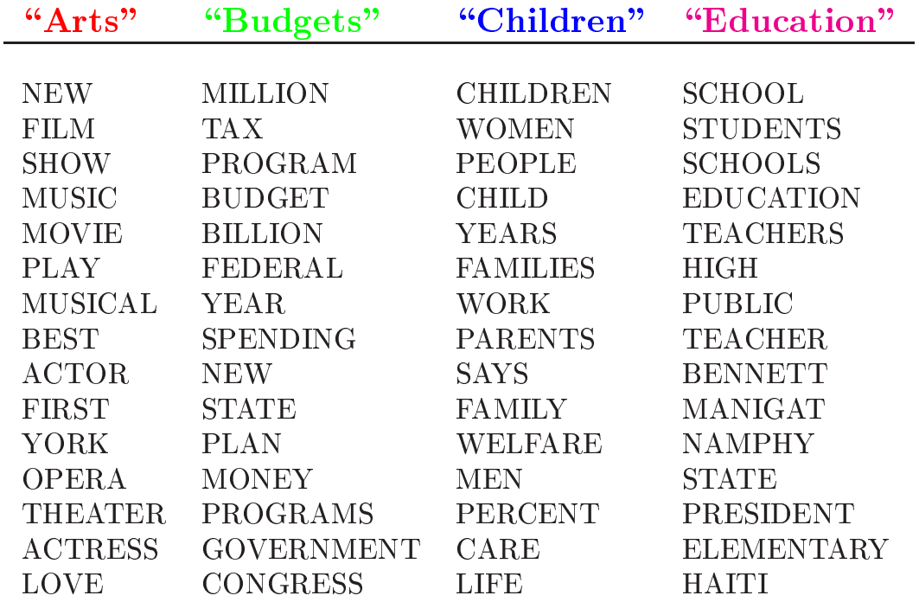
12.4.6 Topics learned by LDA

Slide 49
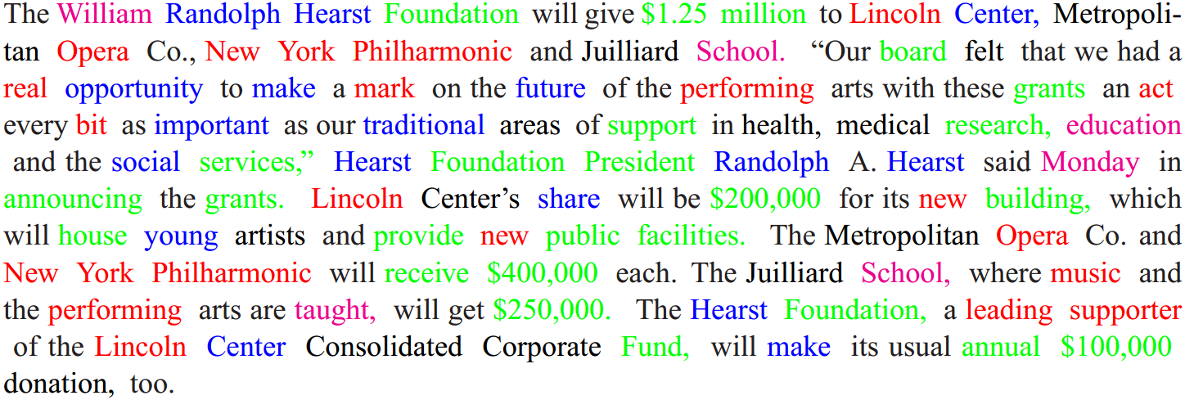
Topic assignments in document
Based on the topics shown in last slide

Slide 50
Summary
In clustering, clusters are inferred from the data without human input (unsupervised learning). However, in practice, it’s a bit less clear: there are many ways of influencing the outcome of clustering: number of clusters, similarity measure, representation of documents. Because clustering is considered an unsupervised version of classification, it is often used as a building block to solve the latter.
This module introduces the K-means clustering algorithm, LDA and several cluster evaluation techniques including purity, Rand Index and F-measure.

