Slide 1
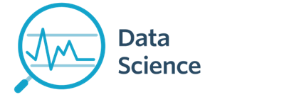
Module 13 - Evaluations
CS 620 / DASC 600
Introduction to Data Science & Analytics
Dr. Sampath Jayarathna
Old Dominion University

Slide 2
Overview
While data preparation and training a machine learning model is a key step in the machine learning pipeline, it’s equally important to measure the performance of this trained model. How well the model generalizes on the unseen data is what defines adaptive vs non-adaptive machine learning models.
In this module we will learn different metrics for performance evaluation to improve the overall predictive power of our models before we roll it out for production on unseen data. Different machine learning algorithms search for different trends and patterns. One algorithm isn’t the best across all data sets or for all use cases. To find the best solution, you need to conduct many experiments, evaluate machine learning algorithms, and tune their hyperparameters.

Slide 3
Objectives
define the need for model evaluation
understand a wide variety of evaluation metrics.
learn how to perform evaluation of learning algorithms and model selection.
interpret machine learning problems using significance testing
compare and contrast multiple models using evaluation metrics such as ROC curves and Interpolation

Slide 4
Relevance
Evaluation metrics are used to measure the quality of the statistical or machine learning model. Evaluating machine learning models or algorithms is essential for any project. There are many different types of evaluation metrics available to test a model.
It is very important to use multiple evaluation metrics to evaluate your model. This is because a model may perform well using one measurement from one evaluation metric, but may perform poorly using another measurement from another evaluation metric. Using evaluation metrics are critical in ensuring that your model is operating correctly and optimally. In general, the evaluation used should be closely matching the business objectives. Using the right metric can have more influence on you model performance than the algorithm you use.

Slide 5
13.1 What is Evaluation

Slide 6
13.1.1 Evaluation
Evaluation = Process of judging the merit or worth of something
Evaluation is key to building effective and efficient Data Science systems
usually carried out in controlled experiments
online testing can also be done

Slide 7
Why System Evaluation?
There are many models/ algorithms/ systems, which one is the best?
What is the best component for:
similarity function (cosine, correlation,…)
Term selection (stopword removal, stemming…)
Term weighting (TF, TF-IDF,…)
How far down the list will a user need to look to find some/all relevant documents in text retrieval?

Slide 8
13.1.2 Regression / classification models
Predictive modeling / Supervised learning
A model is a specification of mathematical/probabilistic relationships that exist between different variables
The goal is usually to use existing data to develop models that we can use to predict outcomes for new data, such as
Predicting whether an email message is spam or not
Predicting whether a credit card transaction is fraudulent
Predicting which advertisement a shopper is most likely to click on
Predicting which football team is going to win the Super Bowl
Predicting stock price of a given company
Predicting number of buyers of a certain product
Predicting user ratings of a new movie
Predicting the grade of a disease
Nominal
(categorical with
No particular order)
Continuous / ordinal

Slide 9
13.1.3 Performance evaluation
How predictive is the model we learned?
For regression, usually R² or MSE
For classification, many options (discuss later today)
Accuracy can be used, with caution
Performance on the training data (data used to build models) is not a good indicator of performance on future data
Q: Why?
A: Because new data will probably not be exactly the same as the training data!

Slide 10
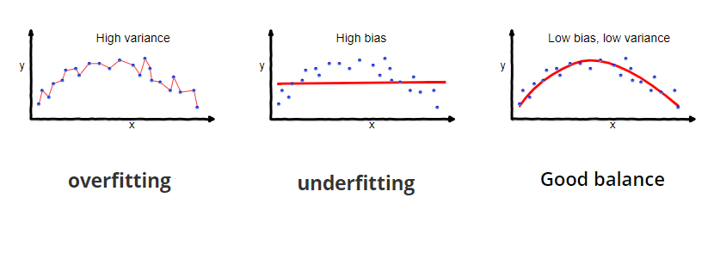
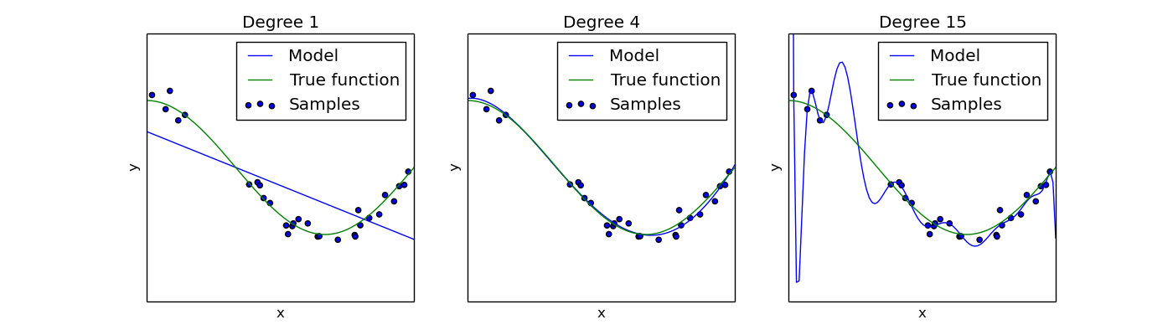
13.1.4 Overfitting vs underfitting
Overfitting – fitting the training data too precisely - usually leads to poor results on new data
Underfitting – model does not fit training data well
Underfitting
Overfitting
High bias, low variance
Low bias, high variance
Increase # of features or complexity of model
Get more training data, or reduce # of features or complexity of model

Slide 11
13.1.5 Evaluation on “LARGE” data
If many (thousands) of examples are available, then how can we evaluate our model?
A simple evaluation is sufficient
Randomly split data into training and test sets (e.g. 2/3 for train, 1/3 for test)
For classification, make sure training and testing have similar distribution of class labels
Build a model using the train set and evaluate it using the test set.

Slide 12
13.1.6 Model Evaluation Step 1: Split data into train and test sets
THE PAST
Results Known
0
Training set
3
2
5
Data
1
Testing set

Slide 13
Model Evaluation Step 2: Build a model on a training set
THE PAST
Results Known
0
Training set
3
2
5
Data
1
Model Builder
Testing set

Slide 14
Model Evaluation Step 3: Evaluate on test set
Results Known
0
Training set
3
2
5
Data
1
Model Builder
Evaluate
Predictions
3
4
1
2
Y
N
Testing set

Slide 15
13.1.7 A note on parameter tuning
It is important that the test data is not used in any way to build the model
Some learning schemes operate in two stages:
Stage 1: builds the basic structure
Stage 2: optimizes parameter settings
The test data can’t be used for parameter tuning!
Proper procedure uses three sets: training data, validation data, and test data
Validation data is used to optimize parameters

Slide 16
13.1.8 Evaluation on “small” data, 1
The holdout method reserves a certain amount for testing and uses the remainder for training
Usually: one third for testing, the rest for training
For “unbalanced” datasets, samples might not be representative
Few or none instances of some classes
Stratified sample: advanced version of balancing the data
Make sure that each class is represented with approximately equal proportions in both subsets

Slide 17
Evaluation on “small” data, 2
What if we have a small data set?
The chosen 2/3 for training may not be representative.
The chosen 1/3 for testing may not be representative.

Slide 18
13.2 Cross Validation

Slide 19
13.2.1 Cross-validation
Cross-validation more useful in small datasets
First step: data is split into k subsets of equal size
Second step: each subset in turn is used for testing and the remainder for training
This is called k-fold cross-validation
For classification, often the subsets are stratified before the cross-validation is performed
The error estimates are averaged to yield an overall error estimate

Slide 20
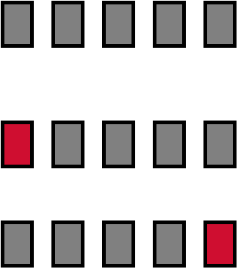
13.2.2 Cross-validation example:
Break up data into groups of the same size
Hold aside one group for testing and use the rest to build model
Repeat
Test
20

Slide 21
13.2.3 More on cross-validation
Standard method for evaluation: stratified ten-fold cross-validation
Why ten? Extensive experiments have shown that this is the best choice to get an accurate estimate
Stratification reduces the estimate’s variance
Even better: repeated stratified cross-validation
E.g. ten-fold cross-validation is repeated ten times and results are averaged (reduces the variance)

Slide 22
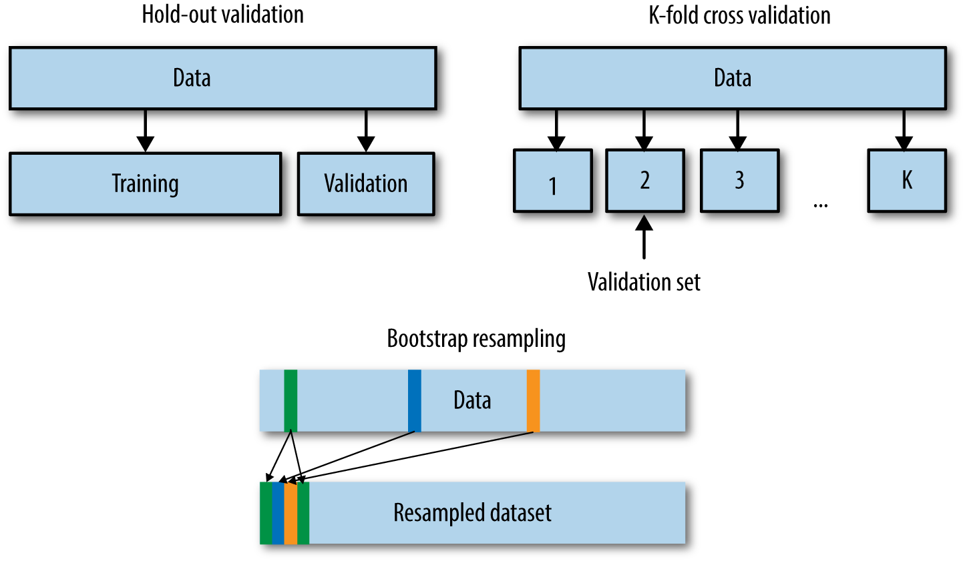
13.2.4 The bootstrap
CV uses sampling without replacement
The same instance, once selected, can not be selected again for a particular training/test set
The bootstrap uses sampling with replacement to form the training set
Sample a dataset of n instances n times with replacement to form a new dataset of n instances
Use this data as the training set
Use the instances from the original dataset that don’t occur in the new training set for testing

Slide 23
13.2.5 The bootstrap
The bootstrap approach allows us to use a computer to mimic the process of obtaining new data sets, so that we can estimate the variability of our estimate without generating additional samples.
Rather than repeatedly obtaining independent data sets from the population, we instead obtain distinct data sets by repeatedly sampling observations from the original data set with replacement.
Each of these “bootstrap data sets” is created by sampling with replacement, and is the same size as our original dataset. As a result some observations may appear more than once in a given bootstrap data set and some not at all.

Slide 24
13.3 Evaluation Metrics

Slide 25
13.3.1 Precision and Recall
Space of all documents
Relevant +
Retrieved
Relevant
Retrieved
Not Relevant + Not Retrieved

Slide 26
13.3.2 Confusion Matrix
A confusion matrix is a table that is often used to describe the performance of a classification model (or "classifier") on a set of test data
true positives (TP): These are cases in which we predicted positive (they have the disease), and they do have the disease.
true negatives (TN): We predicted negative, and they don't have the disease.
false positives (FP): We predicted positive, but they don't actually have the disease. (Also known as a "Type I error.")
false negatives (FN): We predicted negative, but they actually do have the disease. (Also known as a "Type II error.")
 | Actual: Positive | Actual: Negative
Predicted: Positive | tp | fp = Type I error
Predicted: Negative | fn = Type II error | tn

Slide 27
13.3.3 Precision and Recall in Text Retrieval
Precision
The ability to retrieve top-ranked documents that are mostly relevant.
Precision P = tp/(tp + fp)
Recall
The ability of the search to find all of the relevant items in the corpus.
Recall R = tp/(tp + fn)
 | Relevant | Nonrelevant
Retrieved | tp | fp
Not Retrieved | fn | tn

Slide 28
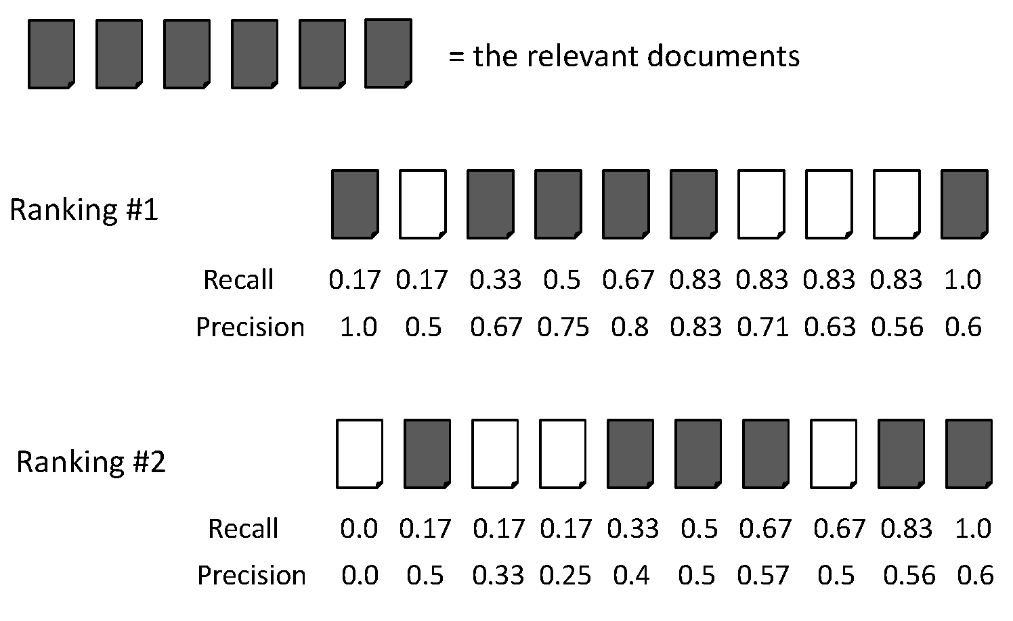
13.3.4 Precision/Recall : Example
Recall = 2/6 = 0.33
Precision = 2/3 = 0.67

Slide 29
Precision/Recall : Example
Recall = 5/6 = 0.83
Precision = 5/6 = 0.83

Slide 30
13.3.5 Accuracy
Overall, how often is the classifier correct?
Number of correct predictions / Total number of predictions
Accuracy = tp+tn/(tp + fp + fn + tn)
Accuracy = 1+90/(1+1+8+90) = 0.91
91 correct prediction out of 100 total examples
Precision = 1/2 and Recall =1/9
Accuracy alone doesn't tell the full story when you're working with a class-imbalanced data set
 | Positive | Negative
Predicted Positive | 1 | 1
Predicted Negative | 8 | 90
Notes:
Resampling: Over sample / Under sample

Slide 31
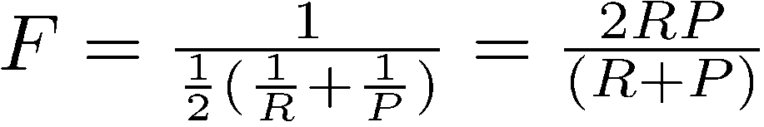
13.3.6 F Measure (F1/Harmonic Mean)
One measure of performance that takes into account both recall and precision.
Harmonic mean of recall and precision:
Why harmonic mean?
harmonic mean emphasizes the importance of small values, whereas the arithmetic mean is affected more by outliers that are unusually large
Data are extremely skewed; over 99% documents are non-relevant. This is why accuracy is not an appropriate measure
Compared to arithmetic mean, both need to be high for harmonic mean to be high.

Slide 32
F Measure (F1/Harmonic Mean) : example
Recall = 2/6 = 0.33
Precision = 2/3 = 0.67
F = 2*Recall*Precision/(Recall + Precision)
= 2*0.33*0.67/(0.33 + 0.67) = 0.44

Slide 33
F Measure (F1/Harmonic Mean) : example
Recall = 5/6 = 0.83
Precision = 5/6 = 0.83
F = 2*Recall*Precision/(Recall + Precision)
= 2*0.83*0.83/(0.83 + 0.83) = 0.83

Slide 34

Activity 28
 | Relevant =6 | Nonrelevant=4
Retrieved =6 | tp = 5 | fp = 1
Not Retrieved | fn = 1 | tn = 3
Accuracy of a retrieval model is defined by,
Accuracy = $\frac{tp + tn}{tp+tn+fp+fn}$
Calculate the tp, fp, fn, tn, accuracy F measure for Ranking algorithm #1 and #2 for the highlighted location in the ranking.
Submit your solution to piazza Activity 28 thread.

Slide 35
13.3.7 Mean Average Precision (MAP)
Average Precision: Average of the precision values at the points at which each relevant document is retrieved.
Ex1: (1 + 1 + 0.75 + 0.667 + 0.38 + 0)/6 = 0.633
Ex2: (1 + 0.667 + 0.6 + 0.5 + 0.556 + 0.429)/6 = 0.625
Averaging the precision values from the rank positions where a relevant document was retrieved
Set precision values to be zero for the not retrieved documents

Slide 36
Average Precision: Example

Slide 37
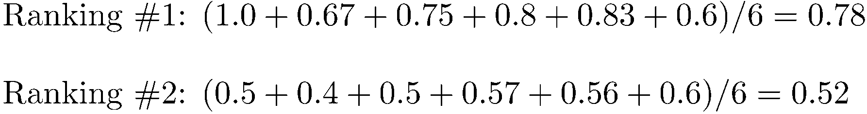
Average Precision: Example

Slide 38
Average Precision: Example

Slide 39
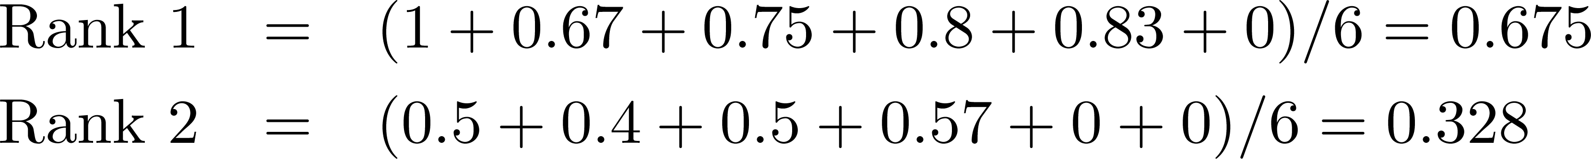
Average Precision: Example
Miss one relevant document

Slide 40
Average Precision: Example
Miss two relevant documents

Slide 41
13.3.8 Mean Average Precision (MAP)
Summarize rankings from multiple queries by averaging average precision
Most commonly used measure in research papers
Assumes user is interested in finding many relevant documents for each query
Requires many relevance judgments in text collection

Slide 42
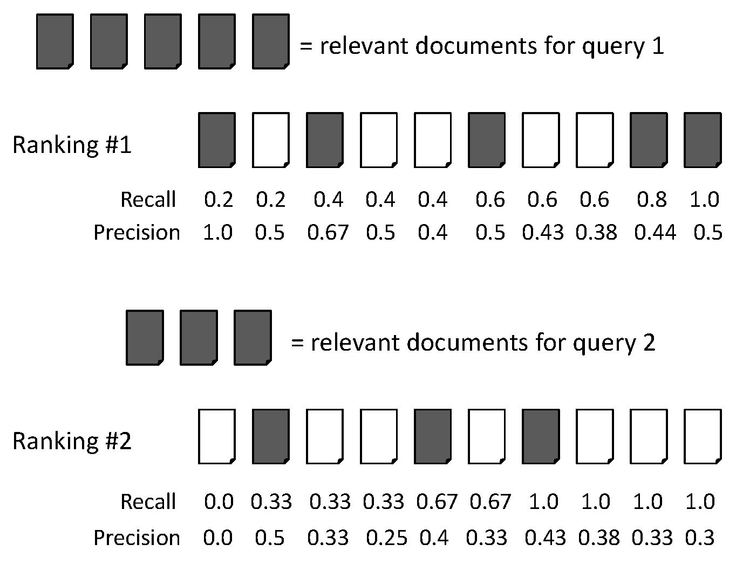
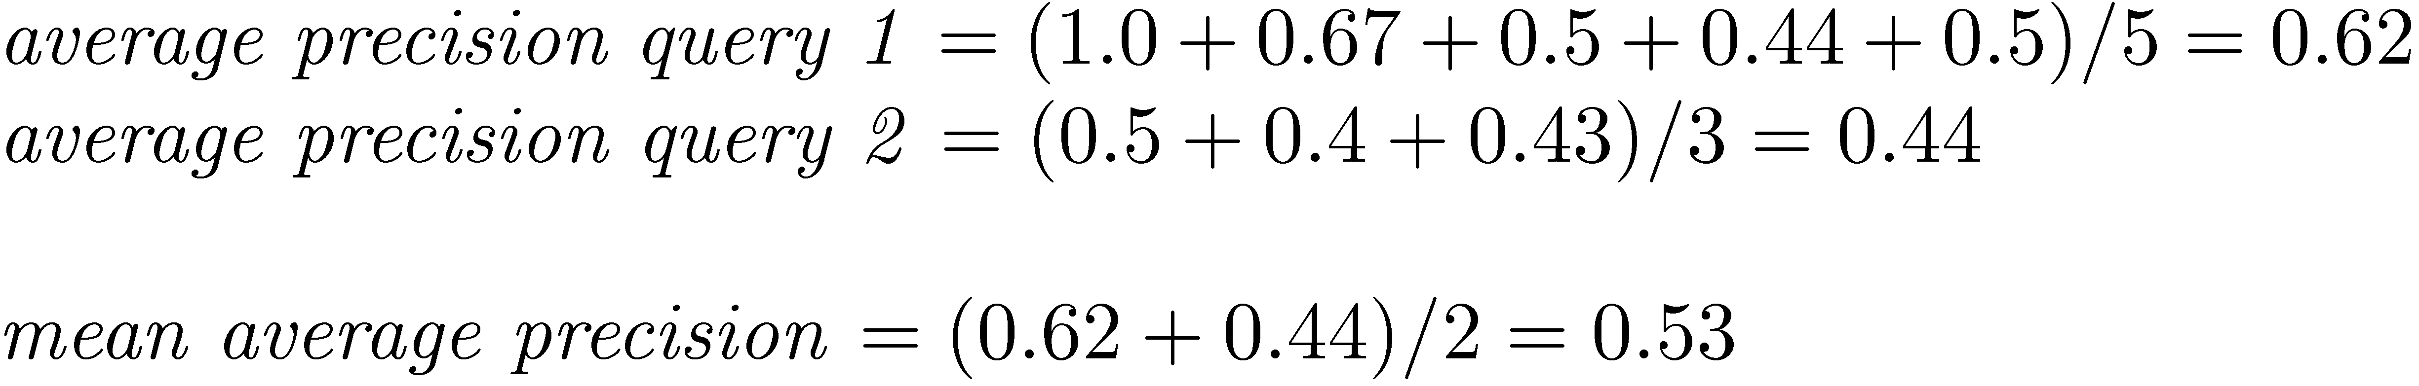
Mean Average Precision (MAP)

Slide 43
13.4 Evaluation Multiple Models

Slide 44
13.4.1 Recall-Precision Graph
The Recall-Precision Graph is created using the standard Recall values from the Recall Level and Precision Averages.
Typically these graphs slope downward from left to right, enforcing the notion that as more relevant documents are retrieved (recall increases), the more nonrelevant documents are retrieved (precision decreases).
This graph is the most commonly used method for comparing systems. The plots of different runs can be superimposed on the same graph to determine which run is superior.
Curves closest to the upper right-hand corner of the graph (where recall and precision are maximized) indicate the best performance

Slide 45
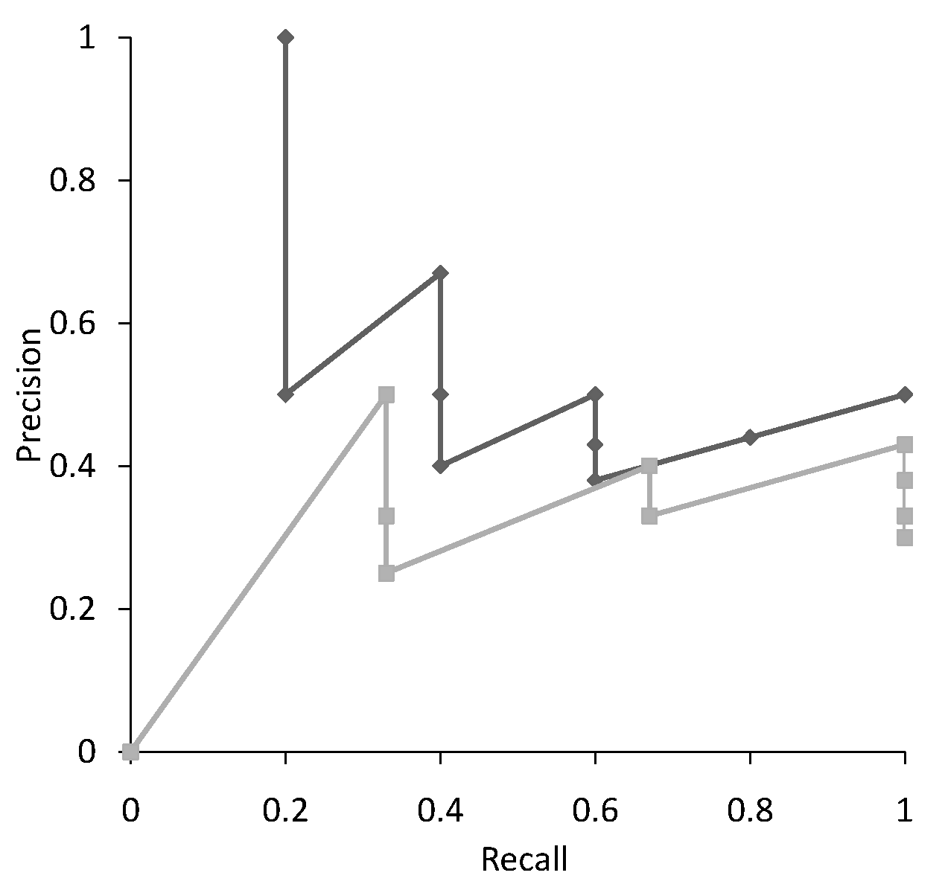
Recall-Precision Graph
Multiple precision for some recalls

Slide 46
13.4.2 Interpolation
Defines precision at any recall level as the maximum precision observed in any recall-precision point at a higher recall level
produces a step function
defines precision at recall 0.0, 0.1……1.0

Slide 47
Interpolation
Recall
Interpolated
Precision
0.0 0.1 0.2 0.3 0.4 0.5 0.6 0.7 0.8 0.9 1.0
1.0

Slide 48
Interpolation
Recall
Interpolated
Precision
0.0 0.1 0.2 0.3 0.4 0.5 0.6 0.7 0.8 0.9 1.0
1.0

Slide 49
Interpolation
Recall
Interpolated
Precision
0.0 0.1 0.2 0.3 0.4 0.5 0.6 0.7 0.8 0.9 1.0
1.0 1.0

Slide 50
Interpolation
Recall
Interpolated
Precision
0.0 0.1 0.2 0.3 0.4 0.5 0.6 0.7 0.8 0.9 1.0
1.0 1.0 1.0

Slide 51
Interpolation
Recall
Interpolated
Precision
0.0 0.1 0.2 0.3 0.4 0.5 0.6 0.7 0.8 0.9 1.0
1.0 1.0 1.0

Slide 52
Interpolation
Recall
Interpolated
Precision
0.0 0.1 0.2 0.3 0.4 0.5 0.6 0.7 0.8 0.9 1.0
1.0 1.0 1.0 0.67

Slide 53
Interpolation
Recall
Interpolated
Precision
0.0 0.1 0.2 0.3 0.4 0.5 0.6 0.7 0.8 0.9 1.0
1.0 1.0 1.0 0.67 0.67 0.5 0.5 0.5 0.5 0.5 0.5

Slide 54
Activity 29
Using interpolation, draw Recall-Precision graph to compare the given ranking algorithms.
Submit your solution to piazza Activity 29 thread.

Slide 55
13.4.3 Recap: Confusion matrix
The confusion matrix (easily generalize to multi-class)
Machine Learning methods usually minimize FP+FN
TPR (True Positive Rate): TP / (TP + FN) = Recall
FPR (False Positive Rate): FP / (TN + FP)
 | Actual: Positive | Actual: Negative
Predicted: Positive | tp | fp
Predicted: Negative | fn | tn

Slide 56
13.4.4 ROC Curves
A receiver operating characteristic curve, i.e. ROC curve, is a graphical plot that illustrates the diagnostic ability of a binary classifier system as its discrimination threshold is varied.
The diagnostic performance of a test, or the accuracy of a test to discriminate diseased cases from normal cases is evaluated using Receiver Operating Characteristic (ROC) curve analysis
A ROC Curve is a way to compare diagnostic tests. It is a plot of the true positive rate against the false positive rate.
Notes:
TPR (True Positive Rate): TP / (TP + FN) = Recall
FPR (False Positive Rate): FP / (TN + FP)
https://towardsdatascience.com/understanding-auc-roc-curve-68b2303cc9c5

Slide 57
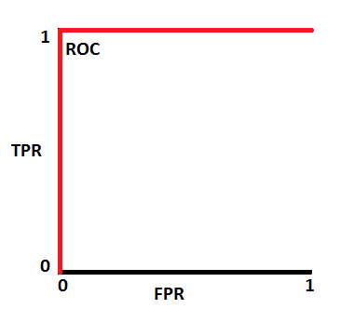
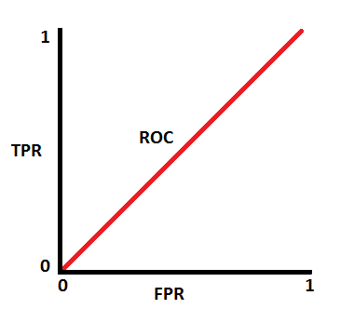
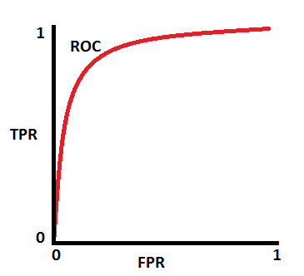
ROC Curves
This is an ideal situation. Model has an ideal measure of separability. It is perfectly able to distinguish between positive class and negative class.
This is the worst situation. When AUC is approximately 0.5, model has no discrimination capacity to distinguish between positive class and negative class. Random predictions.
Notes:
AUC ROC indicates how well the probabilities from the positive classes are separated from the negative classes. https://towardsdatascience.com/understanding-auc-roc-curve-68b2303cc9c5
When we decrease the threshold, we get more positive values thus increasing the sensitivity. Meanwhile, this will decrease the specificity.
Similarly, when we increase the threshold, we get more negative values thus increasing the specificity and decreasing sensitivity.
Specificity gives us the True Negative Rate and (1 — Specificity) gives us the False Positive Rate.

Slide 58
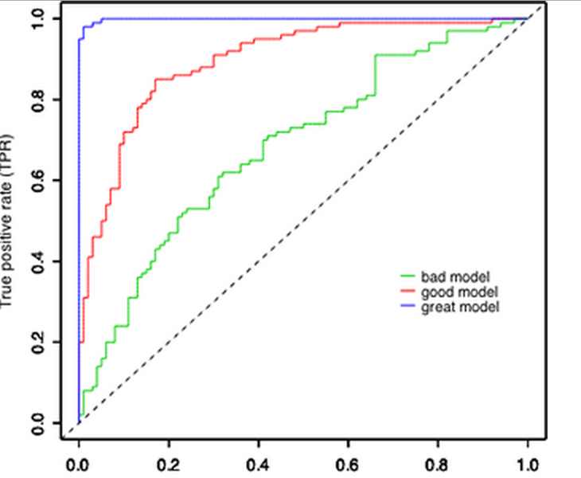
13.4.5 Multiple ROC Curves
Comparison of multiple classifiers is usually straight-forward especially when no curves cross each other. Curves close to the perfect ROC curve have a better performance level than the ones closes to the baseline.

Slide 59
13.4.6 PR Curves Vs ROC Curves
Remember, a ROC curve represents a relation between sensitivity (Recall) and False Positive Rate (Not Precision).
ROC curve plot True Positive Rate Vs. False Positive Rate; Whereas, PR curve plot Precision Vs. Recall.
If your question is, "How well can this classifier be expected to perform in general, go with a ROC curve
If true negative is not much valuable to the problem, or negative examples are abundant. Then, PR-curve is typically more appropriate.
For example, if the class is highly imbalanced and positive samples are very rare, then use PR-curve.
How meaningful is a positive result from my classifier

Slide 60
13.4.7 Cost-Sensitive Learning
Learning to minimize the expected cost of misclassifications
Most classification learning algorithms attempt to minimize the expected number of misclassification errors
In many applications, different kinds of classification errors have different costs, so we need cost-sensitive methods

Slide 61
13.4.8 Examples of Applications with Unequal Misclassification Costs
Medical Diagnosis:
Cost of false positive error: Unnecessary treatment; unnecessary worry
Cost of false negative error: Postponed treatment or failure to treat; death or injury
Fraud Detection:
False positive: resources wasted investigating non-fraud
False negative: failure to detect fraud could be very expensive

Slide 62
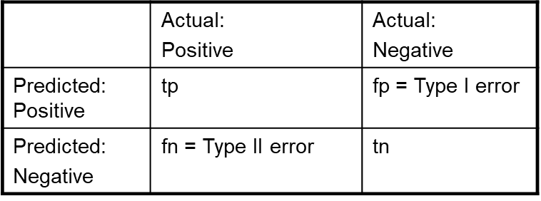
13.4.9 Cost Matrix
Model 1: Confusion matrix
Model 2: Confusion matrix
 | P | N
P | 150 | 40
N | 60 | 250
 | P | N
P | 250 | 45
N | 5 | 200
Actual
FN
Actual
FP
Predicted
Predicted
Cost matrix
 | P | N
P | -1 | 100
N | 1 | 0
Accuracy: 80%
Cost: 150x-1 + 40x100 + 60x1=3910
Accuracy: 90%
Cost: 250x-1 + 45x100 +5x1 = 4255
If we are focusing on accuracy then we will go with the Model 2 (In this case we need to compromise on cost) , however if we are focusing on cost then we will go with the Model 1 (In this case we need to compromise on accuracy).

Slide 63
13.5 Significance Testing

Slide 64
13.5.1 Significance Testing
Also called “hypothesis testing”
Objective: to test a claim about parameter μ
Procedure:
State hypotheses H₀ and H_{a}
Calculate test statistic
Convert test statistic to P-value and interpret
Consider significance level (optional)

Slide 65
13.5.2 Hypotheses
H₀ (null hypothesis) claims “no difference”
H_{a} (alternative hypothesis) contradicts the null
Example: We test whether a population gained weight on average…
H₀: no average weight gain in population H_{a:} H₀ is wrong (i.e., “weight gain”)
Next ⇒ collect data ⇒ quantify the extent to which the data provides evidence against H₀
Notes:
The first step in the procedure is to state the hypotheses null and alternative forms. The null hypothesis (abbreviate “H naught”) is a statement of no difference. The alternative hypothesis (“H sub a”) is a statement of difference. Seek evidence against the claim of H₀ as a way of bolstering H_{a.}
The next slide offers an illustrative example on setting up the hypotheses.

Slide 66
13.5.3 Significance Tests
Given the results from a number of queries, how can we conclude that ranking algorithm B is better than algorithm A?
A significance test
null hypothesis: no difference between A and B
alternative hypothesis: B is better than A
the power of a test is the probability that the test will reject the null hypothesis correctly

Slide 67
13.5.4 t-test
The t test (also called Student’s T Test) compares two averages (means) and tells you if they are different from each other.
The t test also tells you how significant the differences are; In other words it lets you know if those differences could have happened by chance.
Notes:
https://towardsdatascience.com/the-statistical-analysis-t-test-explained-for-beginners-and-experts-fd0e358bbb62

Slide 68
t-test
What are T-Values and P-values?
How big is “big enough”? Every t-value has a p-value to go with it.
A p-value is the probability that the results from your sample data occurred by chance.
P-values are from 0% to 100%. They are usually written as a decimal. For example, a p value of 5% is 0.05.
Low p-values are good; They indicate your data did not occur by chance.
For example, a p-value of .01 means there is only a 1% probability that the results from an experiment happened by chance. In most cases, a p-value of 0.05 (5%) is accepted or 95% confidence that experiment didn’t happen by a chance.

Slide 69
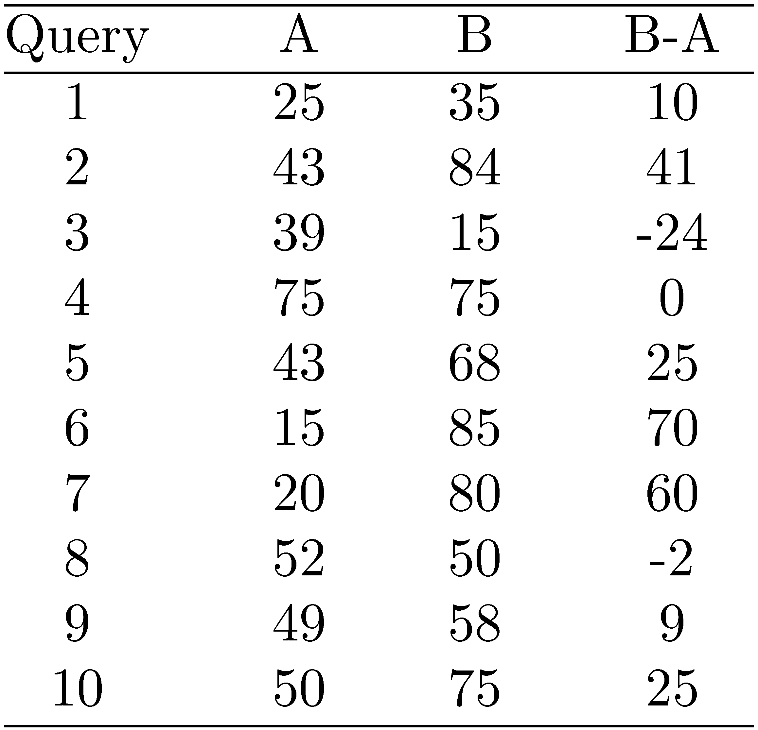
13.5.5 Example Experimental Results
Significance level: α = 0.05
Probability for B=A

Slide 70
Example Experimental Results
p-value = 0.03 < 0.05
Probability for B=A is 0.03
Reject null hypothesis
Avg 41.1 62.5
→ B is better than A
Significance level: α = 0.05, Probability for B=A
The p-value is less than the alpha level: p < 0.05 We can be 95% sure to reject the null hypothesis that there is a significant difference between means.

Slide 71
13.5.5 T-test Python
import scipy.stats as stats
import numpy as np
sample1 = [25, 43, 39, 75, 43, 15, 20, 52, 49, 50]
sample2 = [35, 84, 15, 75, 68, 85, 80, 50, 58, 75]
t_stat, p_val = stats.ttest_ind(sample1, sample2, equal_var=False)
print(t_stat)
print(p_val)
Notes:
For example, let’s assume that “before” and “after” represent test scores, and there was an intervention in between them. If the before and after scores in each row of the example worksheet represent the same subject, it makes sense to calculate the difference between the scores in this fashion—the paired t-test is appropriate. However, if the scores in each row are for different subjects, it doesn’t make sense to calculate the difference. In this case, you’d need to use another test, such as the 2-sample t-test

Slide 72
Summary
When developing machine learning models, it is important to know how much we can really trust that models. How much do we believe that the model we have built is solid enough to accept the conclusions? For example, for a classifier, we should know its accuracy. What is a classifier is biased, or overlearned the data?
This module introduces various evaluation strategies such as cross-validation, bootstrap, evaluation measures for individual models such as precision, recall, F-measure, model comparisons such as MAP, PR curves, ROC curves and significance testing.

