Slide 1

Introduction to Weka
CS 620 / DASC 600
Introduction to Data Science & Analytics
Dr. Sampath Jayarathna

Slide 2
Overview
Weka is a collection of machine learning algorithms for data mining tasks. Weka contains tools for data pre-processing, classification, regression, clustering, association rules, and visualization. It is also well-suited for developing new machine learning schemes.
The goal of this module is to help you to learn WEKA Explorer and KnowledgeFlow. The module will guide you step by step through the analysis of a simple problem using WEKA Explorer preprocessing, classification, clustering, and visualization tools. You will also be able to analyze your data with WEKA KnowledgeFlow using various learning schemes and interpret received results.

Slide 3
Objectives
introduce students to the basic concepts and techniques of Machine Learning
How to navigate Weka, read in data and work with appropriate data formats
how to work through a dataset end-to-end and deliver a set of predictions or a high-performance model.
use Weka to implement basic machine learning models
assess model results with appropriate metrics
develop skills of using a machine learning software for solving practical problems.

Slide 4
Relevance
Weka has been around for quite a while and was developed internally at University of Waikato for research purpose. What makes Weka worthy of try is the easy learning curve. For someone who hasn’t coded for a while, Weka with its GUI provides easiest transition into the world of Data Science.
Being written in Java, those with Java experience can call the library into their code as well. The algorithms can either be applied directly to a dataset or called from your own Java code. Weka contains tools for data pre-processing, classification, regression, clustering, association rules, and visualization.

Slide 5
Weka - Overview

Slide 6
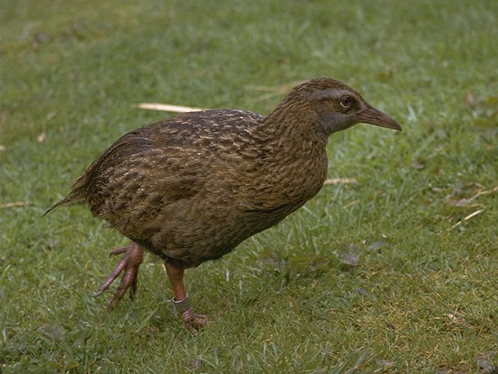
What is WEKA?
Waikato Environment for Knowledge Analysis
It’s a data mining/machine learning tool developed by Department of Computer Science, University of Waikato, New Zealand.
Weka is also a bird found only on the islands of New Zealand.
Website: http://www.cs.waikato.ac.nz/ml/weka/
Support multiple platforms (written in java):
Windows, Mac OS X and Linux

Slide 7
Explore WEKA
What is WEKA?
The Explorer:
Preprocess data
Classification
Clustering
Attribute Selection
Data Visualization
KnowledgeFlow
Visual Modeler

Slide 8
Main Features
49 data preprocessing tools
76 classification/regression algorithms
8 clustering algorithms
3 algorithms for finding association rules
15 attribute/subset evaluators + 10 search algorithms for feature selection

Slide 9
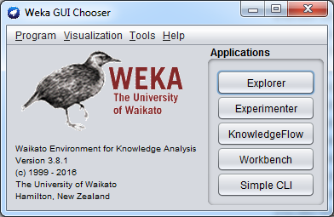
WEKA GUI
Main components
“The Explorer” (exploratory data analysis)
“The Experimenter” (experimental environment)
“The KnowledgeFlow” (process model inspired interface)
“Simple CLI” (Command Line interface)

Slide 10
This module introduce you to
What is WEKA?
The Explorer:
Preprocess data
Classification
Attribute Selection
KnowledgeFlow

Slide 11
WEKA Explorer

Slide 12
Explorer: pre-processing the data
Data can be imported from a file in various formats: ARFF, CSV, C4.5, binary
Data can also be read from a URL or from an SQL database (using JDBC)
Pre-processing tools in WEKA are called “filters”
WEKA contains filters for:
Discretization, normalization, resampling, attribute selection, transforming and combining attributes, …

Slide 13
WEKA “arff” format
@relation heart-disease-simplified
@attribute age numeric
@attribute sex { female, male}
@attribute chest_pain_type { typ_angina, asympt, non_anginal, atyp_angina}
@attribute cholesterol real
@attribute exercise_induced_angina { yes, no}
@attribute class { present, not_present}
@data
63,male,typ_angina,233,no,not_present
67,male,asympt,286,yes,present
67,male,asympt,229,yes,present
38,female,non_anginal,?,no,not_present
...
Numeric attribute
Nominal attribute
Missing value represented by ?
Notes:
Nominal – variables with no inherent order or ranking sequence such as Gender, Race etc.
Ordinal – Variables with an ordered series, such as blood group, performance etc.
Binary – variables with only 2 options, pass/fail, yes/no
All above are Qualitative.
Quantitative: Discrete and Continues

Slide 14
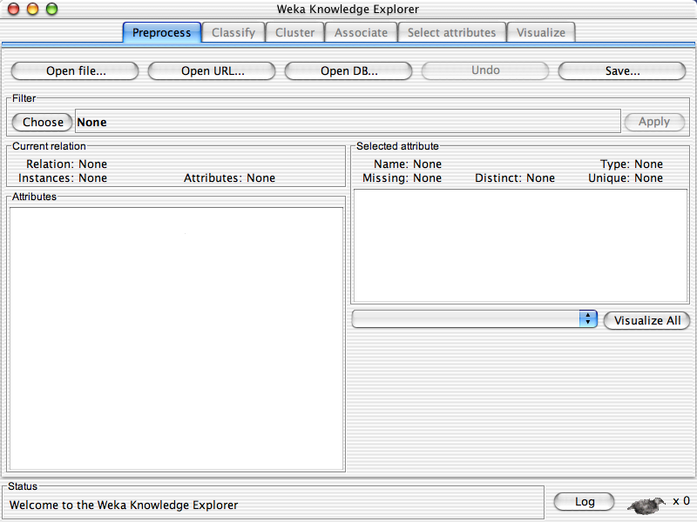

Slide 15
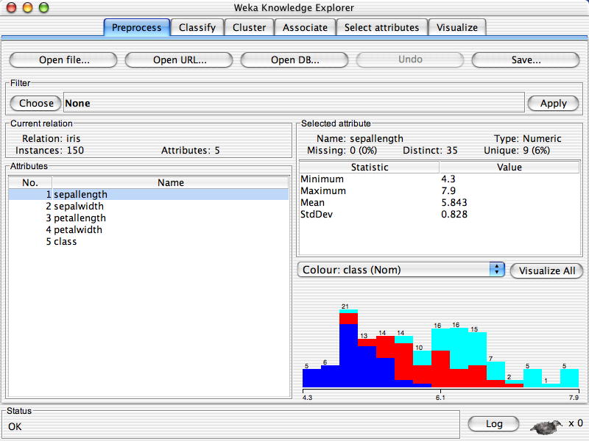

Slide 16
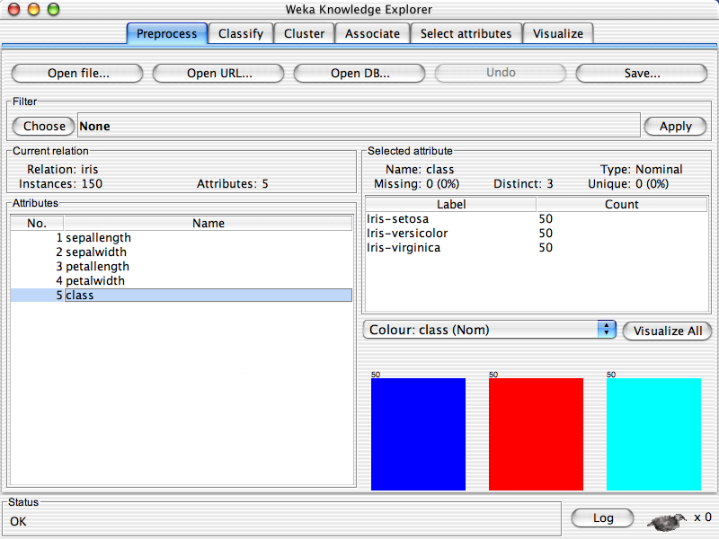

Slide 18
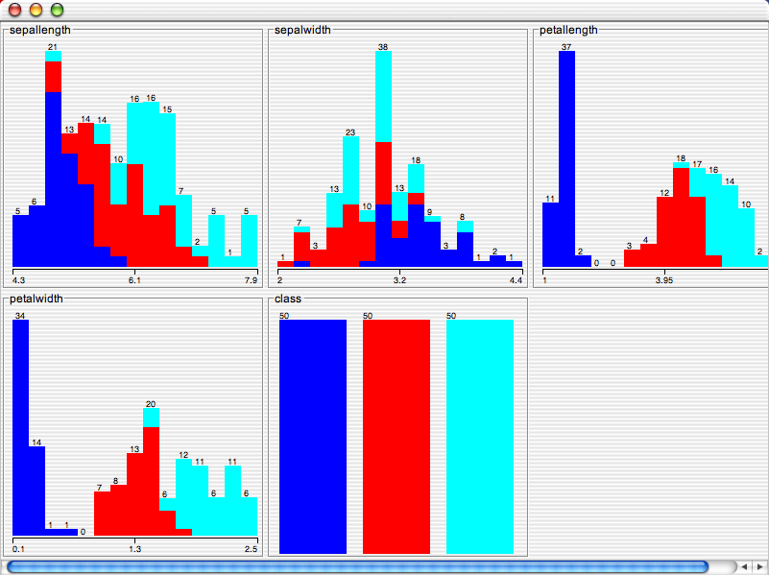

Slide 19
Explorer: building “classifiers”
Classifiers in WEKA are models for predicting nominal or numeric quantities or classes
Implemented classifiers include:
Decision trees and lists, instance-based classifiers, support vector machines, multi-layer perceptrons, logistic regression, Bayes’ nets, …
Bagging, boosting, stacking, error-correcting output codes, locally weighted learning, …

Slide 20
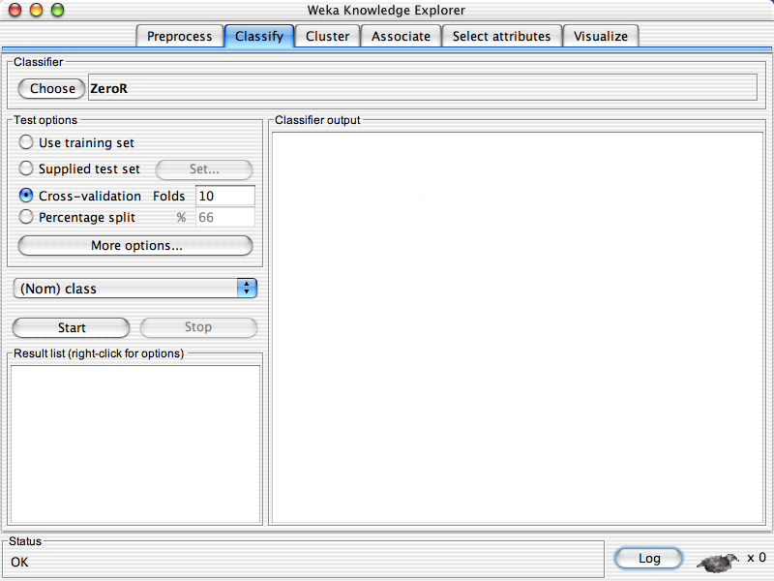

Slide 22
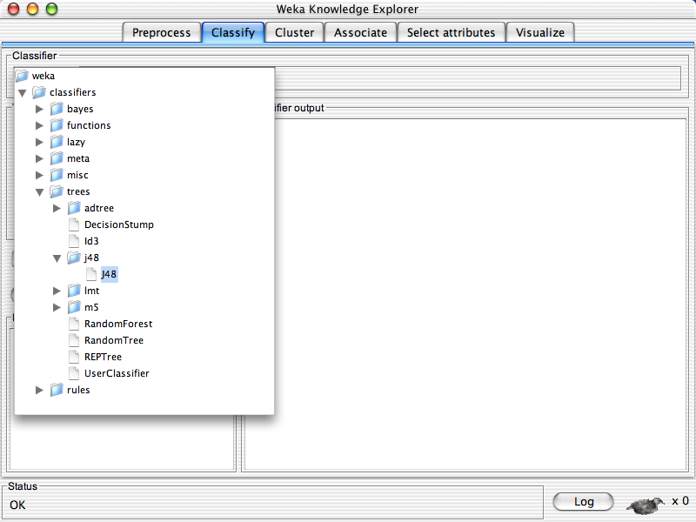

Slide 23
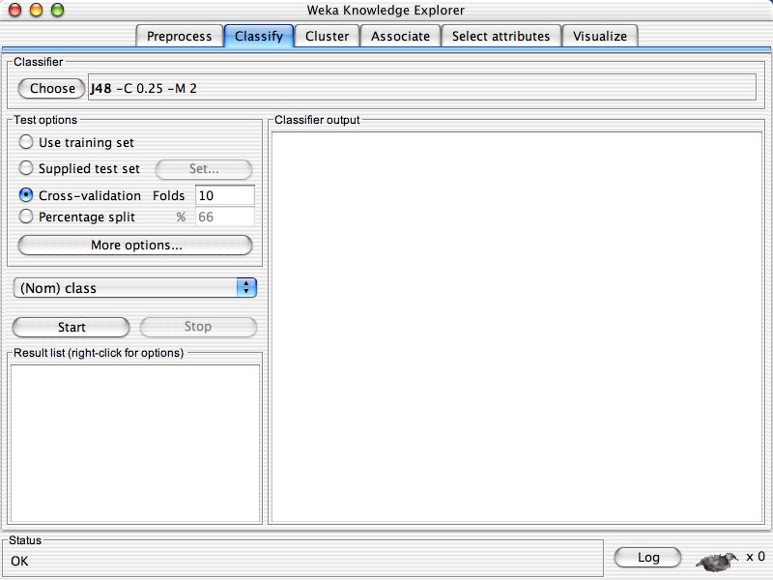

Slide 25
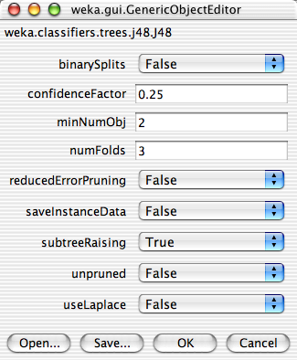

Slide 29
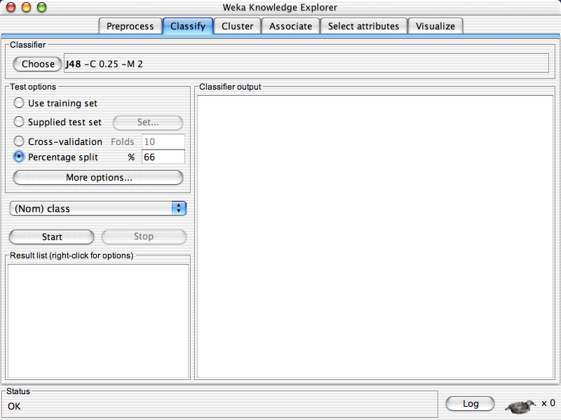

Slide 31
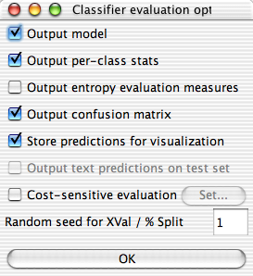

Slide 34
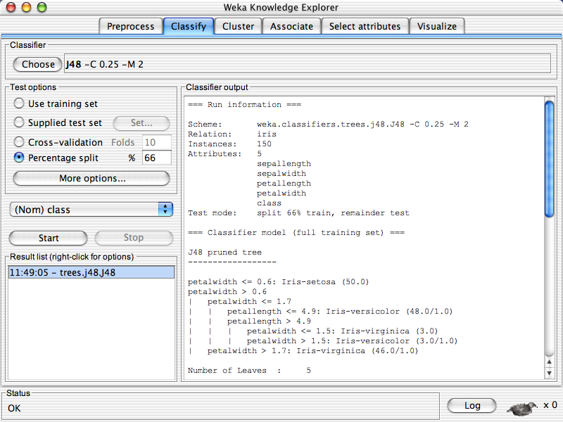

Slide 35
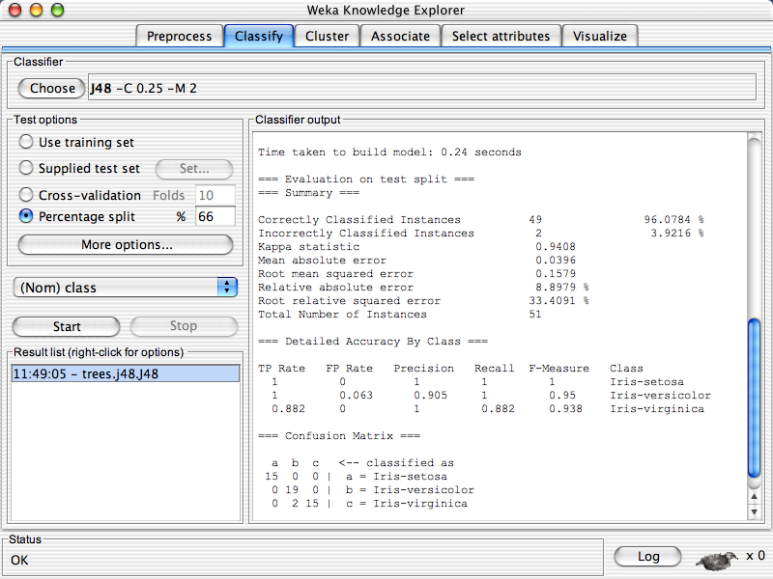
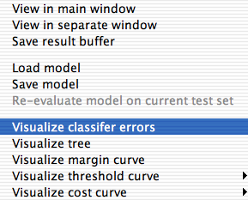

Slide 36
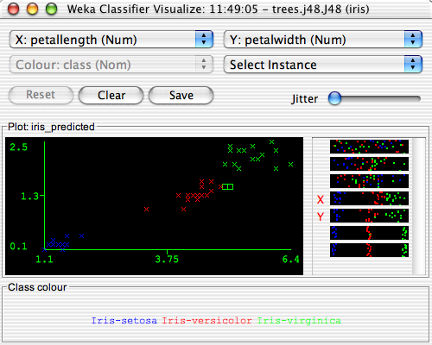

Slide 37
Class Activity 28
WEKA installation comes with several free datasets
Load iris.arff dataset from your WEKA installation directory Weka 3.8.1\data
Use KNN classifier and modify the value of K=1, K=3, K=5 and report the accuracy
Copy/paste the result output to piazza Activity 28 thread.

Slide 38
Explorer: attribute selection
Panel that can be used to investigate which (subsets of) attributes are the most predictive ones
Attribute selection methods contain two parts:
A search method: best-first, forward selection, random, exhaustive, genetic algorithm, ranking
An evaluation method: correlation-based, wrapper, information gain, chi-squared, …
Very flexible: WEKA allows (almost) arbitrary combinations of these two

Slide 39
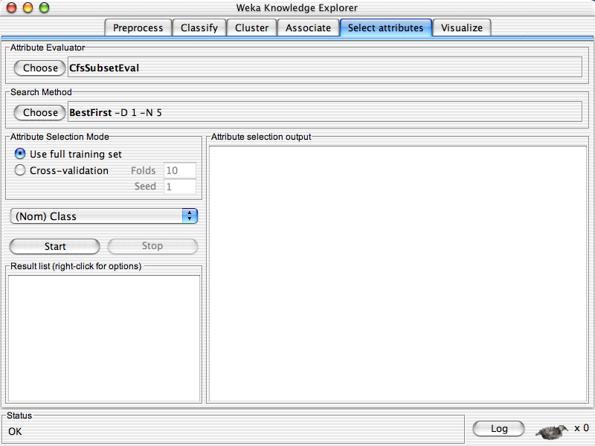

Slide 40
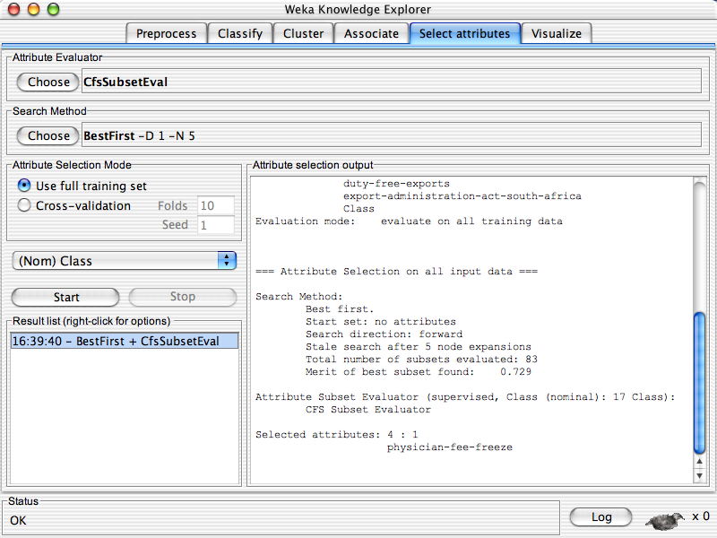

Slide 41
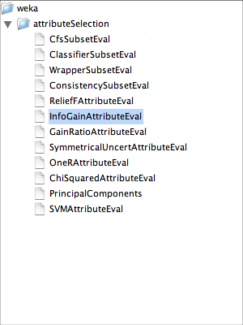

Slide 42
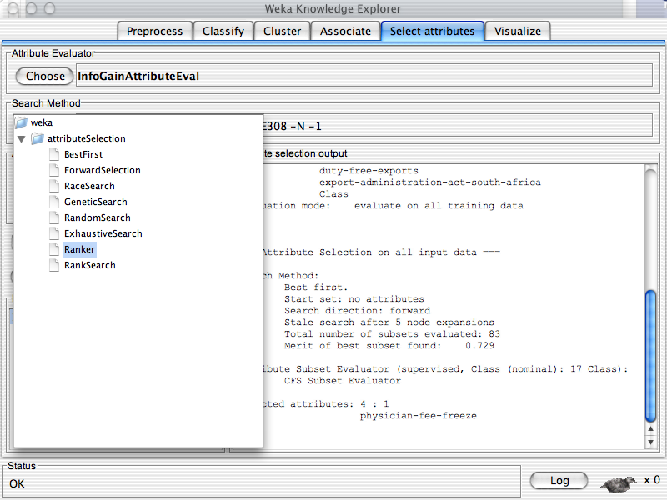

Slide 43
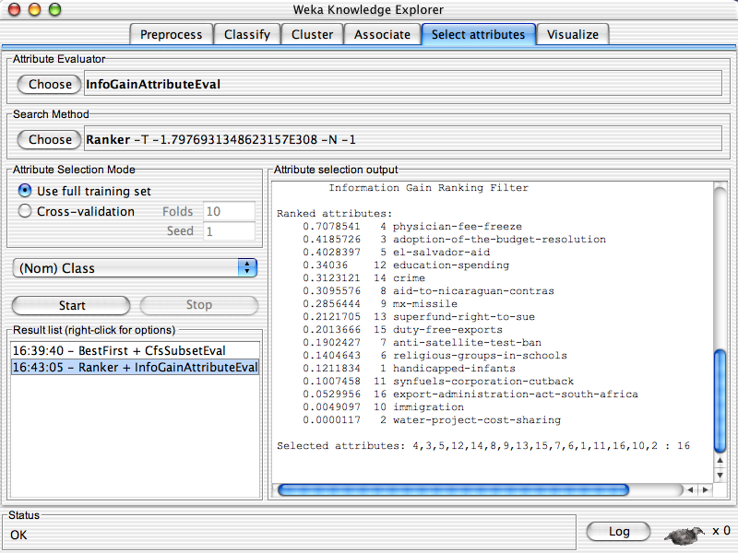

Slide 44
WEKA KnowledgeFlow

Slide 45
Knowledge Flow Interface
“Visual: drag-and-drop” user interface for WEKA - intuitive
Java-Beans-based
Can do everything that Explorer does (plus a bit more), but not as comprehensively as Experimenter
Data sources, classifiers, etc. are beans and can be connected graphically
Data “flows” through modules: e.g.,
“data source” ->“filter” ->“classifier”-> “evaluator”
KF layouts can be saved and re-used later

Slide 46
Knowledge Flow: An Example
What we want to do:
Take a dataset
Do some attribute selection
Perform some classification on the reduced data using 10 fold CV
Examine the subsets selected for each CV fold
Visualize the results in text format and curves

Slide 47
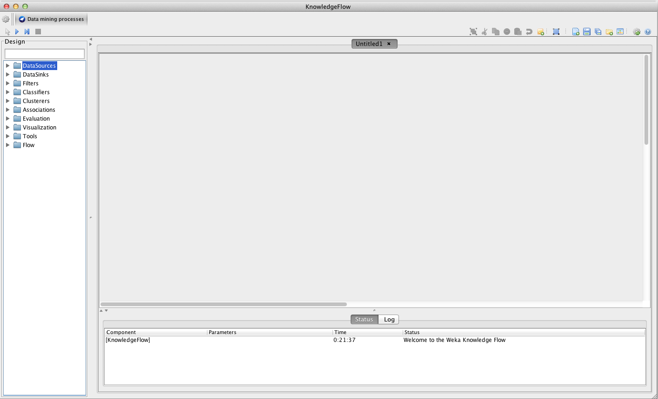

Slide 48
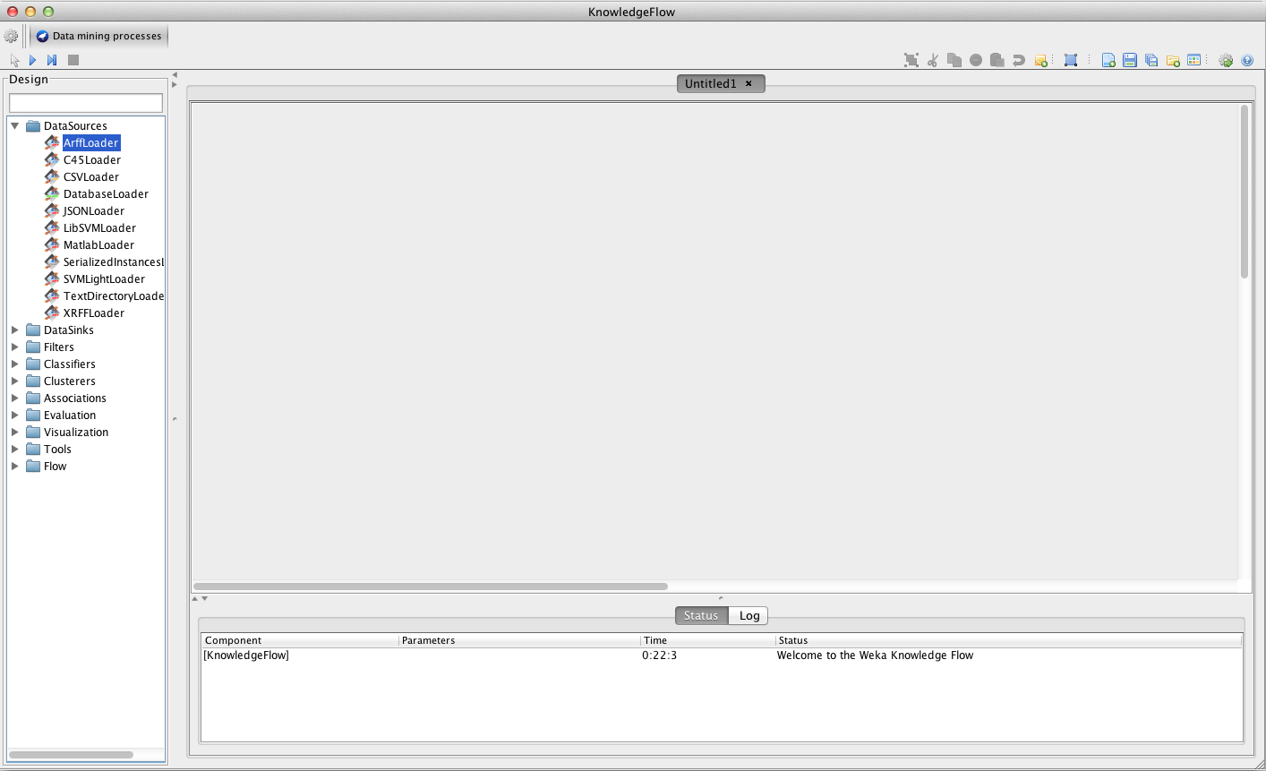

Slide 49
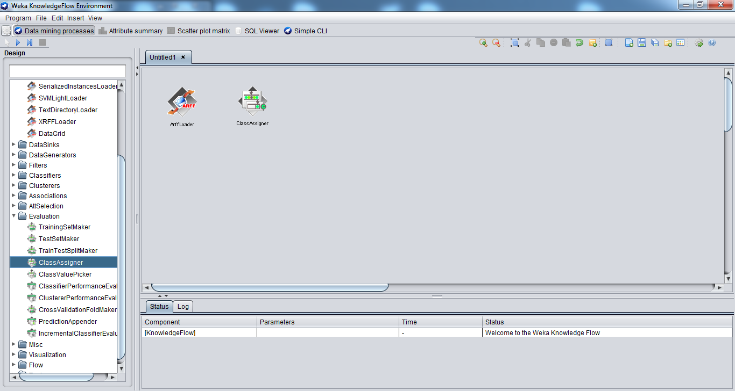
Class Assigner

Slide 50
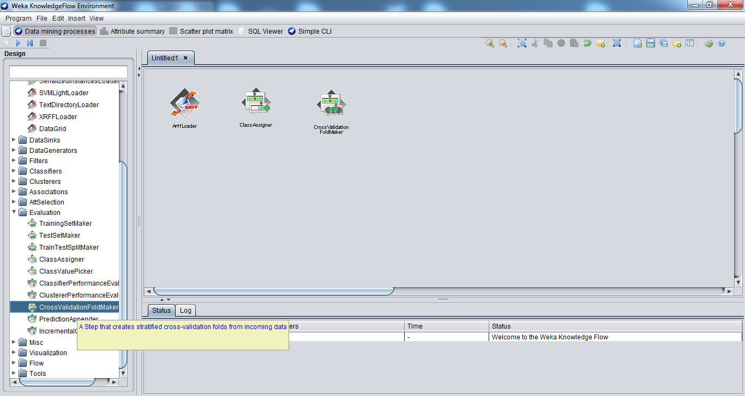
Cross Validation Fold Maker

Slide 51
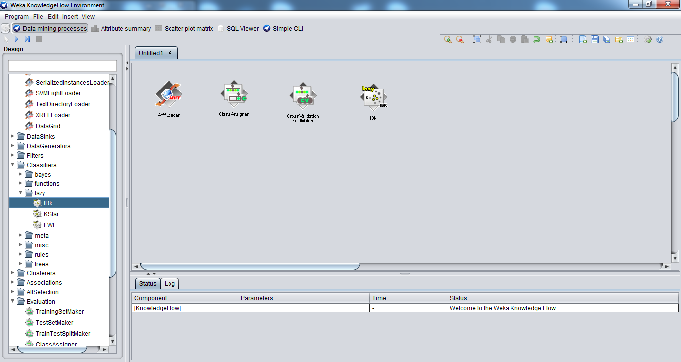
Classifier

Slide 52
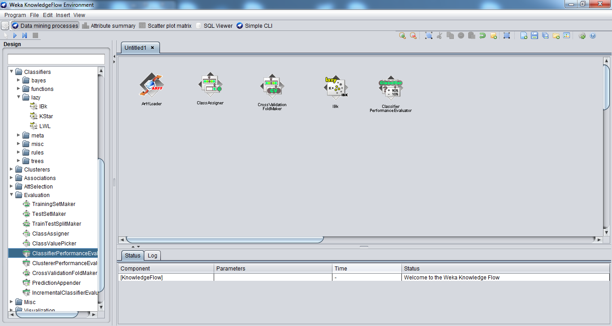
Classifier Performance Evaluator

Slide 53
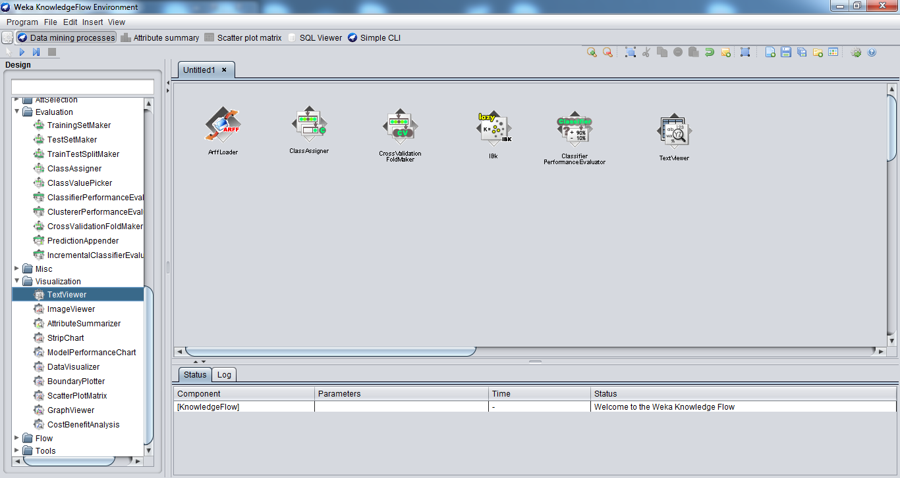
TextViewers can be used for visualization of results as well as examining the processes

Slide 54
TextViewers can be used for visualization of results as well as examining the processes

Slide 55
Run Classifier
Load data from ArffLoader (right click>configure)
Remember to add following into your KnowledgeFlow
ClassAssigner
CrossValidationFoldMaker
Classifier
ModelPerformanceChart from Visualization
Assign class from ClassAssigner
Connect dataset from all to Cross Validation
Get Training and Testing set to classifier
Send batch classifier to performance evaluator

Slide 56
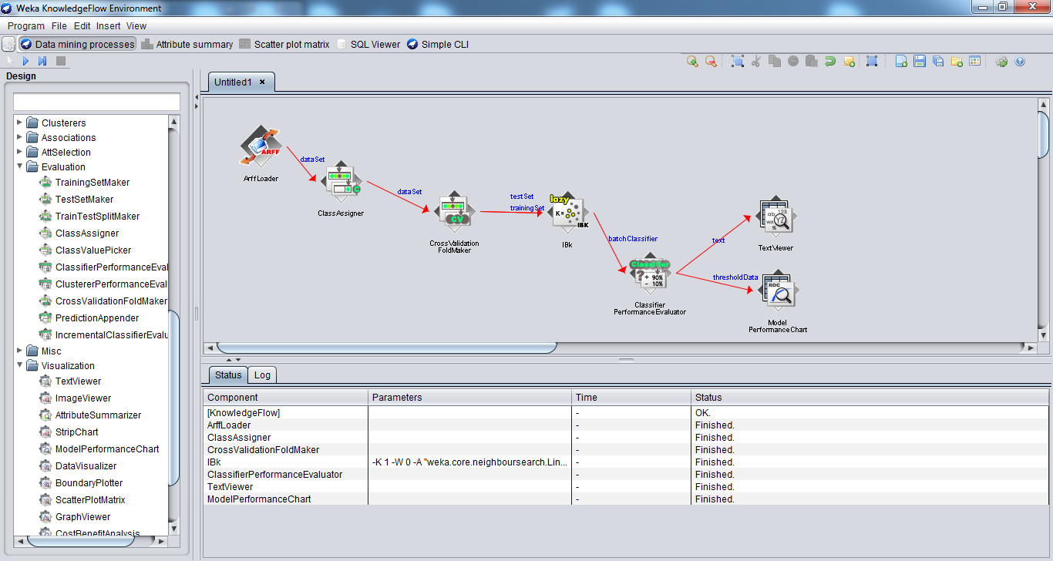

Slide 57
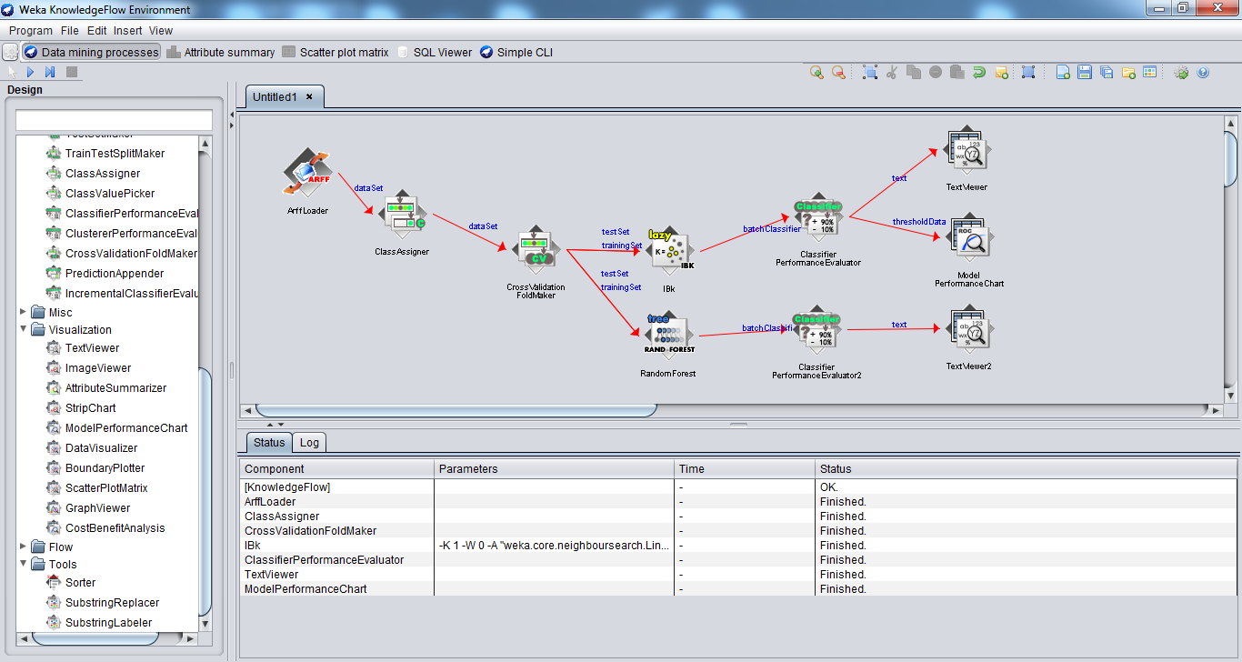
Run multiple classifiers

Slide 58
Class Activity 29
Use the iris.arff dataset for this activity
Create 4 different types of classifiers in WEKA KnowledgeFlow
Submit the image of your KnowledgeFlow workspace to piazza Activity 29 thread.

Slide 59
Summary
Explorer and Knowledge Flow:
Offer useful and flexible ways to perform a range of batches of experiments
Beware of the way in which results are generated!
KF is particularly useful for visualization
Just a snapshot of capabilities of WEKA!

