Slide 1

Module 14 – Delivering Results
CS 620 / DASC 600
Introduction to Data Science & Analytics
Dr. Sampath Jayarathna

Slide 2
Overview
As the “age of Big Data” kicks into high-gear, visualization is an increasingly key tool to make sense of the trillions of rows of data generated every day. Data visualization helps to tell stories by curating data into a form easier to understand, highlighting the trends and outliers. A good visualization tells a story, removing the noise from data and highlighting the useful information.
However, it’s not simply as easy as just dressing up a graph to make it look better or slapping on the “info” part of an infographic. In this module, we will learn effective data visualization, a balancing act between form and function. The plainest graph could be too boring to catch any notice or it make tell a powerful point; the most stunning visualization could utterly fail at conveying the right message or it could speak volumes. The data and the visuals need to work together, and there’s an art to combining great analysis with great storytelling.

Slide 3
Objectives
Learn the need for visual presentations of data for effective communication.
Use knowledge of perception and cognition to evaluate visualization design alternatives.
Design and evaluate color palettes for visualization based on principles of perception.
Apply data transformations such as scale, conditioning, and perception for visualization.
Identify opportunities for application of data visualization in various domains.

Slide 4
Relevance
Data visualization is the graphical representation of information and data. By using visual elements like charts, graphs, and maps, data visualization tools provide an accessible way to see and understand trends, outliers, and patterns in data.
In the world of Big Data, data visualization tools and technologies are essential to analyze massive amounts of information and make data-driven decisions. Data scientists who can gather and quickly act on their data will be more competitive in the marketplace because they can make informed decisions sooner than the competition. Speed is key, and data visualization aides in the understanding of vast quantities of data by applying visual representations to the data.

Slide 5
14.1 Visualization

Slide 6
14.1.1 Why is visualization a topic in this data science?
Visualization belongs in every stage of the data life cycle
Plots can uncover structure in data that can’t be detected from numerical summaries
Visualization is an important story telling skill

Slide 7
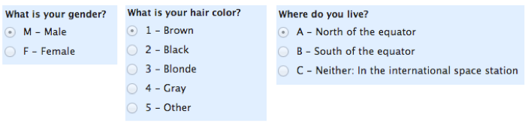
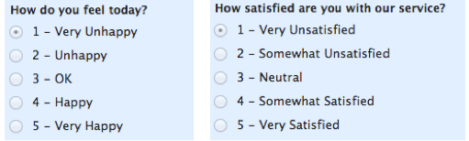
Recap: Good Starting Place – Know your data type
Quantitative (Numeric)
Continuous (e.g., health care expenditure)
Discrete (e.g., number of siblings)
Qualitative (Categorical)
Nominal – or labels (no overlap) (e.g., gender, hair color)
Ordinal – order of the value is important (e.g., Yelp rating, education level)
See the table that maps data types to plot types at the end of this slides

Slide 8
14.1.2 2015 Congressional Hearing: Planned Parenthood
Congressman Chaffetz (R-UT), chair US House Oversight Committee
Investigation of federal funding of Planned Parenthood
Chaffetz showed a plot which originally appeared in a report by Americans United for Life (http://www.aul.org/).
Procedures:
Cancer screenings
Abortion
Time: 2006 to 2013
How many data points are in this plot?

Slide 9
14.1.3 Voter Registration Trends in California
State of California publishes voter registration summaries
http://www.sos.ca.gov/elections/ror/60day presprim/hist reg stats.pdf
Historical registration counts available for presidential election years
What’s confusing or annoying about this plot?

Slide 10
14.1.4 Earnings
Bureau of Labor Statistics
Oversees scientific surveys related to economic health of the country
Current Population Survey
Collects data on the earnings
www.bls.gov - Web interface to a report generating app
Which comparisons can be easily made with this plot?

Slide 11
14.1.5 Cherry Blossom Run
10 mile run in Washington DC each April
Race organizers make results available on Web
Runner name, age, gender, address, hometown, time
Race results from 1999 to 2016
In 2012 nearly 17,000 runners ranging in age from 9 to 89 participated
Scatter plot of run time (minutes) by age (years)
70,000 points in this plot.
What’s the relationship between run time and age?

Slide 12
14.2 Methods

Slide 13
14.2.1 Planned Parenthood Procedures
All points and lines are on the same scale
How does this plot change the perception of the information?
There has been a dramatic decrease in cancer screenings which dominates this plot
The scales of the two procedures are very different – consider representing as percentages instead
Procedures in 2006 and 2013 as a percentage
Abortions increased from 13% to 26% of total procedures

Slide 14
14.2.2 Choosing the Scale
Choose axis limit to fill the plotting region
In necessary,
Zoom in to focus on region with bulk of data
Make multiple plots of different regions
Transform data to improve resolution
Don’t change scale mid-axis
Don’t use two different scales for the same axis

Slide 15
14.2.3 Earnings
Emphasize the important difference –
Lines make it easier to see growth in gap
Placement of one point above the other makes it easier to compare males & females
Juxtapose scatter plots, histograms & keep x and y scales the same across plots to facilitate comparison
Use color and plotting symbols to represent additional variables

Slide 16
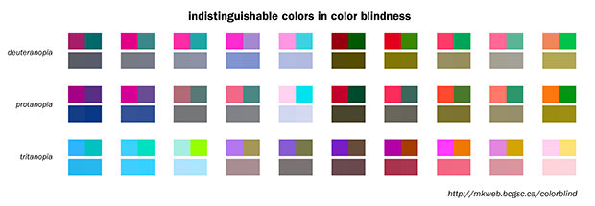
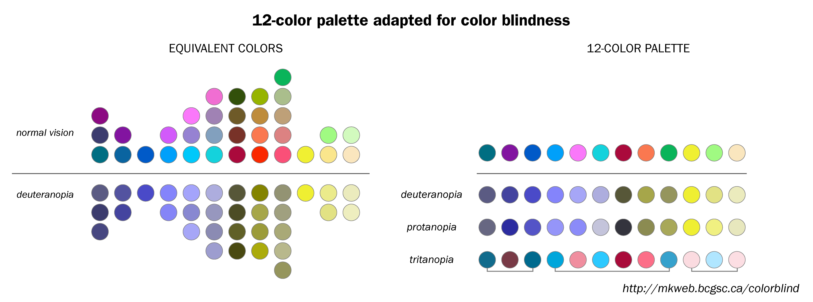
14.2.4 Color Guidelines
Choosing a set of colors which work well together is a challenging task for anyone who does not have an intuitive gift for color
7-10% of males are red-green color blind. Avoid following combinations
Green & Red.
Green & Brown.
Blue & Purple.
Green & Blue.
Light Green & Yellow.
Blue & Grey.
Green & Grey.
Green & Black.

Slide 17
14.2.5 Colorfulness
Saturated/colorful colors are hard to look at for a long time.
They tend to produce an after-image eﬀect which can be distracting.

Slide 18
14.2.6 Luminance
Areas should be rendered with colors of similar luminance (brightness).
Lighter colors tend to make areas look larger than darker colors

Slide 19
14.2.7 Data Type and Color
Qualitative – Choose a qualitative scheme that makes it easy to distinguish between categories
Quantitative – Choose a color scheme that implies magnitude.
Does the data progress from low to high? Use a sequential scheme where light colors are for low values
Do both low and high value deserve equal emphasis? Use a diverging scheme where light colors represent middle values

Slide 20
14.2.8 Examples of Palettes
Diverging
Qualitative
Sequential

Slide 21
14.2.9 Bar plot, Pie chart, Dot chart
Experiments found that angle judgments based on pie charts are less accurate than length judgments from bar charts
Length is easier to compare than area or volume
Lengths that fall on a line are easier to compare than lengths on parallel lines, i.e., judgments based on dot charts are easier to make than judgments based on bar plots

Slide 22
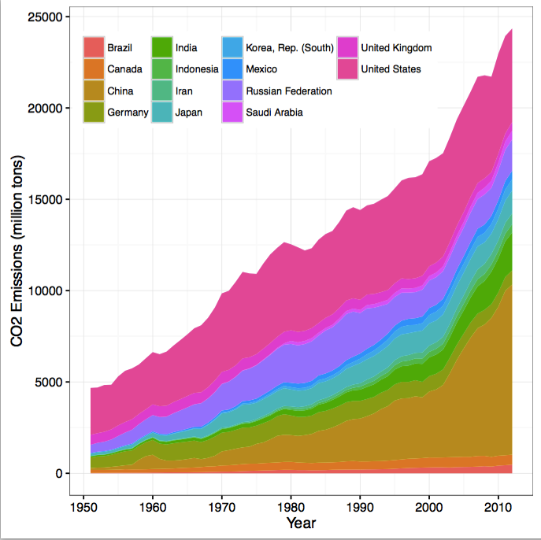
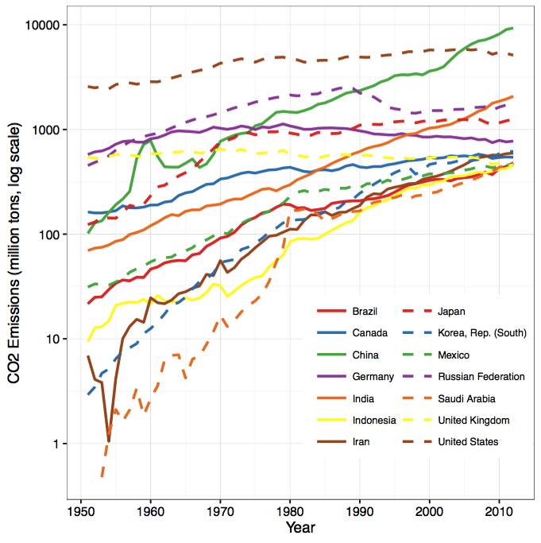
14.2.10 Stacking and Jiggling
Stacked bar plots and histograms are difficult to read because the base line moves from one bar to the next
Line plots where the area between successive lines represent the measurement are very difficult to read because the base line jiggles up and down.
Data on historical carbon dioxide (CO2) emissions from fuel combustion (http://cait.wri.org)

Slide 23
14.3 Filtering

Slide 24
14.3.1 Cherry Blossom Run
3-dimensional histogram is needed, but hard to come by
Use heat map or hexbin plot or transparency

Slide 25
14.3.2 Cherry Blossom Run
Local Smoothing helps us see the center
Not Longitudinal – follow same people in time
Slightly transparent points

Slide 26
14.3.3 Reveal the Data
Choose scale appropriately
Avoid having other graph elements interfere with data
Use visually prominent symbols
Eliminate superfluous material, aka chart junk
Avoid over-plotting

Slide 27
14.3.4 Avoid over-plotting
Why are there so few data points?
Shrink the plotting symbol so they don’t plot on top of each other

Slide 28
14.3.5 Facilitate Comparisons
Put Juxtaposed plots on same scale
Make it easy to distinguish elements of superposed plots, e.g. color, line type
Avoid angles, extra dimensions (e.g., areas rather than lines)
Don’t break the visual metaphor

Slide 29
14.3.6 Comparison: area vs length
Broken Visual metaphor – count is represented by height of word, not area

Slide 30
14.3.7 Make a plot information rich
Describe what you see in the Caption
Add context with Reference Markers (lines and points) including text
Use color and plotting symbols to add more information
Plot the same thing more than once in different ways/scales
Reduce clutter
Label axes, including units
Label points and legends for unusual/interesting observations
Captions should:
Describe what has been graphed
Draw attention to important features
Describe conclusions drawn from graph
Self-contained
Should be comprehensive

Slide 31
14.3.8 Iterate – Example Voter Registration
Location of tick marks under bars
Color of bars – indicate party
Title confusing
Y-axis label confusing
X-axis label missing

Slide 32
Voter Registration Trends
Check data for understanding of how plot is made
Observation? People vote, not counties
Lurking variable? County size - small counties tend to be rural and conservative

Slide 33
Voter Registration Trends
Collect better/more data
Decline to state and other parties are missing

Slide 34
14.3.9 Good Plot Making Practice
Put major conclusions in graphical form
Provide reference information
Proof read for clarity and consistency
Graphing is an iterative process
Multiplicity is OK, i.e., two plots of the same variable may provide different messages
Make plots data rich

Slide 35
14.4 Types of Plots and Tools

Slide 36
14.4.1 Univariate (analysis of one variable) Displays
Type | Plot
Quantitative | Histogram, Density curve Box plot, Violin plot Normal quantile plot (Q-Q plot) Few Observations - Rug plot, Dot plot Caution if discrete: density curves and box plots may be misleading
Qualitative | Dot chart Bar chart Pie chart (avoid!) Caution if ordinal –order of bars, dots, etc. should reflect category order
Notes:
A violin plot is more informative than a plain box plot. While a box plot only shows summary statistics such as mean/median and interquartile ranges, the violin plot shows the full distribution of the data.
A rug plot is a plot of data for a single quantitative variable, displayed as marks along an axis. It is used to visualise the distribution of the data.
Q-Q plots take your sample data, sort it in ascending order, and then plot them versus quantiles calculated from a theoretical distribution.

Slide 37
14.4.2 Bivariate (involves multiple variables) Displays
 | Quantitative | Qualitative
Quantitative | Scatter plot Smooth scatter Smooth lines and curves | Multiple histograms, density curves,
Qualitative |  | Side-by-side bar plot Overlaid Lines plot Side-by-side dot chart Mosaic plot

Slide 38
14.4.3 Example libraries/toolkits/APIs
Pandas plotting (Python) Matplotlib, seaborn https://python-graph-gallery.com/cheat-sheets/
D3.js (JavaScript) https://d3js.org
Shiny (R) https://shiny.rstudio.com
Google Charts (JavaScript) https://developers.google.com/chart/

Slide 39
Summary
Data visualization is the graphical representation of information and data. By using visual elements like scale, color, luminance, charting and filtering, data visualization tools provide an accessible way to see and understand trends, outliers, and patterns in data.
In the world of Big Data, data visualization tools and technologies are essential to analyze massive amounts of information and make data-driven decisions. Our eyes are drawn to colors and patterns. We can quickly identify red from blue, square from circle. Our culture is visual, including everything from art and advertisements to TV and movies.
Data visualization is another form of visual art that grabs our interest and keeps our eyes on the message. When we see a chart, we quickly see trends and outliers. If we can see something, we internalize it quickly. It’s storytelling with a purpose. If you’ve ever stared at a massive spreadsheet of data and couldn’t see a trend, you know how much more effective a visualization can be.

