Slide 1
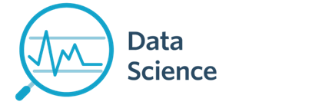
Module 1a - Course Introduction
CS 620 / DASC 600
Introduction to Data Science & Analytics
Dr. Sampath Jayarathna
Old Dominion University

Slide 2
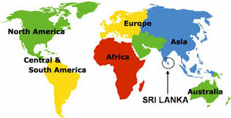
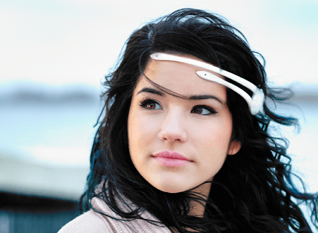
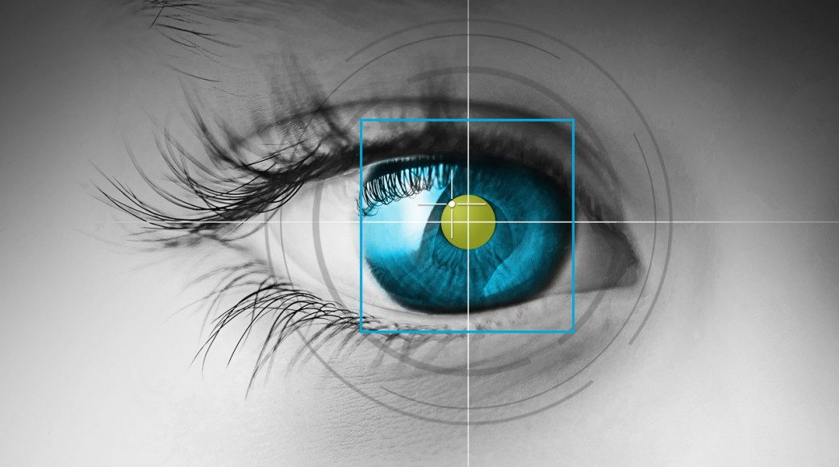
Instructor : Professor Sampath Jayarathna Joined ODU Fall 2018 (Professor Cal Poly 2016-2018) Originally from Sri Lanka
Research : Eye Tracking, Machine Learning, Data Science
Web : http://www.cs.odu.edu/~sampath/
Contact : ECSB 3109, sampath@cs.odu.edu, (757) 683-7787
Office Hours : T 12pm – 1pm, or email me for an appointment. Open Door Policy [Zoom link and password at Piazza]

Slide 3
Course Information
Piazza : https://piazza.com/odu/Fall2023/cs620/home
Canvas : https://canvas.odu.edu/
Prereqs
There are no specific course prerequisites for this course. But, I expect you to be comfortable learning new programming languages/tools/APIs, and knowledge in linear algebra and statistics.

Slide 4

Communication
Piazza:
All questions will be fielded through Piazza.
Many questions everyone can see the answer
You can also post private messages that can only be seen by the instructor
Canvas:
Canvas will be used primarily for course content modules, assignments/homework submission, and grade dissemination.
Email:
Again, email should only be used in rare instances, I will probably point you back to Piazza

Slide 5
Cooperate on Learning
Except for the work you hand in as individual contributions, I strongly encourage you to collaborate and help each other
If in doubt if a collaboration is legitimate: ask!
Don’t claim to have written code that you copied from others or online
Don’t give anyone else your code (to hand in for a grade)
When you rely on the work of others, explicitly list all of your sources – i.e. give credit to those who did the work
Don’t study alone when you don’t have to
Form study groups
Do help each other (without plagiarizing)

Slide 6
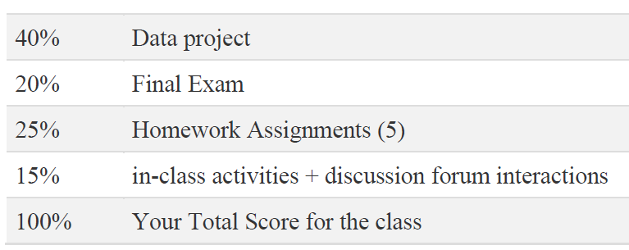
Course Organization
Grading
Required Materials
No textbook is required. All the key course content will be documented in slides, which will be available in the course website after each lecture.

Slide 7
Course Organization
Data Project: More in the next couple of slides…
Final Exam: Canvas/SmarterProctoring. The final exam is comprehensive, closed books. You may bring one standard 8.5" by 11" piece of paper with any notes you deem appropriate or significant (front and back).
Homework: We will have several homework assignments
class Activities ungraded in-class activities

Slide 8
Data Project
The data project is an opportunity to tackle a more challenging data science activity.
For the project, your team (individual or 2-3 students) will work on a dataset of your choosing that is interesting, significant, and relevant to Data Science.
The ultimate goal of your data project is to apply the techniques learn in each week of the class towards your dataset (exploration, wrangling, machine learning, mining, visualization).
We are going to use Google Colab (Colaboratory) (https://colab.research.google.com/), a free Jupyter notebook environment that requires no setup and runs entirely in the cloud.

Slide 9
Data Project - Milestones
In Google Colab
Abstract (5 pts) | Sunday, Sep. 24
Progress Checks I (2pts) and II (3 pts) | Sunday, Oct. 15, Nov. 12
Final Report (20pts) and YouTube Presenation/Demo (10 pts) | Sunday, Dec. 10

Slide 10
Personal devices – Software Setup
Windows/Mac/Linux
Anaconda (or any other IDE)
https://www.anaconda.com/products/individual
Weka
https://www.cs.waikato.ac.nz/ml/weka/downloading.html
jEdit
http://www.jedit.org/index.php?page=download
mongoDB community server
https://www.mongodb.com/try/download/community

Slide 11
To-do and Next time
Sign up for the Piazza
Choose a dataset for your Data Project
Find team members (individual or 2-3 students per team)
Submit your Abstract using Google Colab to Piazza (Colab URL)
Due, Sep. 24
HW1 is out!
Due, Sep 10

