Slide 1

Introduction to Data Science
CS 620 / DASC 600
Introduction to Data Science & Analytics
Dr. Sampath Jayarathna
Old Dominion University

Slide 2
1. Overview
Data science is an interdisciplinary blend of the analytical, computational, and statistical skills necessary to extract knowledge from large and complex sets of data. The proliferation of such data has led to an acute shortage of students with data science skills in the local, national, and global economy.
This course and the rest of the modules will introduce you to this rapidly growing field of Data Science and equip them with some of its basic principles and tools as well as its general mindset. You will learn concepts, techniques and tools they need to deal with various facets of data science practices.

Slide 3
Objectives
Define and explain the key concepts and models relevant to data science.
Understand the processes of data science: identifying the problem to be solved, data collection, preparation, modeling, evaluation and visualization.
Develop an appreciation of the many techniques for data modeling
Be comfortable using commercial and open source tool such as python and associated libraries for data analytics and visualization.

Slide 4
Relevance
Data Science is one of the fastest-growing disciplines at the university level. In industry, we see more job postings that require training in data science. We are living in an era in which the kind of problems that could be solved using data are driving a huge wave of innovations in various industries. Thus, knowing the basics of data and data analysis has become a fundamental skill that everyone needs.

Slide 5
1.1 Data Science

Slide 6
1.1.1 Data Science – A Definition
Data Science is the science which uses computer science, statistics and machine learning, visualization and human-computer interactions to collect, clean, integrate, analyze, visualize, interact with data to create data products.

Slide 7
1.1.2 Goal of Data Science
Turn data into data products.

Slide 8
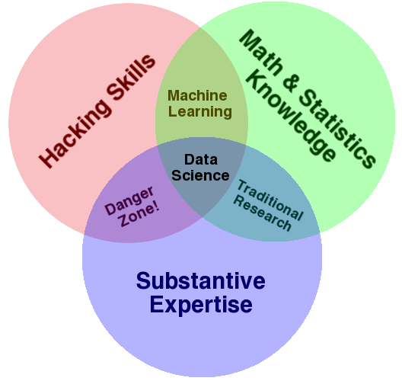
1.1.3 Data Science – A Visual Definition
Notes:
Drew Conway’s definition

Slide 9
1.2 Data Science Trends

Slide 10
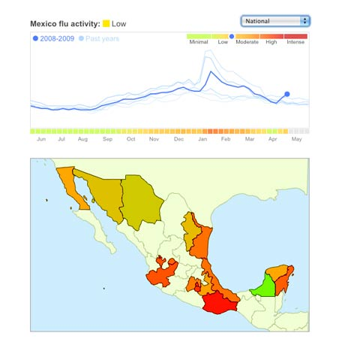
1.2.1 Why all the Excitement?
Exciting new effective
applications of data analytics
e.g.,
Google Flu Trends:
Detecting outbreaks
two weeks ahead
of CDC data
New models are estimating which cities are most at risk for spread of the Ebola virus.
Prediction model is built on
Various data sources,
types and analysis.

Slide 11
1.2.2 Data and Election 2012
…that was just one of several ways that Mr. Obama’s campaign operations, some unnoticed by Mr. Romney’s aides in Boston, helped save the president’s candidacy. In Chicago, the campaign recruited a team of behavioral scientists to build an extraordinarily sophisticated database
…that allowed the Obama campaign not only to alter the very nature of the electorate, making it younger and less white, but also to create a portrait of shifting voter allegiances. The power of this operation stunned Mr. Romney’s aides on election night, as they saw voters they never even knew existed turn out in places like Osceola County, Fl.
-- New York Times, Wed Nov 7, 2012
The White House Names Dr. DJ Patil as the First U.S. Chief Data Scientist, Feb. 18th 2015

Slide 12
1.2.3 Data and Election 2016
Cambridge Analytica has built models that translate the data they harvest into personality profiles for every American adult to have “somewhere close to 4 or 5 thousand data points on every adult in the US.”
Their models are based on the psychometric research of Michal Kosinski. Kosinski and his colleagues developed a model that linked subjects’ Facebook likes with their OCEAN scores. OCEAN refers to a questionnaire used by psychologists that describes personalities along five dimensions — openness to experience, conscientiousness, extraversion, agreeableness, and neuroticism.
Notes:
https://nobaproject.com/modules/personality-traits

Slide 13
Cambridge Analytica has combined this social psychology with data analytics. They collect data from Facebook and Twitter (which is perfectly legal) and have purchased an array of other data — about television preferences, airline travel, shopping habits, church attendance, what books you buy, what magazines you subscribe to — from third-party organizations and so-called data brokers.
They take all this information and use it for what calls “behavioral microtargeting” — basically individualized advertising.
Instead of tailoring ads according to demographics, they use psychometrics.
https://www.youtube.com/watch?v=7bXJ_obaiYQ

Slide 14
1.2.4 Other Data Science Applications
Transaction Databases → Recommender systems (Netflix), Fraud Detection (Security and Privacy)
Wireless Sensor Data → Smart Home, Real-time Monitoring, Internet of Things
Text Data, Social Media Data → Product Review and Consumer Satisfaction (Facebook, Twitter, LinkedIn), E-discovery
Software Log Data → Automatic Trouble Shooting (Splunk)
Genotype and Phenotype Data → Epic, 23andme, Patient-Centered Care, Personalized Medicine
Notes:
https://www.cbc.ca/news/world/dna-from-genealogy-site-used-to-catch-suspected-golden-state-killer-1.4637726

Slide 15
1.3 Data Science Catalysts

Slide 16
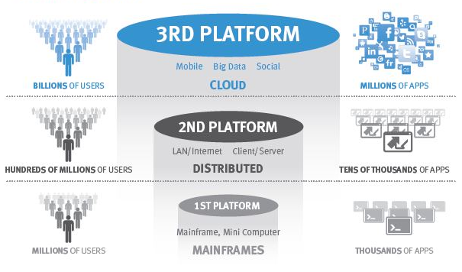
1.3.1 The end of “One size fits all”
A single architecture cannot meet all those demands
3rd platform drives new demands on the databases
Global high availability
Data volumes
Unstructured data
Transaction rates
Latency

Slide 17
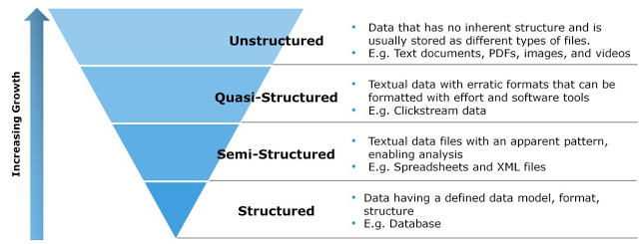
1.3.2 Digital Data: Classification

Slide 18
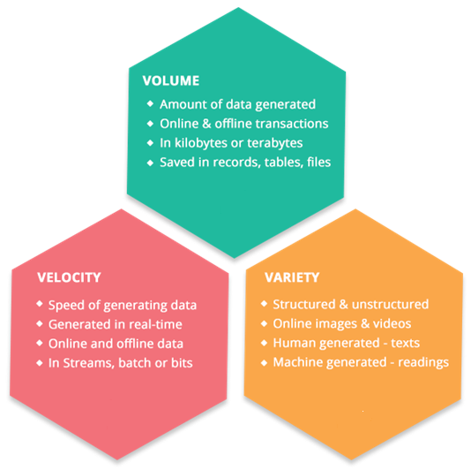

Slide 19
1.3.3 Information Retrieval
Information Retrieval (IR) is finding material (usually documents) of an unstructured nature (usually text) that satisfies an information need from within large collections (usually stored on computers).
Most prominent example: Web Search Engines

Slide 20
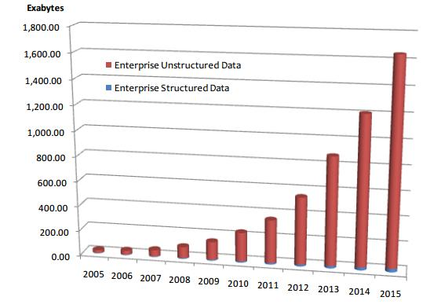
Table 1: People in CS Department
Handling unstructured data
Structured data: database system is a
good choice
Unstructured data is more dominant
Text in Web documents or emails, image, audio, video…
“85 percent of all business information exists as unstructured data”
ID | Name | Job
1 | Jack | Professor
3 | David | Stuff
5 | Tony | IT support
Total Enterprise Data Growth 2005-2015

Slide 21
1.3.4 Instrumented Human
Data sets grow rapidly - in part because they are increasingly gathered by cheap and numerous information-sensing Internet of things devices such as mobile devices, wearables, software logs, cameras, microphones

Slide 22
1.4 Relevant Areas

Slide 23
1.4.1 Databases
 | Databases | Data Science
Data Value | “Precious” | “Cheap”
Data Volume | Modest | Massive
Examples | Bank records, Personnel records, Census, Medical records | Online clicks, GPS logs, Tweets, Building sensor readings
Priorities | Consistency, Error recovery, Auditability | Speed, Availability, Query richness
Structured | Strongly (Schema) | Weakly or none (Text)
Properties | Transactions, ACID* | CAP* theorem (2/3), eventual consistency
Realizations | SQL | NoSQL: MongoDB, CouchDB, Hbase, Cassandra, Riak, Memcached, Apache River, …
ACID = Atomicity, Consistency, Isolation and Durability
CAP = Consistency, Availability, Partition Tolerance

Slide 24
1.4.1 Business Intelligence
Business Intelligence | Data Science
Querying the past | Querying the past present and future

Slide 25
1.4.1 Machine Learning
Machine Learning
Develop new (individual) models
Prove mathematical properties of models
Improve/validate on a few, relatively clean, small datasets
Publish a paper
Data Science
Explore many models, build and tune hybrids
Understand empirical properties of models
Develop/use tools that can handle massive datasets
Take action!

Slide 26
1.5 Data Science Myths

Slide 27
1.5.1 Myths & Truths about Data Science in Industry
You need big data to do anything interesting
You spend most of time analyzing & building models
You need to be a hard-core programmer to be successful
You can communicate results after analysis is done
Can you guess which one is true?

Slide 28
You need ‘big’ data to do anything interesting
You won’t need big data most of the time

Slide 29
Burdens of Big Data
Big data is costly to collect and store
Big data slows down the iteration
Big data is useful only if:
You’re trying to build a data product (i.e., search engine)
You’re dealing with very noisy measurement (i.e., A/B testing)
You’re interested in identifying the exceptions (outliers)
Even then, start with small data!
Notes:
A/B testing (also known as split testing or bucket testing) is a method of comparing two versions of a webpage or app against each other to determine which one performs better.

Slide 30
Determining how much data you need
Exploratory analysis
Do we have enough coverage for all edge cases? (i.e., outliers)
Statistical Inference
Is our confidence interval narrow enough?
Do we have enough statistical power to validate our hypotheses?
Predictive Analysis
Do we have enough data to train/evaluate our model?
Notes:
https://www.simplypsychology.org/confidence-interval.html

Slide 31
You need to be a hard-core programmer
Basic skills (e.g., SQL) get you pretty far

Slide 32
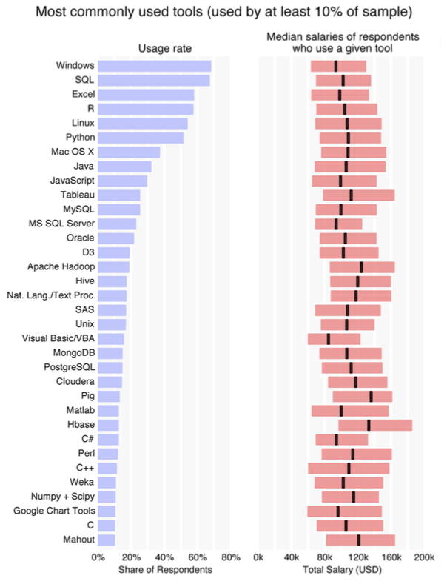
Data Science Tool Usage Survey
Still dominated by simple tools…
Notes:
_{2014/O’Rielly survey data}

Slide 33
You spend most of time analyzing data
You spend most of time preparing data

Slide 34
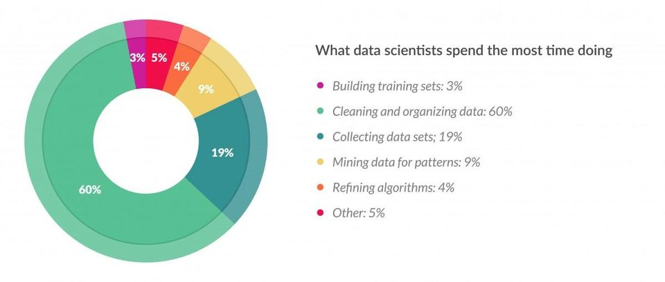
Data scientists, according to interviews and expert estimates, spend from 50 percent to 80 percent of their time mired in this more mundane labor of collecting and preparing unruly digital data, before it can be explored for useful nuggets.

Slide 35
Things can go wrong in many different levels…
Inherent noise / bias in data
The process of collecting the data (instrumentation)
The process of processing the data
Interpretation of processed data
…

Slide 36
Make sure you check for quality issues!
Completeness
Fidelity
Consistency
Is the data representative of the problem space?
Do the measurements capture the reality?
Do different attributes agree with each other?
Any missing observations / attributes?
Any issues of bias or variance?
Are values follow data types specified?

Slide 37
You can communicate results after analysis is done
You need to communicate throughout the process

Slide 38

Imagine you’re in jungle with complete strangers

Slide 39
Why communication is so critical for solving a data problem?
You are seldom given a clear-cut problem (hence the data problem)
The team is composed of people with different expertise / style
No one has complete information of the problem / solution space
You often need to change courses multiple times, along the way

Slide 40
Myths & Truths about Data Science in Industry
You need big data to do anything interesting
You spend most of time analyzing & building models
You need to be a hard-core programmer to be successful
You can communicate results after analysis is done
All these are myths!

Slide 41
Summary
This module introduce the filed of data science, along with various applications. It also points out important differences and similarities with related fields of databases, business intelligence, and machine learning. We have an explosion of data in every sector, with data varying a great deal in its nature, format, size and other aspects. Such data has become substantially important in our daily lives. This module presents several views on myths about data science, and how it affects or is connected to various tasks associated in the life cycle of data science.

