Slide 1

Module 3- NumPy
CS 620 / DASC 600
Introduction to Data Science & Analytics
Dr. Sampath Jayarathna
Old Dominion University

Slide 2
3. Overview
In this module, you will learn about a commonly used data structure in Python for scientific data: NumPy arrays. NumPy (Numeric Python) is the core library for scientific computing in Python. It provides a high-performance multidimensional array object, and tools for working with these arrays. NumPy arrays provide much more efficient storage and data operations as the arrays grow larger in size. NumPy arrays form the core of nearly the entire ecosystem of data science tools in Python, so time spent learning to use NumPy effectively will be valuable no matter what aspect of data science interests you.

Slide 3
Objectives
Describe the key characteristics of NumPy arrays.
Apply arithmetic operations using NumPy arrays.
Run calculations and summarize data in NumPy arrays.
Use indexing to slice (i.e. select) data from NumPy arrays.

Slide 4
Relevance
Numpy is the most basic and a powerful package for working with data in python. If you are going to work on data analysis or machine learning projects, then having a solid understanding of NumPy is nearly mandatory. Because other packages for data analysis (like pandas) is built on top of NumPy and the scikit-learn package which is used to build machine learning applications works heavily with numpy as well.

Slide 5
3.1 NumPy Overview

Slide 6
3.1.1 Numerical Python
Stands for Numerical Python
Is the fundamental package required for high performance computing and data analysis
NumPy is so important for numerical computations in Python is because it is designed for efficiency on large arrays of data.

Slide 7
Internally stores data in a contiguous block of memory, independent of other built-in Python objects, use much less memory than built-in Python sequences.
Standard math functions for fast operations on entire arrays of data without having to write loops
NumPy Arrays are important because they enable you to express batch operations on data without writing any for loops. We call this vectorization.

Slide 8
numpy arrays are dense, continuous, uniformly sized blocks of identically typed data values
Why does this matter?
Keeping data close together results in faster access times.
It's easier to figure out the location of the data
The data is more likely to fit in the processor's cache

Slide 9
3.1.2 NumPy ndarray vs list
One of the key features of NumPy is its N-dimensional array object, or ndarray, which is a fast, flexible container for large datasets in Python.
Whenever you see “array,” “NumPy array,” or “ndarray” in the text, with few exceptions they all refer to the same thing: the ndarray object.
NumPy-based algorithms are generally 10 to 100 times faster (or more) than their pure Python counterparts and use significantly less memory.
import numpy as np
my_arr = np.arange(1000000)
my_list = list(range(1000000))

Slide 10
3.1.3 ndarray
ndarray is used for storage of homogeneous data
i.e., all elements the same type
Every array must have a shape and a dtype
Supports convenient slicing, indexing and efficient vectorized computation
import numpy as np
data1 = [6, 7.5, 8, 0, 1]
arr1 = np.array(data1)
print(arr1)
print(arr1.dtype)
print(arr1.shape)
print(arr1.ndim)

Slide 11
3.1.4 Creating ndarrays
Using list of lists
import numpy as np
data2 = [[1, 2, 3, 4], [5, 6, 7, 8]] #list of lists
arr2 = np.array(data2)
print(arr2.ndim) #2
print(arr2.shape) # (2,4)

Slide 12
Creating ndarrays
array = np.array([[0,1,2],[2,3,4]])
[[0 1 2]
[2 3 4]]
array = np.zeros((2,3))
[[0. 0. 0.]
[0. 0. 0.]]
array = np.ones((2,3))
[[1. 1. 1.]
[1. 1. 1.]]
array = np.eye(3, dtype=int)
[[1. 0. 0.]
[0. 1. 0.]
[0. 0. 1.]]
array = np.arange(0, 10, 2)
[0, 2, 4, 6, 8]
array = np.random.randint(0, 10, (3,3))
[[6 4 3]
[1 5 6]
[9 8 5]]
arange is an array-valued version of the built-in Python range function
Notes:
array = np.eye(3, dtype=int)

Slide 13
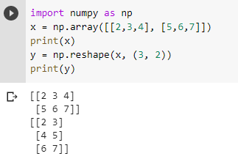
3.1.5 Reshape
The reshape() function is used to give a new shape to an array without changing its data.
numpy.reshape(array, newshape)

Slide 14
3.2 Arithmetic using NumPy

Slide 15
3.2.1 Arithmatic with NumPy Arrays
Any arithmetic operations between equal-size arrays applies the operation element-wise:
arr = np.array([[1., 2., 3.], [4., 5., 6.]])
print(arr)
[[1. 2. 3.]
[4. 5. 6.]]
print(arr * arr)
[[ 1. 4. 9.]
[16. 25. 36.]]
print(arr - arr)
[[0. 0. 0.]
[0. 0. 0.]]
Notes:
np.array(list)

Slide 16
Arithmetic operations with scalars propagate the scalar argument to each element in the array:
Comparisons between arrays of the same size yield boolean arrays:
arr = np.array([[1., 2., 3.], [4., 5., 6.]])
print(arr)
[[1. 2. 3.]
[4. 5. 6.]]
print(arr **2)
[[ 1. 4. 9.]
[16. 25. 36.]]
arr2 = np.array([[0., 4., 1.], [7., 2., 12.]])
print(arr2)
[[ 0. 4. 1.]
[ 7. 2. 12.]]
print(arr2 > arr)
[[False True False]
[ True False True]]

Slide 17
3.3 Indexing and Slicing

Slide 18
3.3.1 One-Dimensional Arrays
One-dimensional arrays are simple; on the surface they act similarly to Python lists:
arr = np.arange(10)
print(arr) # [0 1 2 3 4 5 6 7 8 9]
print(arr[5]) #5
print(arr[5:8]) #[5 6 7]
arr[5:8] = 12
print(arr) #[ 0 1 2 3 4 12 12 12 8 9]

Slide 19
3.3.2 Slicing
As you can see, if you assign a scalar value to a slice, as in arr[5:8] = 12, the value is propagated (or broadcasted) to the entire selection.
arr = np.arange(10)
print(arr) # [0 1 2 3 4 5 6 7 8 9]
arr_slice = arr[5:8]
print(arr_slice) # [5 6 7]
arr_slice[1] = 12345
print(arr) # [ 0 1 2 3 4 5 12345 7 8 9]
arr_slice[:] = 64
print(arr) # [ 0 1 2 3 4 64 64 64 8 9]

Slide 20
3.3.3 NumPy array vs Python built-in list
An important first distinction from Python’s built-in lists is that array slices are views on the original array.
This means that the data is not copied, and any modifications to the view will be reflected in the source array.
As NumPy has been designed to be able to work with very large arrays, you could imagine performance and memory problems if NumPy insisted on always copying data.
If you want a copy of a slice of an ndarray instead of a view, you will need to explicitly copy the array—for example,
arr[5:8].copy()

Slide 21
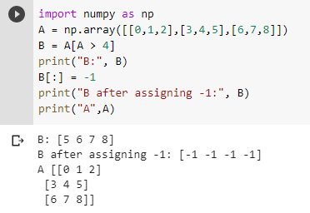
A numpy array object has a pointer to a dense block of memory that stores the data of the array.
Basic slices are just views of this data - they are not a new copy.
Binding the same object to different variables will not create a copy.
Advanced slices will create a copy if bound to a new variable - these are cases where the result may contain elements that are not contiguous in the original array

Slide 22
3.3.4 Indexing
In a two-dimensional array, the elements at each index are no longer scalars but rather one-dimensional arrays:
Thus, individual elements can be accessed recursively. But that is a bit too much work, so you can pass a comma-separated list of indices to select individual elements.
So these are equivalent:
arr2d = np.array([[1, 2, 3], [4, 5, 6], [7, 8, 9]])
print(arr2d[2]) # [7 8 9]
print(arr2d[0][2]) # 3
print(arr2d[0, 2]) #3

Slide 23
Activity 3
Consider the two-dimensional array, arr2d.
Write a code to slice this array to display the midle column,
[2, 5, 8]
Write a code to slice this array to display the last 2 elements of last column array,
[6 9]
Submit your code to piazza Activity 3 thread.
arr2d = np.array([[1, 2, 3], [4, 5, 6], [7, 8, 9]])

Slide 24
3.4 Functions

Slide 25
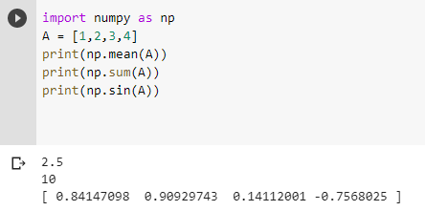
3.4.1 Functions on Arrays
numpy includes a number of standard functions that will work on arrays

Slide 26
3.5 Axis

Slide 27
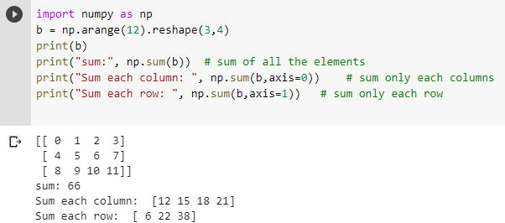
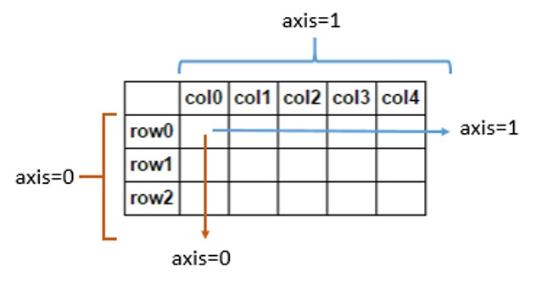
3.5.1 Use of Axis on NumPy
Most aggregation operations take an axis parameter that limits the operation to a specific direction in the array
axis 0: across rows (apply operation to individual columns)
axis 1: across columns (apply operation to individual rows)

Slide 28
Activity 4
Consider the two-dimensional array, arr.
Find the summation of the middle column by skipping the 2 middle rows.
Answer: 1+10 = 11
Submit your code to piazza Activity 4 thread.
arr = np.arange(12).reshape(4,3)
[[ 0 1 2] [ 3 4 5] [ 6 7 8] [ 9 10 11]]

Slide 29
Summary
NumPy is a Python package that stands for ‘Numerical Python’. It is the core library for scientific computing, which contains a powerful n-dimensional array object.
This module introduces the NumPy data structures, implementing multi-dimensional arrays and matrices. These data structures guarantee efficient calculations with matrices and arrays. NumPy arrays are great alternatives to Python Lists introduced in Python Module. Some of the key advantages of NumPy arrays are that they are fast, easy to work with, and give users the opportunity to perform calculations across entire arrays.

Slide 30
Extra: Matrix Manipulations

Slide 31
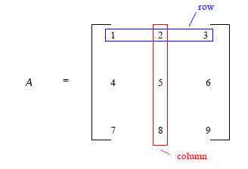
Matrix
A matrix is a rectangular array of numbers organized in rows and columns
If a matrix A has m rows and n columns, then we say that A is an m x n matrix

Slide 32
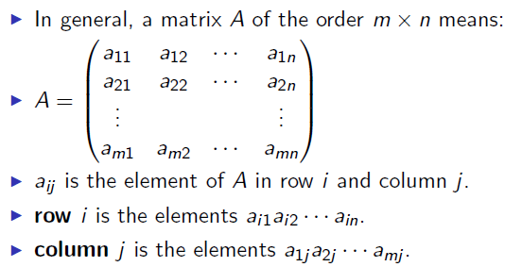
Matrix

Slide 33
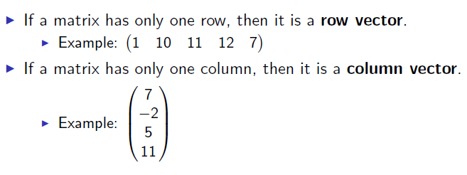
Vectors

Slide 34
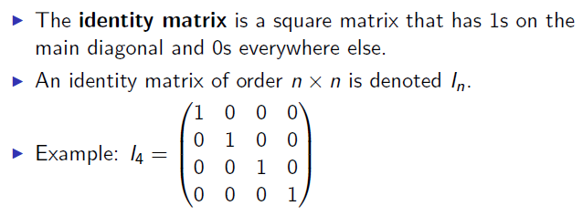
Identity matrix

Slide 35
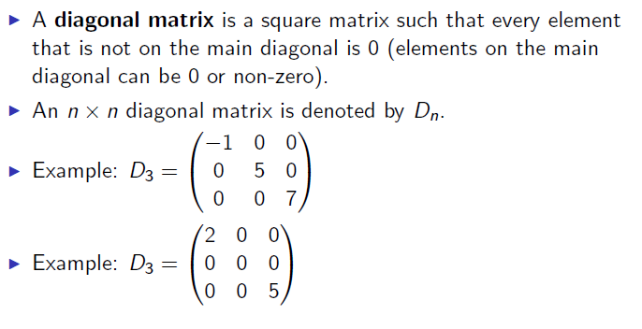
Diagonal matrix

Slide 36
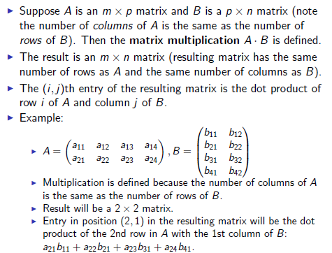
Matrix multiplication

Slide 37
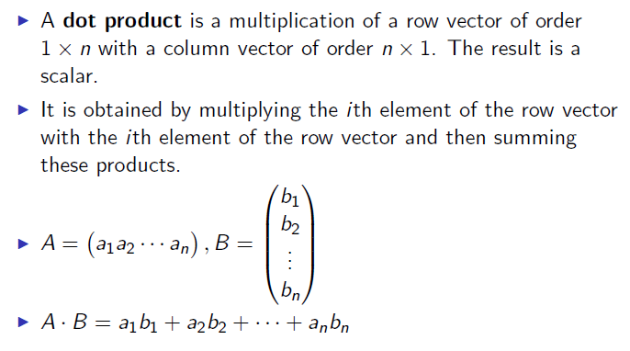
Dot product
a = b = np.arange(5)
print(a)
Out: array([0, 1, 2, 3, 4])
print(b)
Out: array([0, 1, 2, 3, 4])
print(a.dot(b))
Out: 30

