Slide 1

Module 4 - Pandas
CS 620 / DASC 600
Introduction to Data Science & Analytics
Dr. Sampath Jayarathna
Old Dominion University

Slide 2
3. Overview
This module will introduce data manipulation and cleaning techniques using the popular python pandas data science library and introduce the abstraction of the Series and DataFrame as the central data structures for data analysis, along with techniques on how to use functions and techniques to access, retrieve, and modify data.
Pandas is a package/library that built on top of NumPy. There are two basic pandas objects, series and dataframes, which can be thought of as enhanced versions of 1D and 2D NumPy arrays, respectively. Indeed Pandas attempts to keep all the efficiencies that NumPy gives us.

Slide 3
Objectives
Describe the key characteristics of pandas series and dataframes
Convert both structured and unstructured data into Python and parse unstructured data into structured formats
Prepare tabular data, clean it, manipulate it, and run basic analysis on data
Calculate and summarize data in pandas dataframes.

Slide 4
Relevance
pandas DataFrames are the most widely used in-memory representation of complex data collections within Python. Whether in finance, a scientific field, or data science, familiarity with pandas is essential. Pandas is a game changer when it comes to analyzing data with Python and it is one of the most preferred and widely used tools in data munging/wrangling.

Slide 5
4.1 Pandas Overview

Slide 6
4.1.1 Why pandas?
One of the most popular library that data scientists use
Labeled axes to avoid misalignment of data
When merge two tables, some rows may be different
Missing values or special values may need to be removed or replaced
 | height | Weight | Weight2 | age | Gender
Amy | 160 | 125 | 126 | 32 | 2
Bob | 170 | 167 | 155 | -1 | 1
Chris | 168 | 143 | 150 | 28 | 1
David | 190 | 182 | NA | 42 | 1
Ella | 175 | 133 | 138 | 23 | 2
Frank | 172 | 150 | 148 | 45 | 1
 | salary | Credit score
Alice | 50000 | 700
Bob | NA | 670
Chris | 60000 | NA
David | -99999 | 750
Ella | 70000 | 685
Tom | 45000 | 660

Slide 7
4.1.2 Introduction
Created by Wes McKinney in 2008, now maintained by many others.
Author of one of the textbooks: Python for Data Analysis
Powerful and productive Python data analysis and Management Library
Panel Data System
The name is derived from the term "panel data", an econometrics term for data sets that include both time-series and cross-sectional data
Its an open source product.

Slide 8
Python Library to provide data analysis features similar to: R, MATLAB, SAS
Rich data structures and functions to make working with data structure fast, easy and expressive.
It is built on top of NumPy
Key components provided by Pandas:
Series
DataFrame
From now on:
from pandas import Series, DataFrame
import pandas as pd

Slide 9
4.2 Series

Slide 10
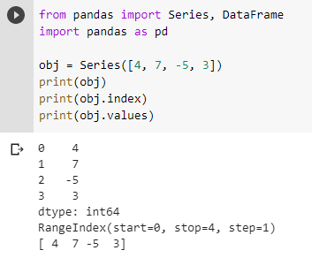
4.2.1 Series Data Structure
One dimensional array-like object
It contains array of data (of any NumPy data type) with associated indexes. (Indexes can be strings or integers or other data types.)
By default , the series will get indexing from 0 to N where N = size -1

Slide 11
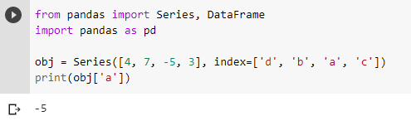

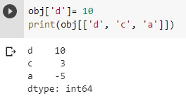
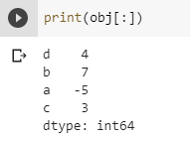
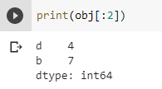
4.2.2 referencing elements
Can reference elements using the index label specified in the [] or using . (dot) operator with label name.
More than 1 element labels require specifying it within [[ ]] double square brackets.
: (colon) will retrieve all the elements in the Series.
Similarly, start:end(exclusive) will retrieve elements from each index. Note that end index is not inclusive.
Notes:
Label slicing is different from positional slicing (end not inclusive)

Slide 12
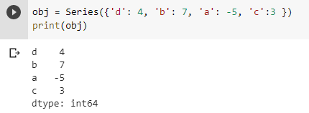
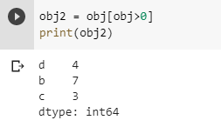
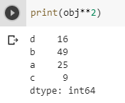

4.2.3 array/dict operations
Can be thought of as a dict. Can be constructed from a dict directly.
NumPy array operations can also be applied, which will preserve the index-value link

Slide 13
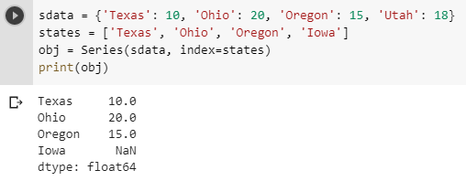
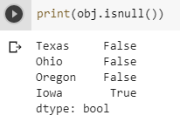
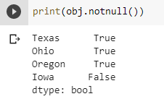
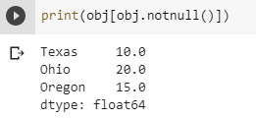
4.2.4 from dictionary
A dict can be passed as input and if no index is specified, then the dictionary keys are taken in a sorted order to construct index. If index is passed, the values in data corresponding to the labels in the index will be pulled out.
dictionary
Missing value

Slide 14
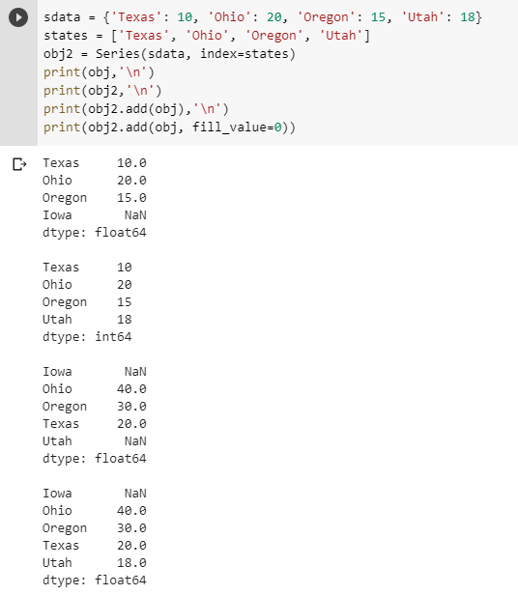
4.2.5 auto alignment
Alignment of Series data by index labels is a fundamental concept in pandas, as well as being one of its most powerful concepts.
Alignment provides automatic correlation of related values in multiple Series objects based upon index labels.
This saves a lot of error-prone effort matching data in multiple sets using standard procedural techniques.
Notes:
print(obj4.add(obj5, fill_value=0)) to avoid NaN

Slide 15
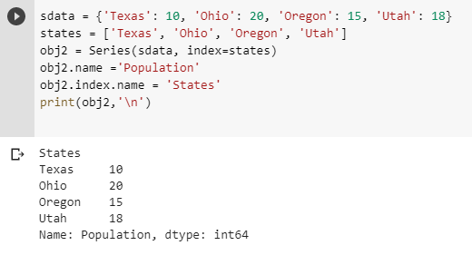
4.2.6 Series name and index name
You can modify the name of the Series and the name of the index of the Series using the name property of each item.

Slide 16
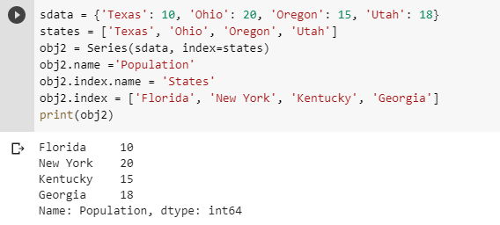
4.2.7 Series name and index name
Index of a series can be changed to a different index.
Index object itself is immutable.
obj2.index[2]='California'
TypeError: Index does not support mutable operations

Slide 17
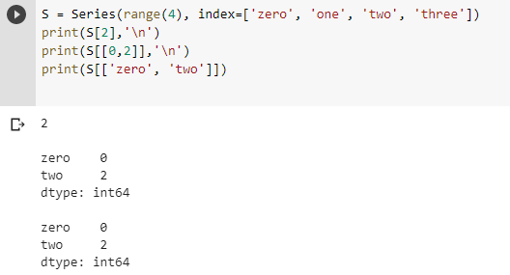
4.2.8 Indexing, selection and filtering
Series can be sliced/accessed with label-based indexes, or using position-based indexes
[[ ]] list operator for items >1

Slide 18
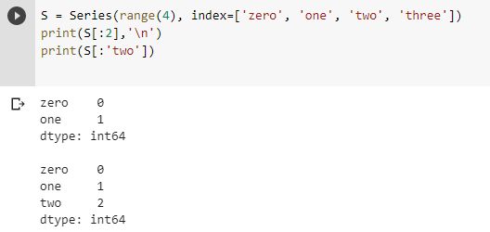
Series can be sliced/accessed with label-based indexes, or using position-based indexes
Use of label is end-Inclusive, but
the index is not-inclusive
Notes:
Slices are

Slide 19
Activity 5
Create a random list of 10 integers in the range from 1 to 100
Generate a Series using above list with index values of 1-10
Name your Series “Random Numbers”
Name your index “idx”
Now generate the Squares of all the values in the Series
Display only the odd index items of this Series. (Hint: experiment with using :: which is any list[start:end:step] )
Also display all the numbers <40 as a list (without the index).
Submit your code to piazza Activity 5 thread.

Slide 20
4.3 DataFrame

Slide 21
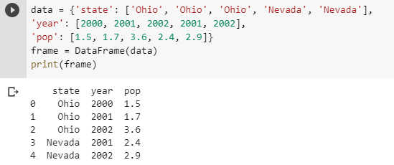
4.3.1 DataFrame Introduction
A DataFrame is a tabular data structure comprised of rows and columns, akin to a spreadsheet or database table.
It can be treated as an ordered collection of columns
Each column can be a different data type
Have both row and column indices

Slide 22
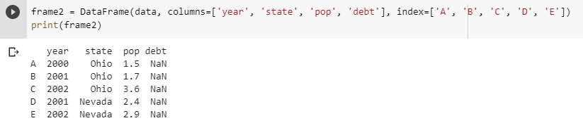
4.3.2 Specifying columns and indices
Order of columns/rows can be specified.
Columns not in data will have NaN.
Same order
Initialized with NaN

Slide 23
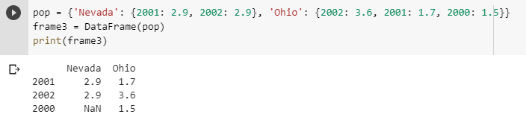
4.3.3 Creating DataFrame from nested dict of dicts
Outer dict keys as columns and inner dict keys as row indices
Union of inner keys (in sorted order)

Slide 24
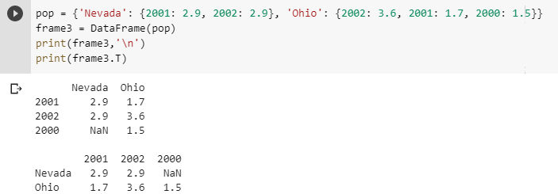
4.3.4 Transpose
Reflect the DataFrame over its main diagonal by writing rows as columns and vice-versa. The property T is an accessor to the method transpose().

Slide 25
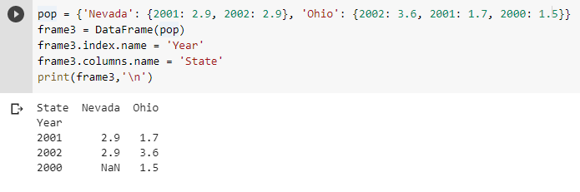
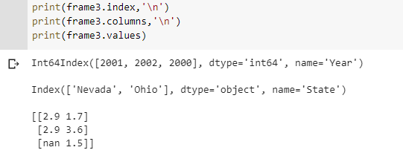
4.3.5 DataFrame – index, columns, values
Similar to Series, you can modify the name of the index as well as name of the columns using name property.
DataFrame.values will print the underlying data content of the DataFrame

Slide 26
4.4 Data Manipulations

Slide 27
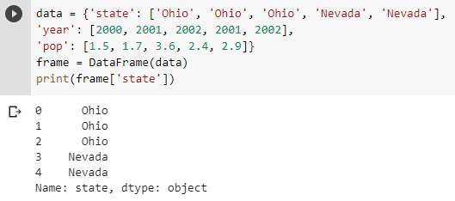
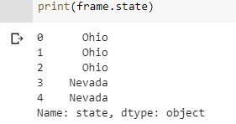
4.4.1 Retrieving a column
A column in a DataFrame can be retrieved as a Series by dict-like notation or as attribute
To retrieve using attribute, DataFrame.columnName

Slide 28
4.4.2 Retrieving a Row or Column
There are multiple ways to select and index rows and columns from Pandas DataFrames. loc for using labels and iloc for using position index (integer)
loc gets rows (or columns) with particular labels from the index.
DataFrame.loc[row_label , column_label]
iloc gets rows (or columns) at particular positions in the index (so it only takes integers).
DataFrame.iloc[row_index, column_index]

Slide 29
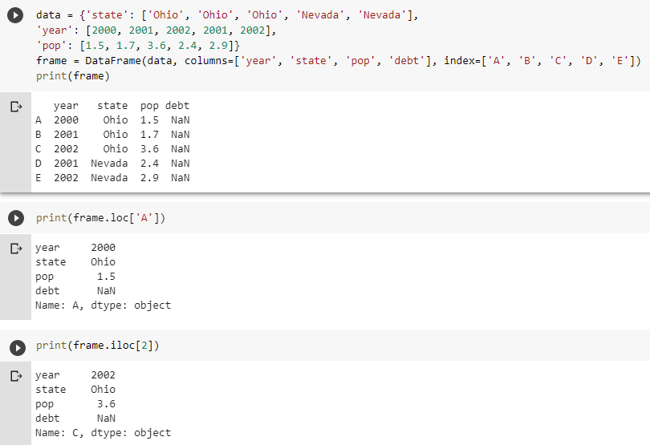
We can specify only the row for both loc or iloc. We are implicitly retrieving all the columns in the DataFrame.

Slide 30
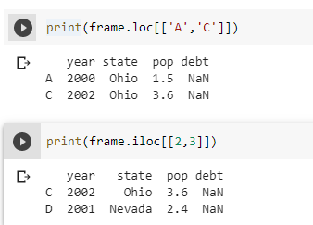
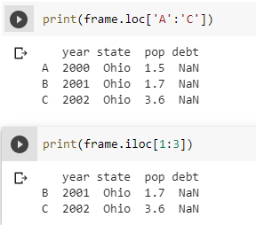
4.4.2 Retrieving a Row or Column
Similarly, we are still specifying the row (including all the columns) in the following examples.
Learning Check: Why the , (comma) doesn’t provide access to both row and columns here?
Similarly, we can use : operator to specify a range of labels or positions (still in rows).

Slide 31
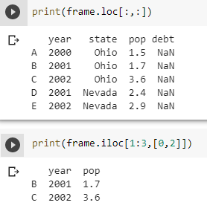
4.4.3 Retrieving Rows and/or Columns
Use the , (comma) when calling rows and/or columns. Here : will retrieve all the rows and all the columns.
We can retrieve certain range using the syntax like only rows B and C, and Year and pop
Learning Check: Why 1:3 didn’t retrieve the row D here? Does that change if you use loc instead?

Slide 32
Activity 6
Download the following csv file and load it to your python module or use the url directly in pd.read_csv(url) which will read it to a DataFrame
https://www.cs.odu.edu/~sampath/courses/data/values.csv
Calculate the average and standard deviation (std) of the column factor_1 and display the result. Pandas mean() and std(). Round each number to only two decimals.
Using iloc, display the row indexes 4, 2, 5 and columns factor_1 and price in that order.
Submit your code to piazza Activity 6 thread.
Notes:
Obj = pd.read_csv(‘values.csv’)

Slide 33
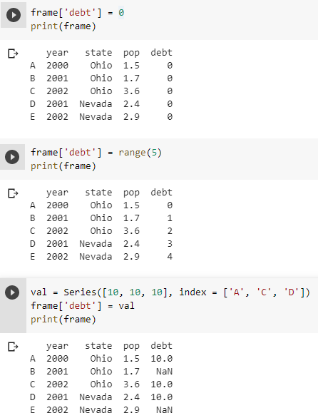
4.4.4 Modifying columns
Column values can be modified using variety of methods such as broadcasting a value to entire column, assigning a range, or generating a Series with values corresponds to certain labels.
Rows or individual elements can be modified similarly. Using loc or iloc.

Slide 34
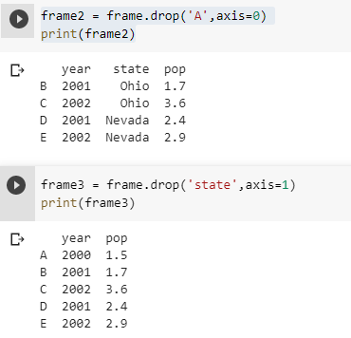
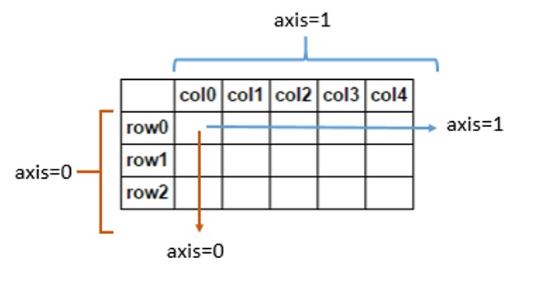
4.4.5 Removing columns
To delete rows and columns from DataFrames, Pandas uses the “drop” function.
To delete a column, row, or multiple items, use the name and specify the “axis” 0 for row and 1 for column.
The drop function returns a new DataFrame, with the columns removed. To actually edit the original DataFrame, the “inplace” parameter can be set to True, and there is no returned value.
Notes:
Df = frame.drop('r1', 0) # 0 for row, 1 for columns

Slide 35
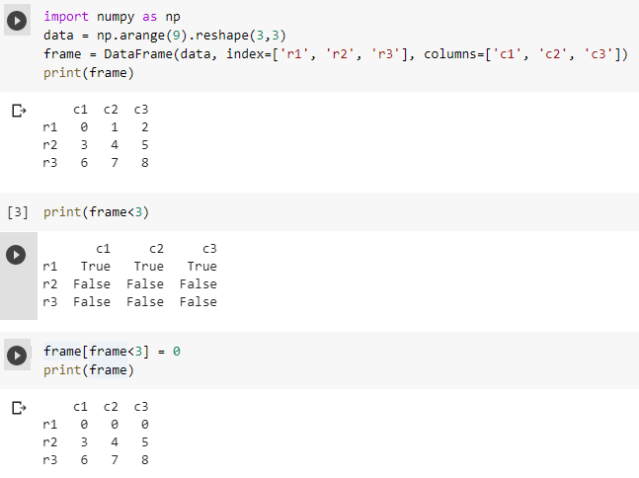
4.4.6 More on DataFrame indexing
NumPy array operations can also be applied to DataFrames.

Slide 36
Activity 7
Create a numpy array of the shape (3,5): 3 rows and 5 columns with random values from 1 to 100
Use np.random.randint(low,high, (shape))
Use above numpy array to generate a Data Frame with index = a,b,c and columns 1,2,3,4, 5
Transpose the DataFrame and change the values less than 40 to 0 in the Data Frame.
Submit your code to piazza Activity 7 thread.
Notes:
Obj = pd.read_csv(‘values.csv’)

Slide 37
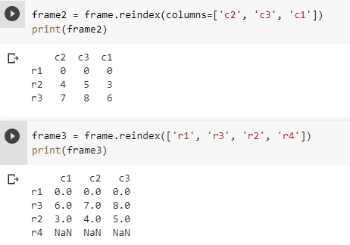
4.4.7 Reindexing
Alter the order of rows/columns of a DataFrame or order of a series according to new index
This returns a new object

Slide 38
4.5 Functions and Missing Data Handling

Slide 39
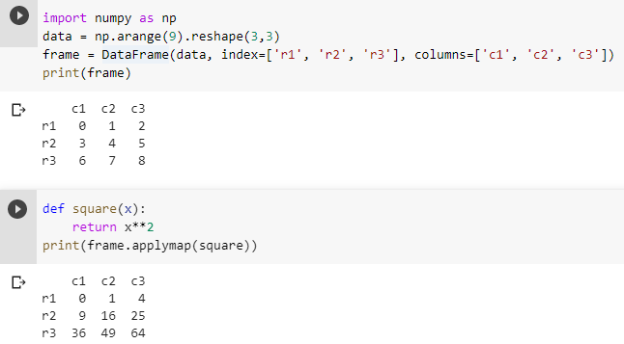
4.5.1 Function application and mapping
DataFrame.applymap(f) applies function f to every entry in the DataFrame.

Slide 40
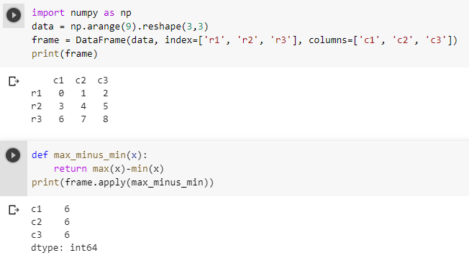
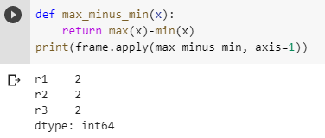
DataFrame.apply(f) applies function f to every column (by default) or row
Default axis=0, means across rows
axis=1, means across columns

Slide 41
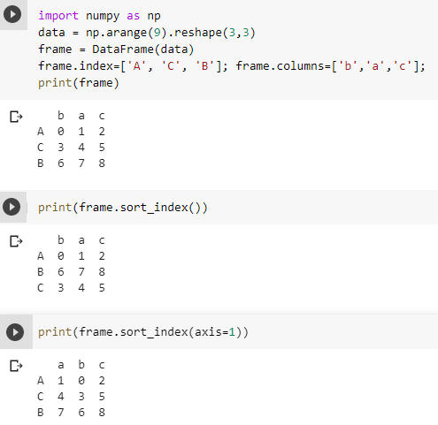
4.5.2 Sorting index
Basically the sorting alogirthm is applied on the axis labels rather than the actual data in the dataframe and based on that the data is rearranged.
We have the freedom to choose what sorting algorithm we would like to apply. There are three possible sorting algorithms that we can use ‘quicksort’, ‘mergesort’ and ‘heapsort’.
sort_index(kind = ‘quicksort’)

Slide 42
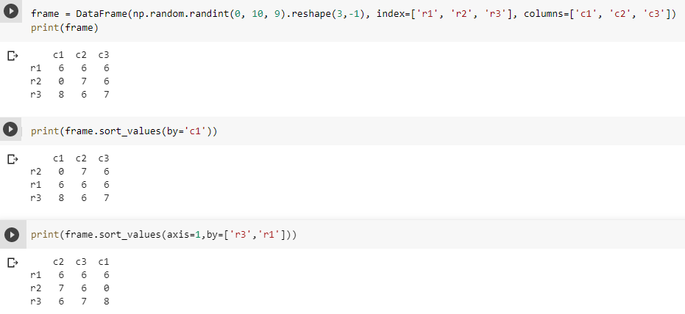
4.5.3 Sorting Values
The sort_values() function is used to sort by the values along either axis.

Slide 43
Activity 8
Use the Data Frame created at the Activity 7
Apply a lambda function to calculate the square root of each value in the data frame
import math math.sqrt()
Using the resultant frame, find the summation of each row and display the results.
Submit your code to piazza Activity 8 thread.
Notes:
Obj = pd.read_csv(‘values.csv’)

Slide 44
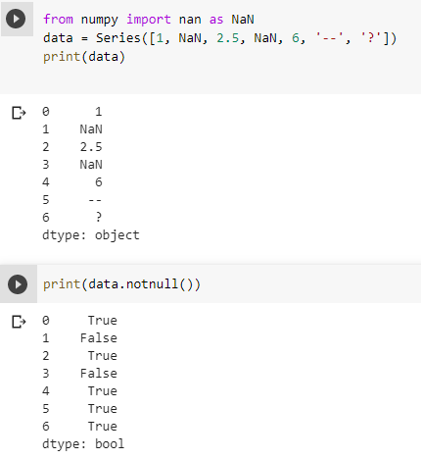
4.5.4 Handling missing data
Handling missing values is an essential part of data cleaning and preparation process because almost all data in real life comes with some missing values.
Lets create a Series with some missing values like NaN, -- and ?
Notes:
s.dropna(inplace=True)

Slide 45
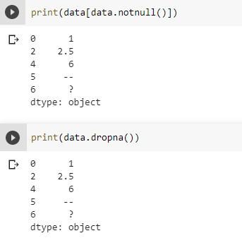
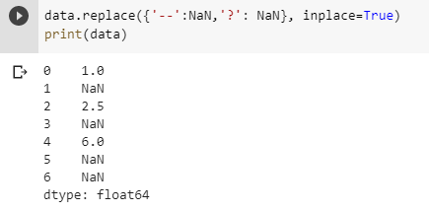
Its straight forward to detect and remove NaN from your Series or DataFrame using notnull() or dropna()
But if you have known values such as --, ?, you can use replace function
Notes:
s.dropna(inplace=True)

Slide 46
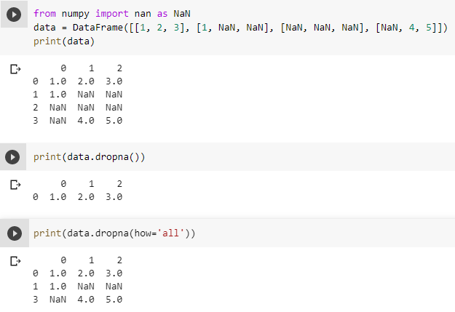
dropna() function with how=‘all’ will eliminate rows (by default) with NaN in the entire row. Use axis=1 to do the same for columns.

Slide 47
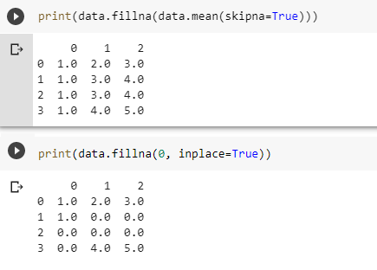
4.5.5 Filling in missing data
fillna() function can be used to fill the missing data.
replace nan with column mean
Modify the dataframe instead of returning a new object (default)

Slide 48
Summary
The Pandas library is one of the most preferred tools for data scientists to do data manipulation and analysis, next to matplotlib for data visualization and NumPy, the fundamental library for scientific computing in Python on which Pandas was built.
This module introduces the Series, and Data Frame, fast, flexible, and expressive Pandas data structures which are designed to make real-world data analysis significantly easier.

