Slide 1
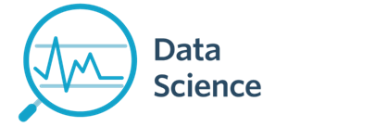
Module 5 - Data Wrangling
CS 620 / DASC 600
Introduction to Data Science & Analytics
Dr. Sampath Jayarathna
Old Dominion University

Slide 2
Overview
Working with data is both an art and a science. We’ve mostly been talked in previous modules about the science part, getting your feet wet with Python tools for Data Science. In this module, lets look at some of the art now.
After you’ve identified the questions you’re trying to answer and have gotten your hands on some data, you might be tempted to dive in and immediately start building models and getting answers. But you should resist this urge. Your first step should be to explore your data.
Data wrangling refers to the process of cleaning, restructuring and enriching the raw data available into a more usable format. This will help the data scientist quicken the process of decision making, and thus get better insights in less time.

Slide 3
Objectives
Critically reflect upon different data sources, types, and formats
Apply data cleaning, preprocessing, and standardization for data analytics
Interpret, assess and discuss data sampling techniques
Apply basic plotting concepts and techniques to data

Slide 4
Relevance
Data wrangling is the process of cleaning, structuring and enriching raw data into a desired format for better decision making in less time. Data wrangling is increasingly ubiquitous at today’s industry. Data has become more diverse and unstructured, demanding increased time spent collecting, cleaning, and organizing data ahead of broader analysis. At the same time, with data informing just about every business decision, business users have less time to wait on technical resources for prepared data.

Slide 5
5.1 What is Data Wrangling?

Slide 6
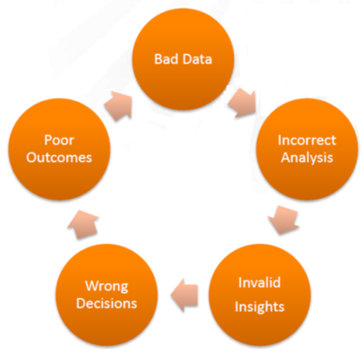
5.1.1 Vicious Circles
This simple data life cycle model highlights how factors in starting with “Bad Data” on one life cycle phase impacted other phases forming vicious (negative) circles.

Slide 7
5.1.2 Data Wrangling
The process of transforming “raw” data into data that can be analyzed to generate valid actionable insights
Data Wrangling : aka
Data preprocessing
Data preparation
Data Cleansing
Data Scrubbing
Data Munging
Data Transformation
Data Fold, Spindle, Mutilate……

Slide 8
5.1.3 Data Wrangling Steps
Iterative process of
Obtain
Understand
Explore
Transform
Augment
Visualize

Slide 9
Data Wrangling Steps
Notes:
Messy data -> tidy data

Slide 10
Data Wrangling Steps

Slide 11
5.2 Exploring your data

Slide 12
5.2.1 How to explore your data?
The simplest case is when you have a one-dimensional data set, which is just a collection of numbers. For example,
daily average number of minutes each user spends on your site,
the number of times each of a collection of data science tutorial videos was watched,
the number of pages of each of the data science books in your data science library.
An obvious first step is to compute a few summary statistics.
You’d like to know how many data points you have, the smallest, the largest, the mean, and the standard deviation.
But even these don’t necessarily give you a great understanding.

Slide 13
5.2.2 Summary statistics of a single data set
Information (numbers) that give a quick and simple description of the data
Maximum value
Minimum value
Range (dispersion): max – min
Mean
Median
Mode
Quantile
Standard deviation
Etc.
0 quartile = 0 quantile = 0 percentile
1 quartile = 0.25 quantile = 25 percentile
2 quartile = .5 quantile = 50 percentile (median)
3 quartile = .75 quantile = 75 percentile
4 quartile = 1 quantile = 100 percentile

Slide 14

Mean vs average vs median vs mode
(Arithmetic) Mean: the “average” value of the data
Average: can be ambiguous
The average household income in this community is $60,000
The average (mean) income for households in this community is $60,000
The income for an average household in this community is $60,000
What if most households are earning below $30,000 but one household is earning $1M
Median: the “middlest” value, or mean of the two middle values
Can be obtained by sorting the data first
Does not depend on all values in the data.
More robust to outliers
Mode: the most-common value in the data
def mean(a): return sum(a) / float(len(a))
def mean(a): return reduce(lambda x, y: x+y, a) / float(len(a))
Quantile: a generalization of median. E.g. 75 percentile is the value which 75% of values are less than or equal to

Slide 15

Variance and standard deviation
Describes the spread of the data from the mean
Is the mean squared of the deviation
Standard deviation (square root of the variance): σ
Easier to understand than variance
Has the same unit as the measurement
Say the data measures height of people in inch, the unit of σ is also inch. The unit for σ² is square inch …

Slide 16

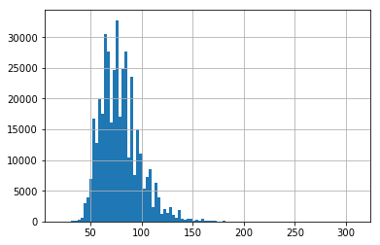
5.2.3 Histograms
Good next step is to create a histogram, in which you group your data into discrete buckets and count how many points fall into each bucket:
The major difference is that a histogram is only used to plot the frequency of score occurrences in a continuous data set that has been divided into classes, called bins. Bar charts, on the other hand, can be used for a great deal of other types of variables including ordinal and nominal data sets.
A histogram is a plot that lets you discover, and show, the underlying frequency distribution (shape) of a set of continuous data. This allows the inspection of the data for its underlying distribution (e.g., normal distribution), outliers, skewness, etc.
Notes:
Nominal Scale is derived from the Latin word “nomalis” which denotes “related to names”, is usually used to indicate categories. These categories have corresponding numbers allotted for analysis of collected data. For example, a person’s gender, ethnicity, hair color etc. are considered to be data for a nominal scale.
Ordinal Scale, on the other hand, involves arranging information in a specific order, i.e. in comparison to one another and “rank” each parameter (variable). For example, after a customer shops from a retail outlet, he/she is asked to fill out a kiosk survey: “On a scale of 1-5, how was your shopping experience?”

Slide 17
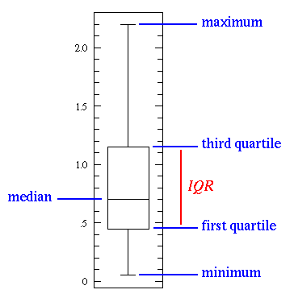
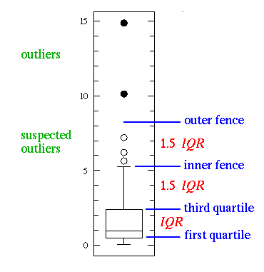
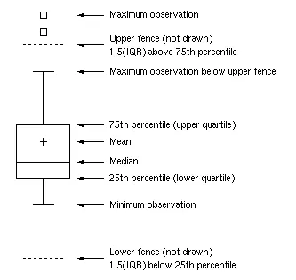
5.2.4 Boxplot
The box plot (a.k.a. box and whisker diagram) is a standardized way of displaying the distribution of data based on the five number summary: minimum, first quartile, median, third quartile, and maximum. In the simplest box plot the central rectangle spans the first quartile to the third quartile (the interquartile range or IQR). A segment inside the rectangle shows the median and "whiskers" above and below the box show the locations of the minimum and maximum.
Notes:
1st quartile − 1.5 IQR and 3rd quartile + 1.5IQR

Slide 18
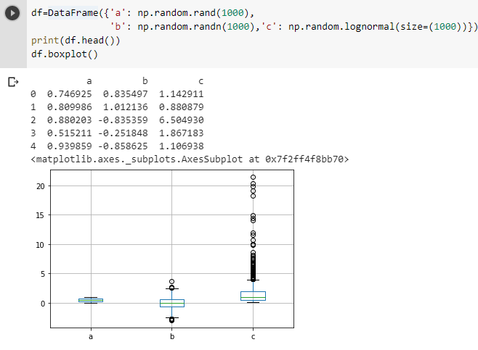
5.2.4 Boxplot example 1
numpy.random.randn generates samples from the normal distribution, numpy.random.lognormal from the lognormal distribution, and numpy.random.rand from uniform (in range [0,1])

Slide 19

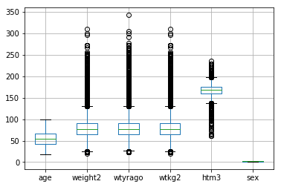
5.2.4 Boxplot example 1

Slide 20
Activity 9: CDC BRFSS Dataset
The Behavioral Risk Factor Surveillance System (BRFSS) https://www.cdc.gov/brfss/index.html is the nation's premier system of health-related telephone surveys that collect state data about U.S. residents regarding their health-related risk behaviors, chronic health conditions, and use of preventive services.
See brfss.csv data file

Slide 21
Activity 9
Download the brfss.csv file and load it to your python module.
https://www.cs.odu.edu/~sampath/courses/data/brfss.csv
Display the content and observe the data
Create a function cleanBRFSSFrame() to clean the dataset
Drop the sex from the dataframe
Drop the rows of NaN values (every single NaN)
Find and display 25th, 50th, 70th percentile of the age. (Hint: DataFrame.<column>.quantile(<quantile vlaue>))
Use Seaborn to display a Violin plot of the height. (Hint: sns.violinplot(data=<dataframe column>)). Read more about box plot variations here http://datavizcatalogue.com/blog/box-plot-variations/
Submit your code to piazza Activity 9 thread.
Notes:
Obj = pd.read_csv(‘values.csv’)

Slide 22
5.3 Sampling Techniques

Slide 23
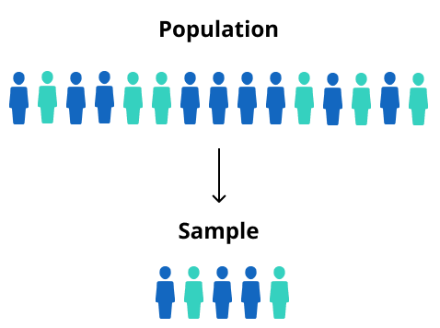
5.3.1 Population vs sample
Sampling is a process used in statistical analysis in which a predetermined number of observations are taken from a larger population
Notes:
Random, stratified, systematic, cluster (natural)

Slide 24

Population: all members of a group in a study
The average height of men
The average height of living male ≥ 18yr in USA between 2001 and 2010
The average height of all male students ≥ 18yr registered in Fall’17
Sample: a subset of the members in the population
Most studies choose to sample the population due to cost/time or other factors
Each sample is only one of many possible subsets of the population
May or may not be representative of the whole population
Sample size and sampling procedure is important
Notes:
Random, stratified, systematic, cluster (natural)

Slide 25
5.3.2 Why do we sample?
Enables research/ surveys to be done more quickly/ timely
Less expensive and often more accurate than large CENSUS ( survey of the entire population)
Given limited research budgets and large population sizes, there is no alternative to sampling.
Sampling also allows for minimal damage or lost
Sample data can also be used to validate census data
A survey of the entire universe (gives real estimate not sample estimate)
Notes:
Examples: election polls

Slide 26
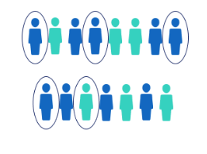
5.3.3 Simple Random Sampling
In Simple Random Sampling, each element of the larger population is assigned a unique ID number, and a table of random numbers or a lottery technique is used to select elements, one at a time, until the desired sample size is reached.
Simple random sampling is usually reserved for use with relatively small populations with an easy-to-use sampling frame ( very tedious when drawing large samples).
Bias is avoided because the person drawing the sample does not manipulate the lottery or random number table to select certain individuals.
Notes:
Obj = pd.read_csv(‘values.csv’)

Slide 27
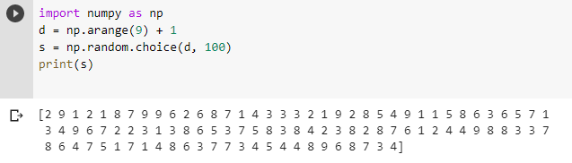
Random Selection
Selects at random
With replacement
From any array
A specified number of times
Notes:
Random, stratified, systematic, cluster (natural)

Slide 28
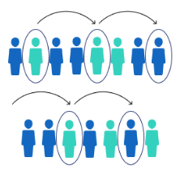
5.3.4 Systematic Sampling
Systematic sampling is a type of probability sampling method in which sample members from a larger population are selected according to a random starting point and a fixed periodic interval.
In this approach, the estimated number of elements in the larger population is divided by the desired sample size to yield a SAMPLNG INTERVAL. The sample is then drawn by listing the population in an arbitrary order and selecting every nth case, starting with a randomly selected.
This is less time consuming and easier to implement.
Systematic sampling is useful when the units in your sampling frame are not numbered or when the sampling frame consists of very long list.
Notes:
Obj = pd.read_csv(‘values.csv’)

Slide 29
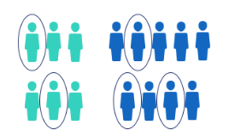
5.3.5 Stratified Sampling
Populations often consist of strata or groups that are different from each other and that consist of very different sizes.
Stratified Sampling ensures that all relevant strata of the population are represented in the sample.
Stratification treats each stratum as a separate population- arranging the sampling frame first in strata before either a simple random technique or a systematic approach is used to draw the sample.
Notes:
Obj = pd.read_csv(‘values.csv’)

Slide 30
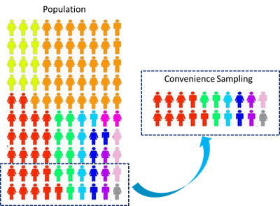
5.3.6 Convenience Sampling
Convenience sampling is where subjects are selected because of their convenient accessibility and proximity to the researcher.
Convenience Sampling involves the selection of samples from whatever cases/subjects or respondents that happens to be available at a given place or time.
Also known as Incidental/Accidental, Opportunity or Grab Sampling. Snow- ball Sampling is a special type of convenience sampling where individuals or persons that have agreed or showed up to be interviewed in the study serially recommend their acquaintances.
Notes:
Obj = pd.read_csv(‘values.csv’)

Slide 31
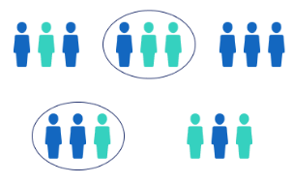
5.3.7 Other Sampling
In Cluster Sampling, samples are selected in two or more stages
Non-probability sampling involves a technique where samples are gathered in a process that does not give all the individuals in the population equal chances of being selected.
Nonprobability sampling procedures are not valid for obtaining a sample that is truly representative of a larger population
Notes:
Obj = pd.read_csv(‘values.csv’)

Slide 32
Activity 10
Given the list of height values of 15 students,
h = [159, 171, 158, 162, 162, 177, 160, 175, 168, 171, 178, 178, 173, 177, 164]
Create a python list called 'height' and sort the list in ascending order
Use the list to create a 'data' dictionary with column label 'h'
Use the 'data' dictionary to populate a pandas DataFrame called 'df'
Create a function 'systematic_sampling' using the df and a 'step' variable as input parameters to generate a systamtic sampling of the given height values.
Obtain a systematic sample of every 3rd student and display the results.
Submit your code to piazza Activity 10 thread.
Notes:
Obj = pd.read_csv(‘values.csv’)

Slide 33
5.4 Data Relationships

Slide 34
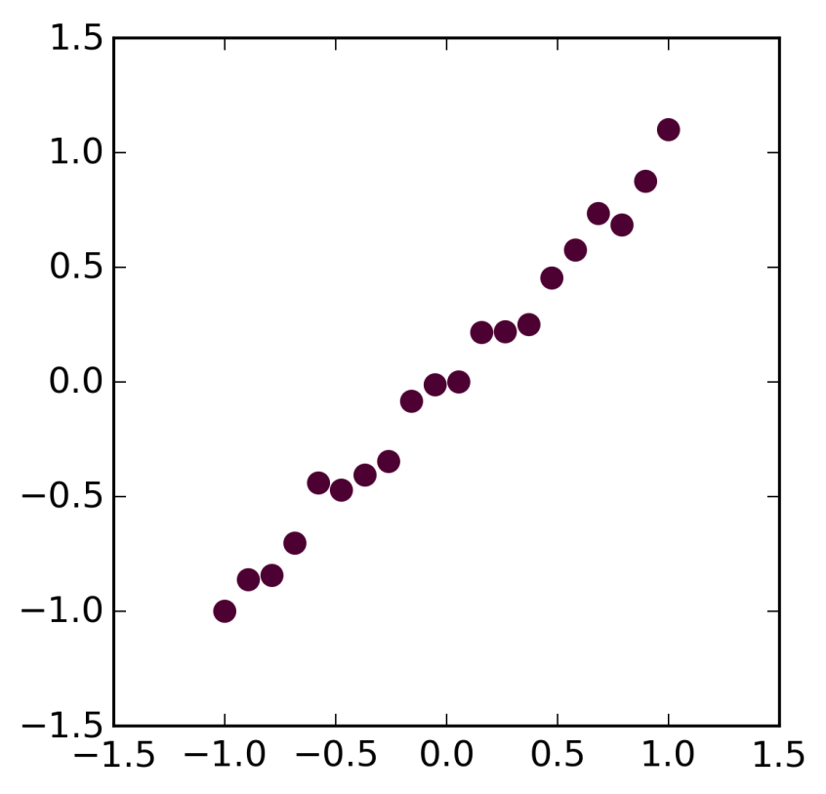
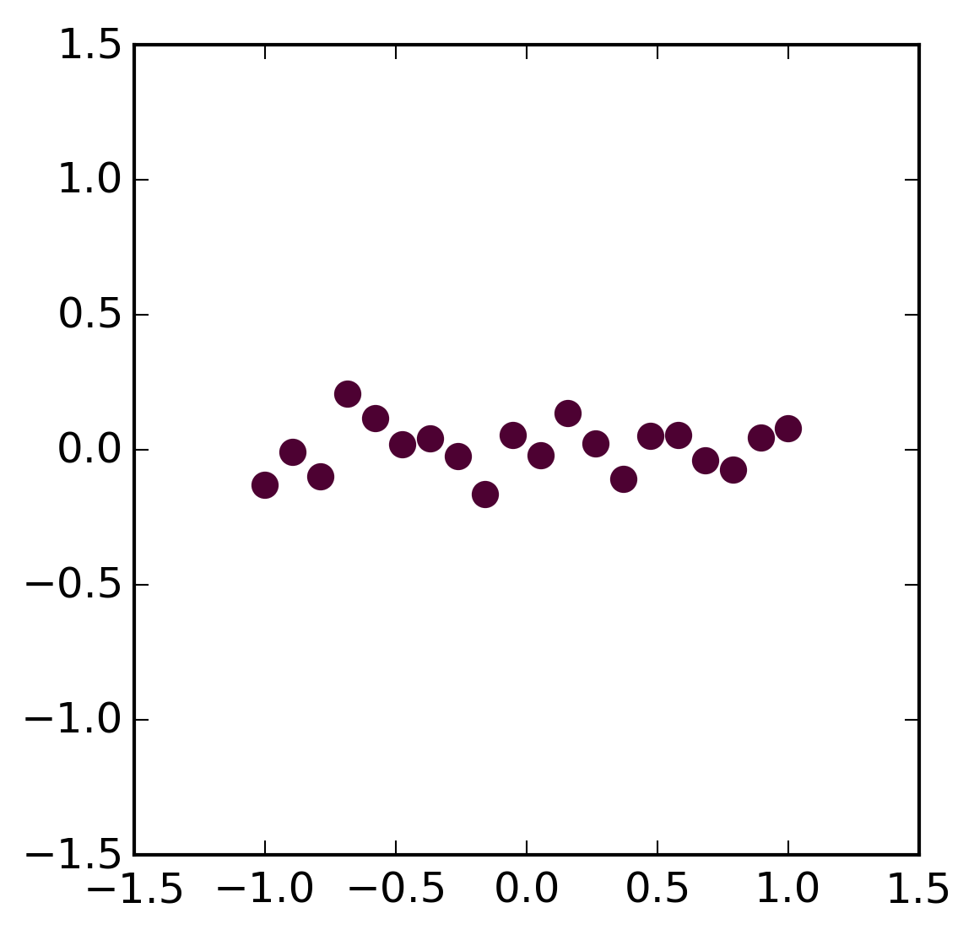
5.4.1 Regression vs Correlation
Regression – estimation of the relationship between variables
Linear regression
Assessing the assumptions
Non-linear regression
Correlation
Correlation coefficient quantifies the association strength
Sensitivity to the distribution
Relationship
No Relationship

Slide 35
Regression vs Correlation
Correlation quantifies the degree to which two variables are related.
Correlation does not fit a line through the data points. You simply are computing a correlation coefficient (r) that tells you how much one variable tends to change when the other one does.
When r is 0.0, there is no relationship. When r is positive, there is a trend that one variable goes up as the other one goes up. When r is negative, there is a trend that one variable goes up as the other one goes down.
Linear regression finds the best line that predicts Y from X.
Correlation is almost always used when you measure both variables. It rarely is appropriate when one variable is something you experimentally manipulate.
Linear regression is usually used when X is a variable you manipulate

Slide 36
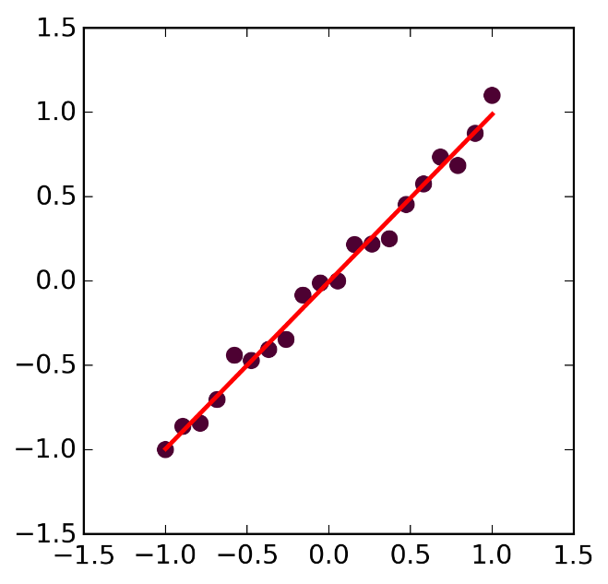
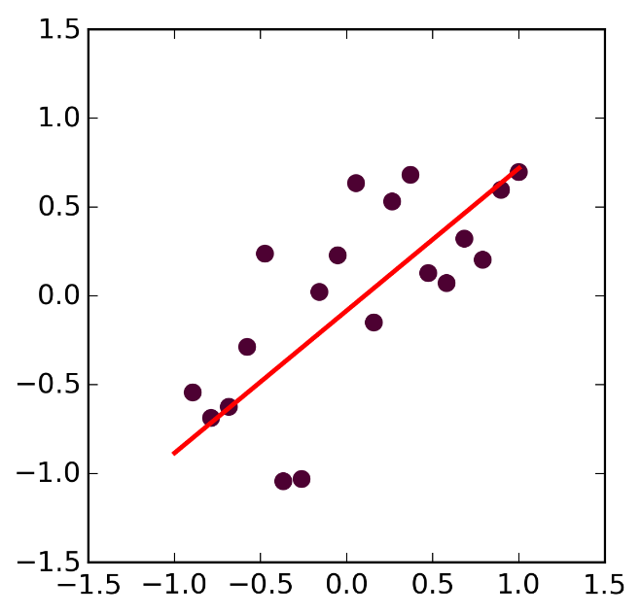
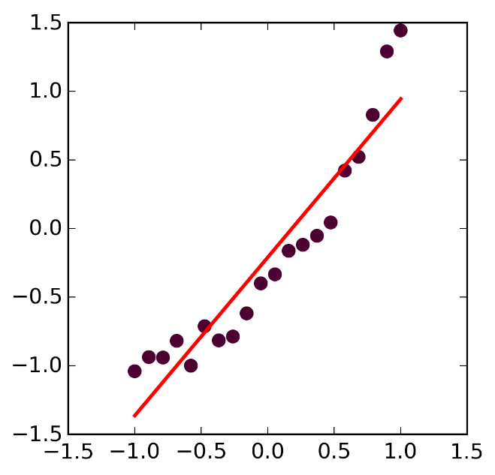
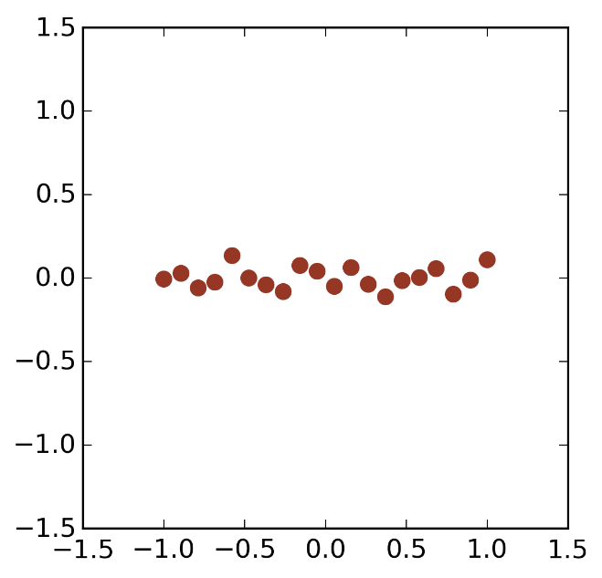
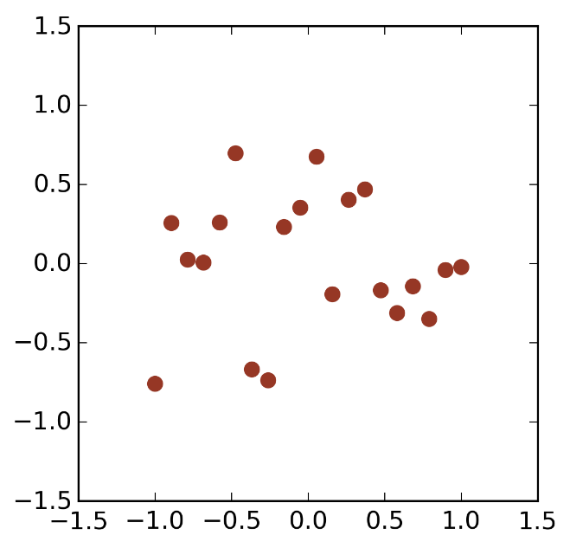
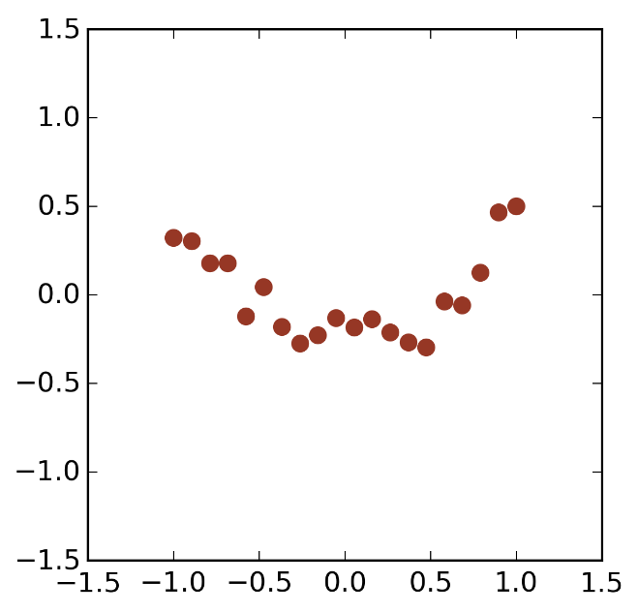
Regression: Residual plots
Linear, Strong
Linear, Weak
Non-Linear
Residuals
Residuals
Residuals

Slide 37

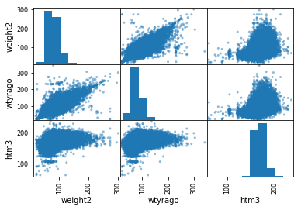
5.4.2 Feature Matrix
We can review the relationships between attributes by looking at the distribution of the interactions of each pair of attributes.
This is a powerful plot from which a lot of inspiration about the data can be drawn. For example, we can see a possible correlation between weight and weight year ago

Slide 38
5.4 Types of Data

Slide 39
5.4.1 Types of Data Attributes
There are different types of attributes
Nominal
Examples: ID numbers, eye color, zip codes
Ordinal
Examples: rankings (e.g., taste of potato chips on a scale from 1-10), grades, height {tall, medium, short}
Interval
Examples: calendar dates, temperatures in Celsius or Fahrenheit.
Ratio
Examples: temperature in Kelvin, length, time, counts

Slide 40
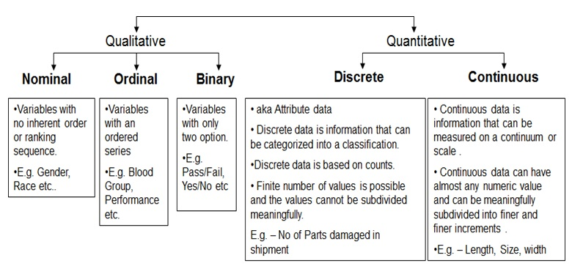
Continuous
Interval: Ordered, meaningful/equal differences between units, no natural zero (temperature in F/C, IQ, age)
Ratio (includes everything from interval and one additional attribute "zero" point): Ordered, meaningful/equal differences between units, natural zero (temperature in Kelvin, height, weight)

Slide 41
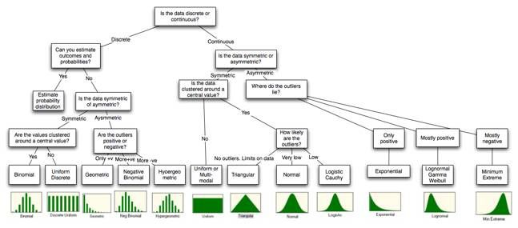
5.4.2 Data transformation
Transform data to obtain a certain distribution
transform data so different columns became comparable / compatible
Typical transformation approach:
Z-score transformation
Scale to between 0 and 1
mean normalization

Slide 42
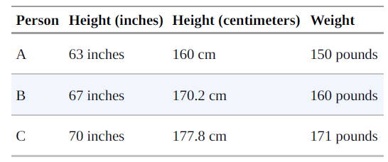
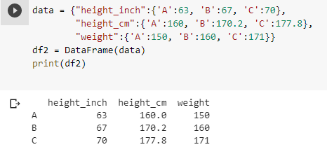
5.4.3 Why normalization (re-scaling) required?
Many techniques are sensitive to the scale of your data. For example, imagine that you have a data set consisting of the heights and weights of hundreds of data scientists, and that you are trying to identify clusters of body sizes.

Slide 43
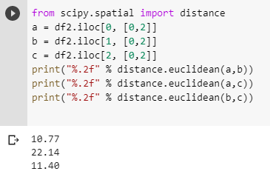
Why normalization (re-scaling) required?

Slide 44
5.4.4 Z-score transformation/ Standardization
Z scores, or standard scores, indicate how many standard deviations an observation is above or below the mean. These scores are a useful way of putting data from different sources onto the same scale.
The z-score linearly transforms the data in such a way, that the mean value of the transformed data equals 0 while their standard deviation equals 1. The transformed values themselves do not lie in a particular interval like [0,1] or so.
Z score: Z = (x - sample mean)/sample standard deviation.

Slide 45
5.4.4 Z-score transformation
Suppose you weigh an apple and it weighs 110 grams. There’s no way to tell from the weight alone how this apple compares to other apples.
However, as you’ll see, after you calculate its Z-score, you know where it falls relative to other apples.
Standardization are a great way to understand where a specific observation falls relative to the entire distribution.
They also allow you to take observations drawn from normally distributed populations that have different means and standard deviations and place them on a standard scale. This standard scale enables you to compare observations that would otherwise be difficult.

Slide 46

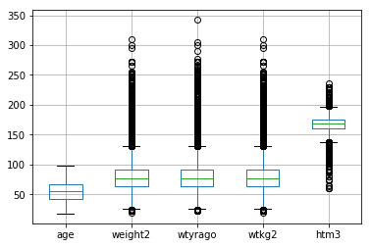
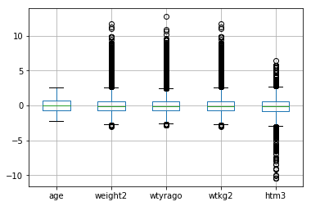
Z-score transformation
Before z-score transformation
After z-score transformation

Slide 47

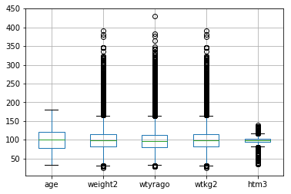
5.4.5 Mean-based scaling
Before mean-based transformation
After mean-based transformation

Slide 48
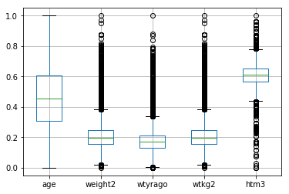
Activity 11
Use the brfss.csv file and load it to your python module.
Use the min-max algorithm to re-scale the data (normalization). Remember to drop the column ‘sex’ from the dataframe before the rescaling. (series – series.min())/(series.max() – series.min())
Create a boxplot (DataFrame.boxplot()) of the dataset.
Submit your code to piazza Activity11 thread.
Notes:
Obj = pd.read_csv(‘values.csv’)

Slide 49
Summary
The process of data wrangling is more complicated if there’s missing or corrupt data, and some data may need cleaning or transforming before we can even begin to do any processing with it.
Data wrangling is becoming very important that many organization have specific job positions just for this kind of work. There is some technique, some science, and engineering involved in this process introduced in this module including exploration of data types, sampling techniques, transformation and visualizations.

