Slide 1

Module 6- Semi-Structured Data (XML, JSON)
CS 620 / DASC 600
Introduction to Data Science & Analytics
Dr. Sampath Jayarathna
Old Dominion University

Slide 2
Overview
In order to make meaning out of data, it has to be effectively organized, stored and analyzed. That’s why it’s important to know the nature of the data — specifically whether it’s structured or unstructured. Structured data fits into predefined fields and can be organized into a spreadsheet or a relational database, while unstructured data is heterogenous and does not map to standard fields.
There is a third type of data, however, that falls somewhere between structured and unstructured, and that’s called semi-structured data. Data can come in multiple forms from numerous sources, including an ever-expanding amount of machine-generated data from applications, sensors, mobile devices, etc. To support these new types of data, semi-structured data formats, such as JSON, Avro, ORC, Parquet, and XML, with their support for flexible schemas, have become popular standards for transporting and storing data. This module will introduce you to XML and JSON, two of the most popular data-exchange formats.

Slide 3
Objectives
Understand what is a semi-structured data model and why it is useful
Learn the core syntax of XML, DTD, and JSON
Describe how XML and JSON can be applied to well-constructed documents
Implement codes to demonstrate understanding of knowledge related to XML and JSON
Develop experience with semi-structured data approaches towards NoSQL

Slide 4
Relevance
Semi-structured data does not have a rigid schema, so it does not conform to a data table or relational database structure. However, it has classifying characteristics associated with it, such as internal semantic tags or metadata or markings, that enable analysis.
The reason that this third category exists (between structured and unstructured data) is because semi-structured data is considerably easier to analyze than unstructured data. Many Big Data solutions and tools have the ability to ‘read’ and process either JSON or XML. This reduces the complexity to analyze structured data, compared to unstructured data.

Slide 5
6.1 Extensible Markup Language

Slide 6
6.1.1 Introduction
XML: Extensible Markup Language
Defined by the WWW Consortium (W3C)
Documents have tags giving extra information about sections of the document
E.g. <title> XML </title> <slide> Introduction …</slide>
Extensible, unlike HTML
Users can add new tags, and separately specify how the tag should be handled for display

Slide 7
The ability to specify new tags, and to create nested tag structures make XML a great way to exchange data, not just documents.
Much of the use of XML has been in data exchange applications, not as a replacement for HTML
Tags make data (relatively) self-documenting
E.g. <?xml version = "1.0"?>
<bank>
<account>
<account_number> A-101 </account_number>
<branch_name> Downtown </branch_name>
<balance> 500 </balance>
</account>
<depositor>
<account_number> A-101 </account_number>
<customer_name> Johnson </customer_name>
</depositor>
</bank>

Slide 8
6.1.2 XML: Motivation
Data interchange is critical in today’s networked world
Examples:
Banking: funds transfer
Order processing (especially inter-company orders)
Scientific data
Chemistry, Genetics
Paper flow of information between organizations is being replaced by electronic flow of information
Each application area has its own set of standards for representing information
XML has become the basis for all new generation data interchange formats
For awhile, XML (extensible markup language) was the only choice for open data interchange. But over the years there has been a lot of transformation in the world of open data sharing. The more lightweight JSON (Javascript object notation) has become a popular alternative to XML for various reasons.

Slide 9
Earlier generation formats were based on plain text with line headers indicating the meaning of fields
Similar in concept to email headers
Does not allow for nested structures, no standard “type” language
Tied too closely to low level document structure (lines, spaces, etc)
Each XML based standard defines what are valid elements, using
XML type specification languages to specify the syntax
DTD (Document Type Descriptors)
XML Schema
Plus textual descriptions of the semantics
XML allows new tags to be defined as required
However, this may be constrained by DTDs
A wide variety of tools is available for parsing, browsing and querying XML documents/data

Slide 10
6.1.3 Comparison with Structured (Relational) Data
Inefficient: tags, which in effect represent schema information, are repeated
Better than relational tuples as a data-exchange format
Unlike relational tuples, XML data is self-documenting due to presence of tags
Non-rigid format: tags can be added
Allows nested structures
Wide acceptance, not only in database systems, but also in browsers, tools, and applications

Slide 11
6.1.4 Structure of XML Data
Tag: label for a section of data
Element: section of data beginning with <tagname> and ending with matching </tagname>
Elements must be properly nested
Proper nesting
<account> … <balance> …. </balance> </account>
Improper nesting
<account> … <balance> …. </account> </balance>
Formally: every start tag must have a unique matching end tag, that is in the context of the same parent element.
Every document must have a single top-level element

Slide 12
Example XML document
<?xml version = "1.0"?>
<bank-1> <customer>
<customer_name> Hayes </customer_name>
<customer_street> Main </customer_street>
<customer_city> Harrison </customer_city>
<account>
<account_number> A-102 </account_number>
<branch_name> Perryridge </branch_name>
<balance> 400 </balance>
</account>
<account>
…
</account>
</customer> . .
</bank-1>

Slide 13
6.1.4 Structure of XML Data (Cont.)
Mixture of text with sub-elements is legal in XML.
Example:
<account>
This account is seldom used any more.
<account_number> A-102</account_number>
<branch_name> Perryridge</branch_name>
<balance>400 </balance> </account>
Useful for document markup, but discouraged for data representation

Slide 14
6.1.5 Attributes
Elements can have attributes
<account acct-type = “checking” >
<account_number> A-102 </account_number>
<branch_name> Perryridge </branch_name>
<balance> 400 </balance>
</account>
Attributes are specified by name=value pairs inside the starting tag of an element
An element may have several attributes, but each attribute name can only occur once
<account acct-type = “checking” monthly-fee=“5”>

Slide 15
6.1.6 Attributes vs. Subelements
Distinction between subelement and attribute
In the context of documents, attributes are part of markup, while subelement contents are part of the basic document contents
In the context of data representation, the difference is unclear and may be confusing
Same information can be represented in two ways
<account account_number = “A-101”> …. </account>
<account> <account_number>A-101</account_number> … </account>
Suggestion: use attributes for identifiers of elements, and use subelements for contents

Slide 16
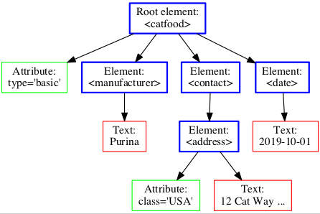
Class Activity 12
cat-food.xml
Add 1 more Cat Food brand to the xml
Submit your code to piazza Activity 12 thread.

Slide 17
6.2 XML DTD

Slide 18
6.2.1 More on XML Syntax
Elements without subelements or text content can be abbreviated by ending the start tag with a /> and deleting the end tag
<account number=“A-101” branch=“Perryridge” balance=“200 />
To store string data that may contain tags, without the tags being interpreted as subelements, use CDATA as below
<![CDATA[<account> … </account>]]>
Here, <account> and </account> are treated as just strings
CDATA stands for “character data”, text that will NOT be parsed by a parser

Slide 19
6.2.2 XML Document Schema
Database schemas constrain what information can be stored, and the data types of stored values
XML documents are not required to have an associated schema
However, schemas are very important for XML data exchange
Otherwise, a site cannot automatically interpret data received from another site
Two mechanisms for specifying XML schema
Document Type Definition (DTD)
Widely used
XML Schema
Newer, increasing use

Slide 20
6.2.3 Why DTDs?
XML documents are designed to be processed by computer programs
If you can put just any tags in an XML document, it’s very hard to write a program that knows how to process the tags
A DTD specifies what tags may occur, when they may occur, and what attributes they may (or must) have
A DTD allows the XML document to be verified (shown to be legal)
A DTD that is shared across groups allows the groups to produce consistent XML documents
Notes:
3

Slide 21
6.2.4 DTD example: XML
<?xml version="1.0"?>
<!DOCTYPE weatherReport SYSTEM "http://www.mysite.com/mydoc.dtd">
<weatherReport>
<date>05/29/2002</date>
<location> <city>Philadelphia</city>, <state>PA</state>
<country>USA</country> </location> <temperature-range>
<high scale="F">84</high>
<low scale="F">51</low> </temperature-range>
</weatherReport>
mydoc.dtd
<!ELEMENT weatherReport (date, location, temperature-range)> <!ELEMENT date (#PCDATA)> <!ELEMENT location (city, state, country)> <!ELEMENT city (#PCDATA)> <!ELEMENT state (#PCDATA)> <!ELEMENT country (#PCDATA)> <!ELEMENT temperature-range ((low, high)|(high, low))> <!ELEMENT low (#PCDATA)> <!ELEMENT high (#PCDATA)> <!ATTLIST low scale (C|F) #REQUIRED> <!ATTLIST high scale (C|F) #REQUIRED>

Slide 22
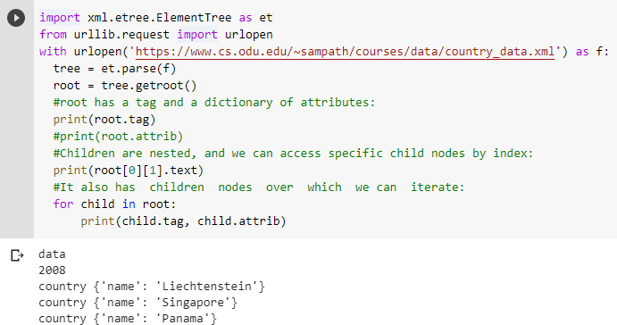
6.2.5 XML Parsing
# For more information: https://docs.python.org/2/library/xml.etree.elementtree.html

Slide 23
6.3 JavaScript Object Notation (JSON)

Slide 24
6.3.1 JSON as an XML Alternative
JSON = JavaScript Object Notation
It’s really language independent
most programming languages can easily read it and instantiate objects or some other data structure
JSON is a light-weight alternative to XML for data-interchange
Started gaining tracking ~2006 and now widely used
http://json.org/ has more information

Slide 25
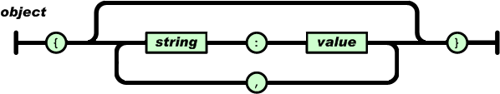
6.3.2 JSON Data – A name and a value
A name/value pair consists of a field name (in double quotes), followed by a colon, followed by a value
Unordered sets of name/value pairs
Begins with { (left brace)
Ends with } (right brace)
Each name is followed by : (colon)
Name/value pairs are separated by , (comma)
{
"employee_id": 1234567,
"name": "Jeff Fox",
"hire_date": "1/1/2013",
"location": "Norwalk, CT",
"consultant": false
}

Slide 26
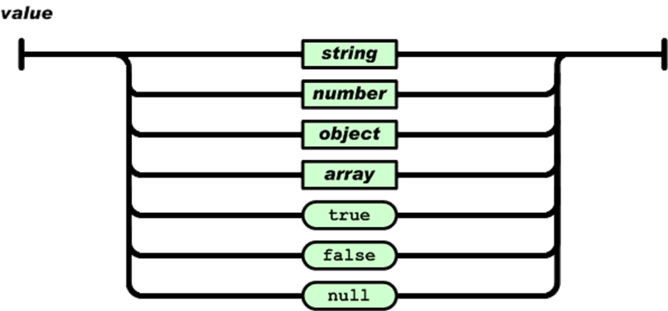
In JSON, values must be one of the following data types:
a string
a number
an object (JSON object)
an array
a boolean
null
{
"employee_id": 1234567,
"name": "Jeff Fox",
"hire_date": "1/1/2013",
"location": "Norwalk, CT",
"consultant": false
}

Slide 27
Strings in JSON must be written in double quotes.
{ "name":"John" }
Numbers in JSON must be an integer or a floating point.
{ "age":30 }
Values in JSON can be objects.
{ "employee":{ "name":"John", "age":30, "city":"New York" } }
Values in JSON can be arrays.
{ "employees":[ "John", "Anna", "Peter" ] }

Slide 28
6.3.3 Another example: XML vs JSON
<?xml version="1.0"?>
<employees> <employee> <firstName>John</firstName> <lastName>Doe</lastName> </employee> <employee> <firstName>Anna</firstName> <lastName>Smith</lastName> </employee> <employee> <firstName>Peter</firstName> <lastName>Jones</lastName> </employee> </employees>
{"employees":[ { "firstName":"John", "lastName":"Doe" }, { "firstName":"Anna", "lastName":"Smith" }, { "firstName":"Peter", "lastName":"Jones" } ]}

Slide 29
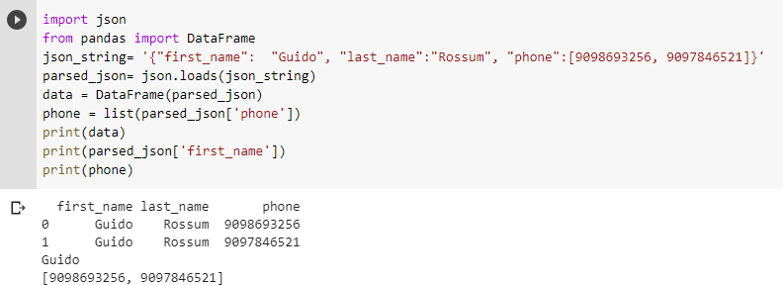
6.3.4 JSON Parsing
Note: For external file read, use json.load and data pretty print to display the content of json file.
from pprint import pprint
data = json.load(open('data.json'))
pprint(data)

Slide 30
Class Activity 13
Convert the following bookstore.xml to bookstore.json
<?xml version="1.0"?>
<bookstore>
<book category="sci-fi">
<title lang="en"> 2001</title>
<author>Arthur C. Clarke</author>
<price>$30.0</price>
<year>1968</year>
</book>
<book>
<title lang="rs">Story about a True Man</title>
<author>Boris Polevoy</author>
<price>$20.00</price>
<year>1952</year>
</book>
</bookstore>
Submit your code to piazza Activity 13 thread.

Slide 31
Class Activity 14
Given the following json file, find all the book "tiles" by author "Addy Osmani" Note: pandas read_json(url) will read directly a json to a DataFrame. If you download the file, you can also use json.load(open("books.json"))
https://www.cs.odu.edu/~sampath/courses/data/books.json
Submit your code to piazza Activity 14 thread.

Slide 32
6.3.5 XML vs JSON
JSON is Like XML Because
Both JSON and XML are "self describing" (human readable)
Both JSON and XML are hierarchical (values within values)
Both JSON and XML can be parsed and used by lots of programming languages
JSON is Unlike XML Because
JSON doesn't use end tag
JSON is shorter
JSON is quicker to read and write
JSON can use arrays
JSON has a better fit for OO systems than XML
The biggest difference is:
XML has to be parsed with an XML parser. JSON can be parsed by a standard JavaScript function.

Slide 33
6.3.6 Why JSON?
Steps involved in exchanging data from web server to browser involves:
Using XML
Fetch an XML document from web server.
Use the XML DOM to loop through the document.
Extract values and store in variables.
It also involves type conversions.
Using JSON
Fetch a JSON string.
Parse the JSON using JavaScript functions.

Slide 34
Summary
Semi structured data does not have the same level of organization and predictability of structured data. The data does not reside in fixed fields or records, but does contain elements that can separate the data into various hierarchies. This module introduces two examples of semi structured data formats, XML and JSON.
Many developers compare JSON to XML when building applications that share data across disparate systems, especially across the web. This often turns into a "JSON vs XML" argument as each side defends their preferred format. It turns out that JSON and XML have slightly different purposes, and so it's not always fair (or relevant) to say that one is "better" than the other. It depends on the purpose.

