Slide 1

Module 7 -NoSQL
DASC/CS 620
Introduction to Data Science & Analytics

Slide 2
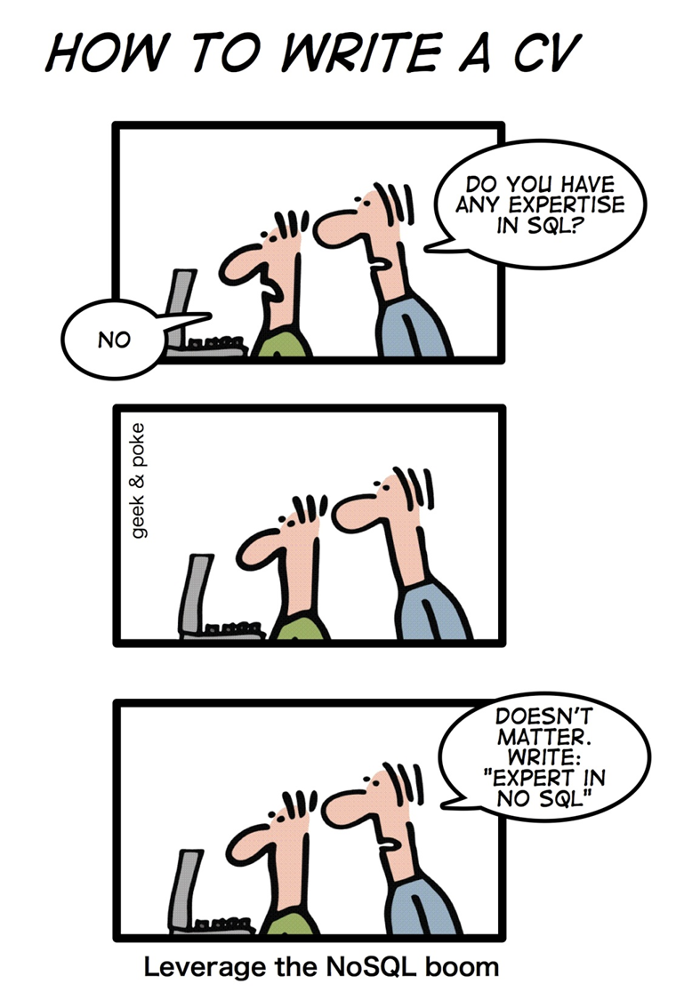
NoSQL!
NoSQL databases are currently a hot topic in some parts of computing, with over a hundred different NoSQL databases.

Slide 3
RDBMS Characteristics
Data stored in columns and tables
Relationships represented by data
Data Manipulation Language
Data Definition Language
Transactions
Abstraction from physical layer
Applications specify what, not how
Physical layer can change without modifying applications
Create indexes to support queries
In Memory databases

Slide 4
Transactions – ACID Properties
Atomic – All of the work in a transaction completes (commit) or none of it completes
a transaction to transfer funds from one account to another involves making a withdrawal operation from the first account and a deposit operation on the second. If the deposit operation failed, you don’t want the withdrawal operation to happen either.
Consistent – A transaction transforms the database from one consistent state to another consistent state. Consistency is defined in terms of constraints.
a database tracking a checking account may only allow unique check numbers to exist for each transaction
Isolated – The results of any changes made during a transaction are not visible until the transaction has committed.
a teller looking up a balance must be isolated from a concurrent transaction involving a withdrawal from the same account. Only when the withdrawal transaction commits successfully and the teller looks at the balance again will the new balance be reported.
Durable – The results of a committed transaction survive failures
A system crash or any other failure must not be allowed to lose the results of a transaction or the contents of the database. Durability is often achieved through separate transaction logs that can "re-create" all transactions from some picked point in time (like a backup).

Slide 5
No SQL?
NoSQL stands for:
No Relational
No RDBMS
Not Only SQL
NoSQL is an umbrella term for all databases and data stores that don’t follow the RDBMS principles
A class of products
A collection of several (related) concepts about data storage and manipulation
Often related to large data sets

Slide 6
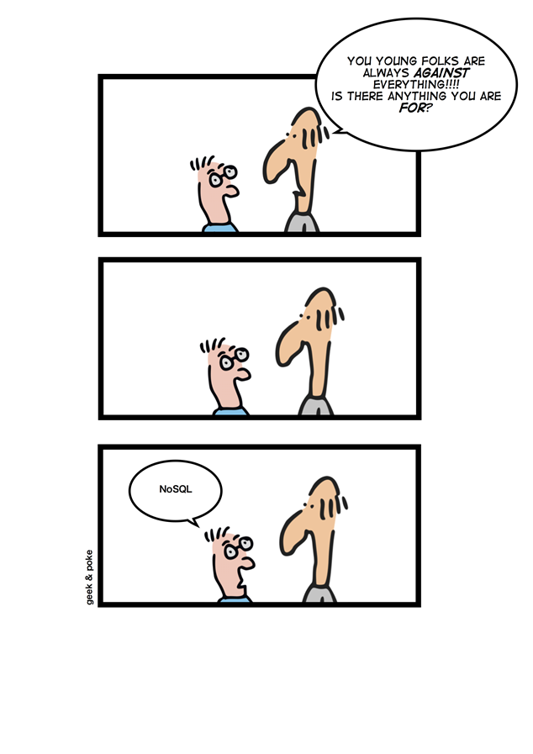
NoSQL Definition
From www.nosql-database.org:
Next Generation Databases mostly addressing some of the points: being non-relational, distributed, open-source and horizontal scalable. The original intention has been modern web-scale databases. The movement began early 2009 and is growing rapidly. Often more characteristics apply as: schema-free, easy replication support, simple API, eventually consistent / BASE (not ACID), a huge data amount, and more.

Slide 7
Where does NoSQL come from?
Non-relational DBMSs are not new
But NoSQL represents a new incarnation
Due to massively scalable Internet applications
Based on distributed and parallel computing
Development
Starts with Google
First research paper published in 2003
Continues also thanks to Lucene's developers/Apache (Hadoop) and Amazon (Dynamo)
Then a lot of products and interests came from Facebook, Netfix, Yahoo, eBay, Hulu, IBM, and many more

Slide 8
Dynamo and BigTable
Three major papers were the seeds of the NoSQL movement
BigTable (Google)
Dynamo (Amazon)
Distributed key-value data store
Eventual consistency
CAP Theorem (discuss in a sec ..)
Notes:
-> BigTable: http://labs.google.com/papers/bigtable.html
-> Dynamo: http://www.allthingsdistributed.com/2007/10/amazons_dynamo.html and http://www.allthingsdistributed.com/files/amazon-dynamo-sosp2007.pdf
-> Amazon and consistency
* http://www.allthingsdistributed.com/2010/02
* http://www.allthingsdistributed.com/2008/12

Slide 9
NoSQL and Big Data
NoSQL comes from Internet, thus it is often related to the “big data” concept
How much big are “big data”?
Over few terabytes Enough to start spanning multiple storage units
Challenges
Efficiently storing and accessing large amounts of data is difficult, even more considering fault tolerance and backups
Manipulating large data sets involves running immensely parallel processes
Managing continuously evolving schema and metadata for semi-structured and un-structured data is difficult

Slide 10
How did we get here?
Explosion of social media sites (Facebook, Twitter) with large data needs
Rise of cloud-based solutions such as Amazon S3 (simple storage solution)
Just as moving to dynamically-typed languages (Python, Ruby, Groovy), a shift to dynamically-typed data with frequent schema changes
Open-source community

Slide 11
Why are RDBMS not suitable for Big Data
The context is Internet
RDBMSs assume that data are
Dense
Largely uniform (structured data)
Data coming from Internet are
Massive and sparse
Semi-structured or unstructured
With massive sparse data sets, the typical storage mechanisms and access methods get stretched

Slide 12
NoSQL Distinguishing Characteristics
Large data volumes
Google’s “big data”
Scalable replication and distribution
Potentially thousands of machines
Potentially distributed around the world
Queries need to return answers quickly
Mostly query, few updates
Asynchronous Inserts & Updates
Schema-less
ACID transaction properties are not needed – BASE
CAP Theorem
Open source development

Slide 13
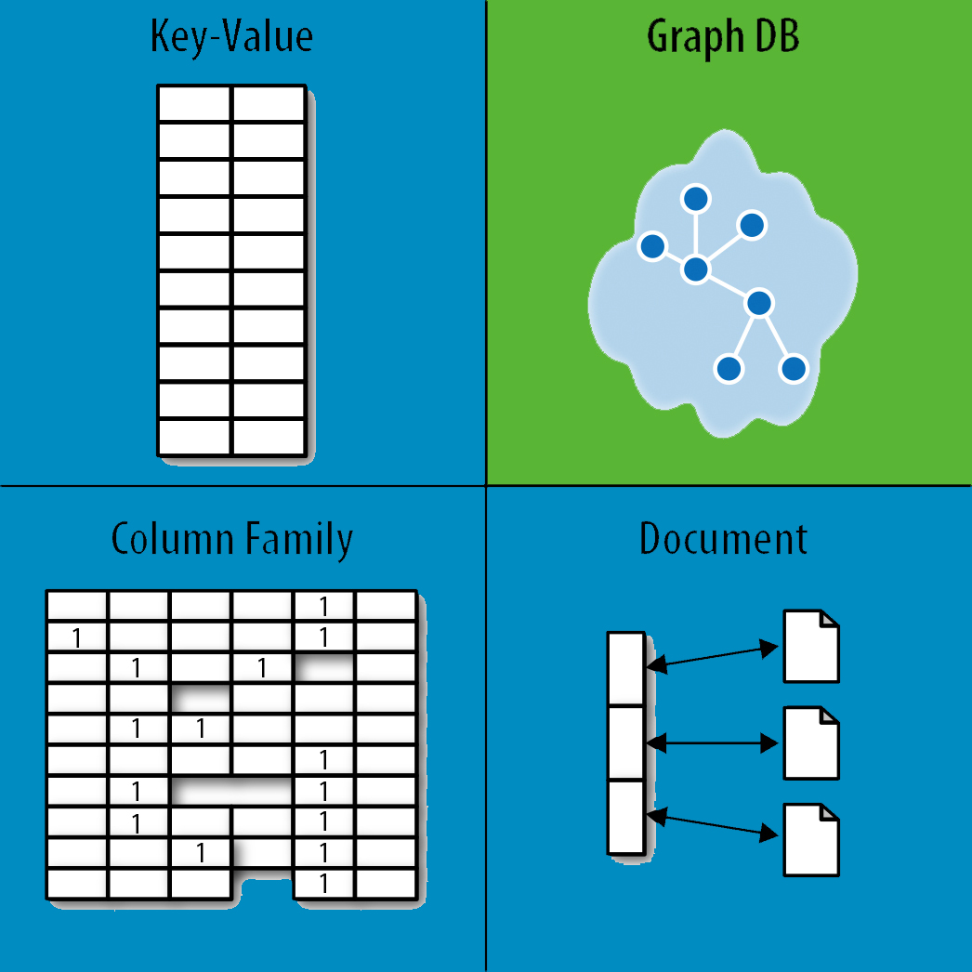
NoSQL Database Types
Discussing NoSQL databases is complicated because there are a variety of types:
Sorted ordered Column Store
Optimized for queries over large datasets, and store columns of data together, instead of rows
Document databases:
pair each key with a complex data structure known as a document.
Key-Value Store :
are the simplest NoSQL databases. Every single item in the database is stored as an attribute name (or 'key'), together with its value.
Graph Databases :
are used to store information about networks of data, such as social connections.

Slide 14
Document Databases (Document Store)
Documents
Loosely structured sets of key/value pairs in documents, e.g., XML, JSON, BSON
Encapsulate and encode data in some standard formats or encodings
Are addressed in the database via a unique key
Documents are treated as a whole, avoiding splitting a document into its constituent name/value pairs
Allow documents retrieving by keys or contents
Notable for:
MongoDB (used in FourSquare, Github, and more)
CouchDB (used in Apple, BBC, Canonical, Cern, and more)

Slide 15
Document Databases (Document Store)
The central concept is the notion of a "document“ which corresponds to a row in RDBMS.
A document comes in some standard formats like JSON (BSON).
Documents are addressed in the database via a unique key that represents that document.
The database offers an API or query language that retrieves documents based on their contents.
Documents are schema free, i.e., different documents can have structures and schema that differ from one another. (An RDBMS requires that each row contain the same columns.)

Slide 16
Document Databases, JSON
{
_id: ObjectId("51156a1e056d6f966f268f81"),
type: "Article",
author: "Derick Rethans",
title: "Introduction to Document Databases with MongoDB",
date: ISODate("2013-04-24T16:26:31.911Z"),
body: "This arti…"
},
{
_id: ObjectId("51156a1e056d6f966f268f82"),
type: "Book",
author: "Derick Rethans",
title: "php|architect's Guide to Date and Time Programming with PHP",
isbn: "978-0-9738621-5-7"
}

Slide 17
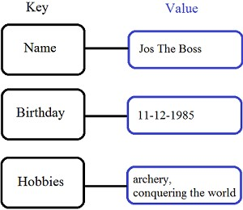
Key/Value stores
Store data in a schema-less way
Store data as maps
HashMaps or associative arrays
Provide a very efficient average running time algorithm for accessing data
Notable for:
Couchbase (Zynga, Vimeo, NAVTEQ, ...)
Redis (Craiglist, Instagram, StackOverfow, flickr, ...)
Amazon Dynamo (Amazon, Elsevier, IMDb, ...)
Apache Cassandra (Facebook, Digg, Reddit, Twitter,...)
Voldemort (LinkedIn, eBay, …)
Riak (Github, Comcast, Mochi, ...)

Slide 18
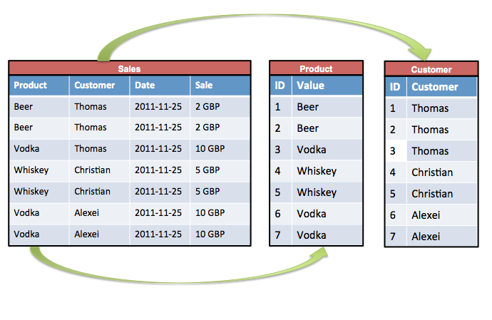
Sorted Ordered Column-Oriented Stores
Data are stored in a column-oriented way
Data efficiently stored
Avoids consuming space for storing nulls
Columns are grouped in column-families
Data isn’t stored as a single table but is stored by column families
Unit of data is a set of key/value pairs
Identified by “row-key”
Ordered and sorted based on row-key
Notable for:
Google's Bigtable (used in all Google's services)
HBase (Facebook, StumbleUpon, Hulu, Yahoo!, ...)

Slide 19
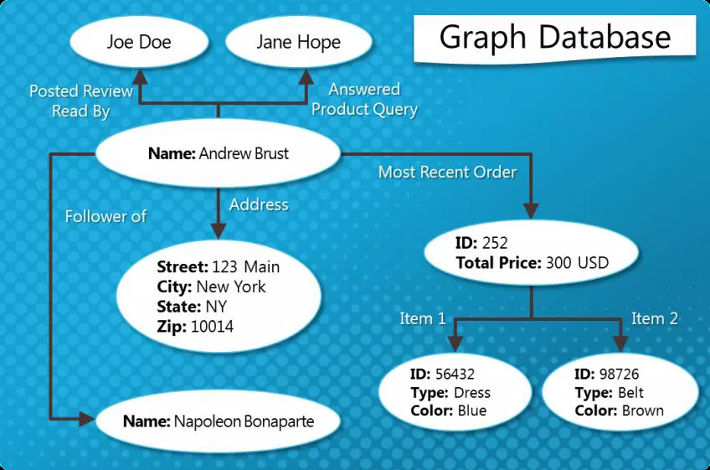
Graph Databases
Graph-oriented
Everything is stored as an edge, a node or an attribute.
Each node and edge can have any number of attributes.
Both the nodes and edges can be labelled.
Labels can be used to narrow searches.

Slide 20
Dealing with Big Data and Scalability
Issues with scaling up when the dataset is just too big
RDBMS were not designed to be distributed
Traditional DBMSs are best designed to run well on a “single” machine
Larger volumes of data/operations requires to upgrade the server with faster CPUs or more memory known as ‘scaling up’ or ‘Vertical scaling’
NoSQL solutions are designed to run on clusters or multi-node database solutions
Larger volumes of data/operations requires to add more machines to the cluster, Known as ‘scaling out’ or ‘horizontal scaling’
Different approaches include:
Master-slave
Sharding (partitioning)

Slide 21
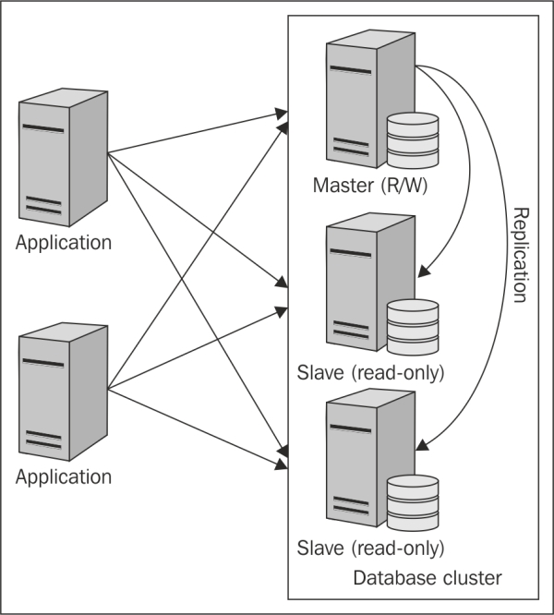
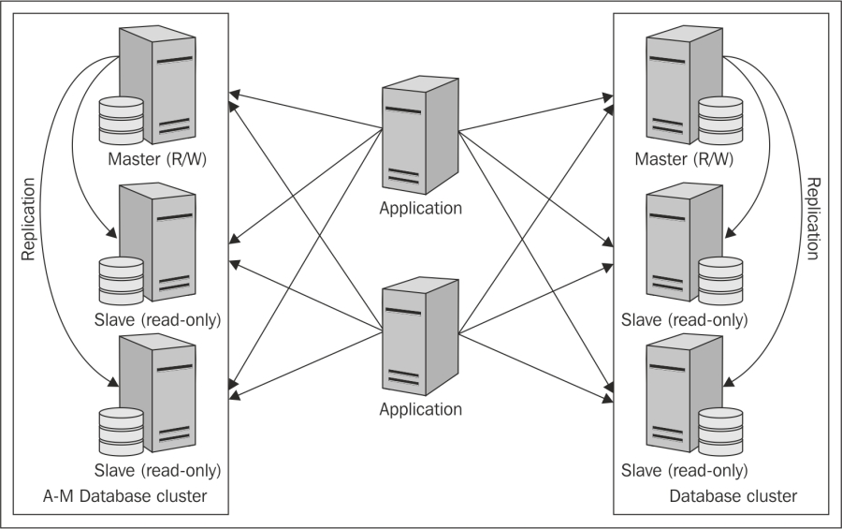
Scaling RDBMS
Master-Slave
All writes are written to the master. All reads performed against the replicated slave databases
Critical reads may be incorrect as writes may not have been propagated down
Large data sets can pose problems as master needs to duplicate data to
Sharding
Any DB distributed across multiple machines needs to know in what machine a piece of data is stored or must be stored
A sharding system makes this decision for each row, using its key

Slide 22
NoSQL, No ACID
RDBMSs are based on ACID (Atomicity, Consistency, Isolation, and Durability) properties
NoSQL
Does not give importance to ACID properties
In some cases completely ignores them
In distributed parallel systems it is difficult/impossible to ensure ACID properties
Long-running transactions don't work because keeping resources blocked for a long time is not practical

Slide 23
BASE Transactions
Acronym contrived to be the opposite of ACID
Basically Available,
Soft state,
Eventually Consistent
Characteristics
Weak consistency – stale data OK
Availability first
Best effort
Approximate answers OK
Aggressive (optimistic)
Simpler and faster

Slide 24
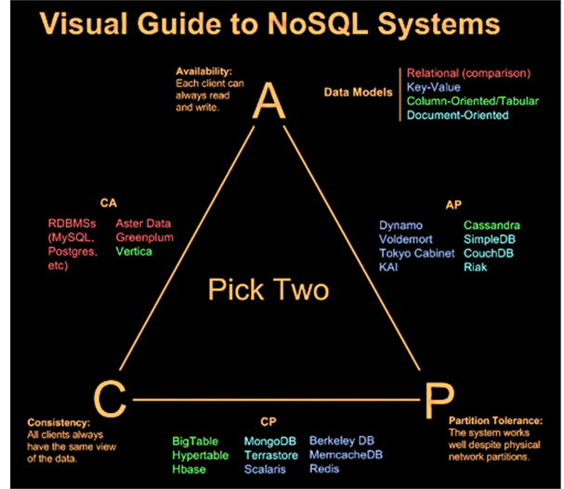
CAP Theorem
A congruent and logical way for assessing the problems involved in assuring ACID-like guarantees in distributed systems is provided by the CAP theorem
At most two of the following three can be maximized at one time
Consistency
Each client has the same view of the data
Availability
Each client can always read and write
Partition tolerance
System works well across distributed physical networks

Slide 25
CAP Theorem: Two out of Three
CAP theorem – At most two properties on three can be addressed
The choices could be as follows:
Availability is compromised but consistency and partition tolerance are preferred over it
The system has little or no partition tolerance. Consistency and availability are preferred
are always avConsistency is compromised but systems ailable and can work when parts of it are partitioned

Slide 26
Consistency or Availability
Consistency and Availability is not “binary” decision
AP systems relax consistency in favor of availability – but are not inconsistent
CP systems sacrifice availability for consistency- but are not unavailable
This suggests both AP and CP systems can offer a degree of consistency, and availability, as well as partition tolerance
C
A
P

Slide 27
Performance
There is no perfect NoSQL database
Every database has its advantages and disadvantages
Depending on the type of tasks (and preferences) to accomplish
NoSQL is a set of concepts, ideas, technologies, and software dealing with
Big data
Sparse un/semi-structured data
High horizontal scalability
Massive parallel processing
Different applications, goals, targets, approaches need different NoSQL solutions

Slide 28
Where would I use it?
Where would I use a NoSQL database?
Do you have somewhere a large set of uncontrolled, unstructured, data that you are trying to fit into a RDBMS?
Log Analysis
Social Networking Feeds (many firms hooked in through Facebook or Twitter)
External feeds from partners
Data that is not easily analyzed in a RDBMS such as time-based data
Large data feeds that need to be massaged before entry into an RDBMS

Slide 29
Don’t forget about the DBA
It does not matter if the data is deployed on a NoSQL platform instead of an RDBMS.
Still need to address:
Backups & recovery
Capacity planning
Performance monitoring
Data integration
Tuning & optimization
What happens when things don’t work as expected and nodes are out of sync or you have a data corruption occurring at 2am?
Who you gonna call?
DBA and SysAdmin need to be on board

Slide 30
The Perfect Storm
Large datasets, acceptance of alternatives, and dynamically-typed data has come together in a perfect storm
Not a backlash/rebellion against RDBMS
SQL is a rich query language that cannot be rivaled by the current list of NoSQL offerings
So you have reached a point where a read-only cache and write-based RDBMS isn’t delivering the throughput necessary to support a particular application.
You need to examine alternatives and what alternatives are out there.
The NoSQL databases are a pragmatic response to growing scale of databases and the falling prices of commodity hardware.

Slide 31
Summary
Most likely, 10 years from now, the majority of data is still stored in RDBMS.
Leading users of NoSQL datastores are social networking sites such as Twitter, Facebook, LinkedIn, and Digg.
Not every problem is a nail and not every solution is a hammer.
NoSQL has taken a field that was "dead" (database development) and suddenly brought it back to life.

